Slide 1


Slide 3

Is it a square?
1)
2)
3)
4)

Slide 4
Is it a square?
1)
2)
3)
4)

Slide 6

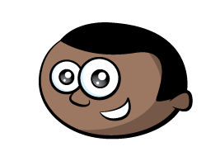
Rectangles

Slide 7
Rectangles

Slide 8
Triangles

Slide 9
Pentagons

Slide 10
Do you think it was a triangle, a square, a rectangle or a pentagon?
Hmm, triangle, square, rectangle, pentagon.

Slide 11
Do you think it was a triangle, a square, a rectangle or a pentagon?
Hmm, triangle, square, rectangle, pentagon.

Slide 12
Have a go at the questions on the worksheet.

