Slide 1


Slide 3
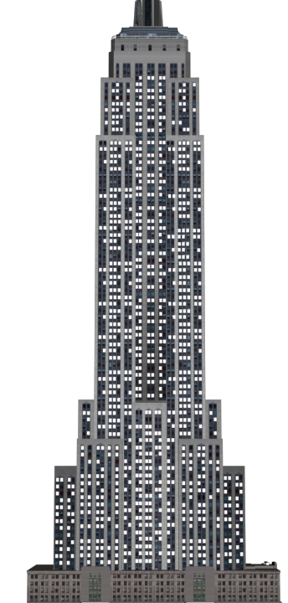

Horizontal or Vertical?
1) Is this building stretching up horizontally or vertically?
2) Is the line of the horizon
horizontal or vertical?
3) Do elevators travel
horizontally or vertically?

Slide 4
Horizontal or Vertical?
1) Is this building stretching up horizontally or vertically?
2) Is the line of the horizon
horizontal or vertical?
3) Do elevators travel
horizontally or vertically?
Vertically
Horizontal
Vertically

Slide 6
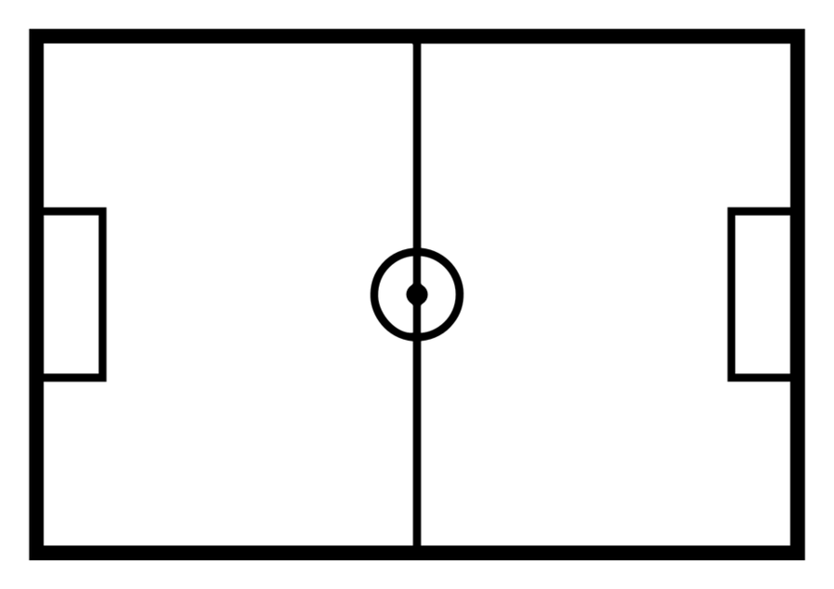
What is a vertical line of symmetry?

Slide 9
Have a go at questions 1 and 2 on the worksheet

Slide 10

Have a think

Slide 11
Have a go at question 3 on the worksheet

Slide 12


Hey, one of us has made a mistake
Have a think

Slide 13
Have a go at questions 4 and 5 on the worksheet

