Slide 1


Slide 3
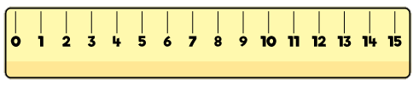
What comes next:
short, shorter, ________
2) What comes next:
long, longer, _________
3) What word is 15? fifty fifteen
4) What do we call this?

Slide 4
What comes next:
short, shorter, ________
2) What comes next:
long, longer, _________
3) What word is 15? fifty fifteen
4) What do we call this?
shortest
longest
ruler

Slide 6

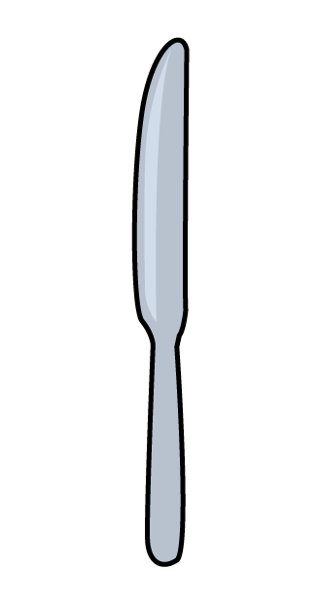
Measure length
Have a think
The knife is 9 cm

Slide 7

Measure and compare length
Have a think
5 cm
6 cm
3 cm

Slide 8
Have a go at questions 1 and 2 on the worksheet

Slide 9
Which is longer?
Have a think
The red tower is 9 cm
The yellow tower is 10 cm

Slide 10


Which is longer?
Have a think
They are the same length!
The red tower is 10 cm
The pink tower is 10 cm

Slide 11
Which is longer?
Have a think
The red tower is 9 cm
The pink tower is 12 cm

Slide 12
Have a go at question 3 on the worksheet

Slide 13

How can you make them the same length?
I can add 3 more
The red tower is 9 cm
The red tower is 12 cm
The pink tower is 12 cm
Have a think

