Slide 1


Slide 3
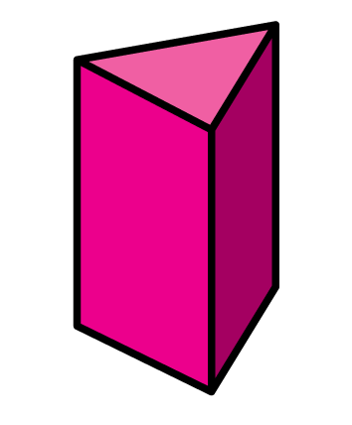
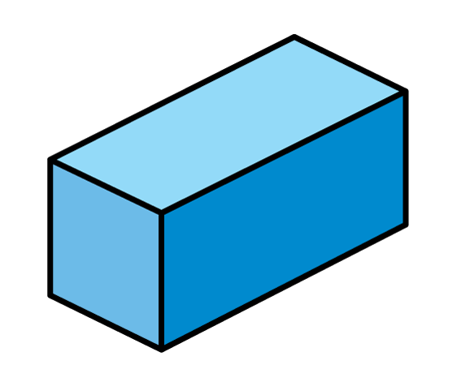
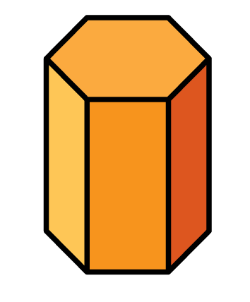
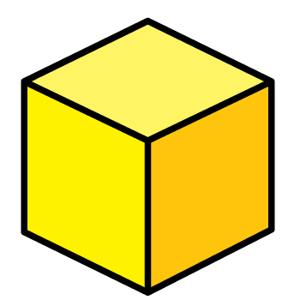
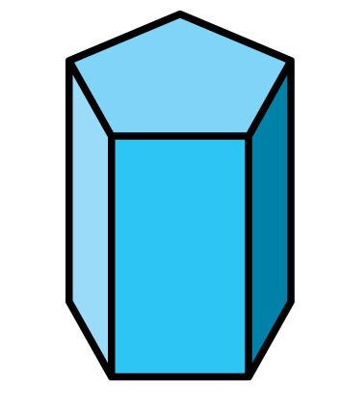
Which shapes have 6 faces?

Slide 4
Which shapes have 6 faces?
5
7
8

Slide 6
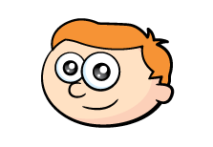
Board Game
Notes:
Can be backwards and forwards

Slide 7

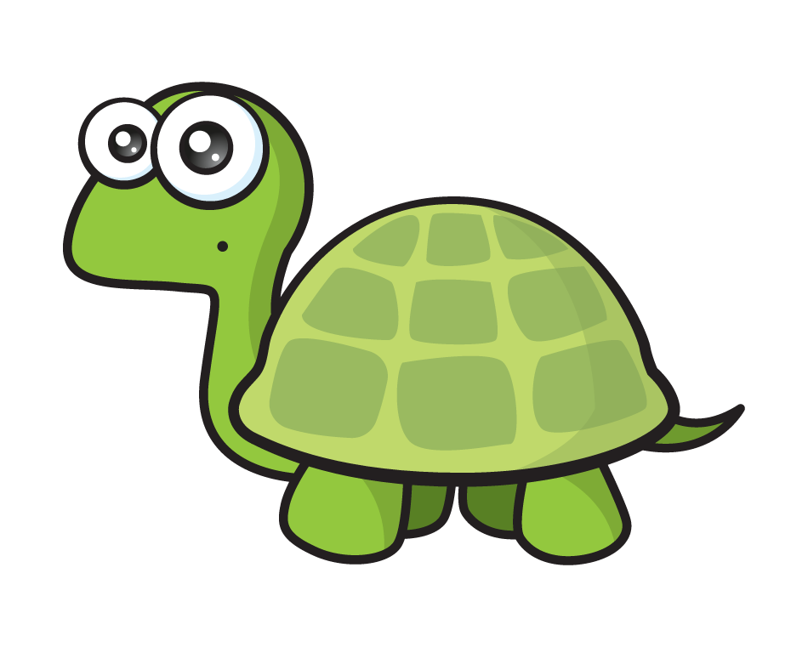
I know a cuboid has the same number of faces as a cube
I think they will have the same number of edges too
Faces
?
6
Edges
Notes:
Can be backwards and forwards

Slide 8
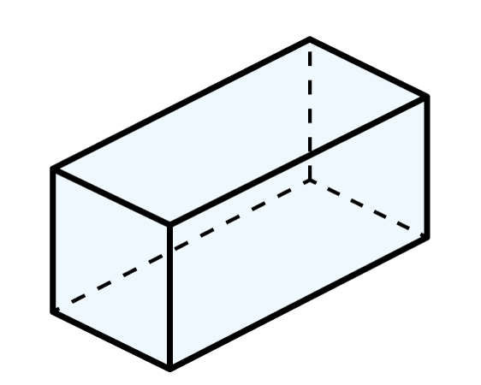
I think a good idea would be to work from the top down
Faces
?
6
Edges
12
Notes:
Can be backwards and forwards

Slide 9
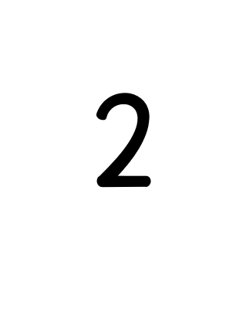
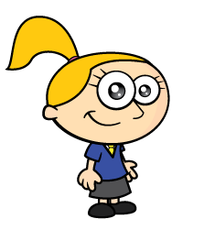
Here’s my huge cube. I can walk around it and count the edges.
Faces
?
6
Edges
12
Notes:
Can be backwards and forwards

Slide 10
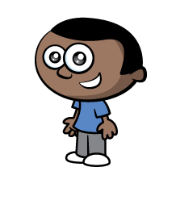
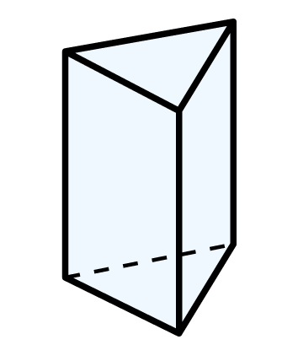

Slide 11

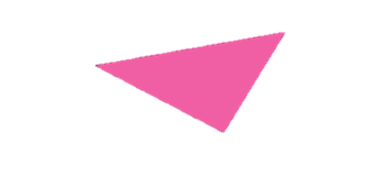

I think an edge is where two faces meet

Slide 12
Have a go at the rest of the questions on the worksheet

