Slide 1


Slide 3
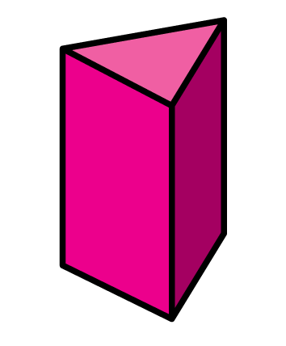
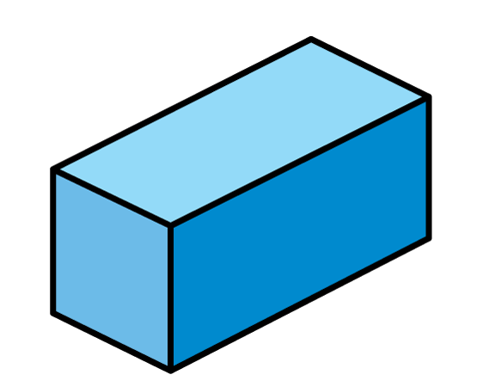
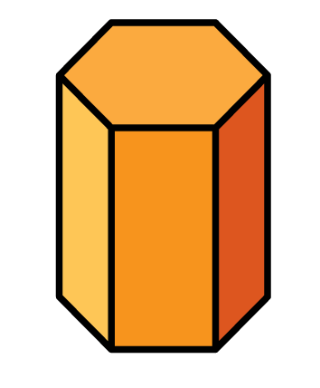
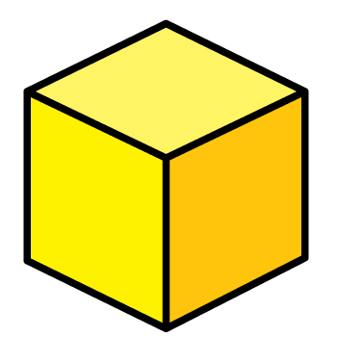
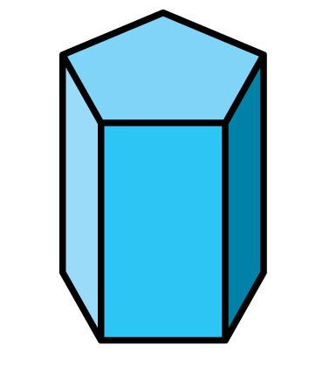
Which shapes have 12 edges?

Slide 4
Which shapes have 12 edges?
9
12
15
18

Slide 6
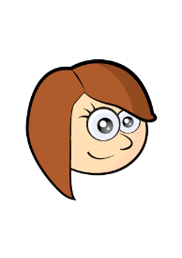

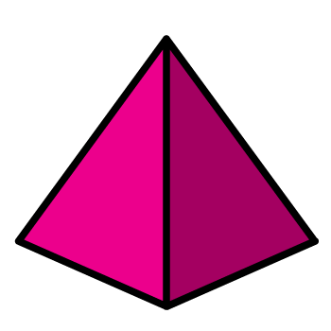
Notes:
Can be backwards and forwards

Slide 7

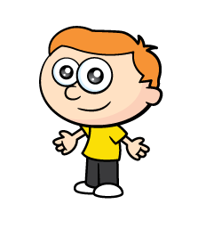
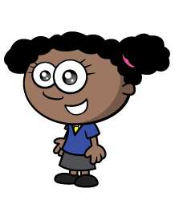
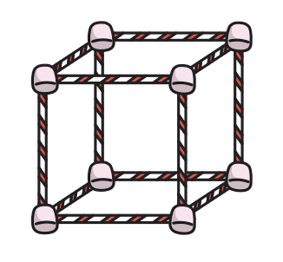
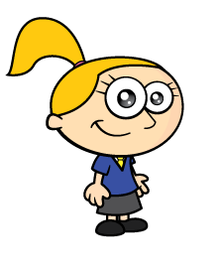
Have a think
Notes:
Whitney has also been building towers using cubes. Let’s havwe a look.
Pause the video here and see if you can answer these questions.
How did you get on?
Did Whitney use more or less cubes than Jack? That’s right she used less cubes because she built less towers

Slide 8
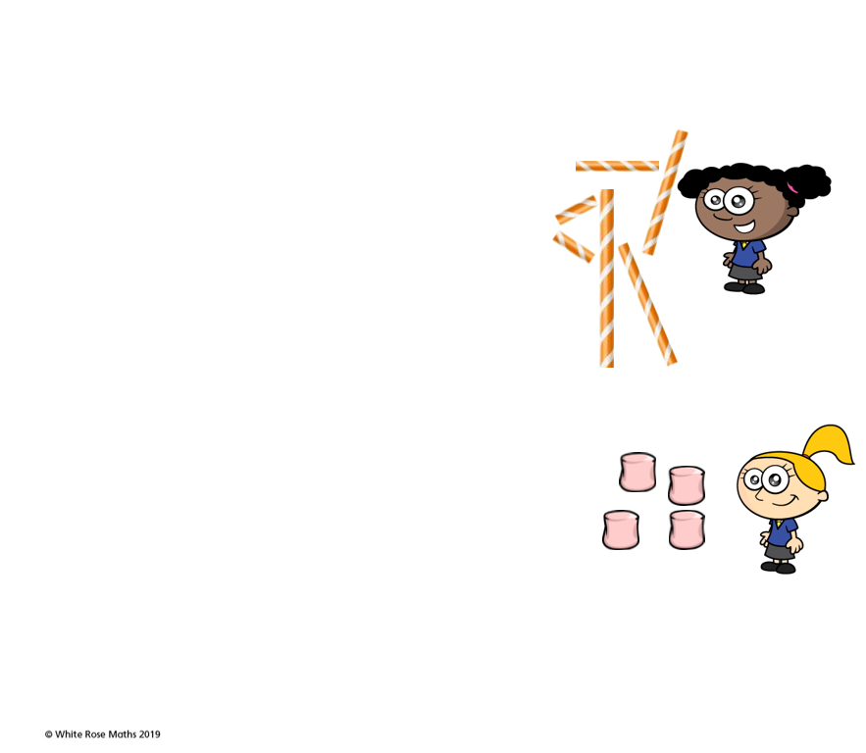

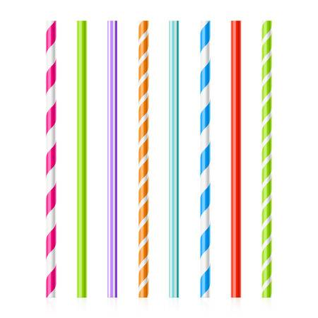
Faces 4 Edges 6 Vertices 4
Notes:
Whitney has also been building towers using cubes. Let’s havwe a look.
Pause the video here and see if you can answer these questions.
How did you get on?
Did Whitney use more or less cubes than Jack? That’s right she used less cubes because she built less towers

Slide 9
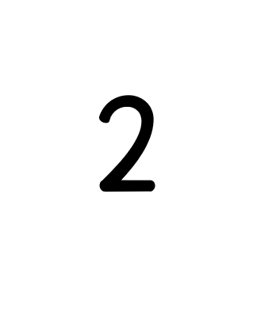

Faces 6 Edges 12 Vertices 8
1
2
Notes:
Whitney has also been building towers using cubes. Let’s havwe a look.
Pause the video here and see if you can answer these questions.
How did you get on?
Did Whitney use more or less cubes than Jack? That’s right she used less cubes because she built less towers

Slide 10

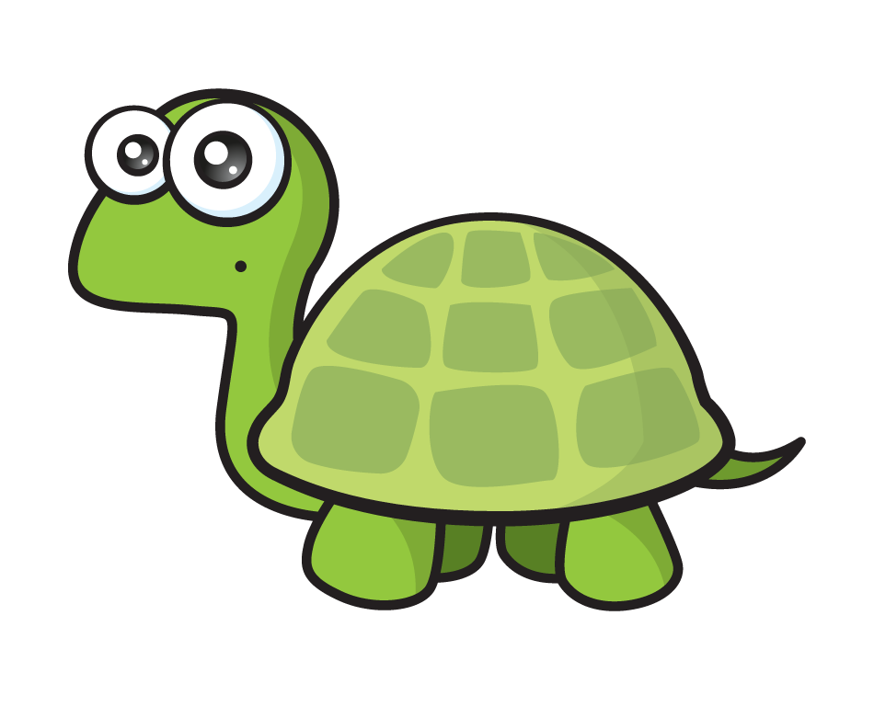
I know a cuboids have the same number of faces and edges as cubes
I think they will have the same number of vertices too
Vertices
Faces
Edges
?
6
12
8
Notes:
Can be backwards and forwards

Slide 11
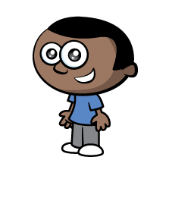

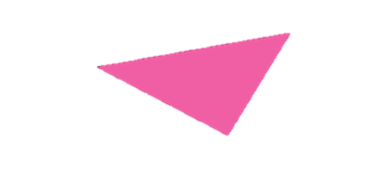

An edge is where two faces meet
I think a vertex is where two or more edges meet

Slide 12
Have a go at the rest of the questions on the worksheet

