Slide 1


Slide 3
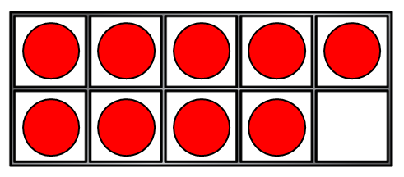
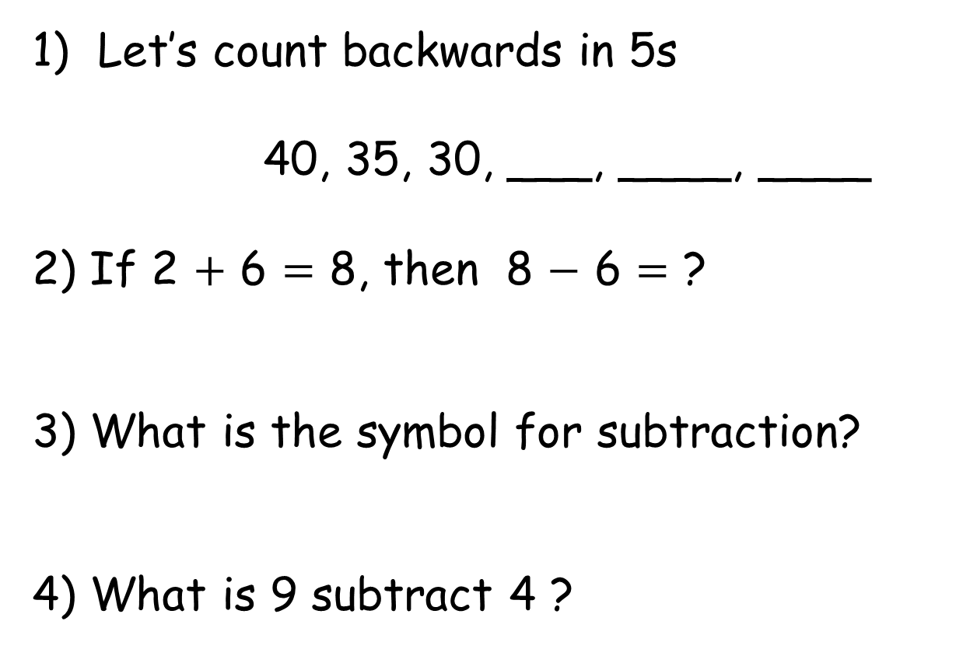
Let’s count backwards in 5s
40, 35, 30, ___, ____, ____
2) If 2 + 6 = 8, then 8 $−$ 6 = ?
3) What is the symbol for subtraction?
4) What is 9 subtract 4 ?

Slide 4

Let’s count backwards in 5s
40, 35, 30, ___, ____, ____
2) If 2 + 6 = 8, then 8 $−$ 6 = ?
3) What is the symbol for subtraction?
4) What is 9 subtract 4 ?
25 20 15
2
$$−$$
5

Slide 6




Subtracting lengths
I think someone ate part of my bar!
1
6 $−$ 5 =

Slide 7

Subtracting lengths
I ate some before it was all gone!
3
6 $−$ 3 =

Slide 8
Have a go at question 1 on the worksheet

Slide 9


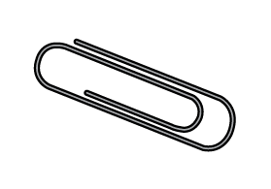


Subtracting lengths
Have a think
3
9 $−$ 6 =

Slide 10


Subtracting lengths
Have a think
7
9 $−$ 2 =

Slide 11
Have a go at question 2 on the worksheet

Slide 12



Subtracting lengths
Have a think
2
6 $−$ 4 =

Slide 13


Subtracting lengths
Have a think
4
6 $−$ 2 =

Slide 14






Liam kicked the football 20 blocks.
Dora kicked the football 16 blocks.
Have a think
Who kicked it the longest?
How much longer?
11
16 $−$ 5 =
4
20 $−$ 16 =
Tommy kicked it 5 blocks less than Dora.
How far did Tommy kick the football?

Slide 15
Have a go at questions 3 and 4 on the worksheet

