Slide 1


Slide 3


Game 1
Annie
Eva
Ron
Mo
Game 2
Annie
Eva
Ron
Mo
Key $=$ 10 pins knocked down
Who knocked most pins down in game 1?
Who knocked most pins down overall?
3) Who improved most in game 2?

Slide 4
Game 1
Annie
Eva
Ron
Mo
Game 2
Annie
Eva
Ron
Mo
Key $=$ 10 pins knocked down
Who knocked most pins down in game 1?
Who knocked most pins down overall?
3) Who improved most in game 2?
Eva & Ron
Eva
Both Annie and Eva knocked 40 more pins down in game 2

Slide 6

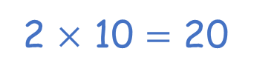
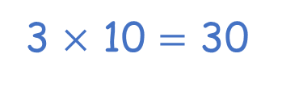
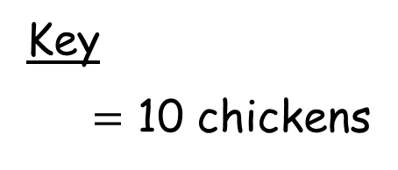
Day | Chickens seen
Monday
Tuesday
Wednesday
Thursday
Friday
Key
$=$ 10 chickens
3 × 10 $=$ 30
2 × 10 $=$ 20
How many chickens were seen on Wednesday?
_____ chickens
30
3
How many chickens were seen on Thursday?
_____ chickens
20

Slide 7


Day | Chickens seen
Monday
Tuesday
Wednesday
Thursday
Friday
Key
$=$ 10 chickens
How many more chickens were seen on Wednesday
than Tuesday?
I know an easier way to compare.
I can subtract to find the difference.

Slide 8
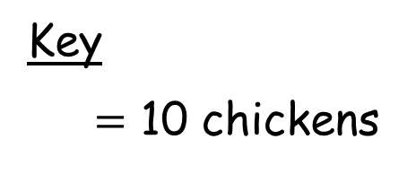
How many more chickens were seen on Wednesday
than Tuesday?
Tuesday
Wednesday
Key
$=$ 10 chickens
30 chickens were seen on Wednesday.
10 chickens were seen on Tuesday.
30 $−$ 10 $=$ 20
20 more chickens were seen on Wednesday than Tuesday.
I can use the pictogram to compare.
I can see there are 20 more chickens on Wednesday.

Slide 9







Player | Goals scored
Alex
Jack
Mo
Rosie
Whitney
Key $=$ 2 goals
I scored 3. That’s the most goals!
Mo scored 4 goals.
What do you notice?
Have a think
16 goals were scored altogether. I know this because there are 8 and each is worth
2 goals.
Mo scored 1 more goal than Whitney.

Slide 10










Slide 11

Rosie
Teddy
Colour | Balloons
Red
Green
Colour | Balloons
Red
Green
Key $=$ 5 balloons
Have a think
How many red balloons are there altogether?
How many more balloons does Rosie have than Teddy?
What is the difference in number between Teddy’s red and green balloons?
15 balloons
15 balloons
0 balloons

Slide 12

Have a go at the questions on the worksheet

