Slide 1
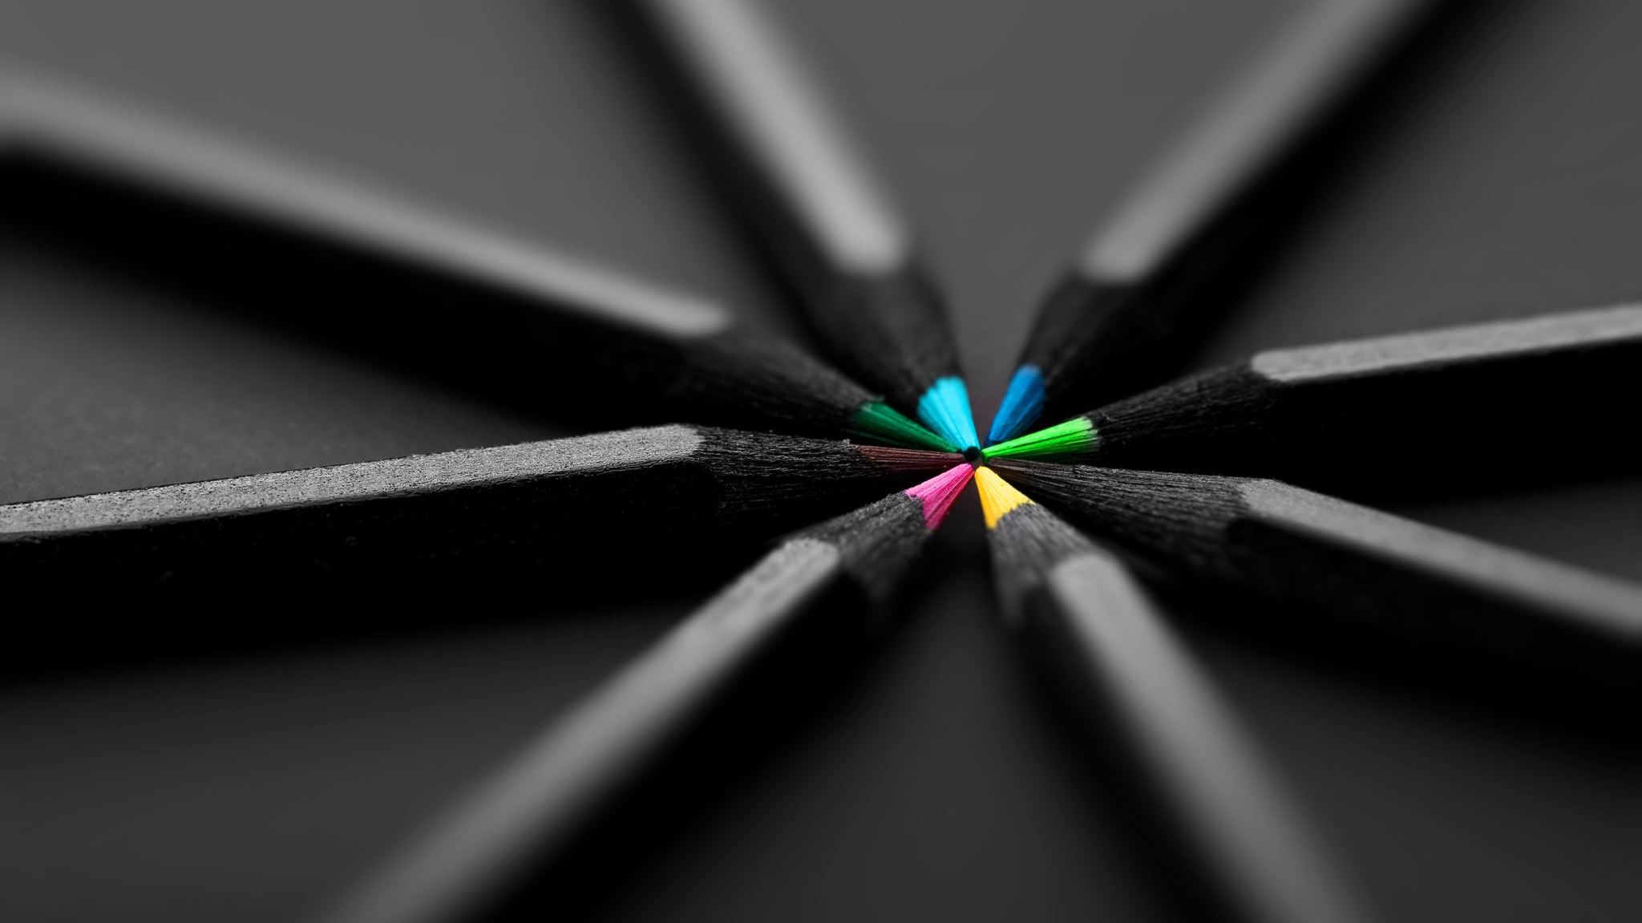
ART
different artists

Slide 2
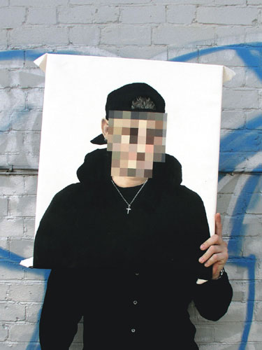
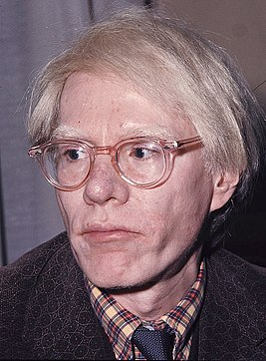
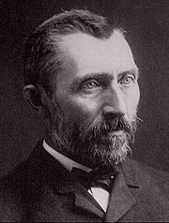
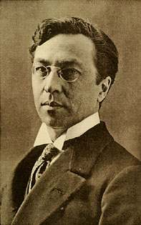
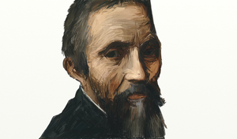
How many famous artists do you know?
Who is your favourite artist?
Why are they your favourite artist?
T

Slide 3
Vincent van Gogh
1853 - 1890
Vincent van Gogh was a Dutch impressionist painter.
He was well known for painting, drawing still life, portraits and self portraits.
Some of Vincent van Gogh’s most famous art includes:
Sunflowers
The starry night
The potato Eaters
Portrait of Dr Gachet
And of course many self portaits.

Slide 4
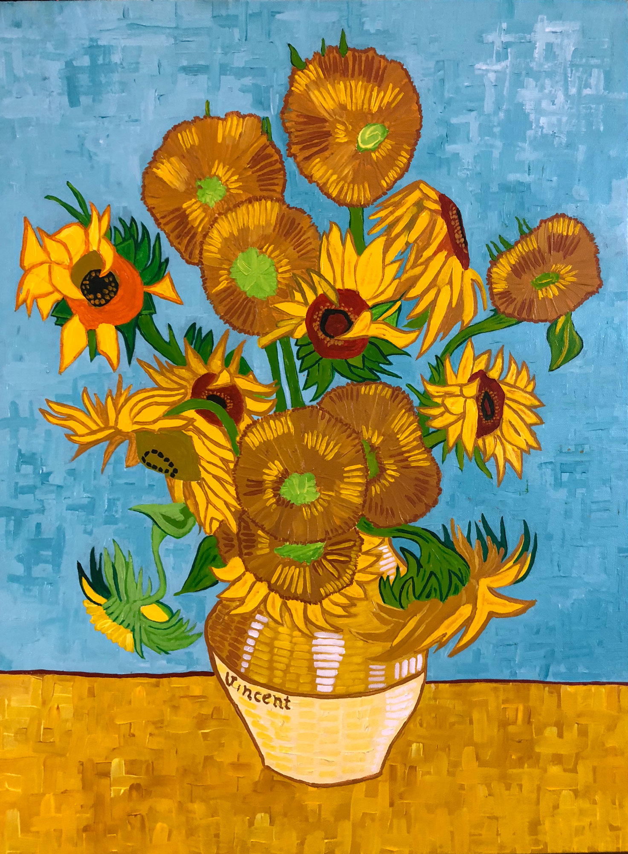
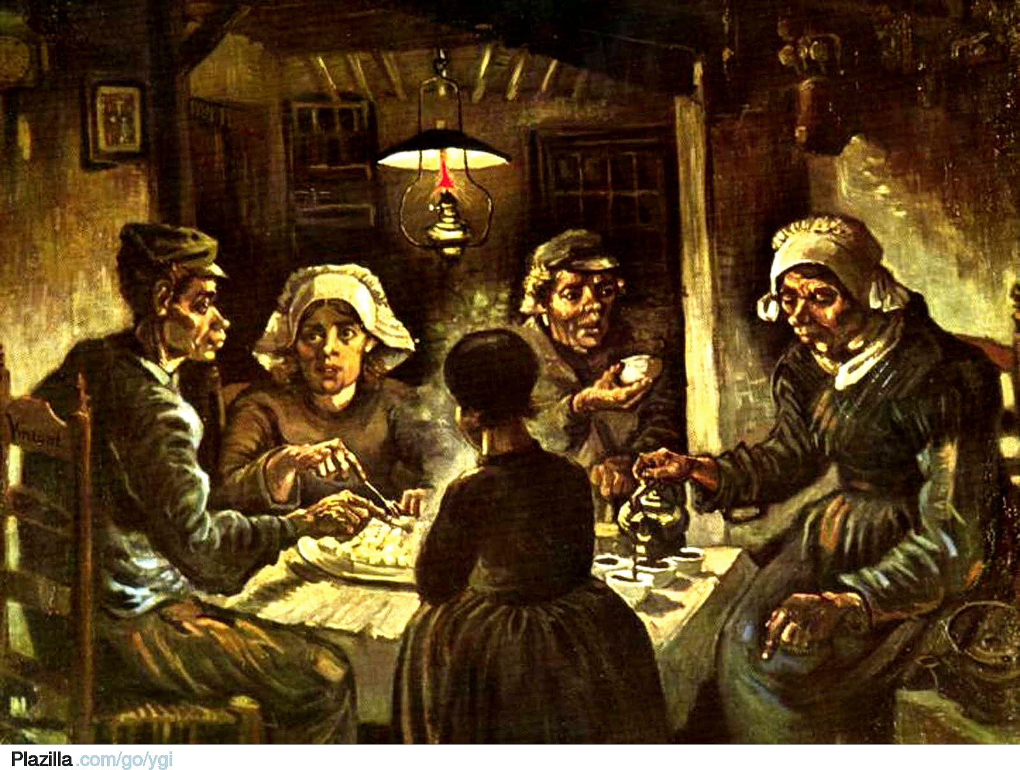
Sunflowers
The Potato Eaters

Slide 5
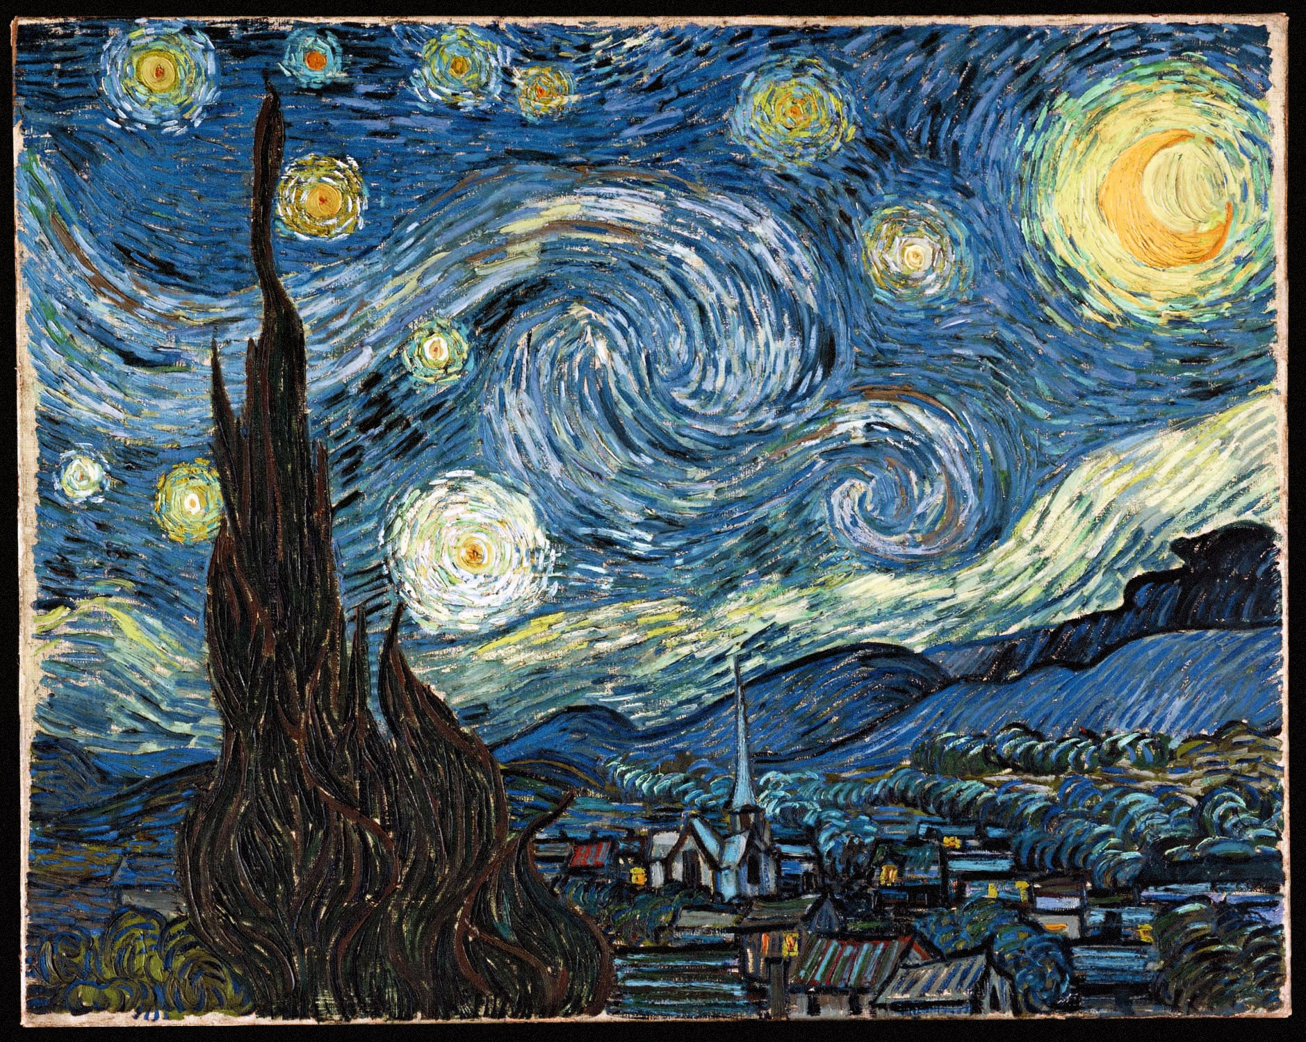
The starry night

Slide 6
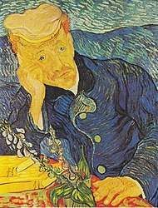
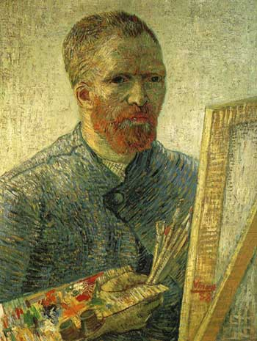
Portrait of Dr Gachet
Self Portrait

Slide 7
Wassily Kandinsky
1866 - 1944
Wassily Kandinsky was a Russian painter, he was a pioneer of abstract art
Some of Wassily Kandinsky’s famous artwork include:
Several Circles
Composition VIII
Circles in a circle
Color study. Squares with concentric circles

Slide 8
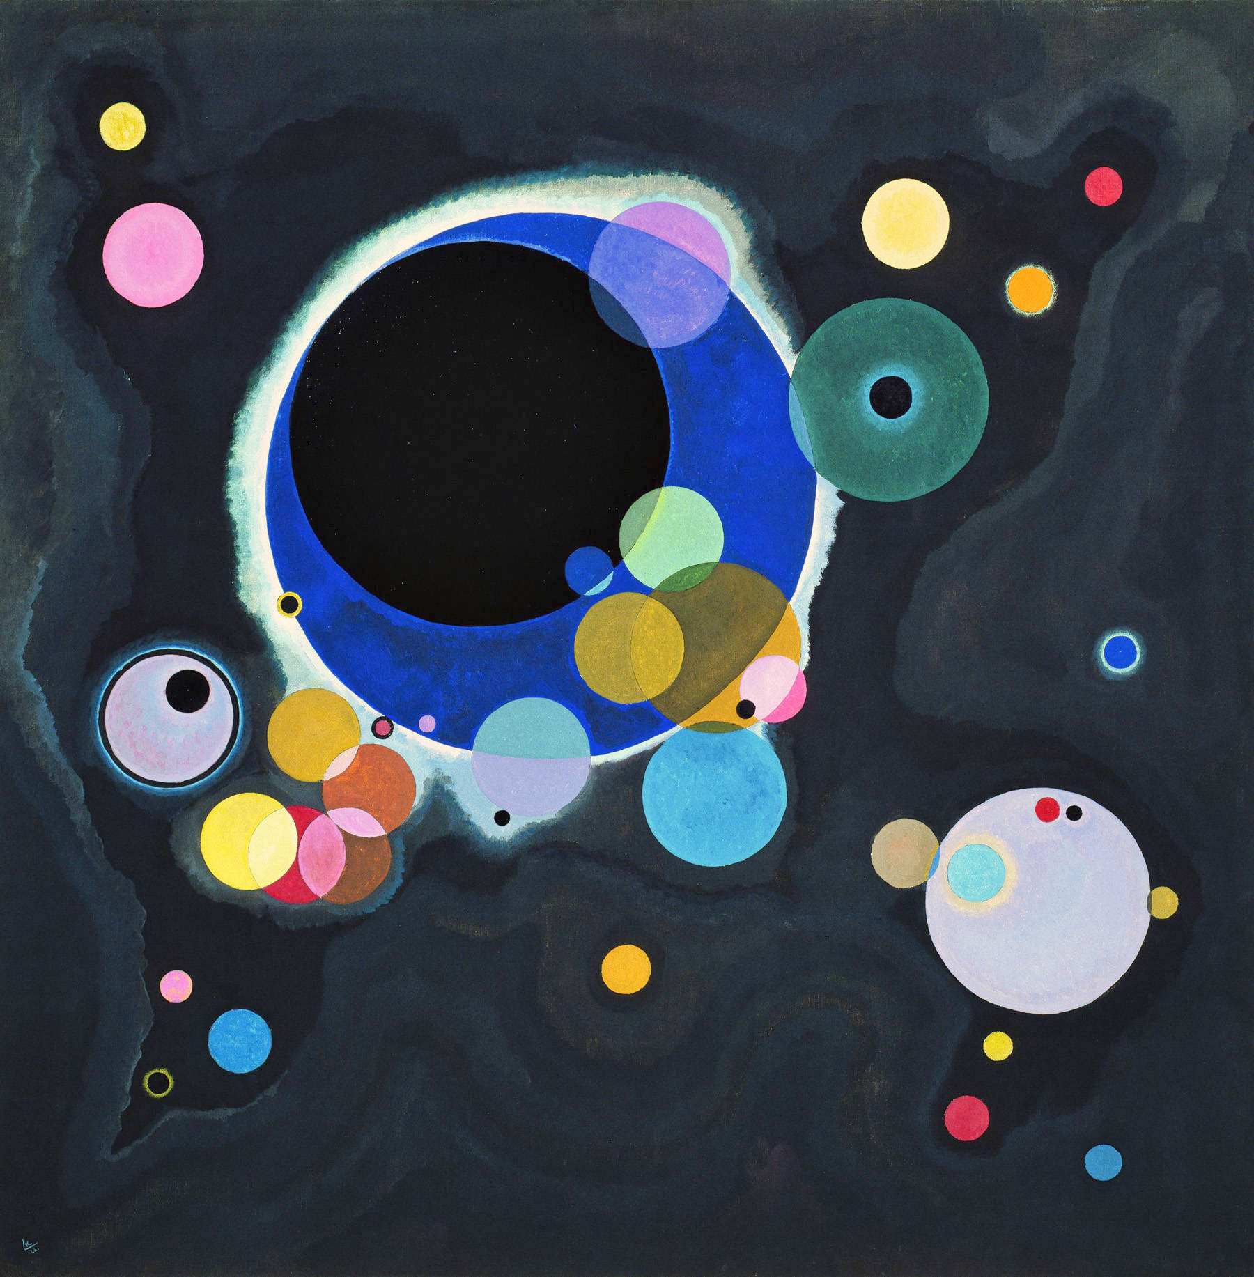
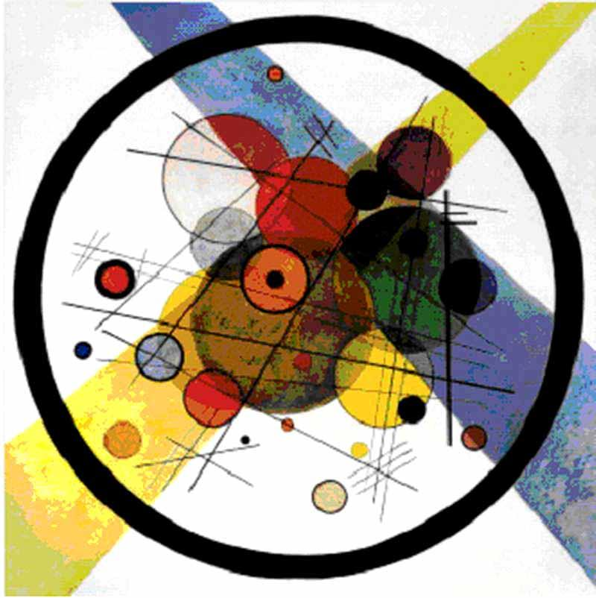
Circles in a circle
Several circles

Slide 9
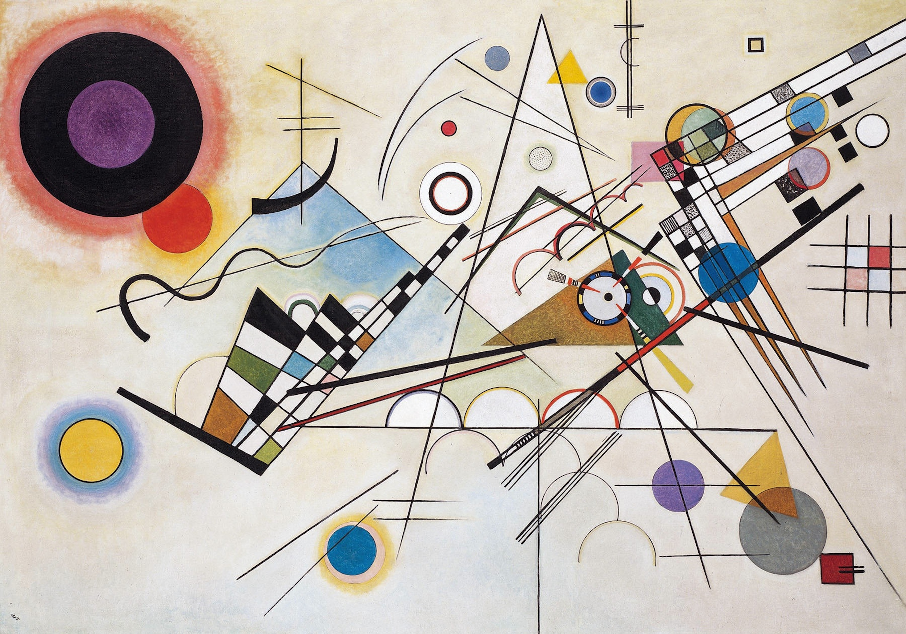
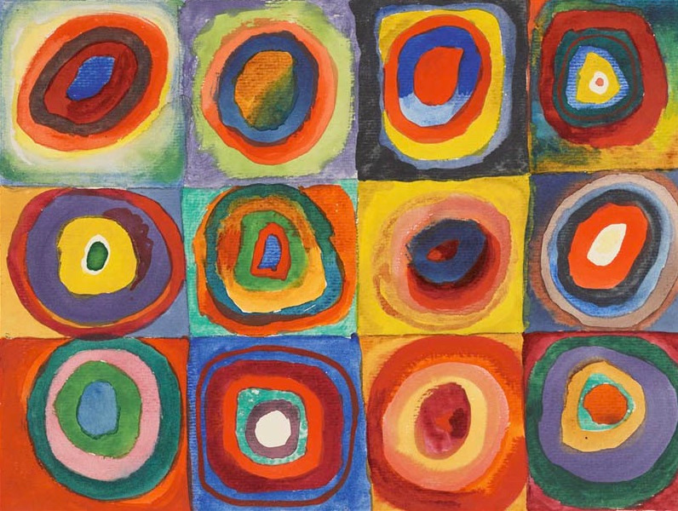
Color study, squares with concentric circles
Composition VIII

Slide 10
Michaelangelo
Michaelangelo is a famous Italian sculptor, painter, architect and poet. He is most famous for painting The Sistine Chapel ceiling and alter.
Before painting The Sistine Chapel he created a very famous sculpture, David which is a masterpiece of Renaissance sculpture.

Slide 11
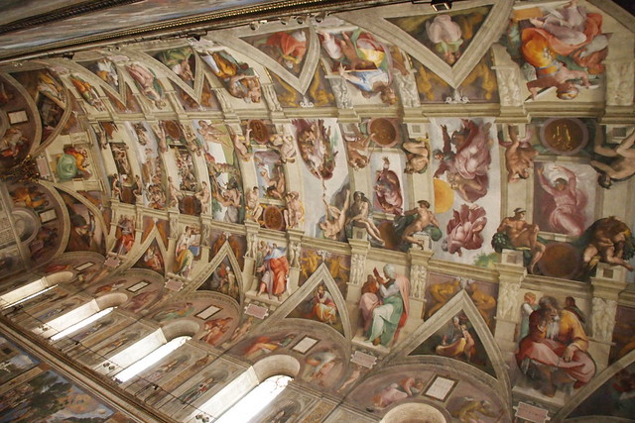
The Sistine Chapel ceiling

Slide 12
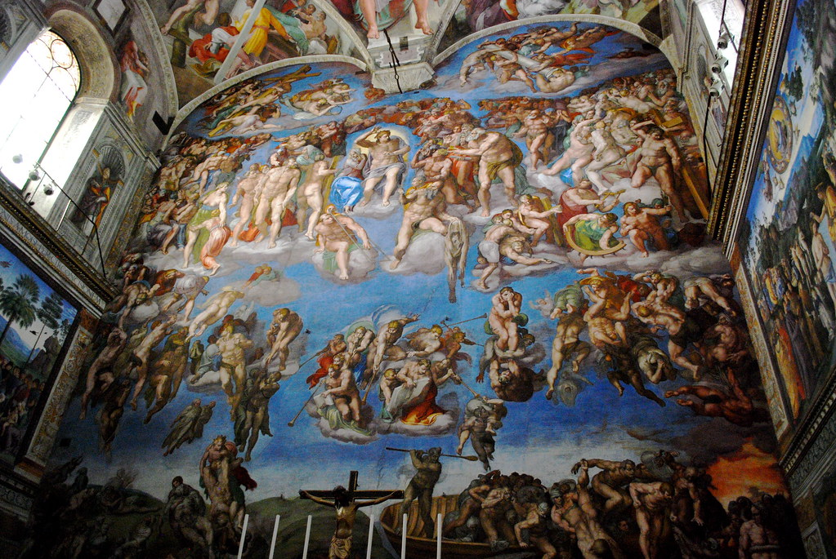
The Last Judgement

Slide 13
Choose a painting or drawing by
a famous artist and have a go at
recreating it.
Use whatever you have at home.
(Pencils, paint, felt tips, crayons etc)
You can google your favourite
artist and choose one of their
Paintings or drawings.
Don’t forget to include the name of the painting/drawing you are recreating.

