Slide 1
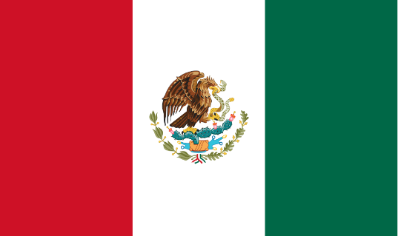
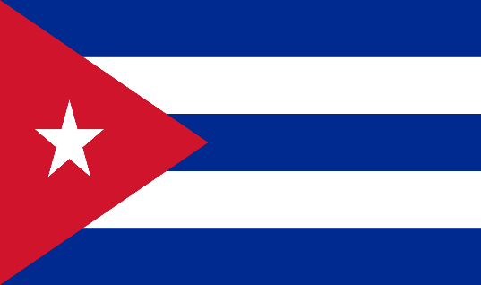
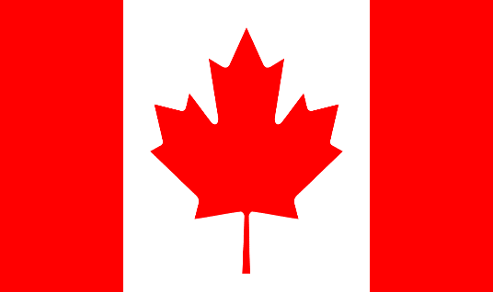

North America
Lesson 1
Geography

Slide 2
Quick Activity
Use the ‘Blank map of the world worksheet’ and label where North America is.

Slide 3
Canada
Capital – Ottawa
Population (2014 est) – 34,834,841
Land Area – 3,855,102 square miles (9,984,670 square km)
Currency – Canadian Dollar
Language – English and French

Slide 4
United States of America (USA)
Capital – Washington, DC
Population (2014 est) – 318,892,103
Land Area – 3,718,691 square miles (9,631,420 square km)
Currency – Dollar
Language – English

Slide 5

Mexico
Capital – Mexico City
Population (2014 est) – 120,286,655
Land Area – 761,602 square miles (1,972,550 square km)
Currency – Mexican Peso
Language – Spanish

Slide 6

Cuba
Capital – Havana
Population (2014 est) – 11,047,251
Land Area – 42,803 square miles (110,860 square km)
Currency – Cuban Peso
Language – Spanish

Slide 7
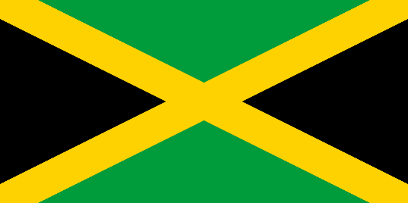
Jamaica
Capital – Kingston
Population (2014 est) – 3,930,050
Land Area – 4,244 square miles (10,991 square km)
Currency – Jamaican Dollar
Language – Jamaican and English

Slide 8
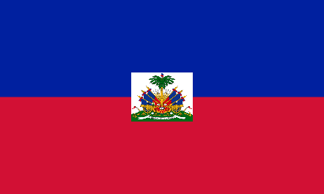
Haiti
Capital – Port-au-Prince
Population (2014 est) – 9,996,731
Land Area – 10,714 square miles (27,750 square km)
Currency – Gourde
Language – Creole and French

Slide 9
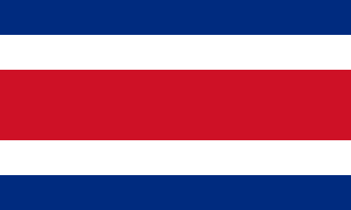
Costa Rica
Capital – San Jose
Population (2014 est) – 4,755,234
Land Area – 19,730 square miles (51,100 square km)
Currency – Colon
Language – Spanish and English

Slide 10
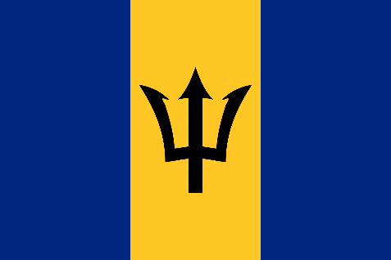
Barbados
Capital – Bridgetown
Population (2014 est) – 289,680
Land Area – 166 square miles (431 square km)
Currency – Barbados Dollar
Language – English

