Slide 1
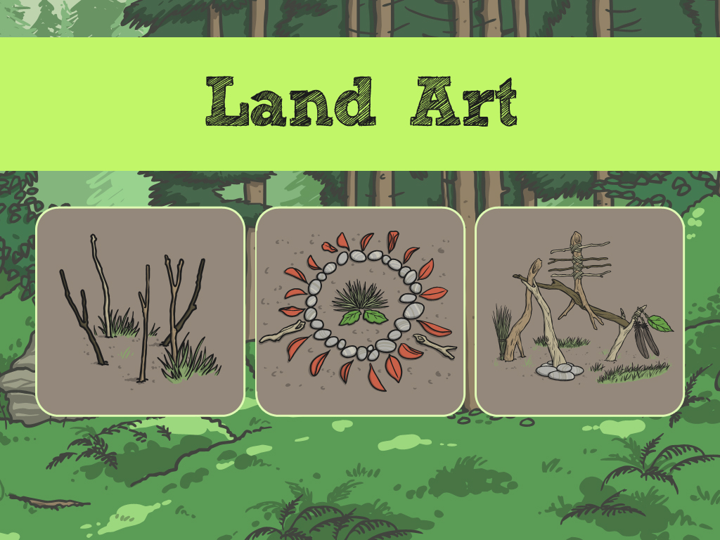



Slide 2
Aim
I can make my own land art in the style of the artist Andy Goldsworthy.

Slide 3
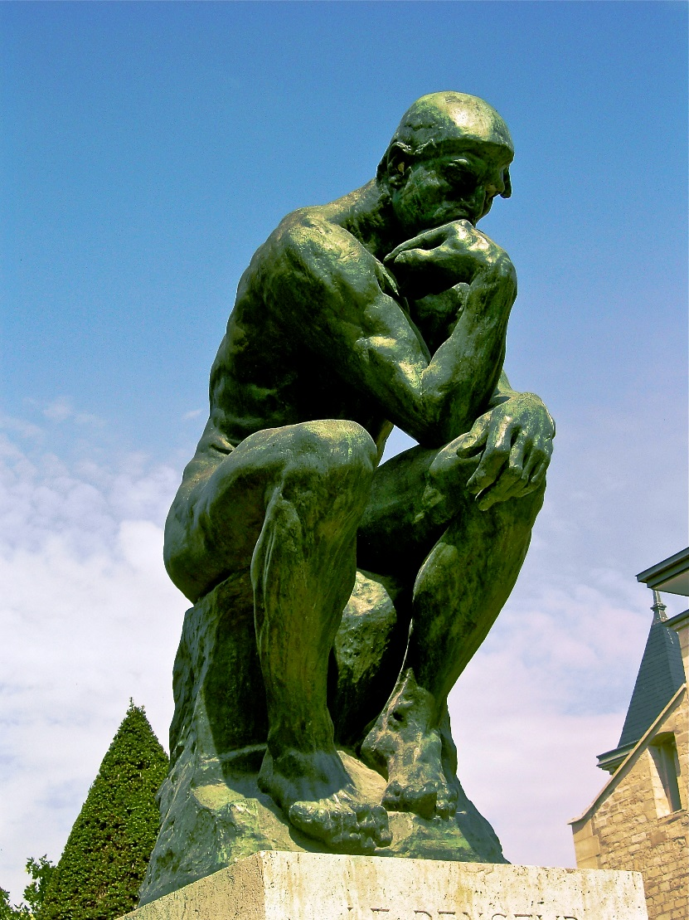
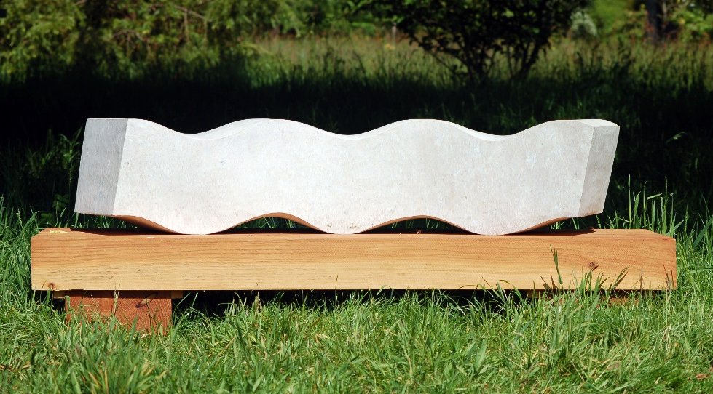
Sculpture
Sculptures are works of art.
Sculptures are 3-D models.
They are not flat like paintings and drawings.
Photo courtesy of archer10 (Dennis) (@flickr.com) - granted under creative commons licence - attribution

Slide 4
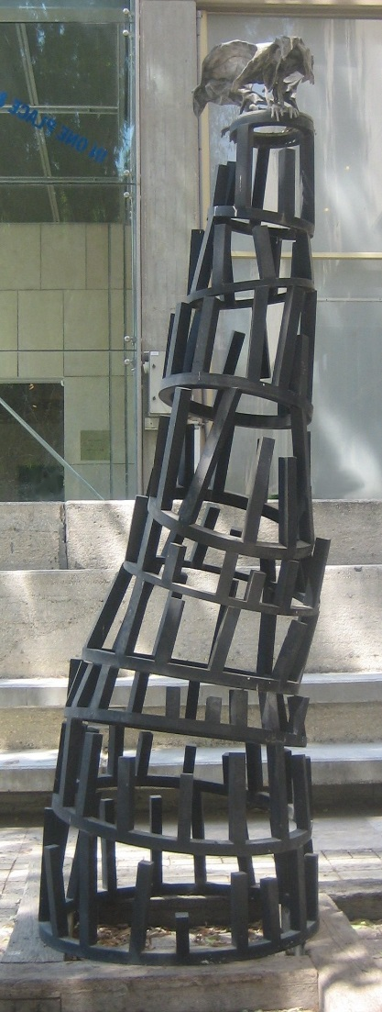
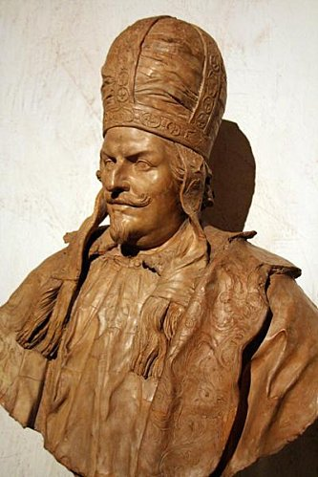
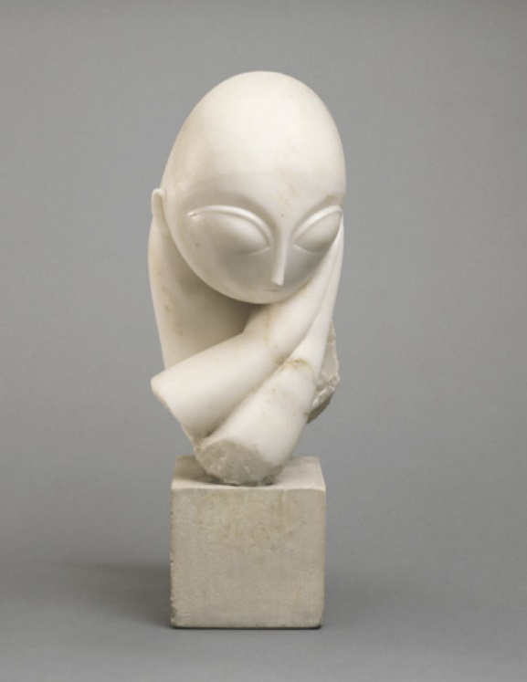
Materials
Most sculptures are made of metal, clay or stone.

Slide 5
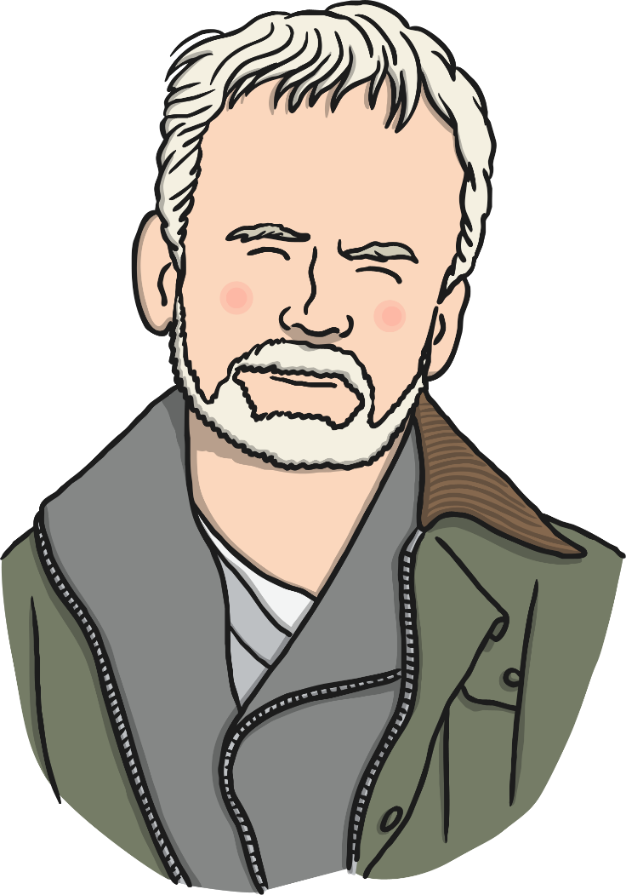
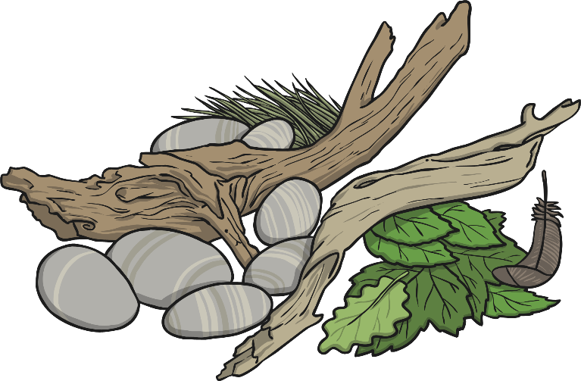
Andy Goldsworthy
Andy Goldsworthy is an artist who makes sculptures from natural materials like rock, sticks and leaves.

Slide 6
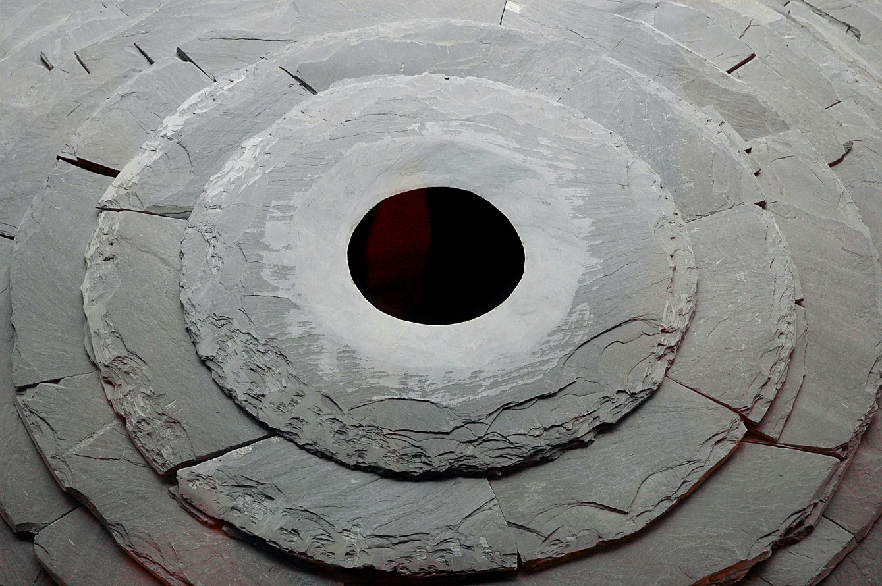
Andy Goldsworthy
This sculpture is made out of a rock called slate.
Roof, 2004 - 2005
Photo courtesy of Thom Watson (@flickr.com)-granted under creative commons licence- attribution

Slide 7
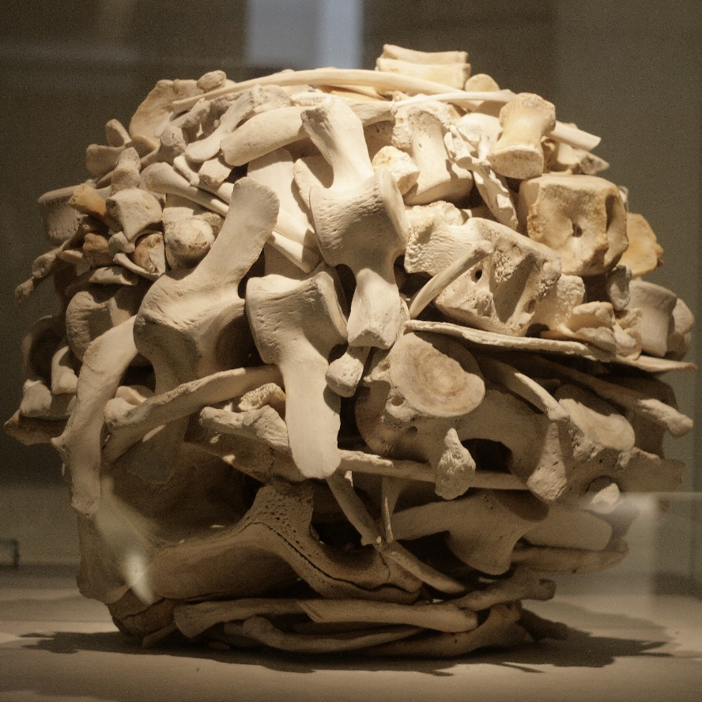
Andy Goldsworthy
This sculpture is made out of whale bones.
Stacked Whalebones, 2001

Slide 8
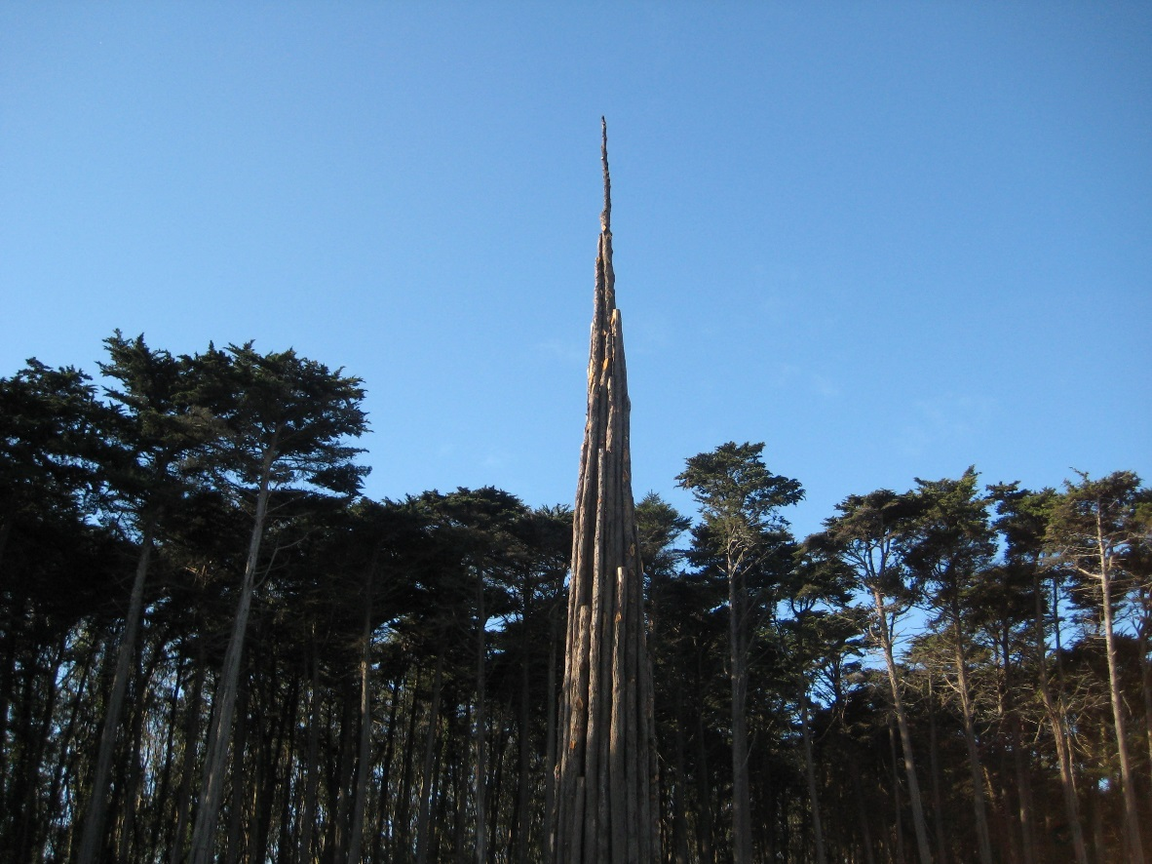
Andy Goldsworthy
This sculpture is made out of wood.
Spire, 2008
Photo courtesy of Moonlightbulb(@flickr.com)-granted under creative commons licence- attribution

Slide 9

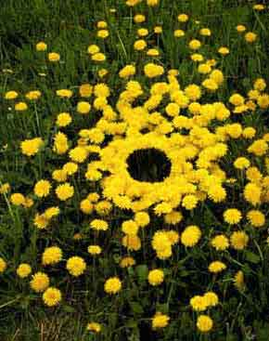


Land Art
What is this land art sculpture made from?

Slide 10

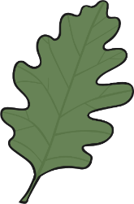


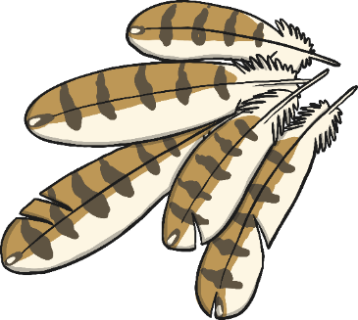

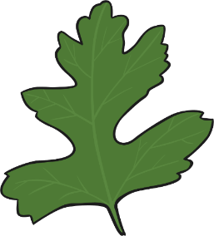
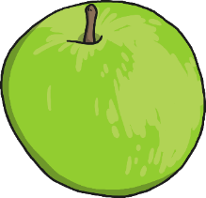

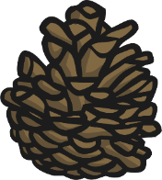
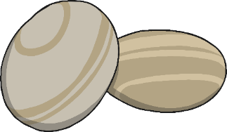
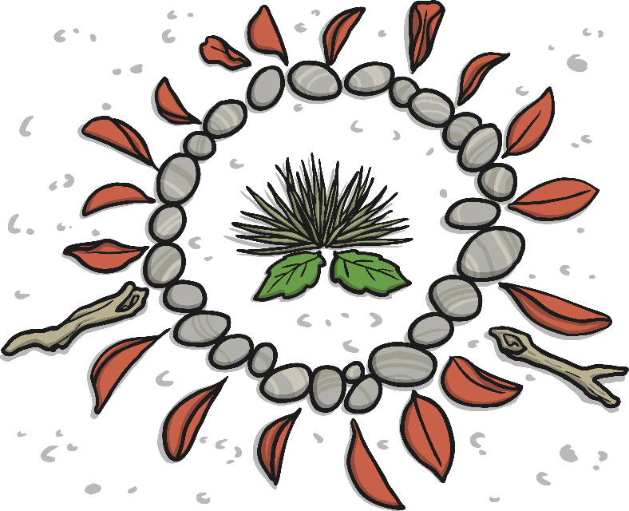
Land Art
Can you use natural materials to make land art sculptures like Andy Goldsworthy?

Slide 11
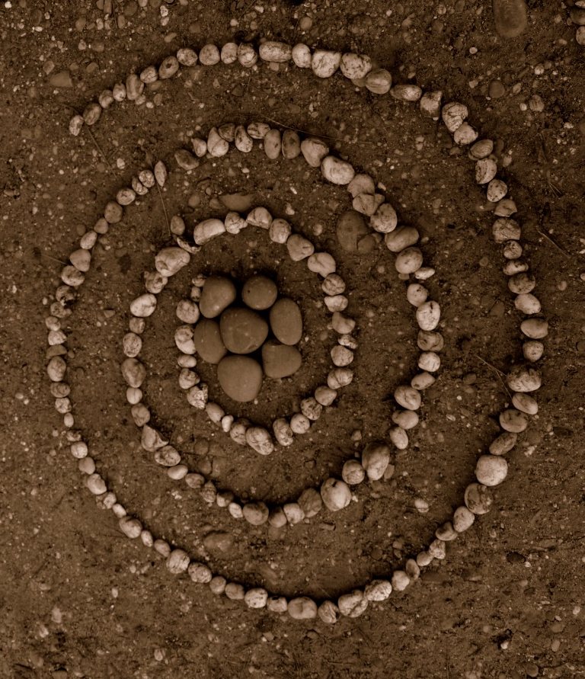
Land Art
This land art is made from pebbles.

Slide 12
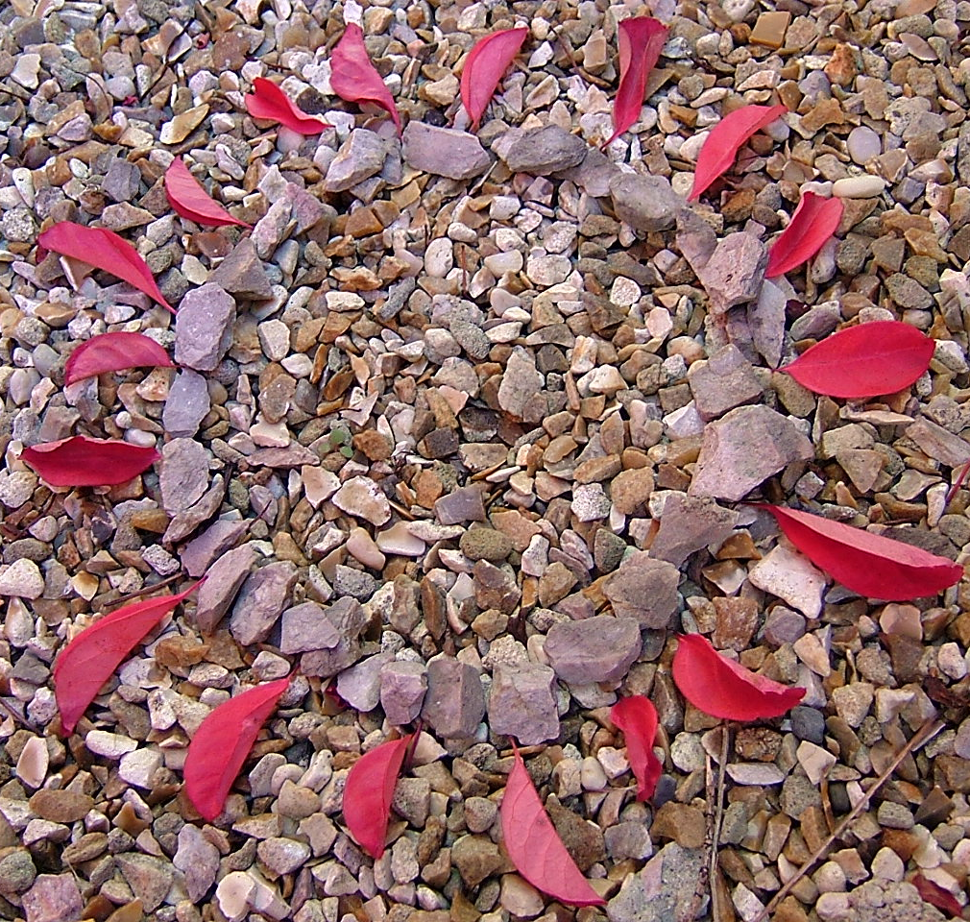


Land Art
This land art is made from leaves and stones.

Slide 13
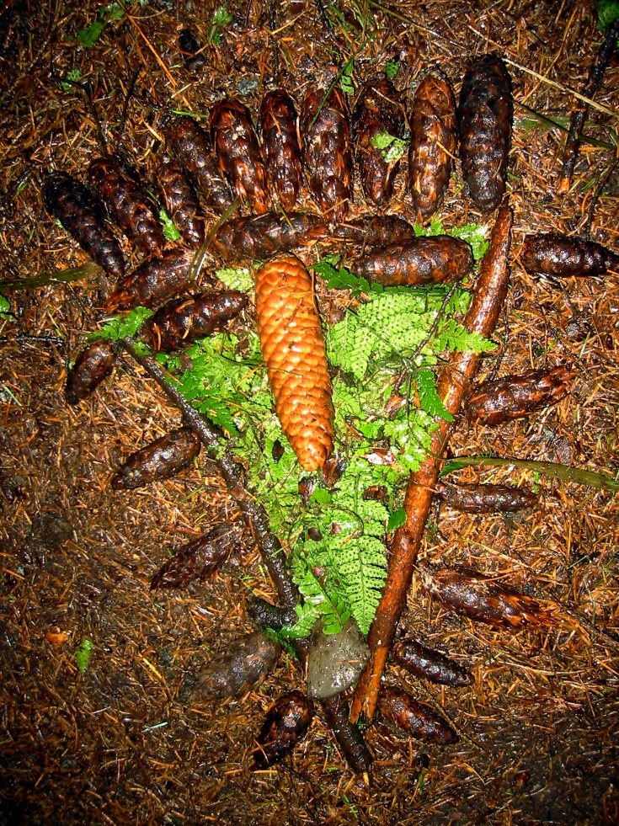


Land Art
This land art is made from leaves, twigs and pine cones.

