Slide 1

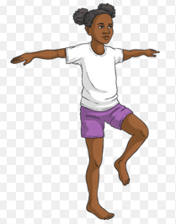
EYFS and KS1 (Reception, Y1 and Y2) - I can stand still on 1 foot for 5 seconds (try with both feet) -I can stand still on 1 foot for 10 seconds (try with both feet) - I can stand still on one foot for 30 seconds (try on both feet) - Whilst on one foot I can complete 5 mini squats (try on both feet)
Fundamental 1- Static Balance
1 Leg Balance
Lower KS2 (Y3 and Y4)
Complete all KS1 activities then try the following:
- I can stand still on one foot for 30 seconds with my eyes closed (try with both feet)
- Whilst on 1 foot I can complete 5 squats (try with both feet)
Whilst on 1 foot I can complete 5 ankle extensions (try with both feet)
Upper KS2 (Y5 and Y6)
Complete all other activities then try the following:
- I can stand still on 1 foot on an uneven surface( like a pillow or cushion) for 30 seconds (try on both feet)
- I can stand still on 1 foot on an uneven surface for 30 seconds with my eyes closed (try on both feet)
- I can stand on one foot and complete 10 squats and ankle extensions (try on both feet, then try with eyes closed)

