Slide 1

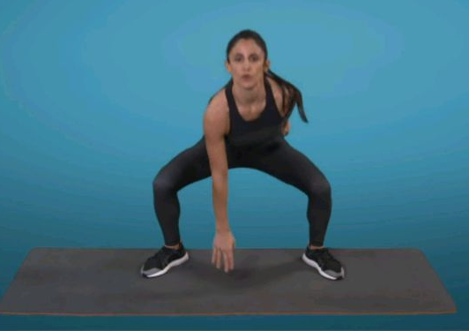
Personal Challenge In Out Jumps
How many In Out jumps can you do in 1 minute?
Remember bend your knees and jump your feet in together then out. As you jump out touch one hand to the ground. Alternate which hand touches
Equipment
- Timer
Practise, Record your score, Try to beat it
Can you beat it by more than 5?

