Slide 1

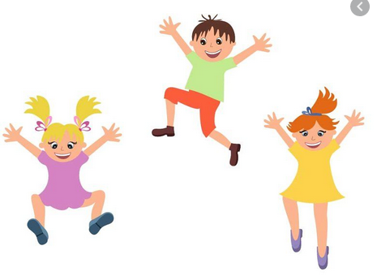
EYFS and KS1 (Reception, Y1 and Y2) - I can keep balanced and jump from 2 feet to 2 feet going forwards, backwards and side to side - I can jump from 2 feet to 2 feet and quarter turn in both directions - I can jump from 2 feet to 1 foot and freeze still when I land (try this on both feet)
Fundamental 4- Dynamic Balance
Jumping and Landing
Lower KS2 (Y3 and Y4)
Complete all KS1 activities then try the following:
- I can jump from 2 feet to 2 feet with a 180 degree turn in both directions
- I can complete a tuck jump and land smoothly
- I can complete a tuck jump and turn 180 degrees in both directions.
- I can jump from 2 feet to 2 feet going forwards, backwards and side to side landing on a line.
Upper KS2 (Y5 and Y6)
Complete all other activities then try the following:
- I can hop forwards and backwards, remaining still when I land
- I can jump from 1 foot to the other foot going forwards and backwards remaining still when I land
- I can hop side to side landing still on a line
- I can jump with my feet together and land in a lunge position

