Slide 1

Art and Design
South and Central American Art
Year One

Slide 2


Slide 3
Aim
I can tell you about the artist Beatriz Milhazes.
I can use Beatriz Milhaze as an inspiration for my own artwork.
Success Criteria
I can tell you the names of some of Beatriz Milhazes’s artworks.
I can tell you facts about Beatriz Milhazes’s life and work.
I can learn something interesting about her work.

Slide 4
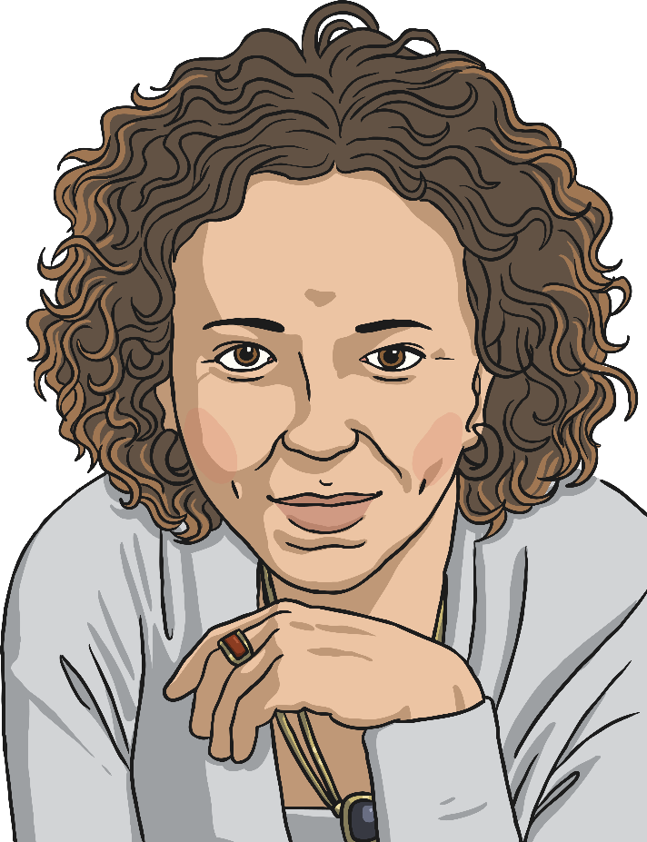
Beatriz Milhazes

Slide 5
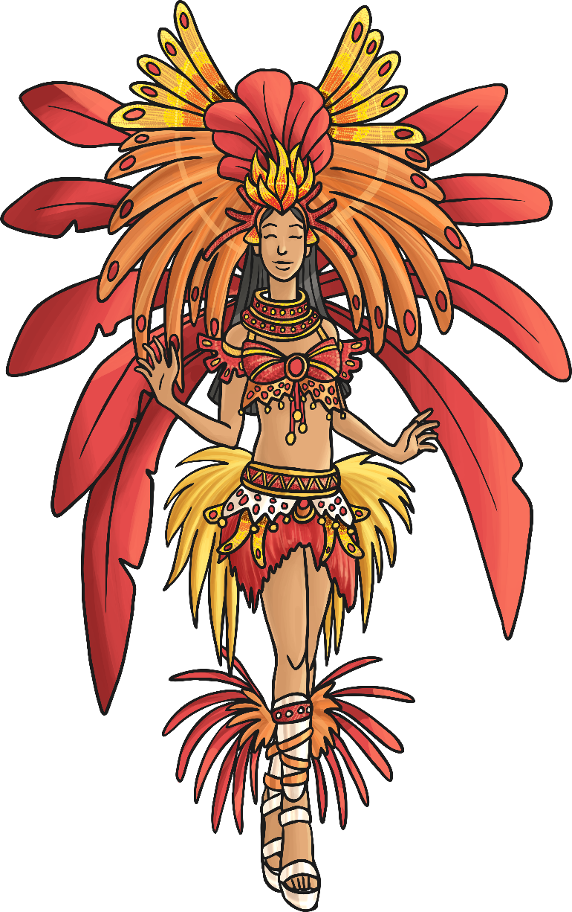
Beatriz Milhazes (1960)
Beatriz Milhazes is a collage artist and painter who uses very colourful materials to create pictures.
She is influenced by the tropical flowers and plants near her home in Brazil, and also the carnivals and culture of Brazil. She uses these inspiring places and experiences, turning them into bright, clashing colours or simple shapes.
Beatriz Milhazes uses shapes in different sizes and overlaps them to create images. She uses coloured papers, sweet wrappers, food packaging, plastic and paints to create her images.
She has created colourful windows, decorated London Underground stations and exhibited her work on canvases too.
Beatriz Milhazes grew up visiting museums and galleries as a young girl. She was very impressed with the work of Matisse, and is still influenced by Mondrian and Bridget Riley.
She repeats circles, squares, stripes, flowers and other simple shapes throughout her work.

Slide 6

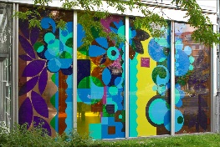
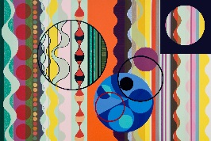

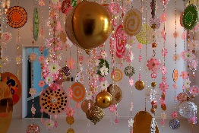
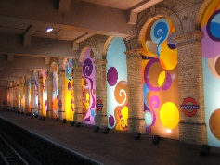
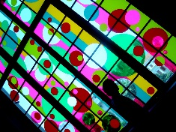
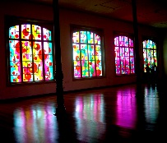
Looking at Paintings
Look at your image.
What can you see in the picture?
What patterns or shapes does the artist use?
How does the picture make you feel?
What colours can you see in the picture?
Why do you think the artist painted it?
If you could give this painting your own title, what would it be?

Slide 7

by Beatriz Milhazes
Photo courtesy of dalbera (@flickr.com) - granted under creative commons licence - attribution

Slide 8
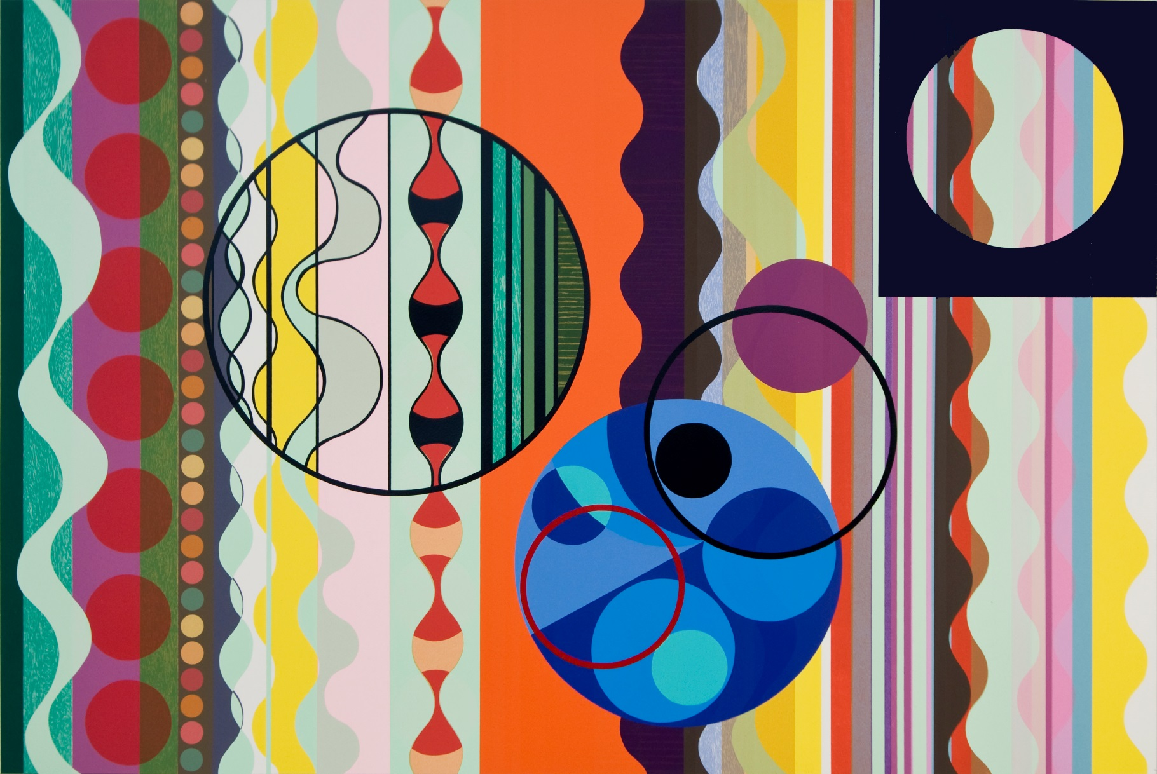
by Beatriz Milhazes
Photo courtesy of durhampress.com - attribution

Slide 9

by Beatriz Milhazes
Photo courtesy of durhampress.com - attribution

Slide 10
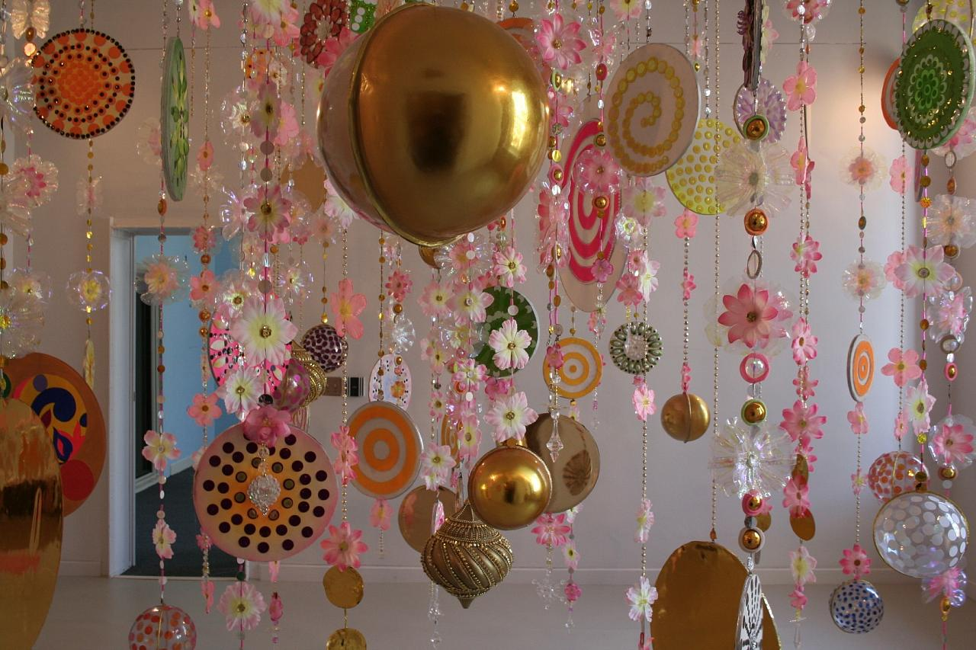
by Beatriz Milhazes
Photo courtesy of findfado (@flickr.com) - granted under creative commons licence - attribution

Slide 11

by Beatriz Milhazes
Photo courtesy of loopzilla (@flickr.com) - granted under creative commons licence - attribution

Slide 12
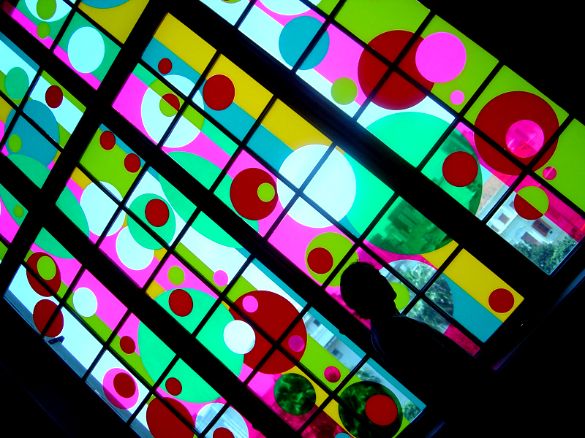
by Beatriz Milhazes
Photo courtesy of lpquintale (@flickr.com) - granted under creative commons licence - attribution

Slide 13
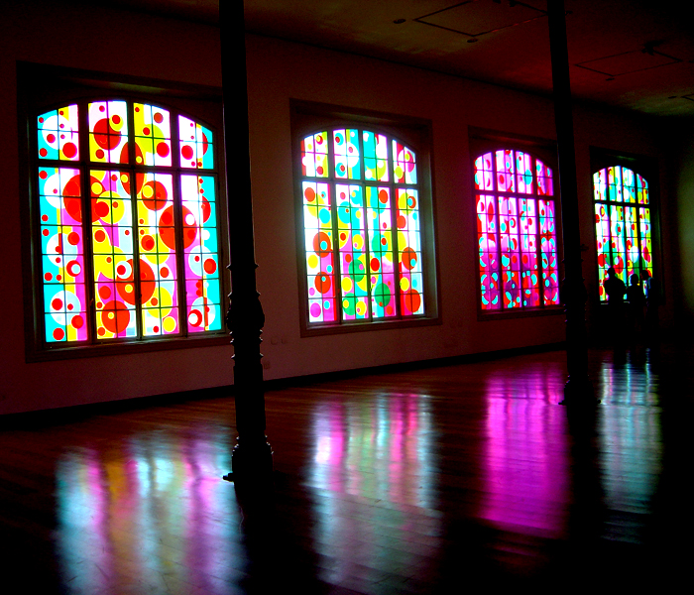
by Beatriz Milhazes
Photo courtesy of lpquintale (@flickr.com) - granted under creative commons licence - attribution

Slide 14


Working with Simple Shapes
Look at the different shapes that the artist uses in her work. How many can you see?
Photo courtesy of durhampress.com - attribution

Slide 15
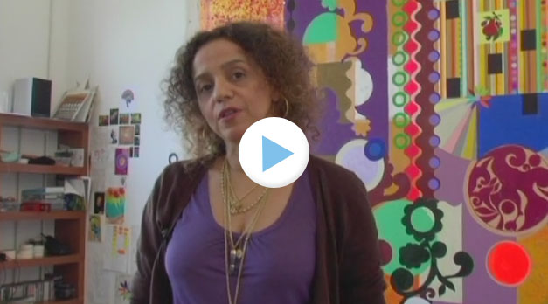

Beatriz Milhazes Film
As you watch the film, jot down on your whiteboard all of the different shapes that you see.

Slide 16
