Slide 1
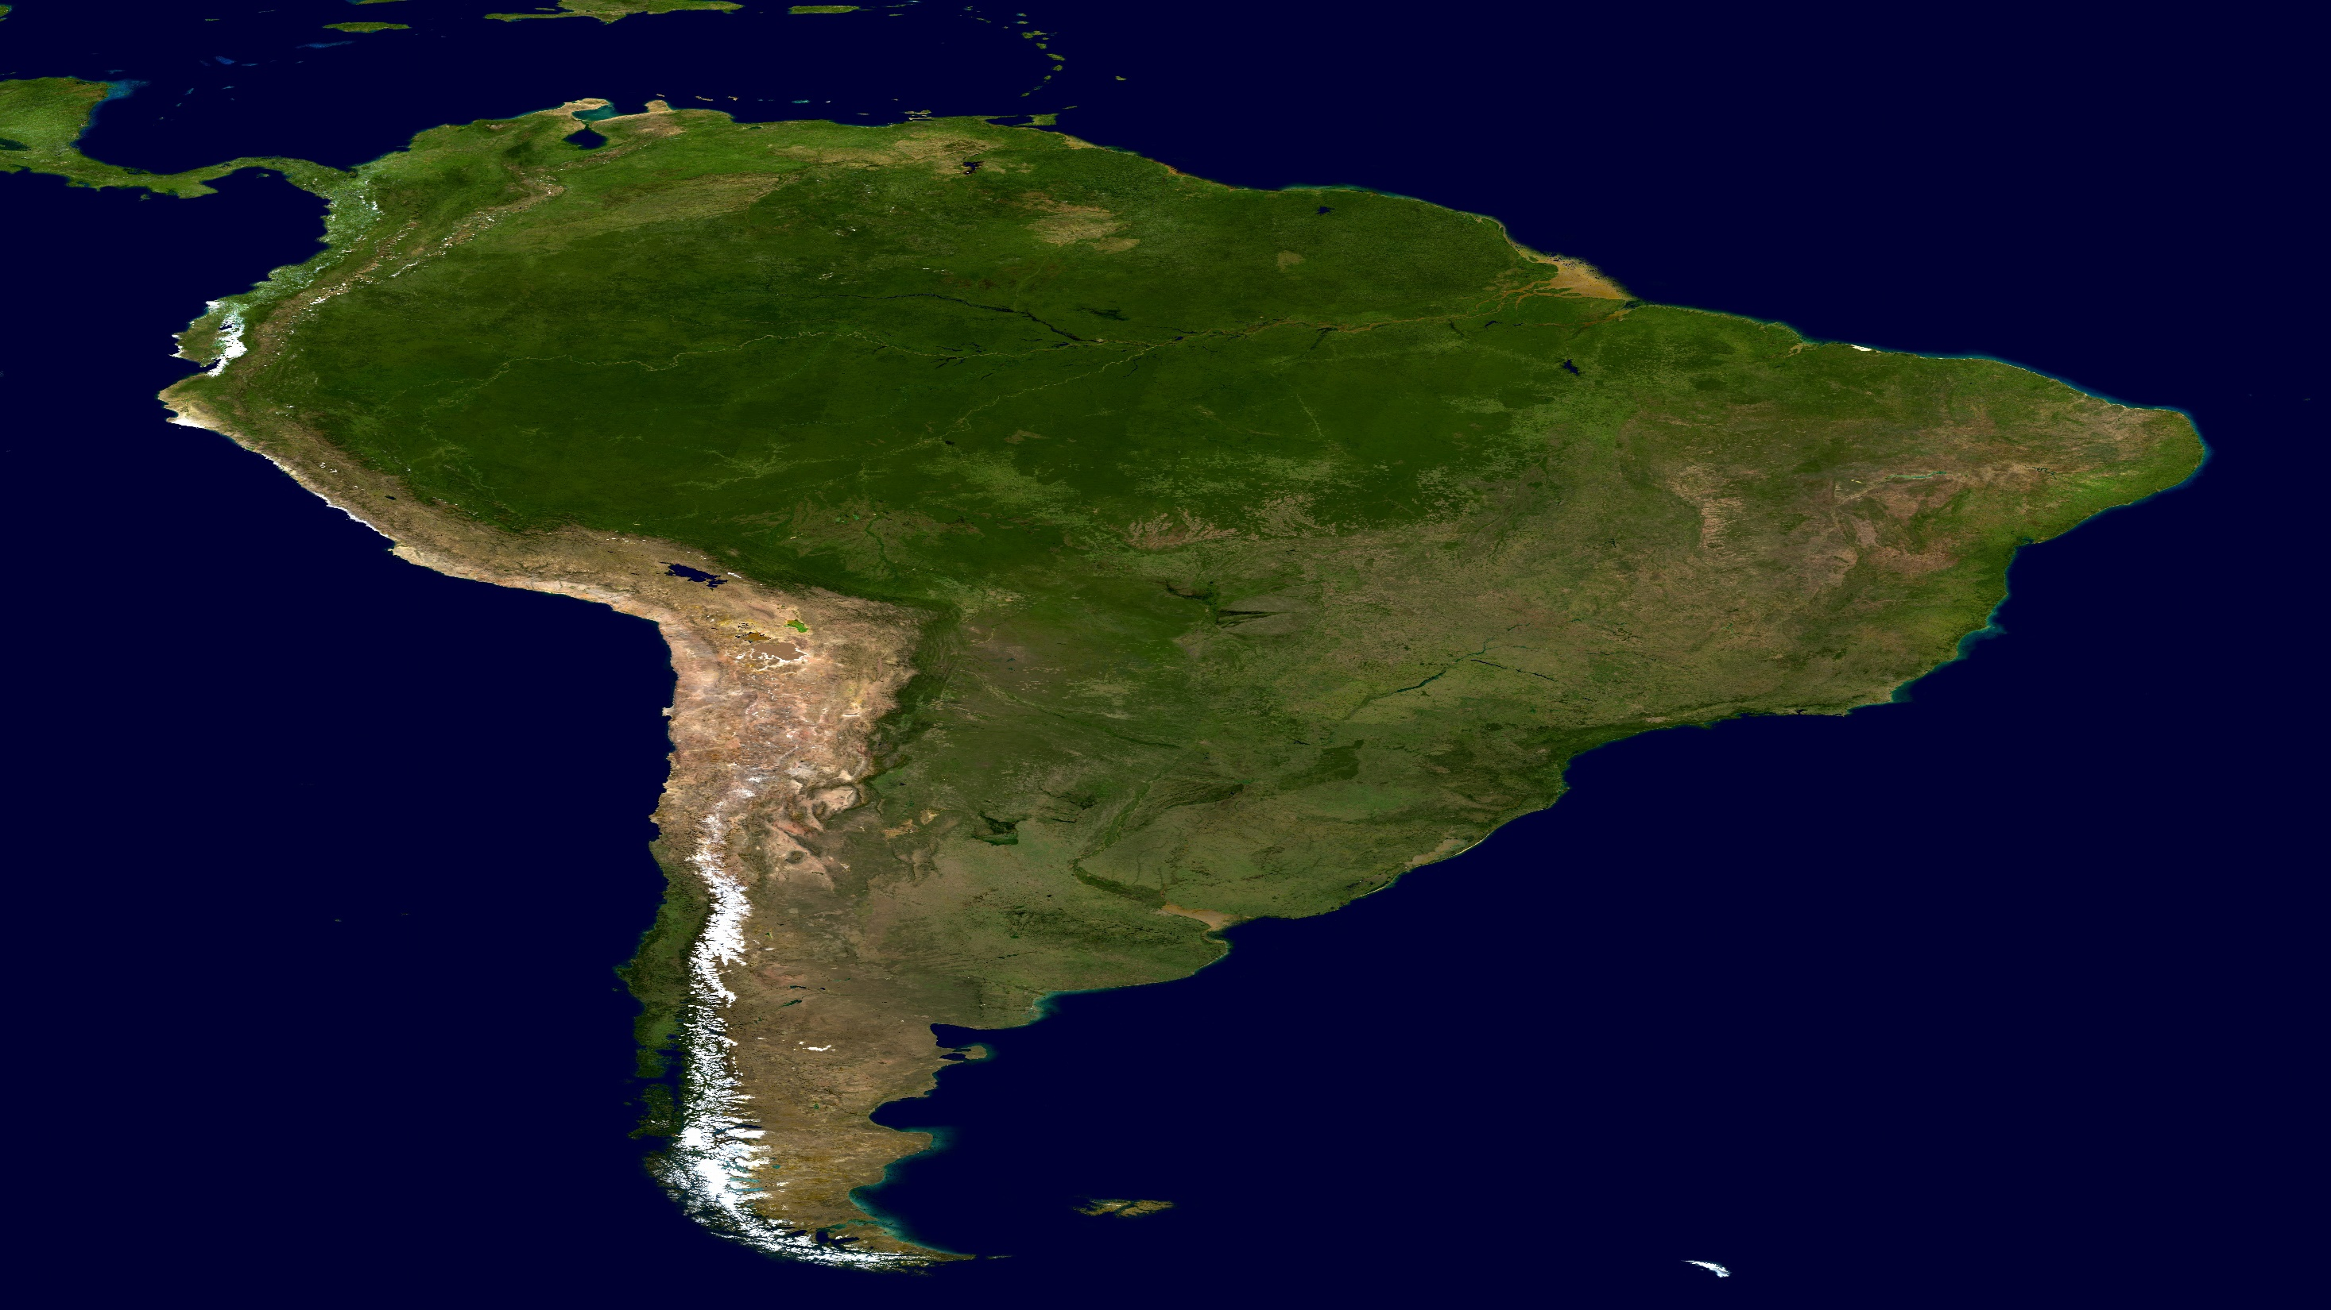
Come and take a tour around South America!

Slide 2
South America has 12 sovereign states.

Slide 3
Argentina
Bolivia
Brazil
Chile
Colombia
Ecuador
Guyana
Paraguay
Peru
Suriname
Uruguay
Venezuela

Slide 4
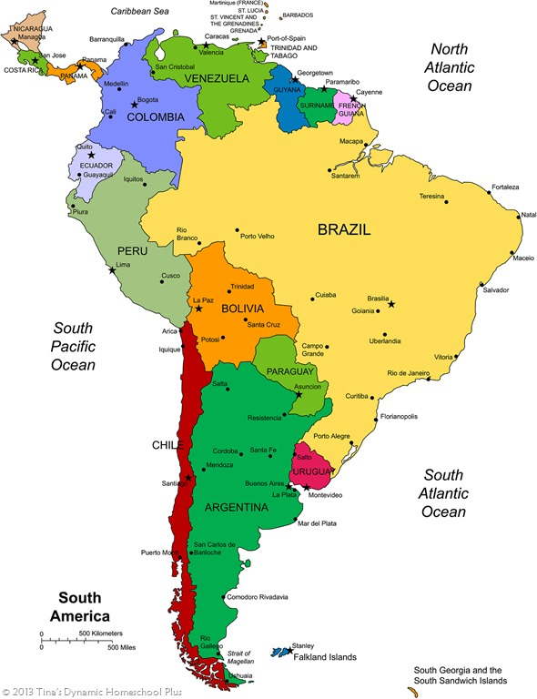

Slide 5
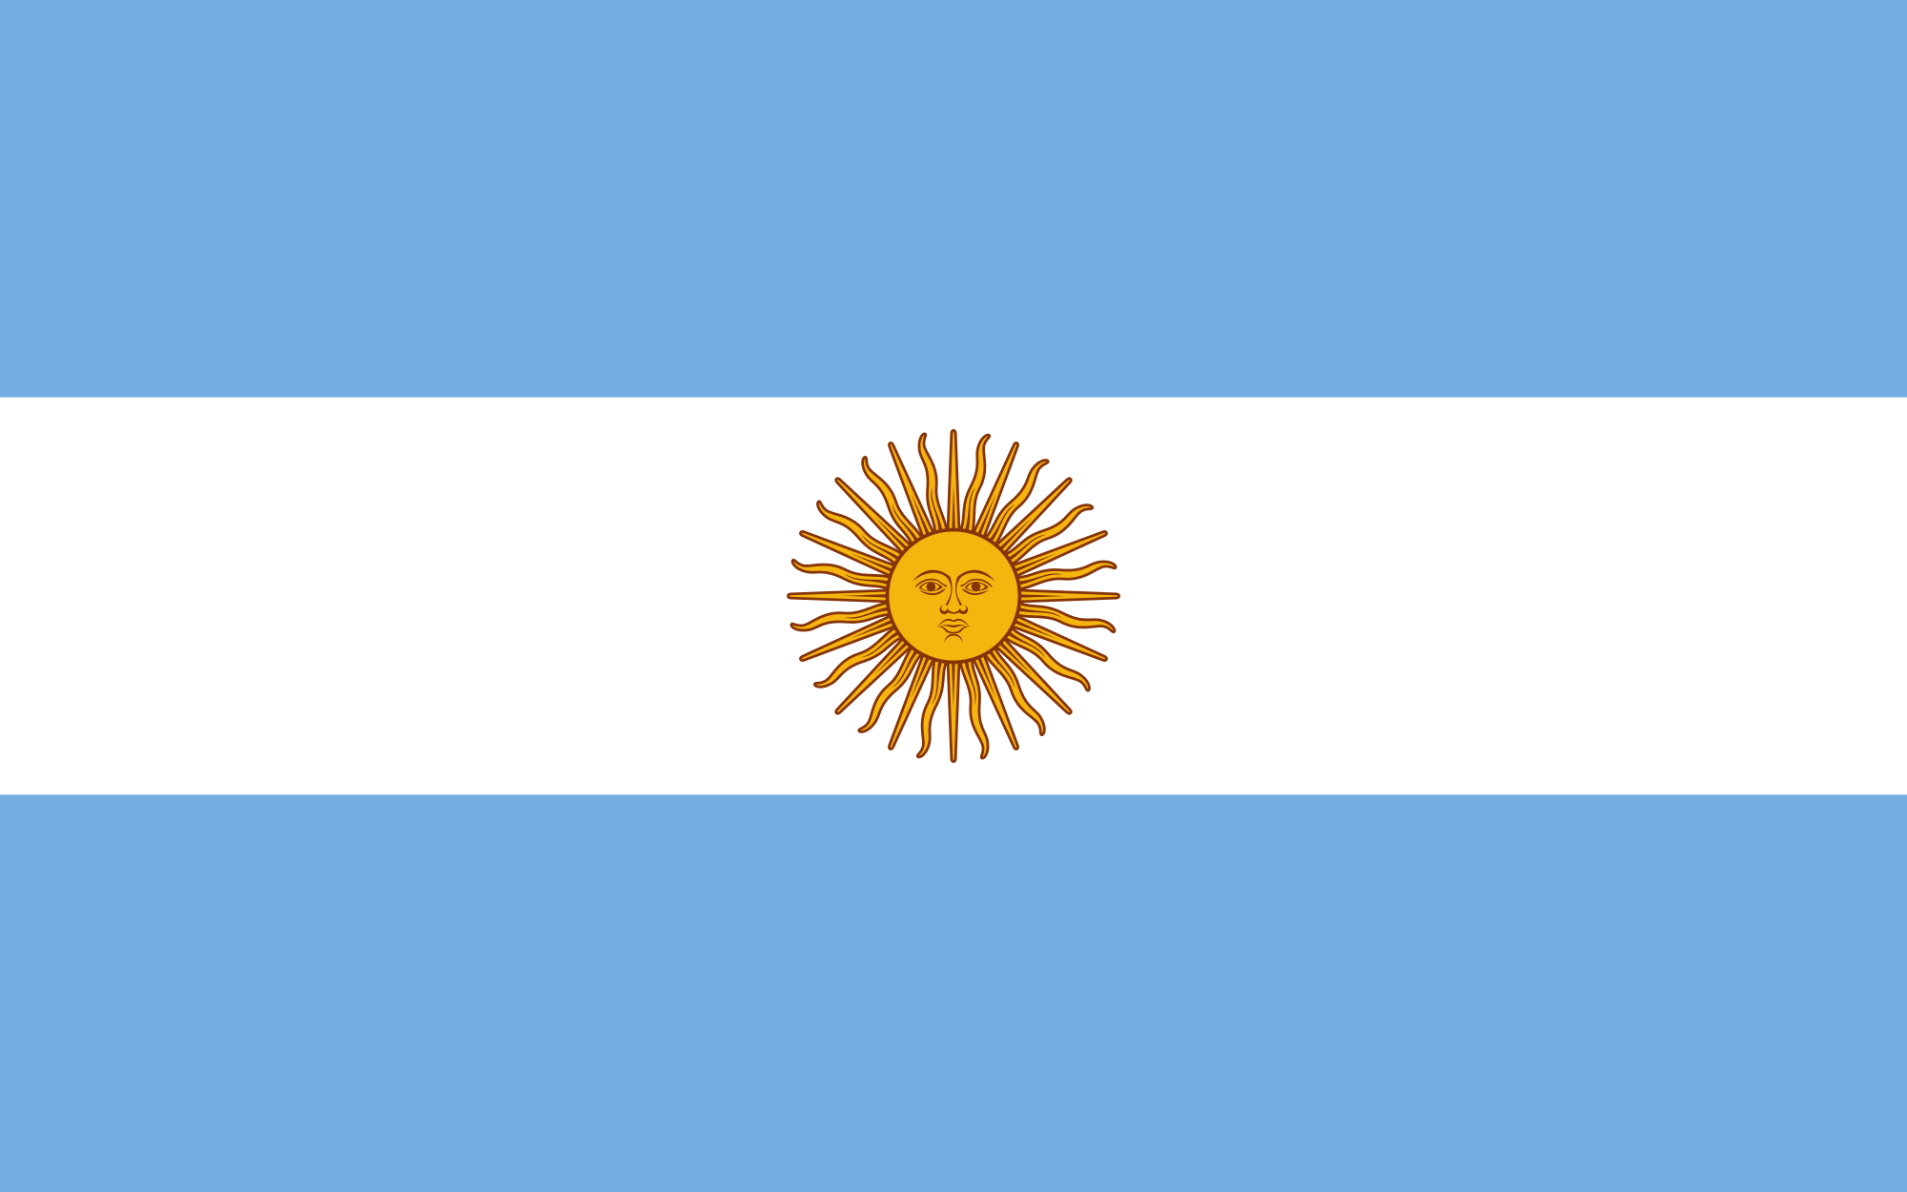
Argentina

Slide 6
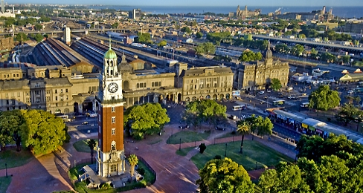
Argentine beef is famous around the world and Argentinian barbecues are very popular
The Latin dance and music called the Tango began in Buenos Aires
Capital city: Buenos Aires
Main language: Spanish

Slide 7
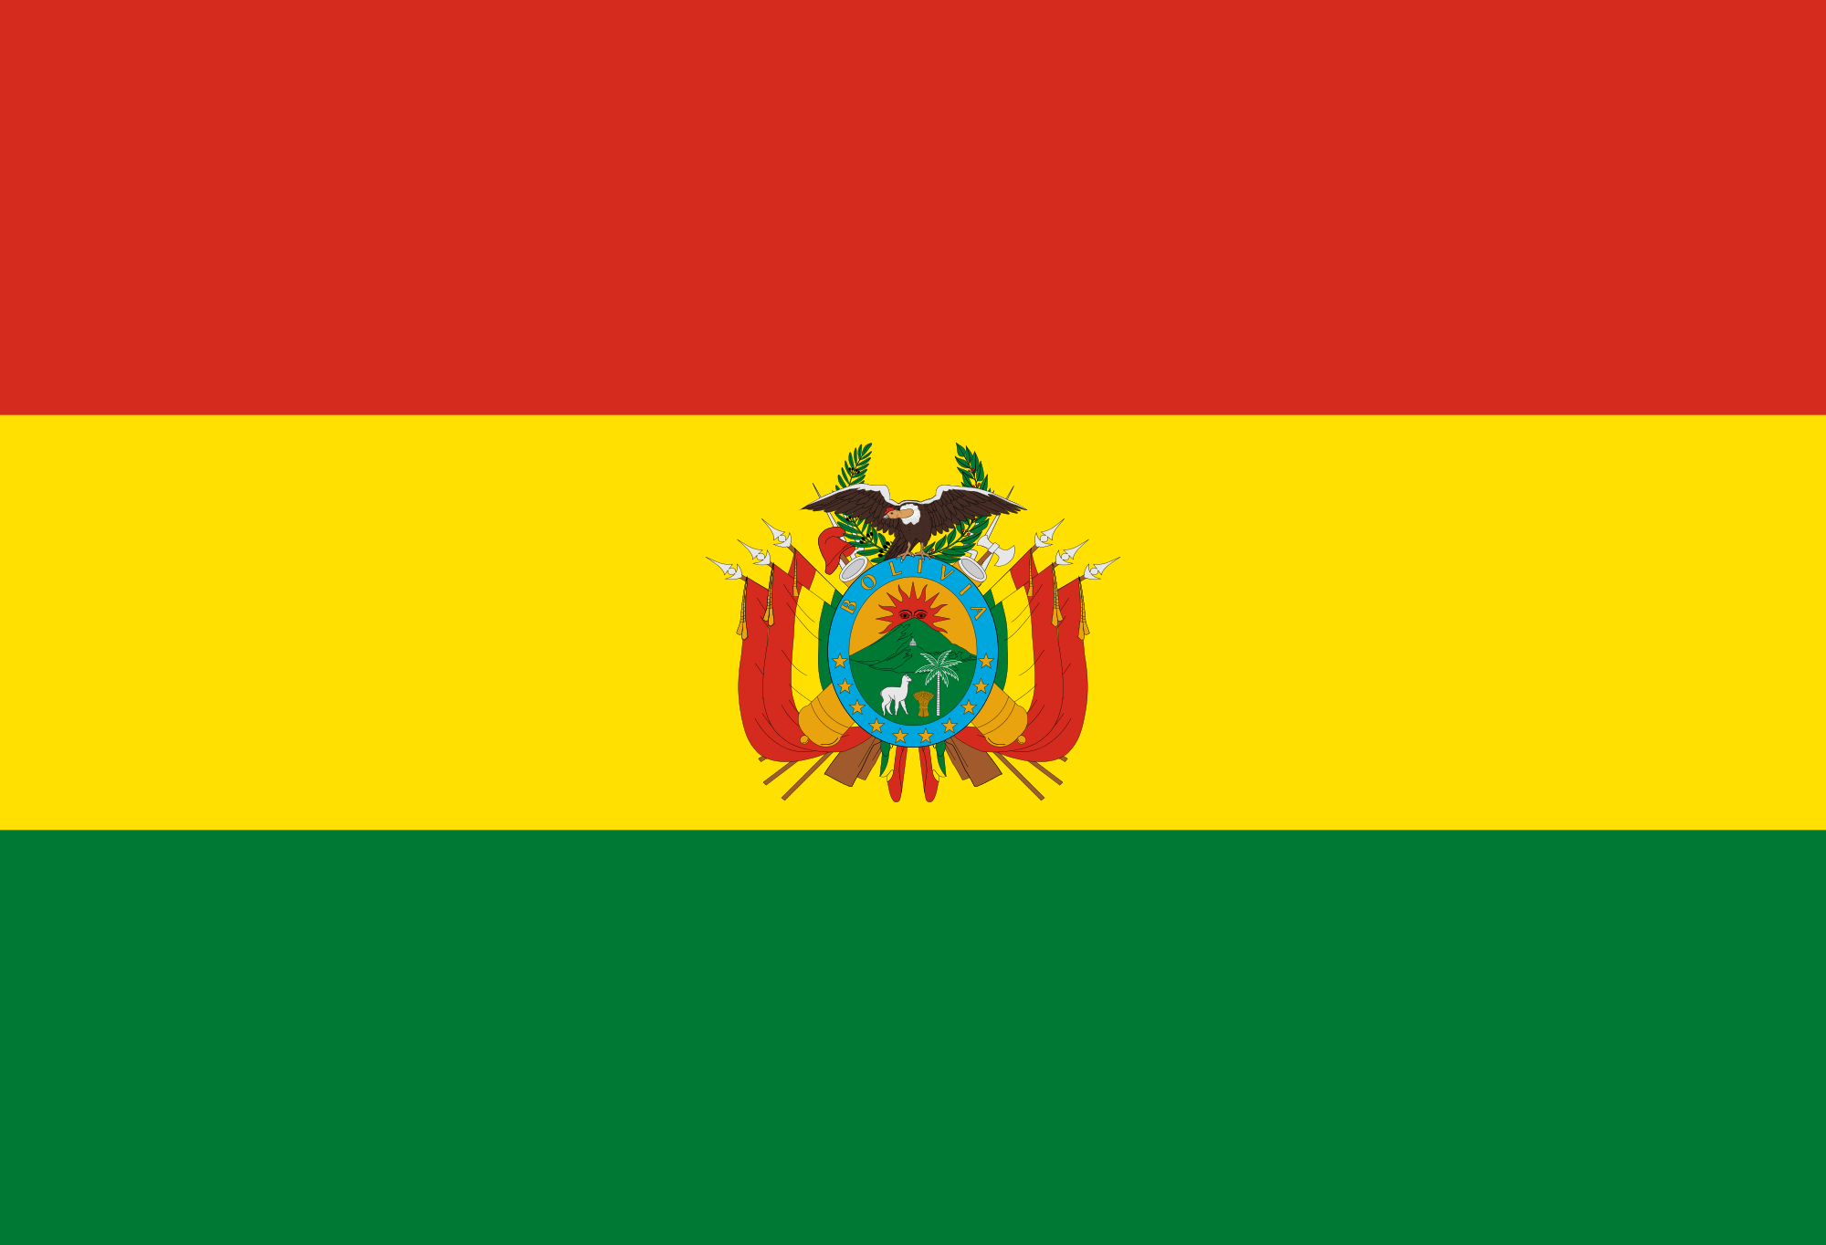
Bolivia

Slide 8
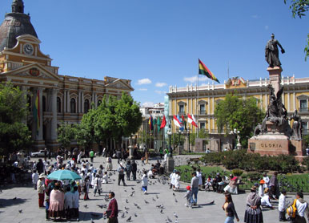
Many natural resources can be found in Bolivia, including Lithium used in batteries
It is home to the highest capital city in the world, La Paz.
Capital city: Sucre/ La Paz
Main language: Spanish

Slide 9
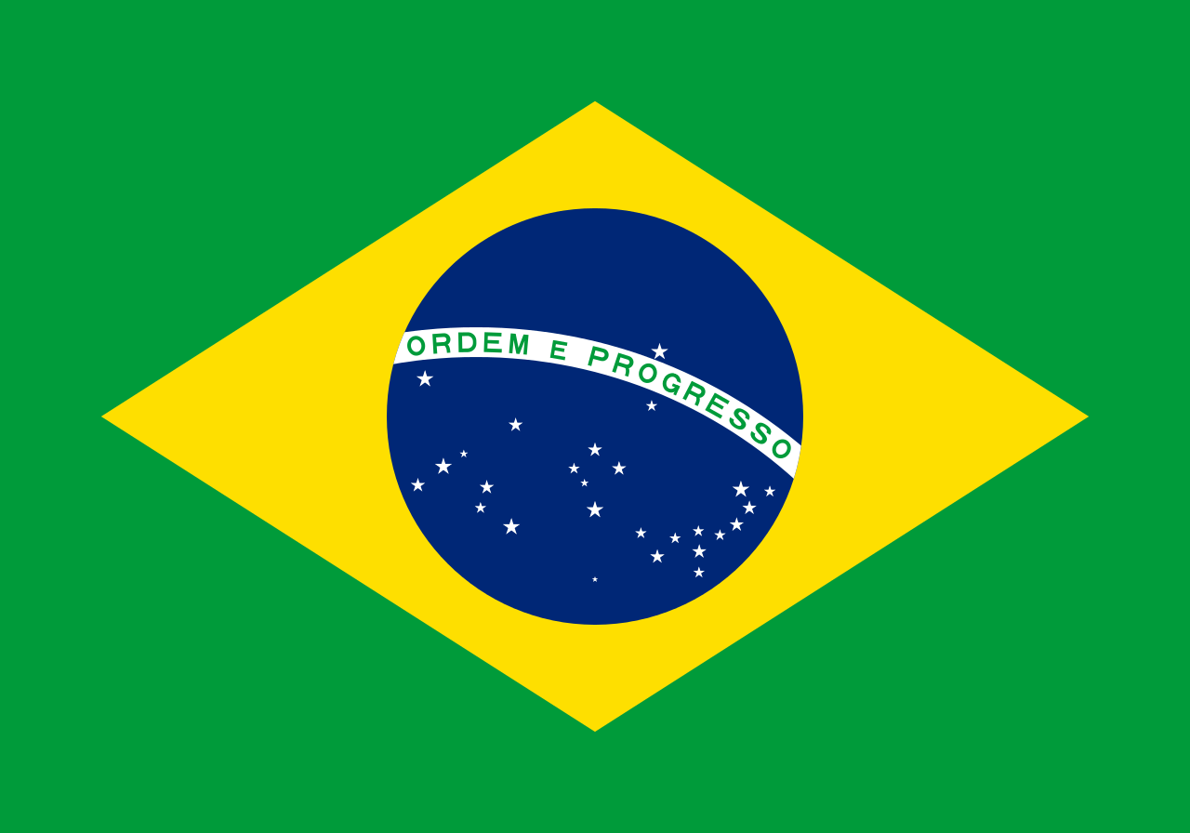
Brazil

Slide 10
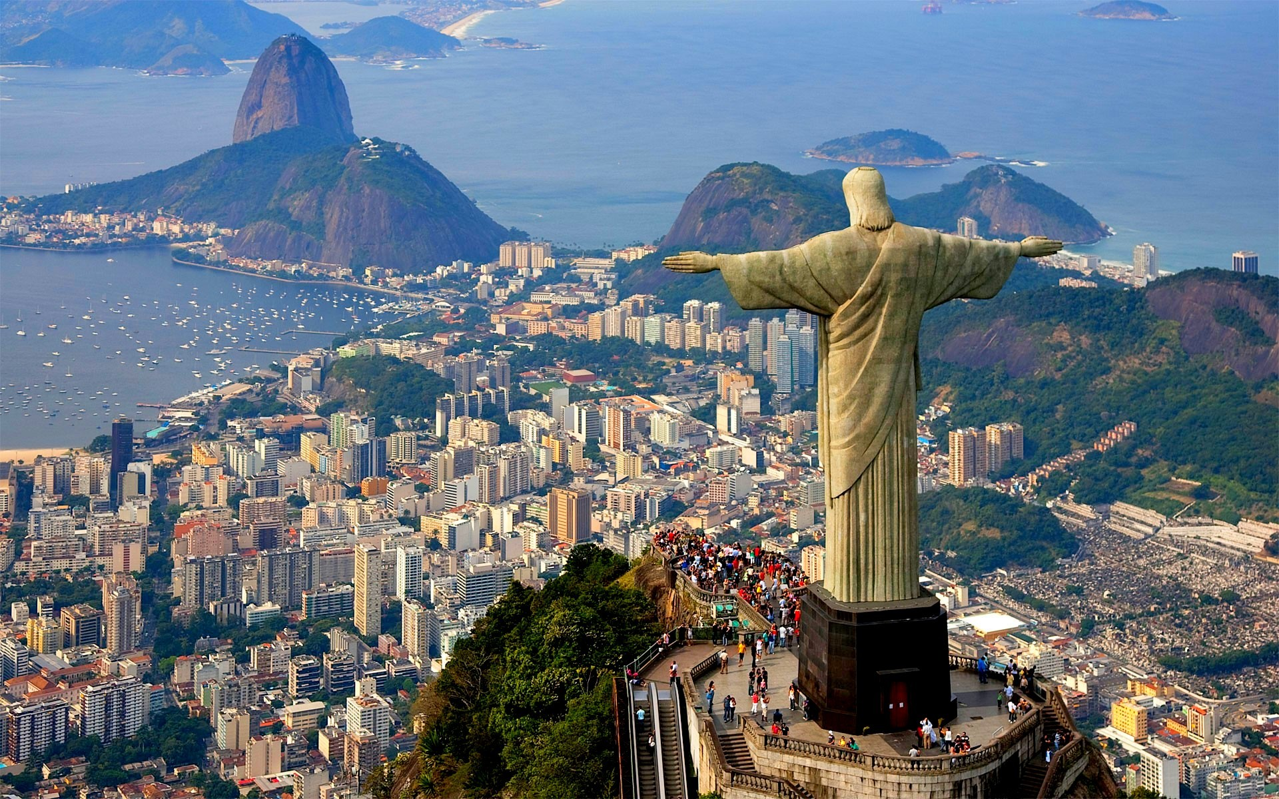
Almost half of the entire South American continent is covered by Brazil
Around 60% of the Amazon Rainforest is located in Brazil
Capital city: Brasilia
Main language: Portuguese

Slide 11
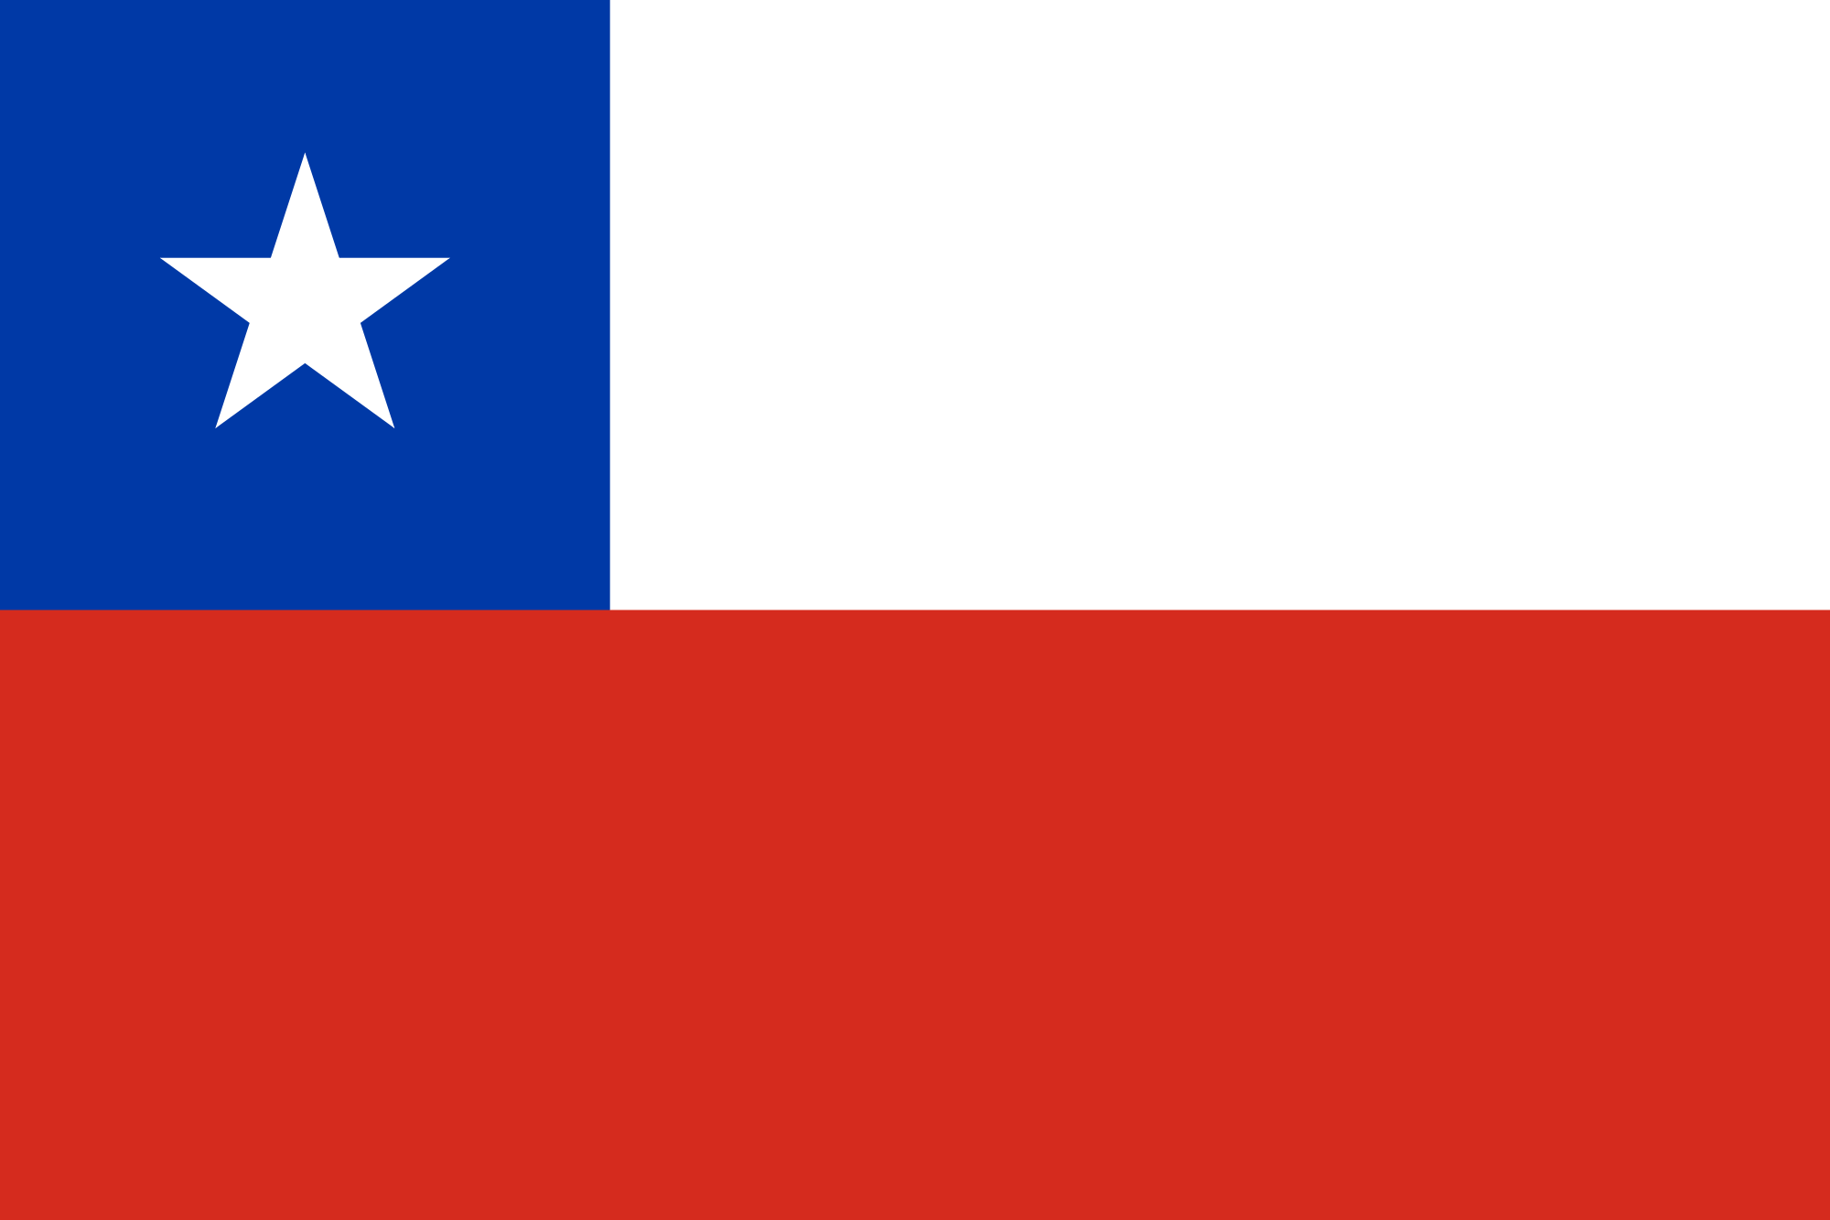
Chile

Slide 12
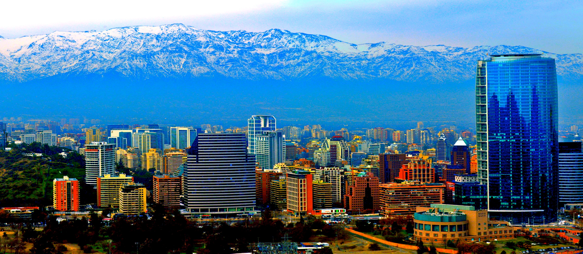
The Atacama desert found in Northern Chile is the driest place on Earth
The national sport of Chile is Rodeo which is still very popular in rural areas
Capital city: Santiago
Main language: Spanish

Slide 13
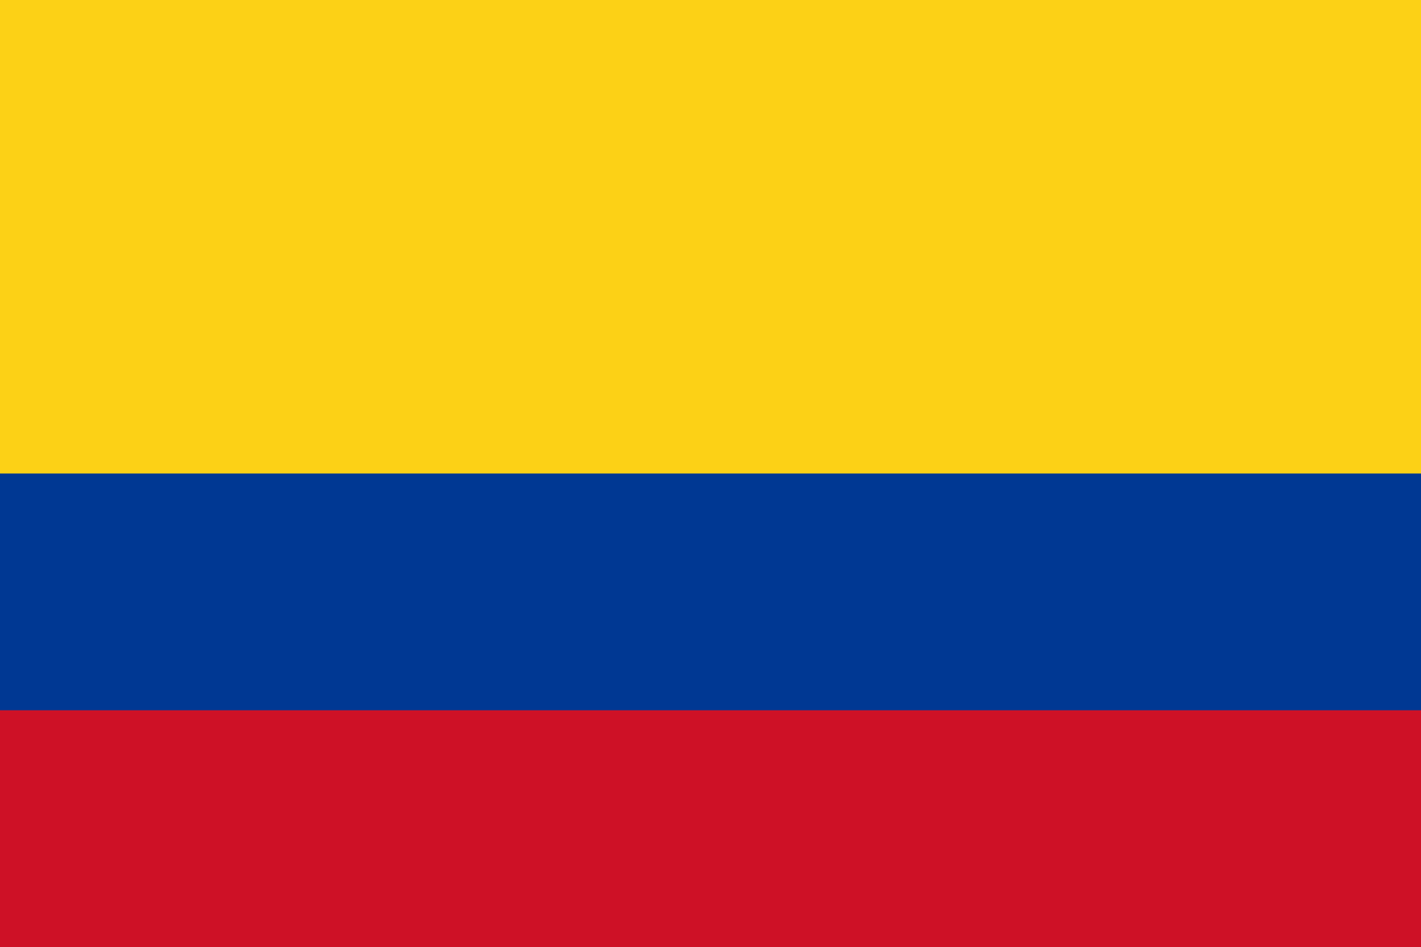
Colombia

Slide 14
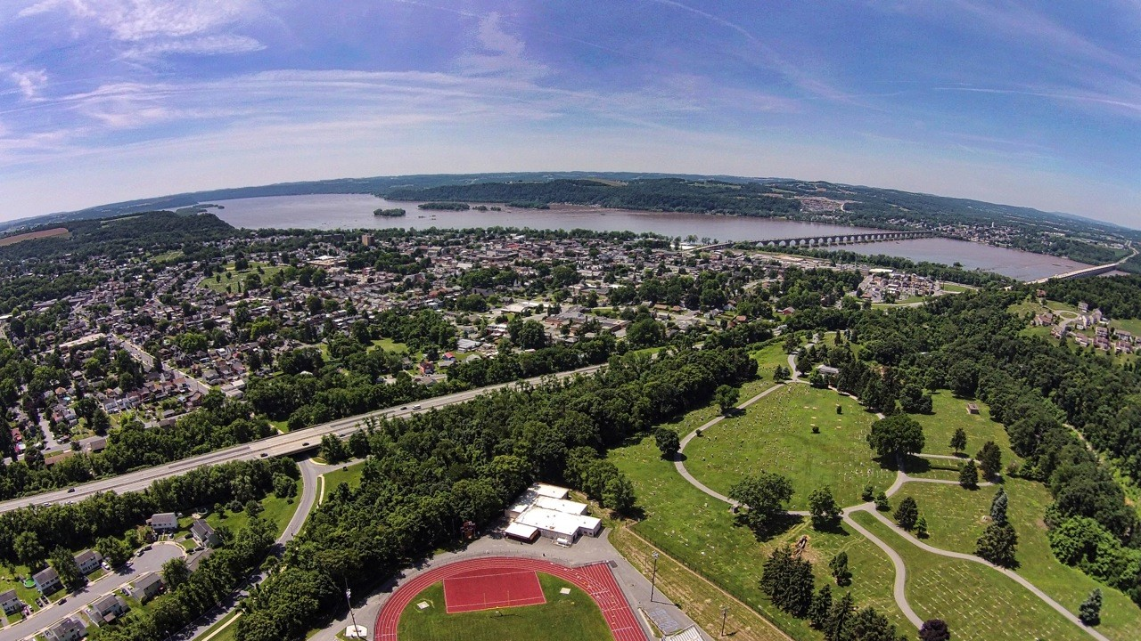
Colombia is the only country in South America that has a coastline on both the Pacific Ocean and Caribbean Sea
They are the world’s leading source of emeralds and are renowned for their coffee
Capital city: Bogota
Main language: Spanish

Slide 15
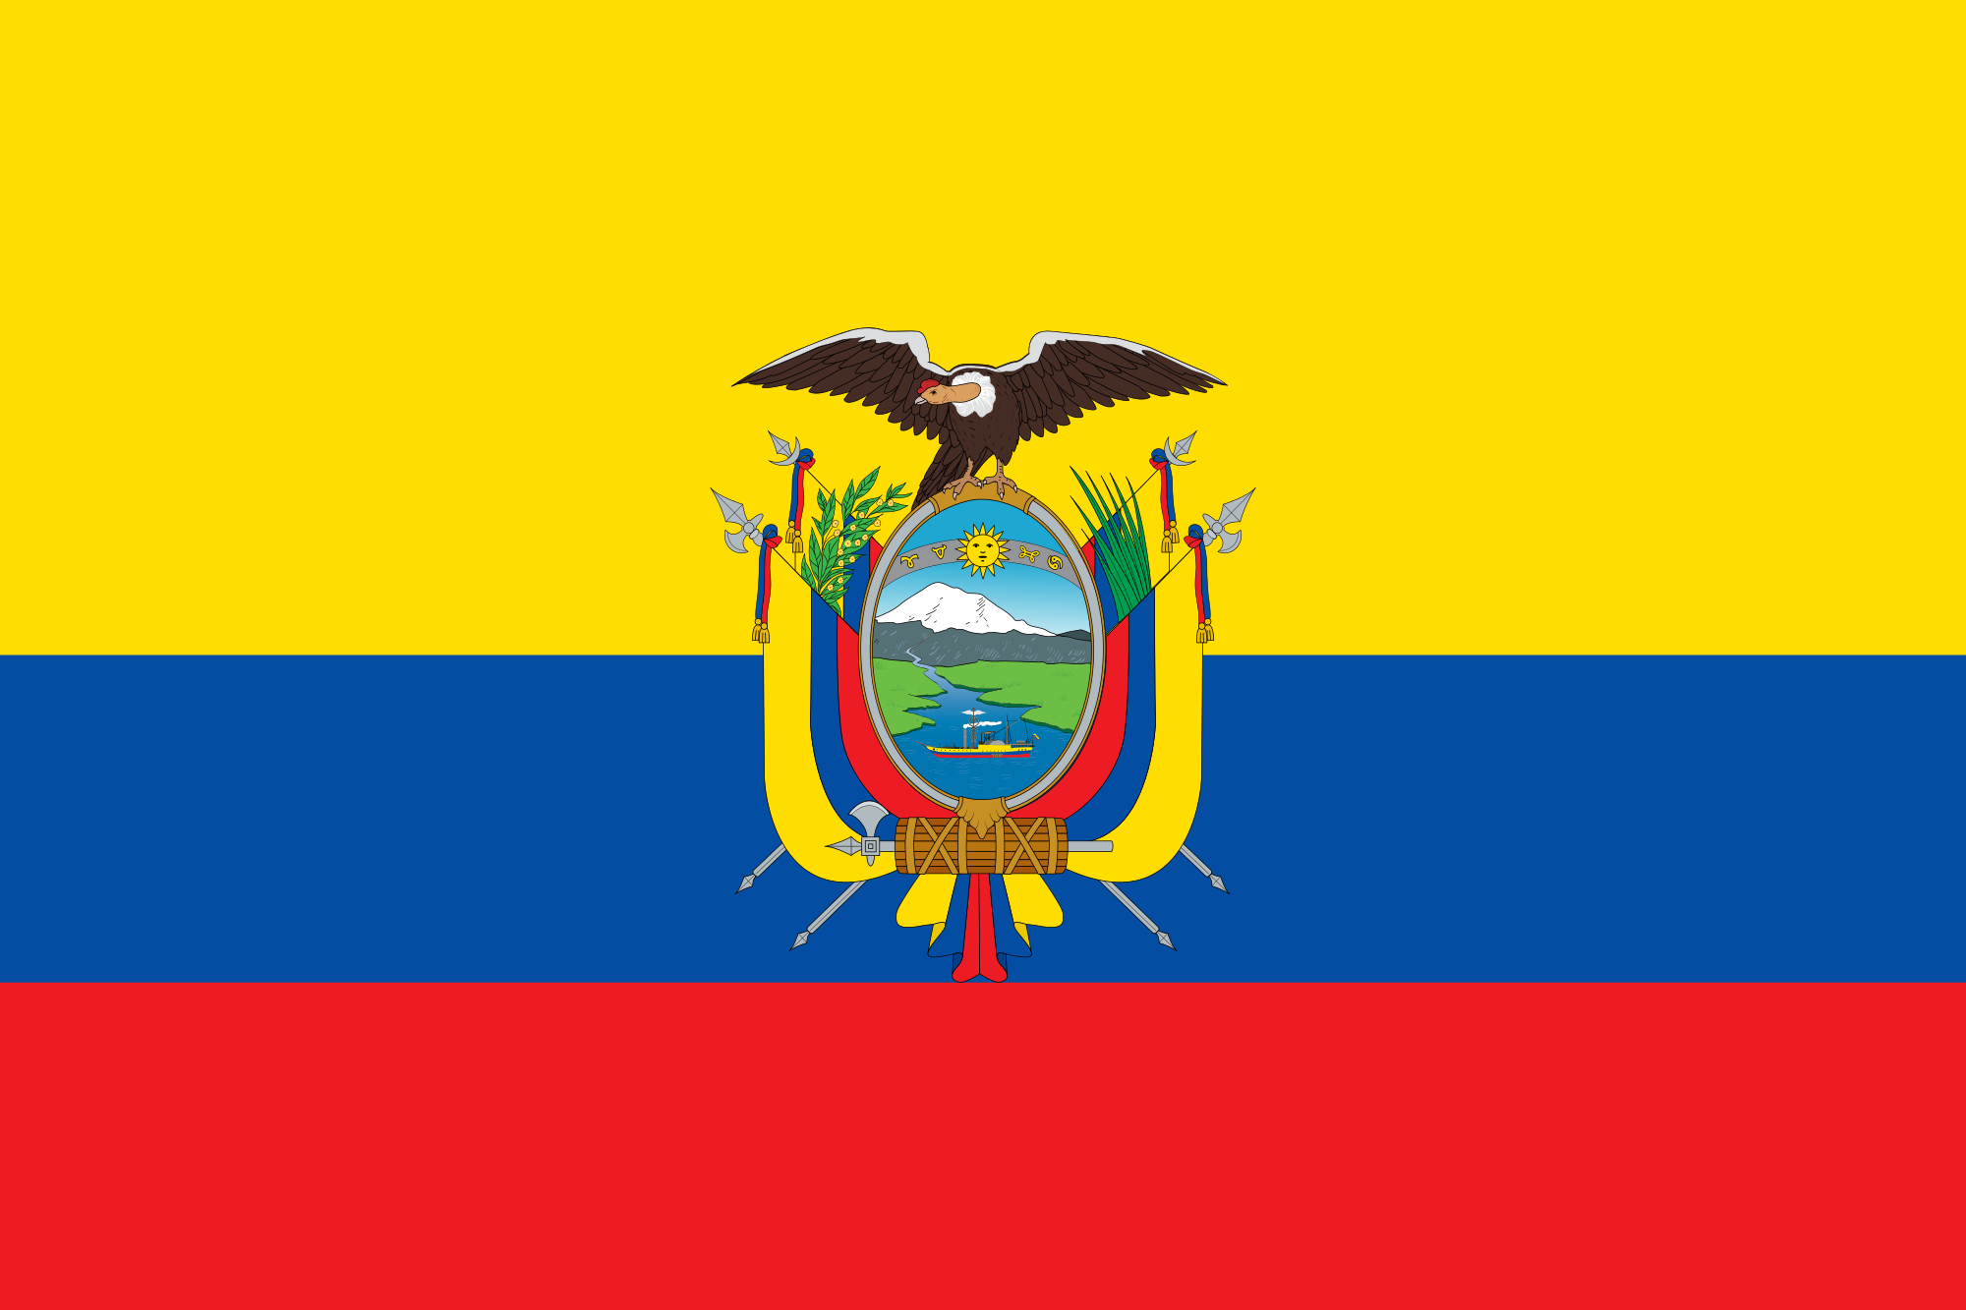
Ecuador

Slide 16
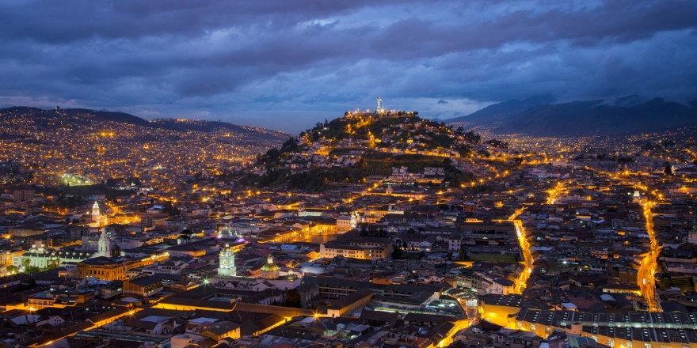
Ecuador are the world’s largest exporter of bananas
There are more mobile phones than people in Ecuador
Capital city: Quito
Main language: Spanish

Slide 17
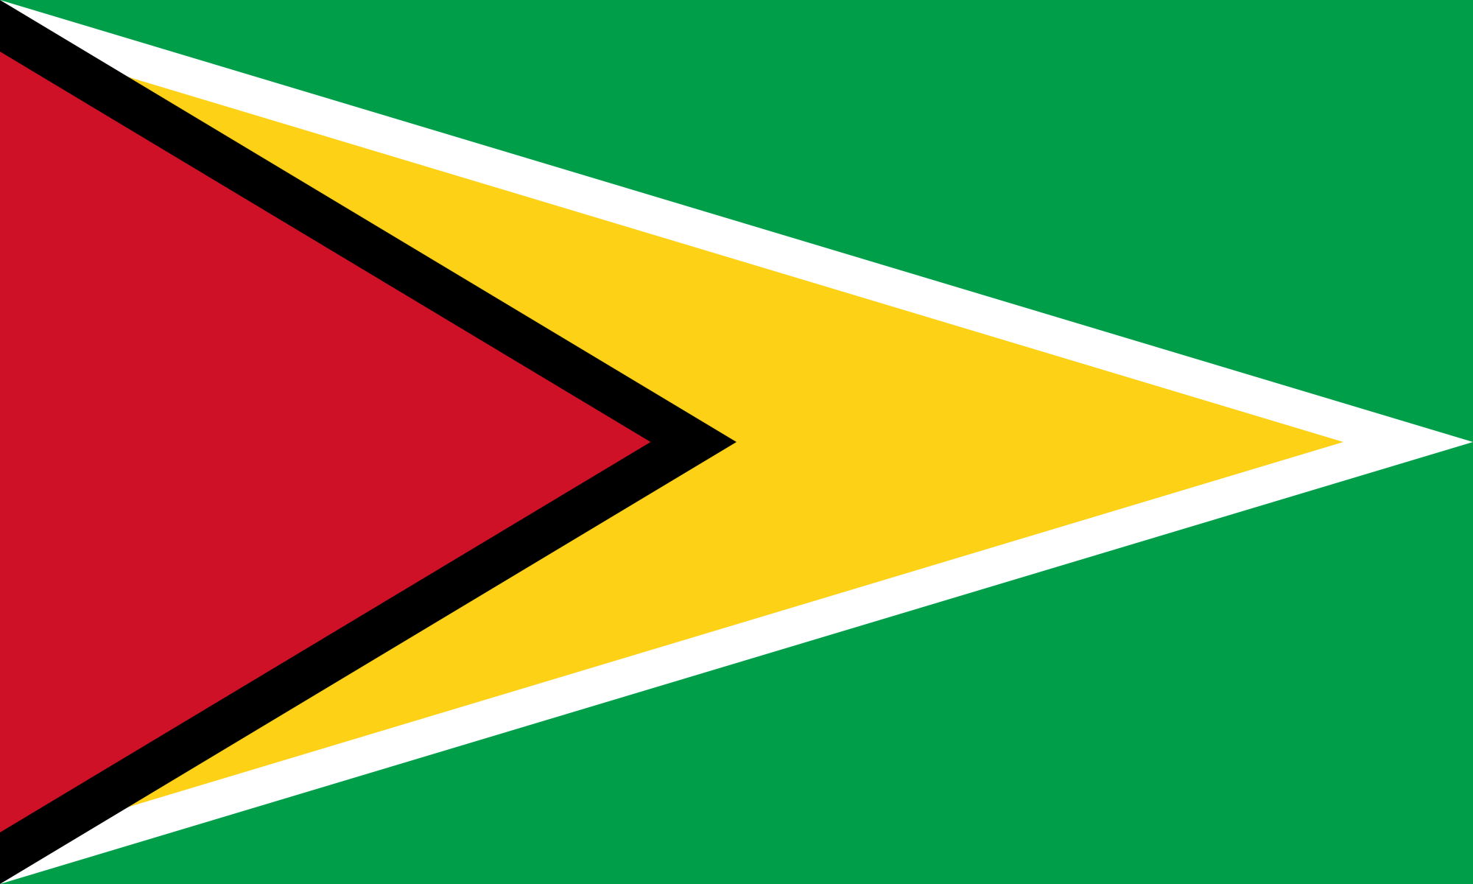
Guyana

Slide 18
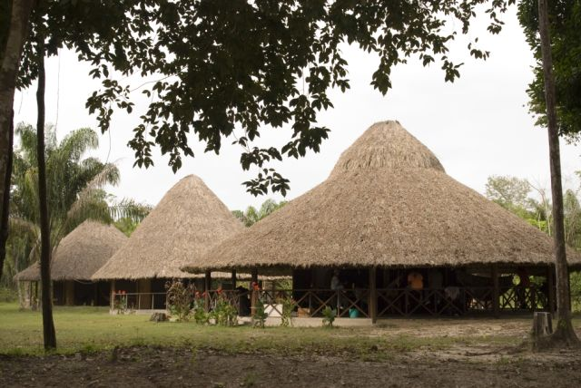
Around 70% of the country is covered by rain forests, making some places inaccessible
Guyana is home to the largest spiders species on Earth; The goliath bird-eating spider
Capital city: Georgetown
Main language: English

Slide 19
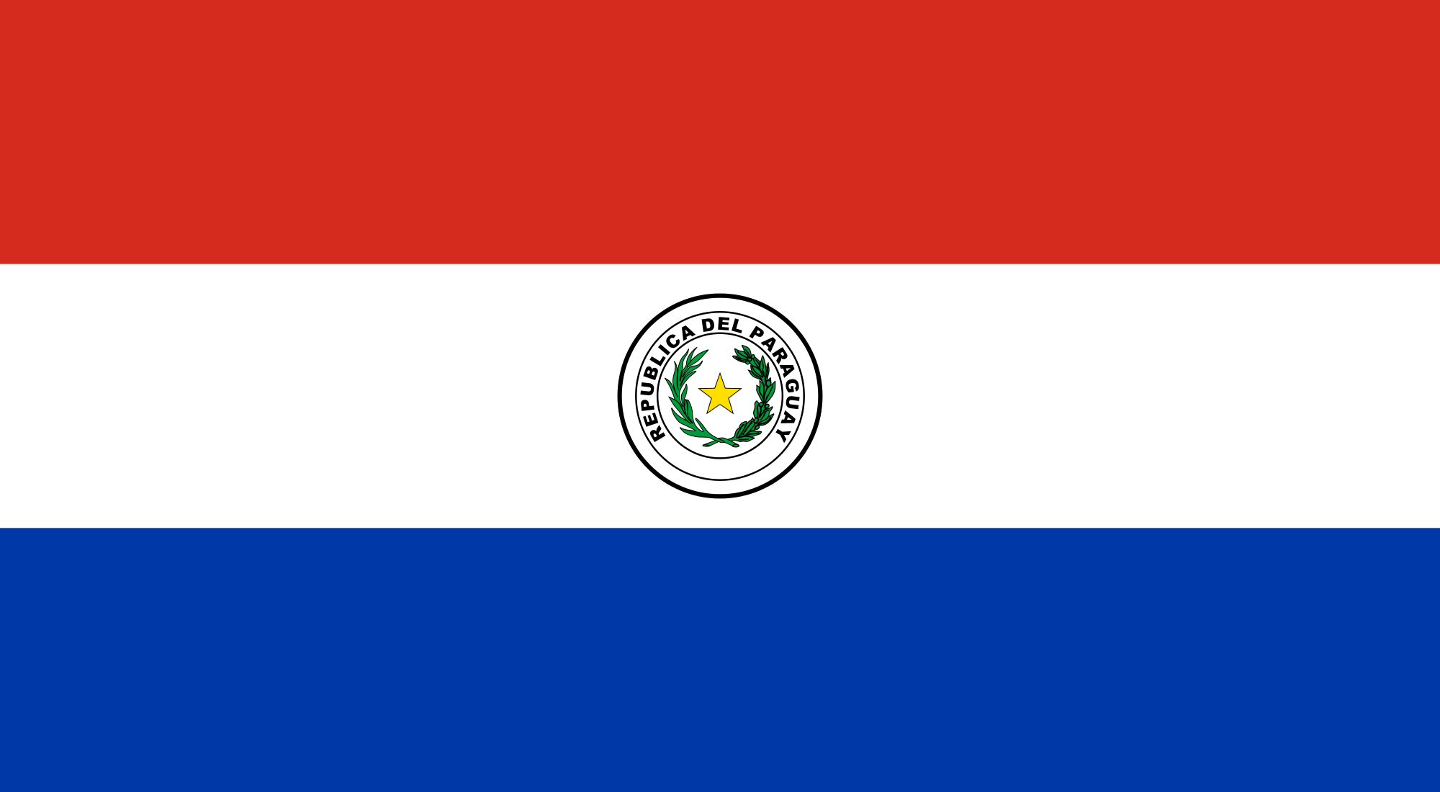
Paraguay

Slide 20
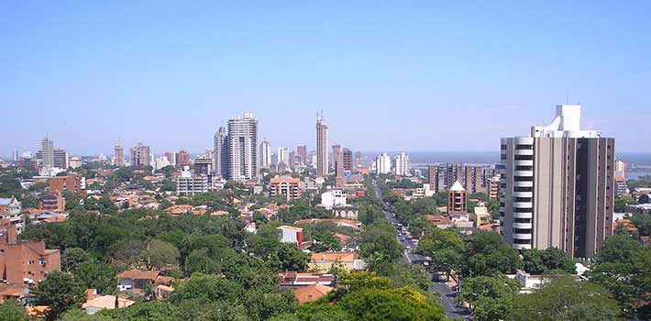
Their navy is the largest of any land-locked country in the world
To announce your arrival at someone's house you clap your hands
Capital city: Asuncion
Main language: Spanish/
Paraguayan guarani

Slide 21
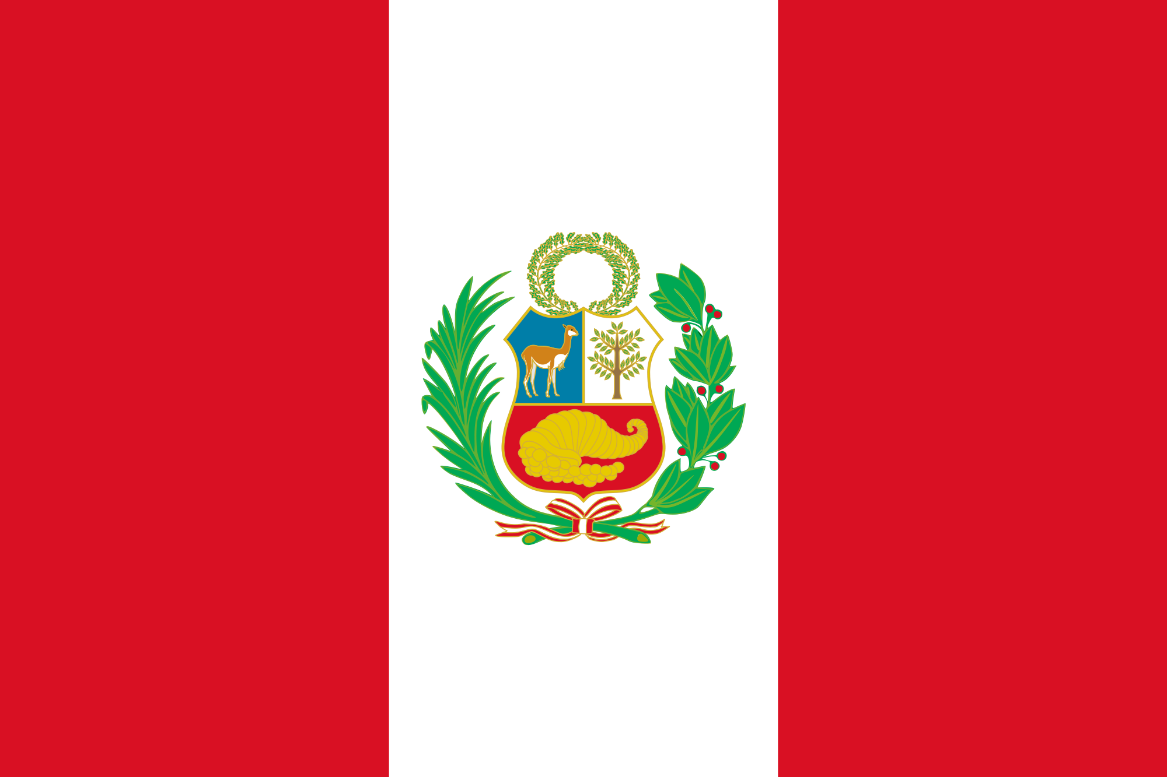
Peru

Slide 22
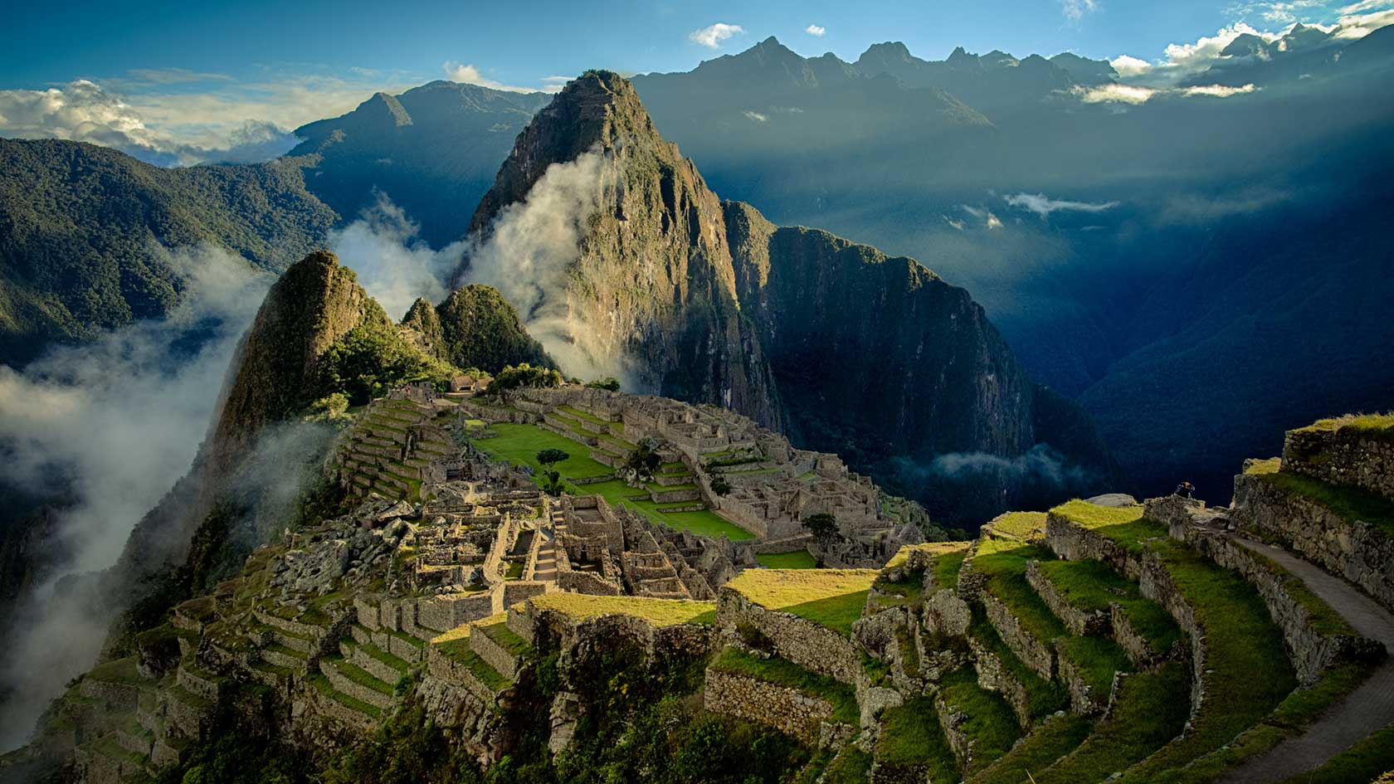
Peru is home to the ancient city of Machu Picchu set high in the Andes mountains
The potato is native to the southern area of modern day Peru
Capital city: Lima
Main language: Spanish

Slide 23
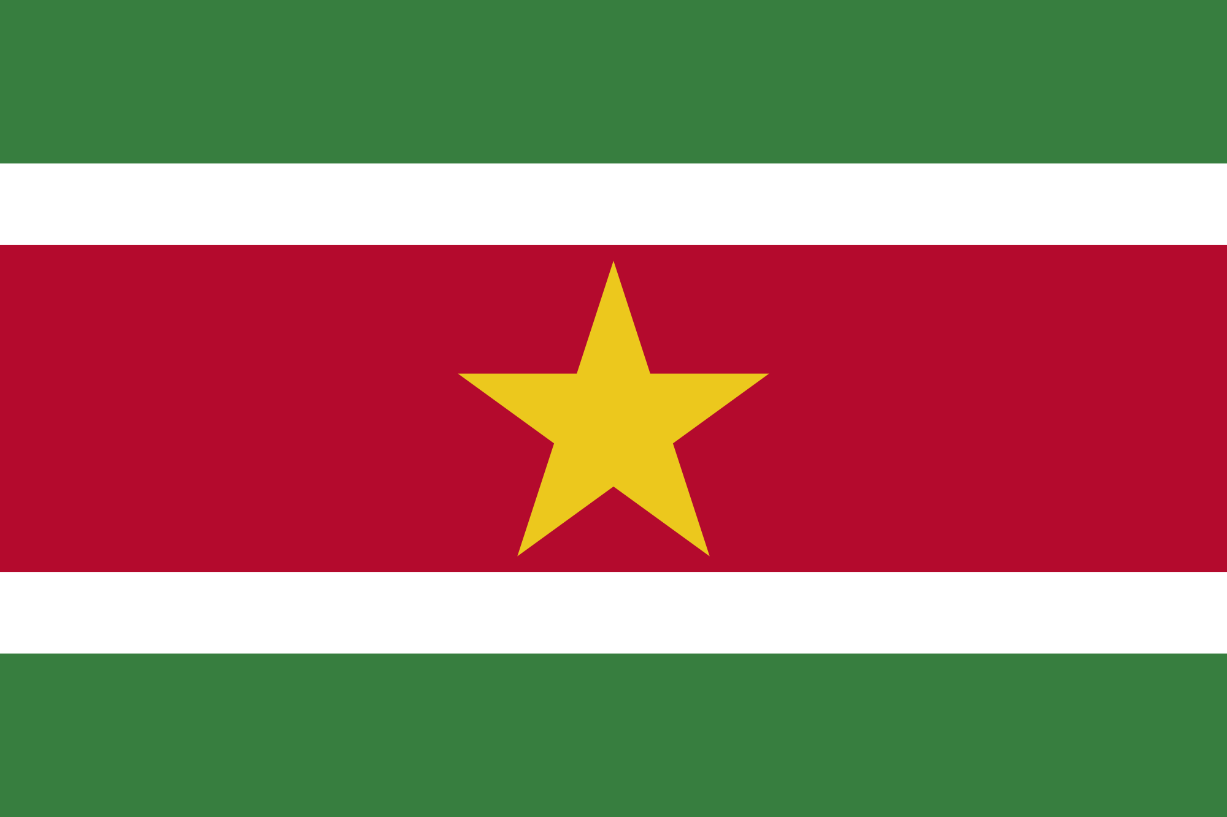
Suriname

Slide 24
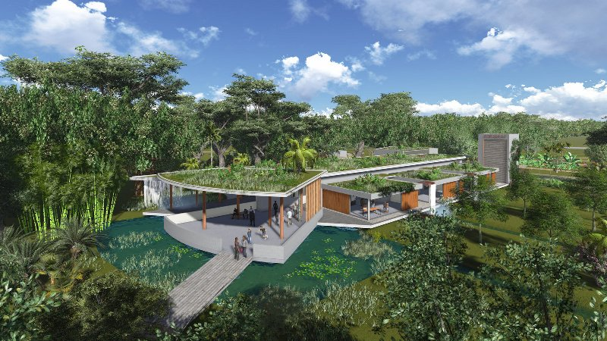
Suriname is the smallest country in South America
It is considered to be culturally Caribbean and has extensive links with these nations
Capital city: Paramaribo
Main language: Dutch

Slide 25
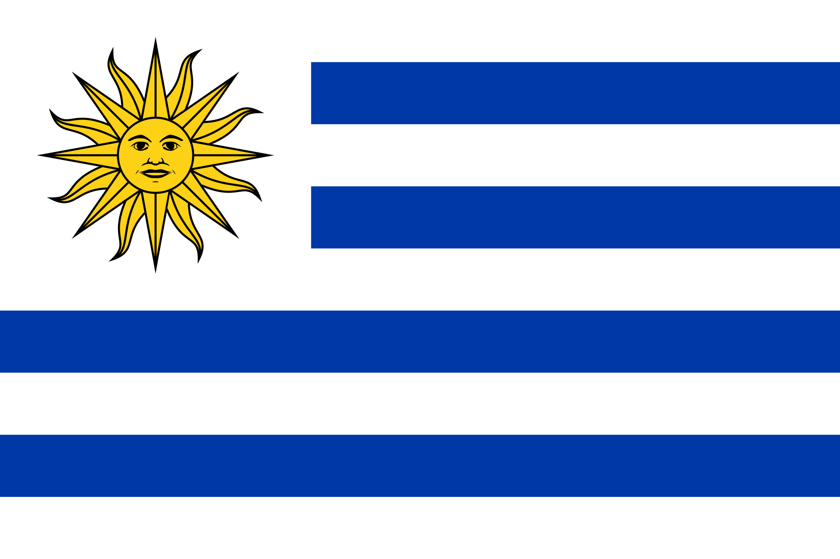
Uruguay

Slide 26
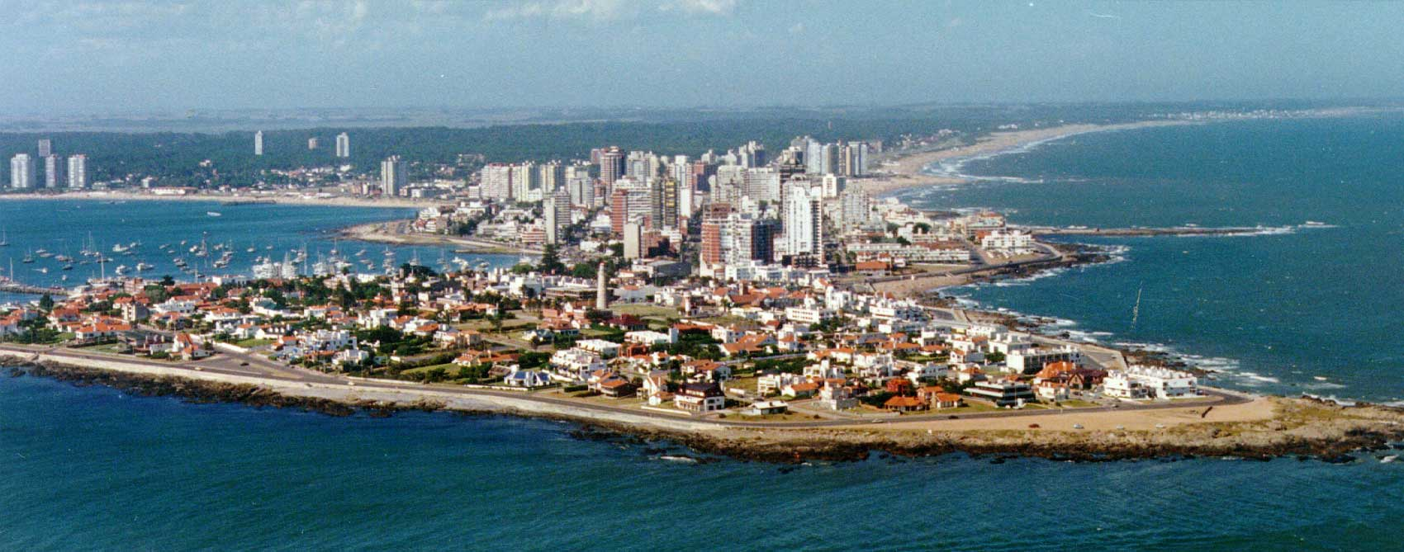
There are more sheep than humans in Uruguay
Uruguay have the world’s poorest politician. Their president donates 90% of his salary
Capital city: Montevideo
Main language: Spanish

Slide 27
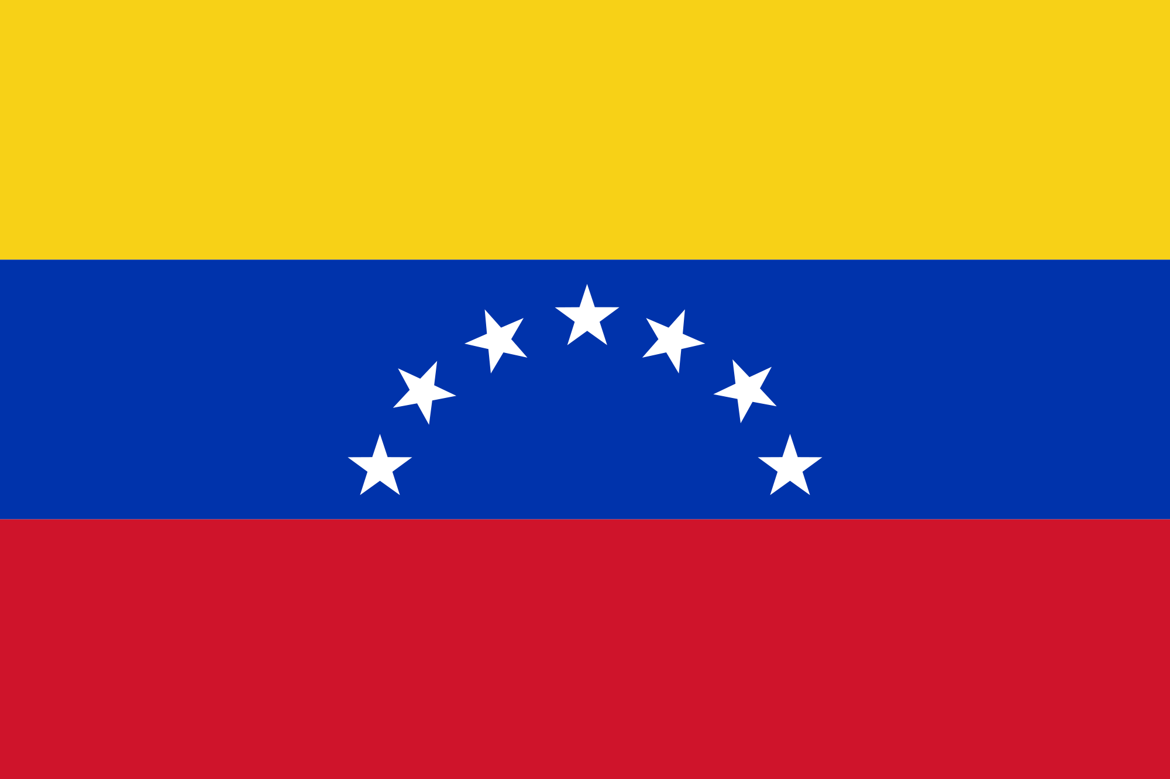
Venezuela

Slide 28
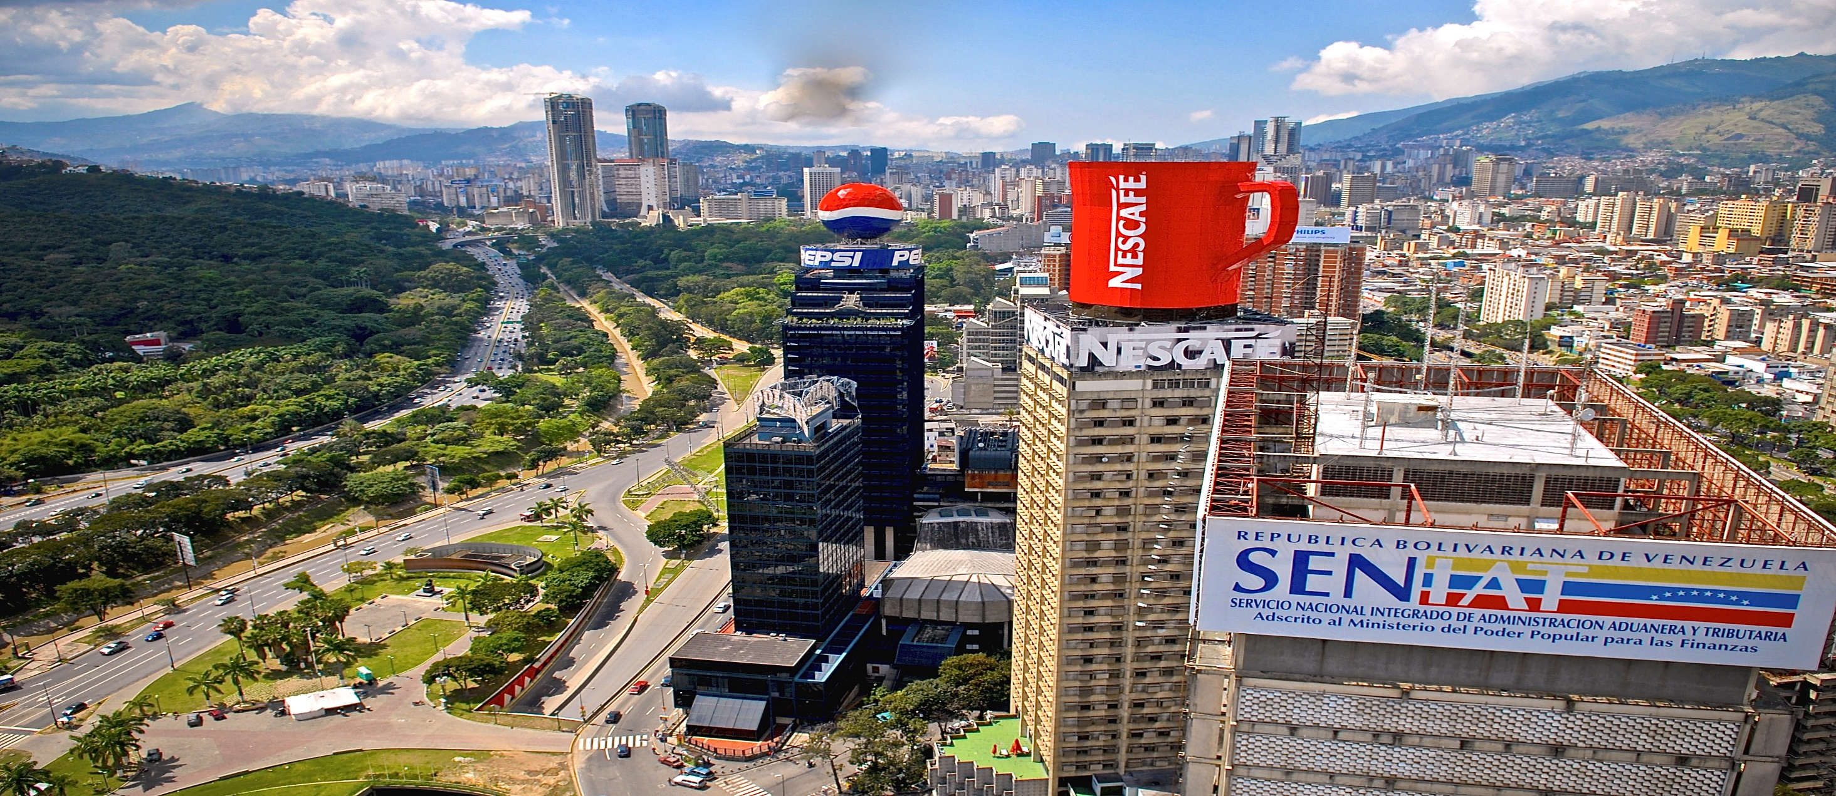
Baseball is the most popular sport in Venezuela
There are over 1400 bird species and 25,000 species of orchids
Capital city: Caracas
Main language: Spanish

