Slide 1

Welcome to miss mckinney’s zoom classroom
We will wait for the majority to arrive before taking the register.
Please ensure your mic is turned off, unless you are replying to a question.
Thank you ☺

Slide 2

28.1.21 Good morning class 4
Your 8.45am task is…read from where you are up to in your reading book…
☺

Slide 3
Zoom behaviour charter
Mic on mute unless Miss McKinney unmutes
Use hand up icon to ask questions
Listen to your teacher
Listen to your friends
Remember your best learning behaviour and our class charter
Do you best ☺

Slide 4
28.1.21 Insect and Amphibian lifecycles
To learn about the lifecycle and reproduction of amphibians and insects
To sketch a detailed & annotated zoological illustration of the lifecycle and reproduction of an amphibian and insects

Slide 5
vocabulary
life cycle
asexual & sexual reproduction
metamorphosis
amphibian
insect

Slide 6
http://www.bbc.co.uk/education/clips/zwrn2p3

Slide 7
Insect and Amphibian lifecycles
List the different organisms – what are the differences between life cycles and how they are not all the same?
Which other organisms have the same lifecycle as the one just shown?
Do they reproduce sexually or asexually?

Slide 8
While most animals reproduce sexually, there are examples where asexual reproduction occurs in the animal world, e.g. sea anemones and starfish, as well as examples where the male gives birth – seahorses.
We can now even clone animals under lab conditions.
We are going focus on the sexual reproduction and life cycles of amphibians and insects….

Slide 9
Now…write down all you know about amphibians and their life cycles, and the same for insects.

Slide 10
Amphibians are cold-blooded, smooth skinned vertebrates which during part or all of their lives can move and breathe both on land and under water (the latter is usually early in their life cycle);
Insects are arthropods that have a body divided into three main parts: head, thorax and abdomen, an exoskeleton, 6 legs, 2 antennae and 2 pairs of wings.
Both undergo metamorphosis during their life cycles.

Slide 11
Complete metamorphosis is a stage in the growth of some animals in which the new form looks completely different from the old, e.g. in life cycles of butterflies and frogs, while some insects, e.g. grasshoppers and dragonflies, go through incomplete metamorphosis with repeated stages of growth & moulting called instars.
The so-called nymphs resemble the adults but lack some features such as wings and sex organs.
What do these look like – break out rooms…
Let’s watch the ant and frog videos…

Slide 12
Look at zoological illustrations and note how parts of the life cycle are included (just like in botanical illustrations).
Why might it be trickier to make zoological illustrations? Animals tend to move more!

Slide 13
Research the details as well as use the videos to help capture moments to draw.
Draw and annotate the life cycle of an amphibian, e.g. frog, toad, newt, salamander. Your diagram should show clearly in which stages they live on land and in which they live in water by making these illustrations of the ecological type.
You are going to copy the style of zoological illustrations by using online footage and research to help you draw in detail, to try and capture the various stages.

Slide 14
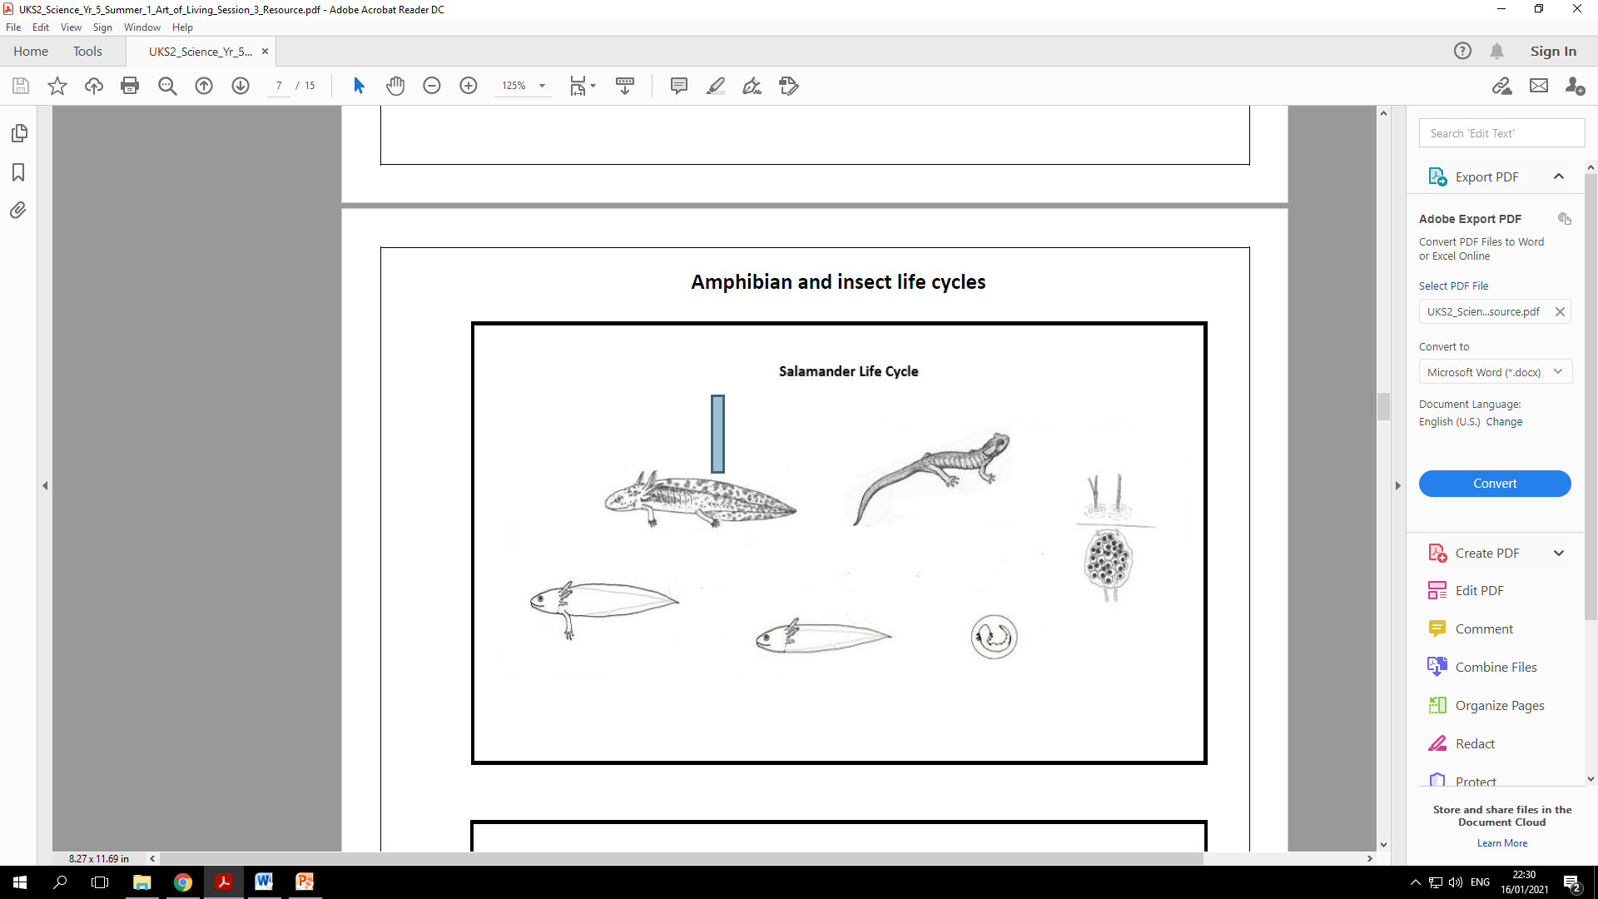

Slide 15
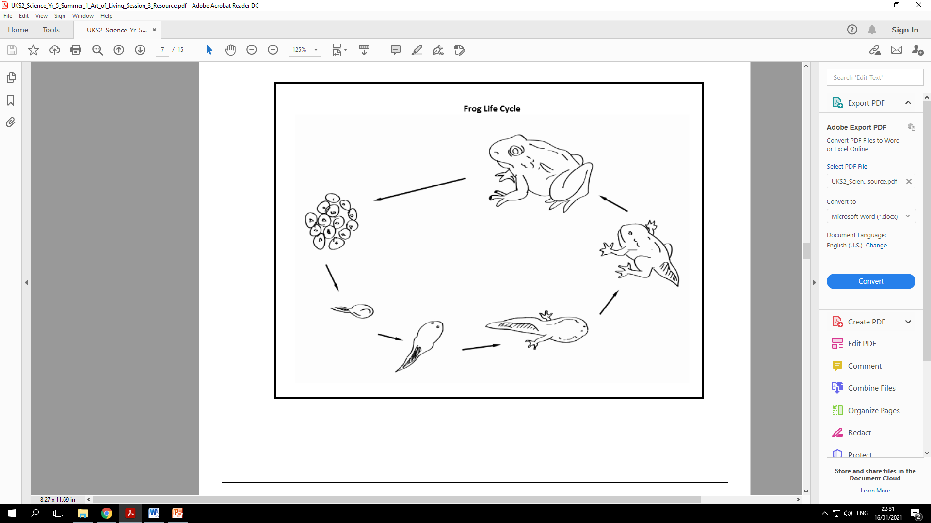

Slide 16
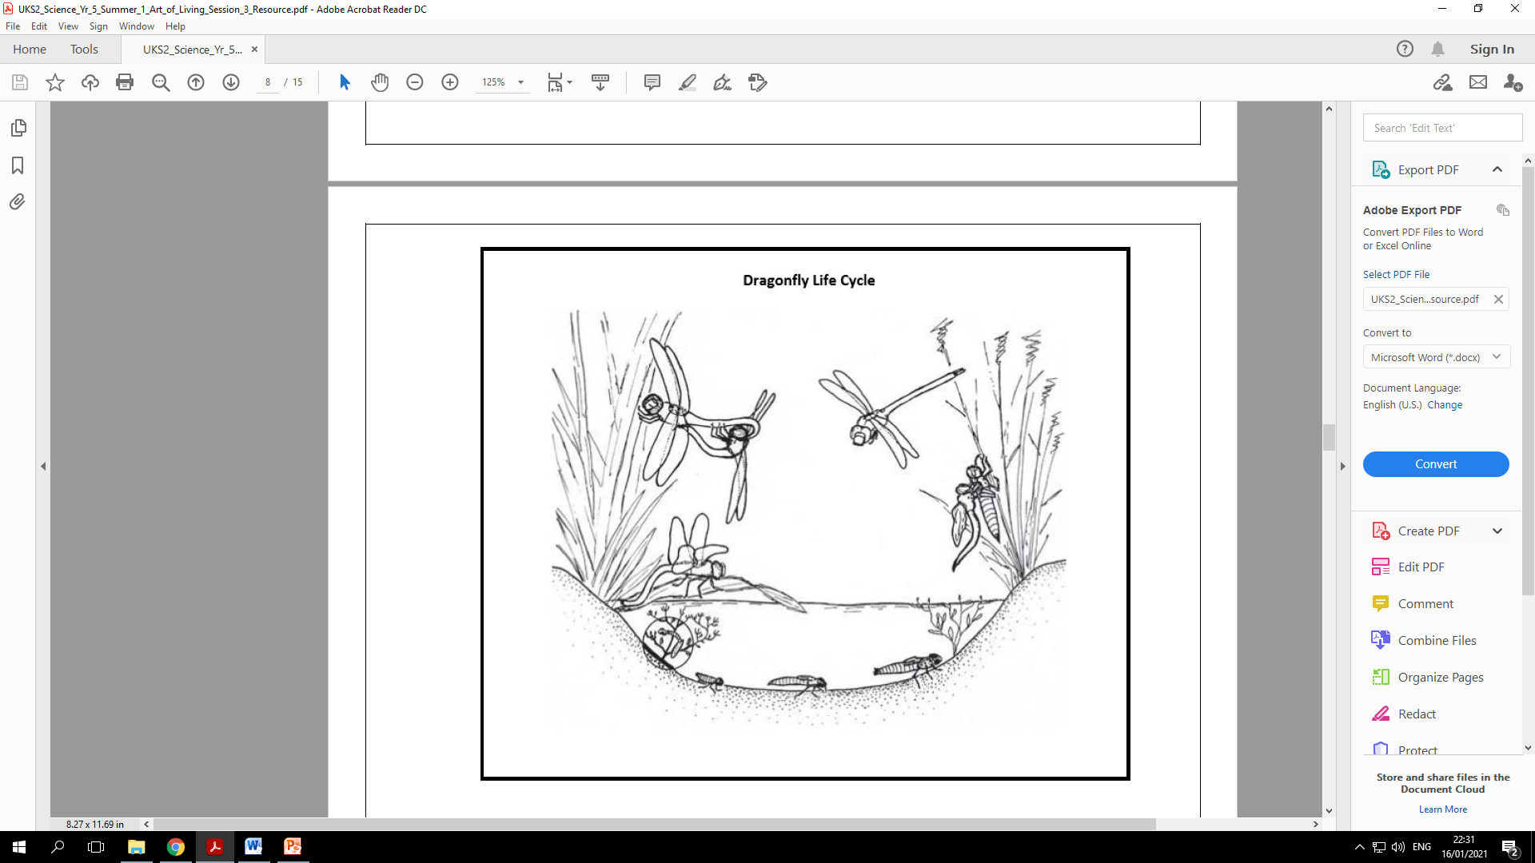

Slide 17
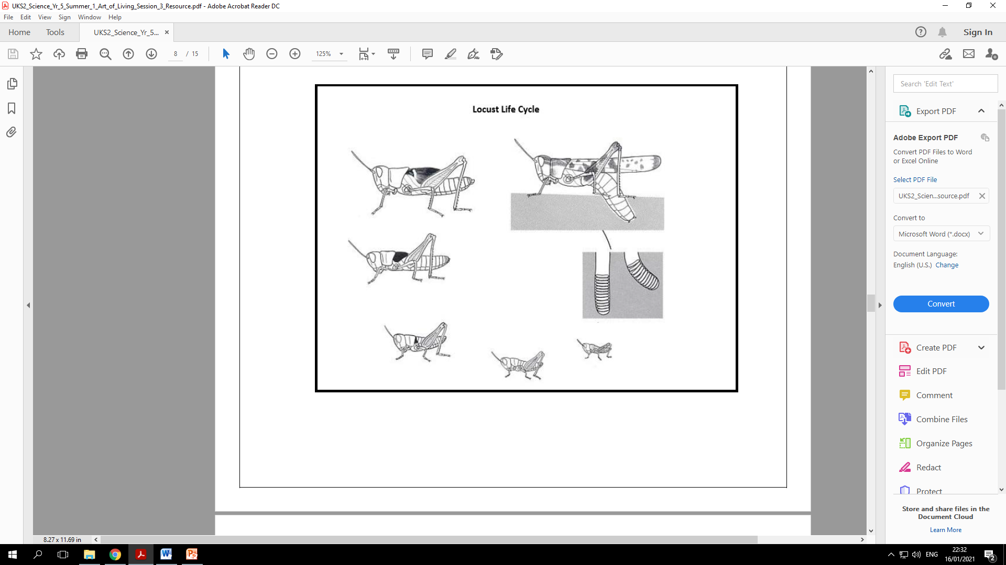

Slide 18
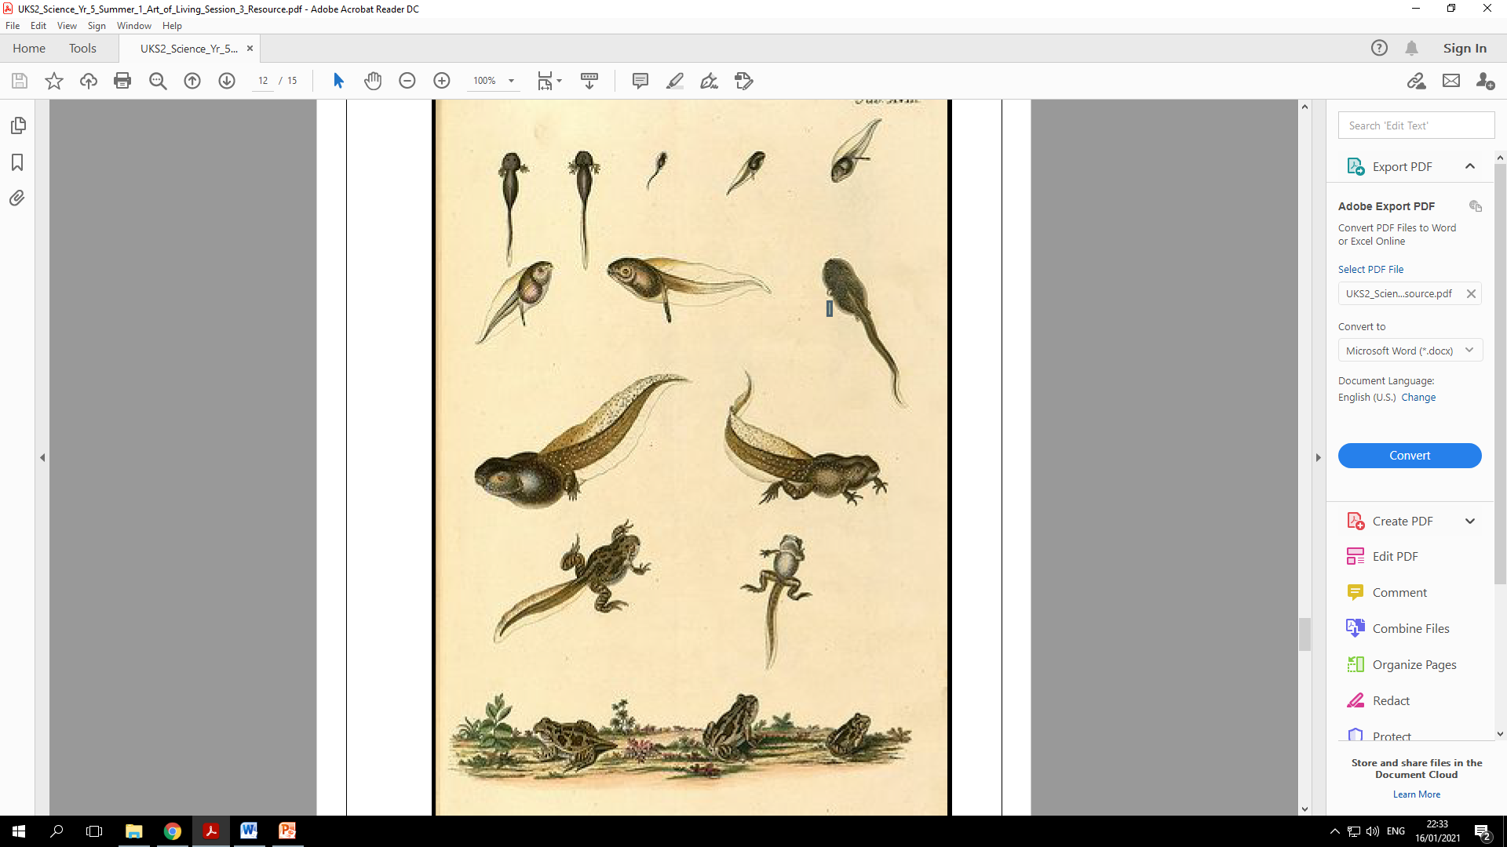

Slide 19
THUMBS UP – have we achieved our objectives?
To learn about the lifecycle and reproduction of amphibians and insects
To sketch a detailed & annotated zoological illustration of the lifecycle and reproduction of an amphibian and insects

Slide 20

Do you know where to find your maths lesson @ 11am?
Please send your science to me on Class DOJO – there will be lots of points up for grabs today!
Last messages - break time for everyone next ☺

