Slide 1

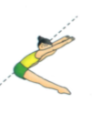
Year 5 and 6 – Gymnastics Body Management Activities 2
Try each of these skills individually then see if you can link them together to make a short sequence.
Towards Japana- Teaching Points
Keep back straight, toes pointed, knees pressed into the floor.
Aim your little toes towards the floor not your big toes.
Keep your knees facing up towards the ceiling.
Push your tummy button towards the floor not your shoulders.
Try to keep legs approximately 90 degrees apart.

Slide 2
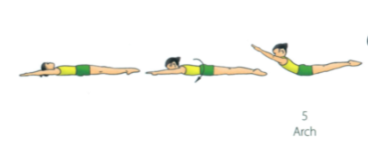
Year 5 and 6 – Gymnastics Body Management Activities 2
Try each of these skills individually then see if you can link them together to make a short sequence.
Arch- Teaching Points
Keep legs together and arms shoulder width apart.
Squeeze bottom muscles in.
Keep legs straight and toes pointed.
Keep head in a neutral position.

Slide 3
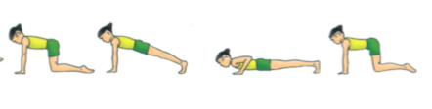
Year 5 and 6 – Gymnastics Body Management Activities 2
Try each of these skills individually then see if you can link them together to make a short sequence.
Front Support lower to floor- Teaching Points
- Try to make a straight line from head to toes.
- Ensure arms are supporting the body vertically under shoulders.
Keep fingers facing forwards.
Keep your head in a neutral position.
Maintain straight body line as you lower to the floor (all body parts touch the floor at the same time).

