Slide 1

Welcome to miss mckinney’s zoom classroom
We will wait for the majority to arrive before taking the register.
Please ensure your mic is turned off, unless you are replying to a question.
Thank you ☺

Slide 2

11.2.21
Good morning class 4
Your 8.45am task is…
Read from where you are up to in your reading book and complete the daily challenge…

Slide 3
Zoom behaviour charter
Mic on mute unless Miss McKinney unmutes
Use hand up icon to ask questions
Listen to your teacher
Listen to your friends
Remember your best learning behaviour and our class charter
Do you best ☺

Slide 4
Today’s learning objectives…
To make observations, as a natural scientist would, recording data and reporting findings
To learn about some famous naturalists

Slide 5
Breakout rooms
What is natural scientist?

Slide 6
A natural scientist, or naturalist, studies natural history, i.e. the study of plants and animals by observation rather than by experimentation.
An animal behaviourist makes a scientific study of everything an animal does (from amoebae to gorillas!), so again they observe very carefully.
Can you name a naturalist?

Slide 7
Charles Darwin
Chris Packham
David Attenborough
Alfred Russel Wallace
Steve Backshall
Steve Irwin
Jane Goodall
George McGavin
Have you seen these people presenting natural history programmes on the television?

Slide 8
What sort of behaviour or processes of animals and plants might be studied?
David Attenborough presenting one of his natural history programmes -these programmes introduce people who are not scientists to many interesting and wonderful aspects of animal and plant life.

Slide 9
Programmes take a long time to make – the naturalists and film crew have to be very patient and can spend long hours waiting to capture a particular behaviour on film;
Filmed in often quite extreme conditions or difficult to access places; some of the plants and animals are rare or timid (in the case of animals) or the behaviour only happens at night (so sometimes infra-red cameras are used).

Slide 10
Feeding, sleeping, finding/building shelter, interacting with other members of their species or with other animals, reacting to stimuli, playing, fighting, learning skills, mating or reproducing, excreting, etc. All things to do with being alive, well and happy!
Why is it important to know about and understand plants and animals?
BREAKOUT ROOMS – 5 REASONS…

Slide 11
To help endangered species
understand why particular habitats are important for survival of particular species
Increases our knowledge and understanding of living things
helps us improve conservation and look after the environment, etc.
The survival of one species is important for the whole food web in that habitat.
Studying and recording information accurately about the natural world helps us to understand and protect it.

Slide 12
Jane Goodall is an expert on primates, particularly well-known for her work with chimpanzees.
Here she is talking about her life.... She started working with just a notebook and binoculars – observing carefully.
https://www.youtube.com/watch?v=5PwcY_axJwA

Slide 13
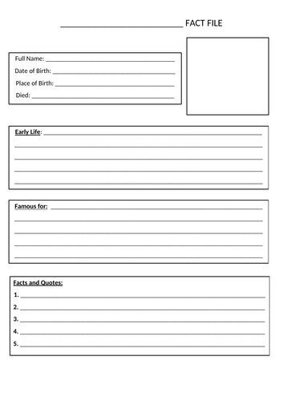
OFF THIS CALL…
Being Natural Scientists: Now it’s your turn to research and make notes on one of the naturalists.
Compile a fact file

Slide 14
THUMBS UP: have we achieved our objectives?
To make observations, as a natural scientist would, recording data and reporting findings
To learn about some famous naturalists
Next half term…Earth and Space for Class 4 ☺

Slide 15

Do you know where to find your maths lesson @ 11am?
Please send your science to me on Class DOJO – there will be lots of points up for grabs today!
Last messages - break time for everyone next ☺

