Slide 1
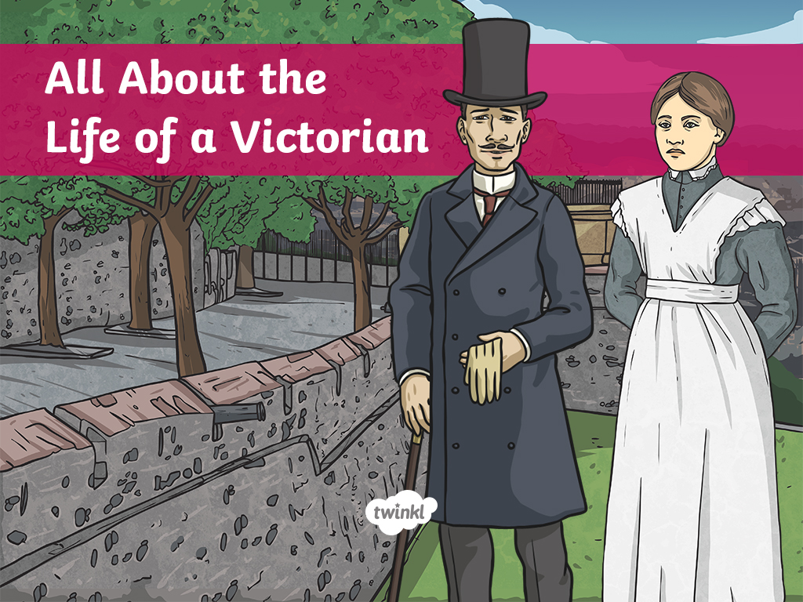

Slide 2
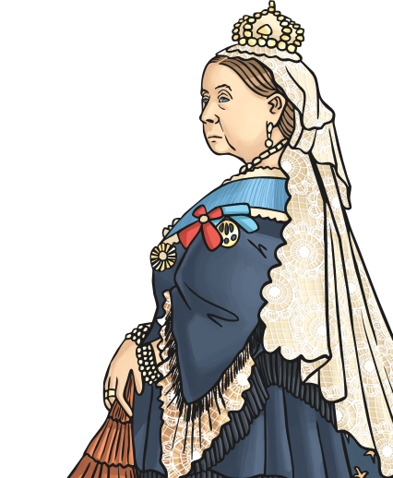
The Victorians
The Victorian era is the time when Queen Victoria was on the throne of the United Kingdom. She came to the throne in 1837 and died in 1901. People who lived during this period are known as Victorians.
Did You Know?
Queen Victoria’s full title was Queen of the United Kingdom of Great Britain and Ireland. In 1876,she was given the title Empress of India. She was also informally known as ‘the Grandmother of Europe’, as so many of her children married into European Royal families.

Slide 3
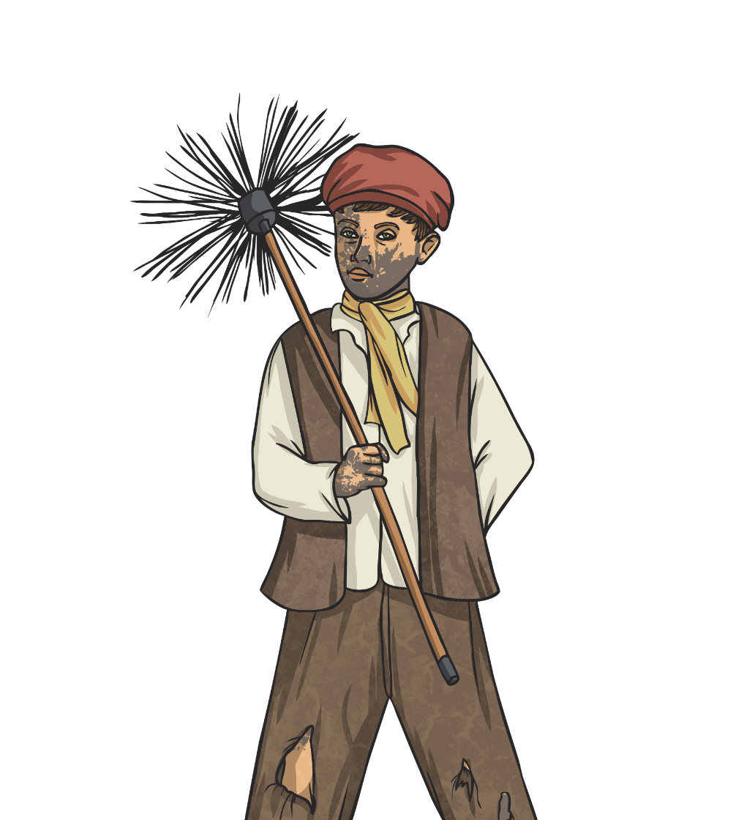
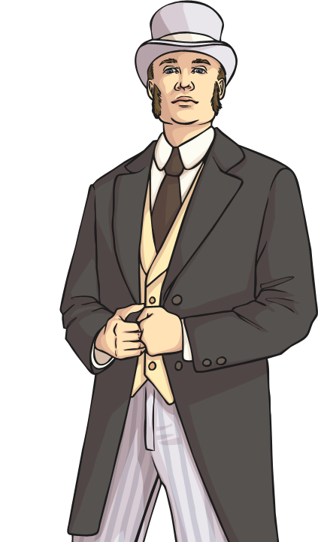
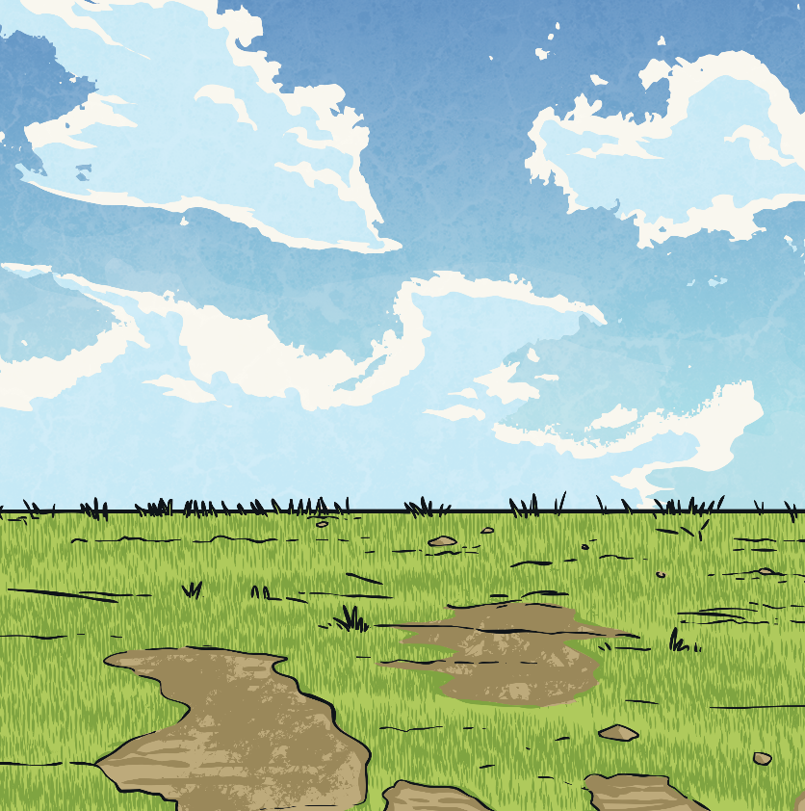
The Victorian Era
The Victorian era was one of great contrasts between
the life of the rich and that of the poor.
The rich lived a life of ease and comfort. They had servants to run their large houses. They wore elaborate clothing and ate meals of many courses.
The life of the Victorian poor was extremely challenging. They often didn’t have enough money for a decent meal or housing. They lived in constant fear of the workhouse.

Slide 4
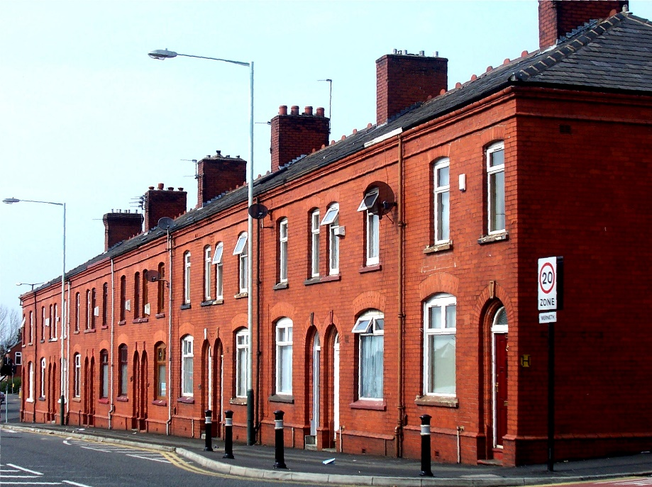
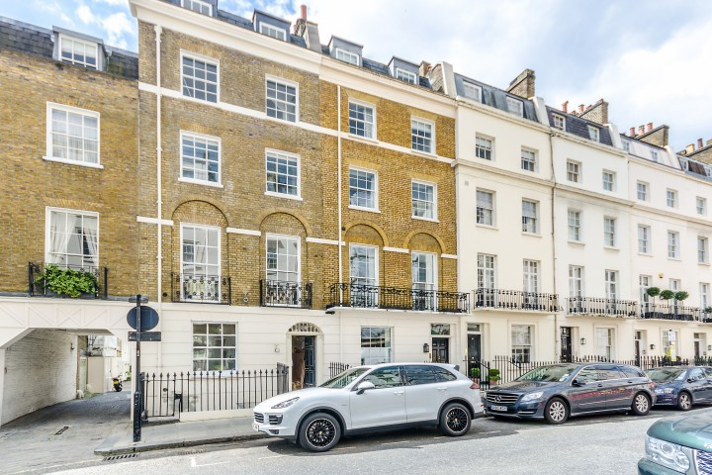
Victorian Houses
Richer Victorians lived in much better houses. They were larger, sometimes even having rooms in the attic for servants to sleep in.
The Industrial Revolution meant large numbers of people moved to towns and cities to work in factories. Rows and rows of back-to-back terraced houses were built for the poor. These houses were very small, with two rooms downstairs and two rooms upstairs. They didn’t usually have gardens, but small yards.

Slide 5
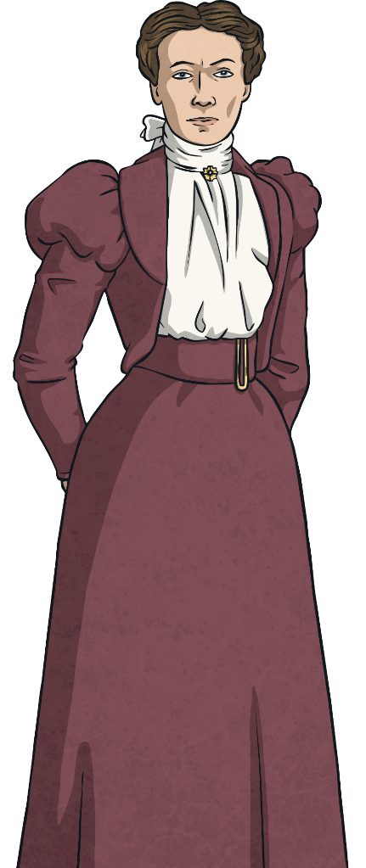
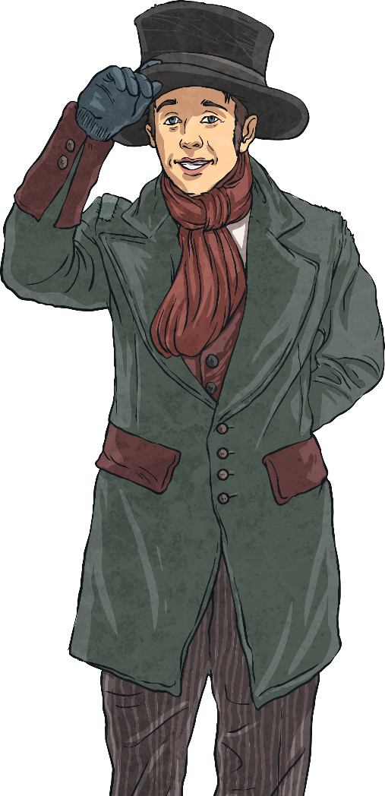
Victorian Clothing for the Rich
Rich women wore corsets under their dresses. These were pulled very tight. Hoops and petticoats were worn to make skirts stand out. At one point, bustles were popular. These gave extra shape to the back
of a skirt. All these layers made getting dressed
quite a long process which required the help of a
maid.
Wealthy Victorian men wore suits
with waistcoats. Bowler hats were
worn outdoors for everyday occasions,
with top hats for special events.
A pocket watch was often carried.

Slide 6

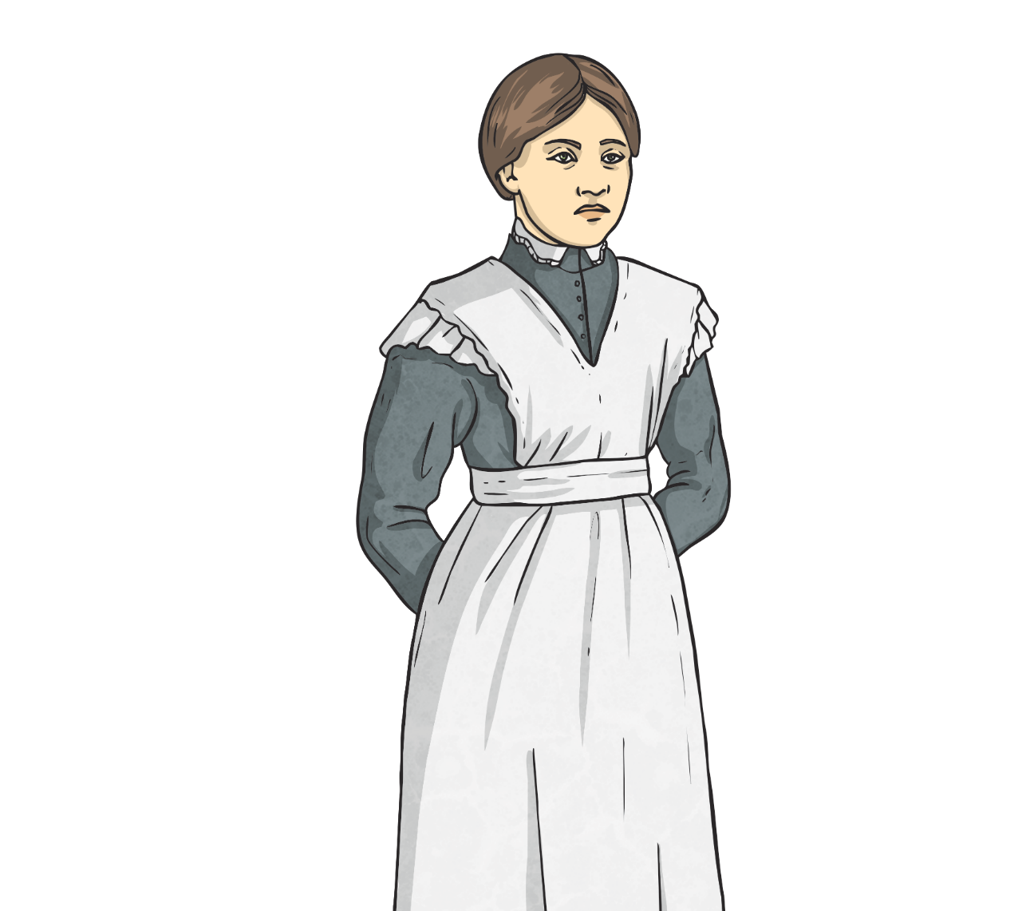
Victorian Clothing for the Poor
Most poor people owned very few outfits. What they wore had to be practical and hard-wearing. If they were fortunate, they would have a slightly better outfit to wear to church on Sundays.
Clothes were dark as it was difficult to keep
clothes clean in factories and mines where
many poor people worked.
Poor people had to make their shoes last. Many wore things called hobnail boots. These boots had nails hammered in to the soles to make them last longer. Men and women wore hats or caps. Men took their hats off inside, women often kept theirs on.

Slide 7
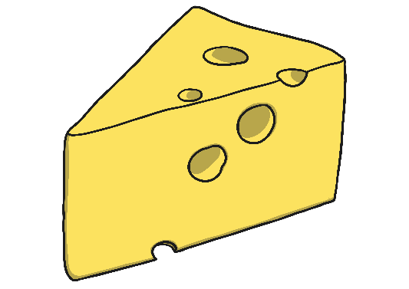
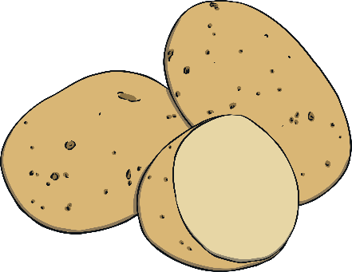
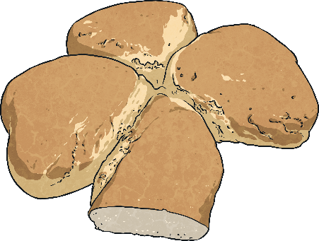
Victorian Food
As with other things in Victorian lives, there were huge differences between the rich and the poor.
Servants prepared food for wealthy families. Breakfast included ham, eggs, bacon, bread and fish. During the day, rich Victorians ate lunch and afternoon tea. Dinner was made up of many courses including soup, a fish course, meat and vegetables and cake.
Poor families spent a large amount of the money they earned on food, yet even this wasn’t enough to provide an adequate diet. They mostly ate bread, milk, cheese and potatoes. Meat was a luxury eaten once a week if they were doing well. Many poor children died of malnutrition.

Slide 8

Victorian Work
Mothers of wealthy Victorian families didn’t work. They spent their days calling on friends and relatives. Most of the child care was done by a nanny. Rich Victorian men had jobs such as doctors, lawyers, bankers and factory owners.
In a poor Victorian family, each member worked as hard as possible to try to earn money in order to survive. Jobs included factory work and mining and was very poorly paid. Even children worked in jobs down mines and sweeping chimneys.

Slide 9
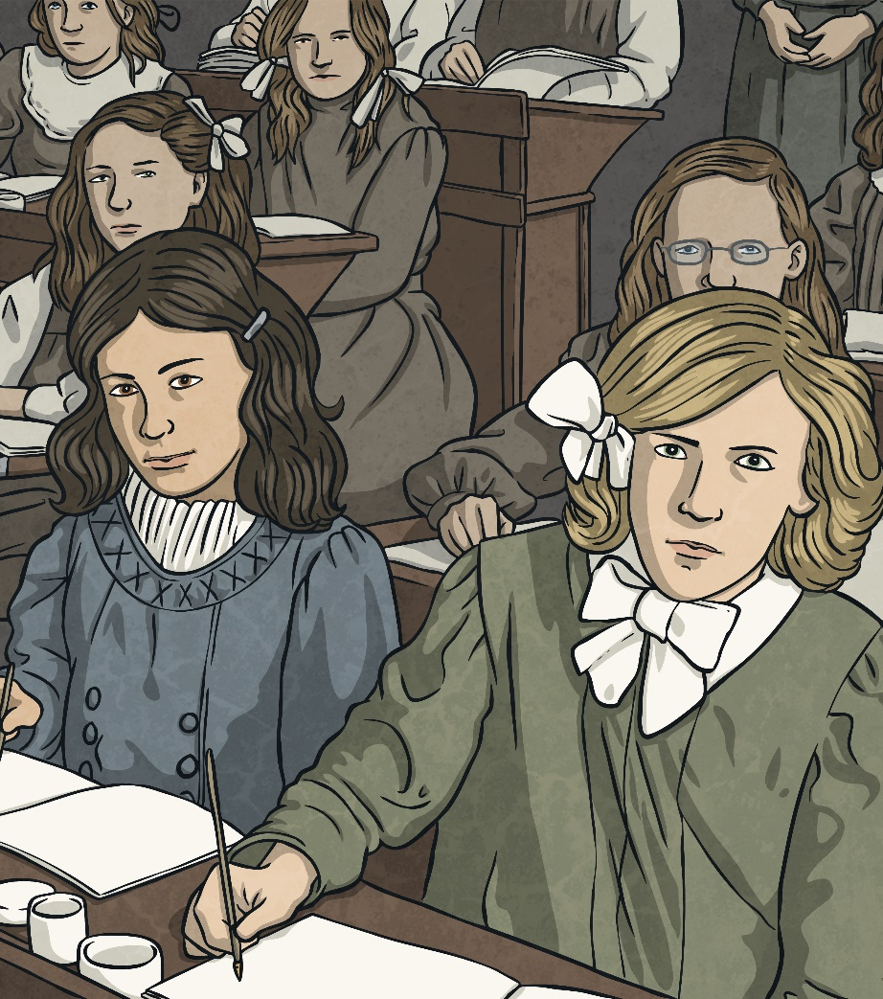
Victorian Schools
Wealthy Victorian children were educated at home by a governess.
At the age of ten, boys would then go to boarding school while girls continued to be taught by a governess.
Until near the end of the Victorian era, parents had to pay to send their children to school. This meant that many poor children received no education and could neither read not write. There were some charity schools to help educate the poor, but most families needed their children working and earning money.

Slide 10
Glossary
Industrial Revolution – a period of time of great technological advances. More things were made in factories, and canals and railways were built.
Malnutrition – a diet of either not enough food or not enough of the right food.
Workhouse – a place where poor Victorian people could end up if they had no money. It was a very hard place to live and families were separated.

