Slide 1
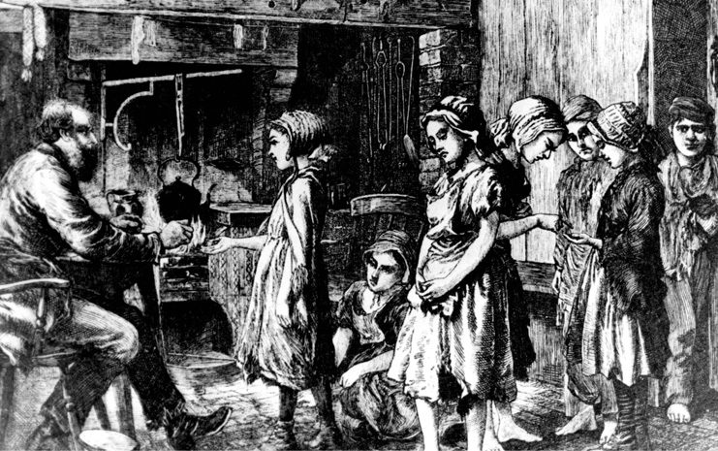
LO: To be able to describe what life was like for a poor child in the 1840s

Slide 2
In Victorian times, many families had 10 or more children. Sadly, many children died as babies, or from diseases such as smallpox and diphtheria. Child-death struck rich and poor families.
In a Victorian town, it was easy to tell who was rich and who was poor. Children from richer homes were well fed, wore warm clothes and had shoes on their feet. They did not work, but went to school or had lessons at home.
Poor children looked thin and hungry, wore ragged clothes, and some had no shoes. Poor children had to work. They were lucky if they went to school.

Slide 3
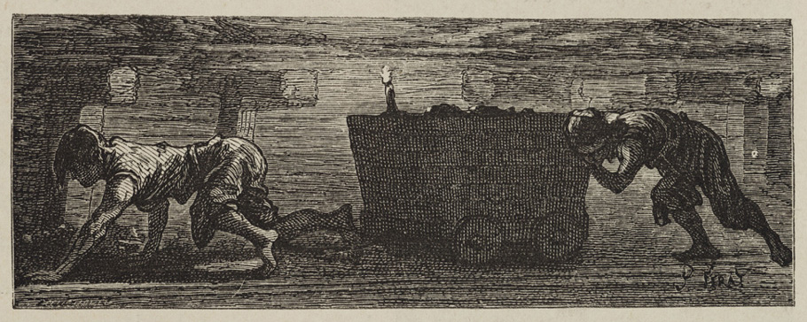
Why did children go to work?
Many Victorian children were poor and worked to help their families. Few people thought this strange or cruel. Families got no money unless they worked, and most people thought work was good for children.
The Industrial Revolution created new jobs, in factories and mines. Many of these jobs were at first done by children, because children were cheap - a child was paid less than adults (just a few pennies for a week's work).

Slide 4
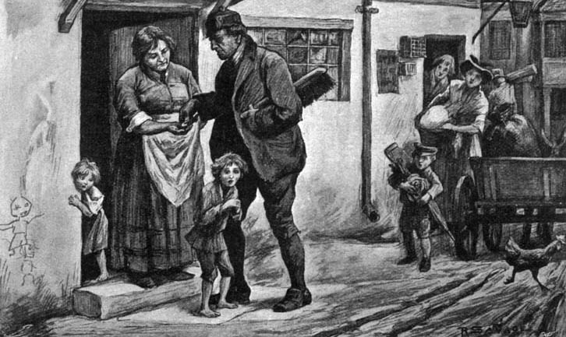
When did children start work?
Many children started work at the age of 5, the same age as children start school today. They went to work as soon as they were big enough.

Slide 5
What jobs did children do?
Children worked on farms, in homes as servants, and in factories.
Children often did jobs that required small size and nimble fingers. But they also pushed heavy coal trucks along tunnels in coal mines.
Boys went to sea, as boy-sailors, and girls went 'into service' as housemaids.
Children worked on city streets, selling things such as flowers, matches and ribbons.
Crossing boys swept the roads clean of horse-dung and rubbish left by the horses that pulled carts and carriages.

Slide 6
http://www.bbc.co.uk/learningzone/clips/children-working-in-coal-mines/145.html

Slide 7
Make a list of what you can find out about the life of poor children from the sources

Slide 8
Imagine YOU are a Victorian child working in a factory and write a diary entry describing the work you would you doing.

Slide 9
http://www.bbc.co.uk/learningzone/clips/child-labourer-will-thorne-describes-how-victorian-children-were-treated-in-the-workhouse/12077.html
Discuss video – could you work here? Reflect on our lives today.

