Slide 1
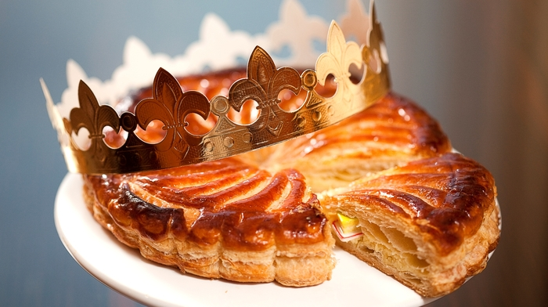
You are going to :-
Listen to a story about a French tradition for Epiphany
Read some information about Epiphany in other countries in Europe
Draw a ‘traditions map’

Slide 2
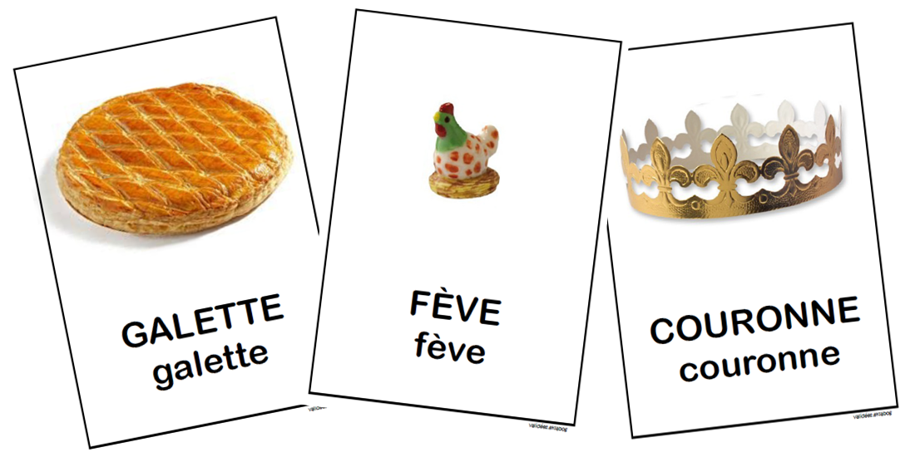
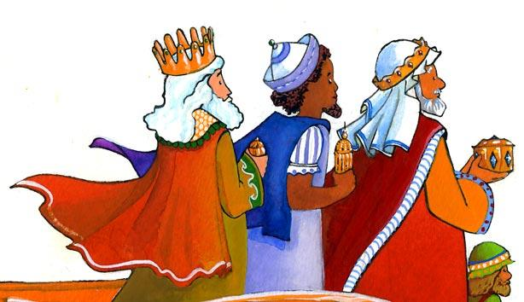
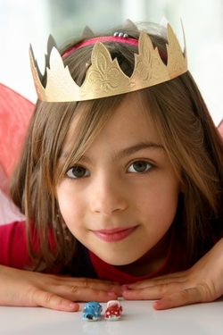
Le 6 janvier, c'est l'Epiphanie. On mange une galette des rois. C'est la fête des trois Rois Mages: Balthazar, Gaspard et Melchior. Dans la galette, il y a une fève et celui qui la trouve devient roi ou reine. On lui pose une couronne sur la tête.

Slide 3
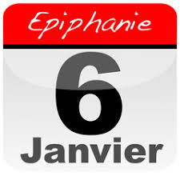
Epiphany is the festival of the Trois Rois and when they arrived in Bethlehem to see Jesus at the first Christmas.
Epiphany is an important celebration in France. Families will gather to share a galette, a special round cake. In the cake is hidden a charm (une fève). Whoever finds la fève is the King (le roi) or the Queen (la reine) for the day!

Slide 4

Listen to this story about the tradition of eating galette.
Who does Trotro help to make the galette?
What does he do with the feve?
Who goes under the table?
Who finds the feve in their piece of cake and becomes queen?
Who do they choose to be king with them?

Slide 5
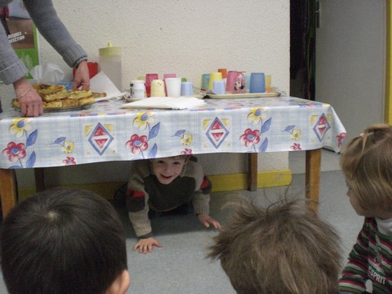
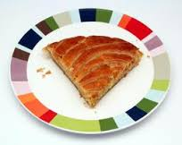
The youngest guest goes under the table and they ask him to whom give each portion.
C’est pour qui?
Et celle-ci?
Et cella-la?

Slide 6
Listen to this story about the tradition of eating galette.
Who does Trotro help to make the galette? Son papa - his dad.
What does he do with the feve? Cache dans la galette - hides it in the cake.
Who goes under the table? Boubou (because he is the youngest. He then decides who gets which piece of cake WITHOUT looking so he can’t know who might get the feve).
Who finds the feve in their piece of cake and becomes queen? Nana.
Who do they choose to be king with them? Trotro

Slide 7
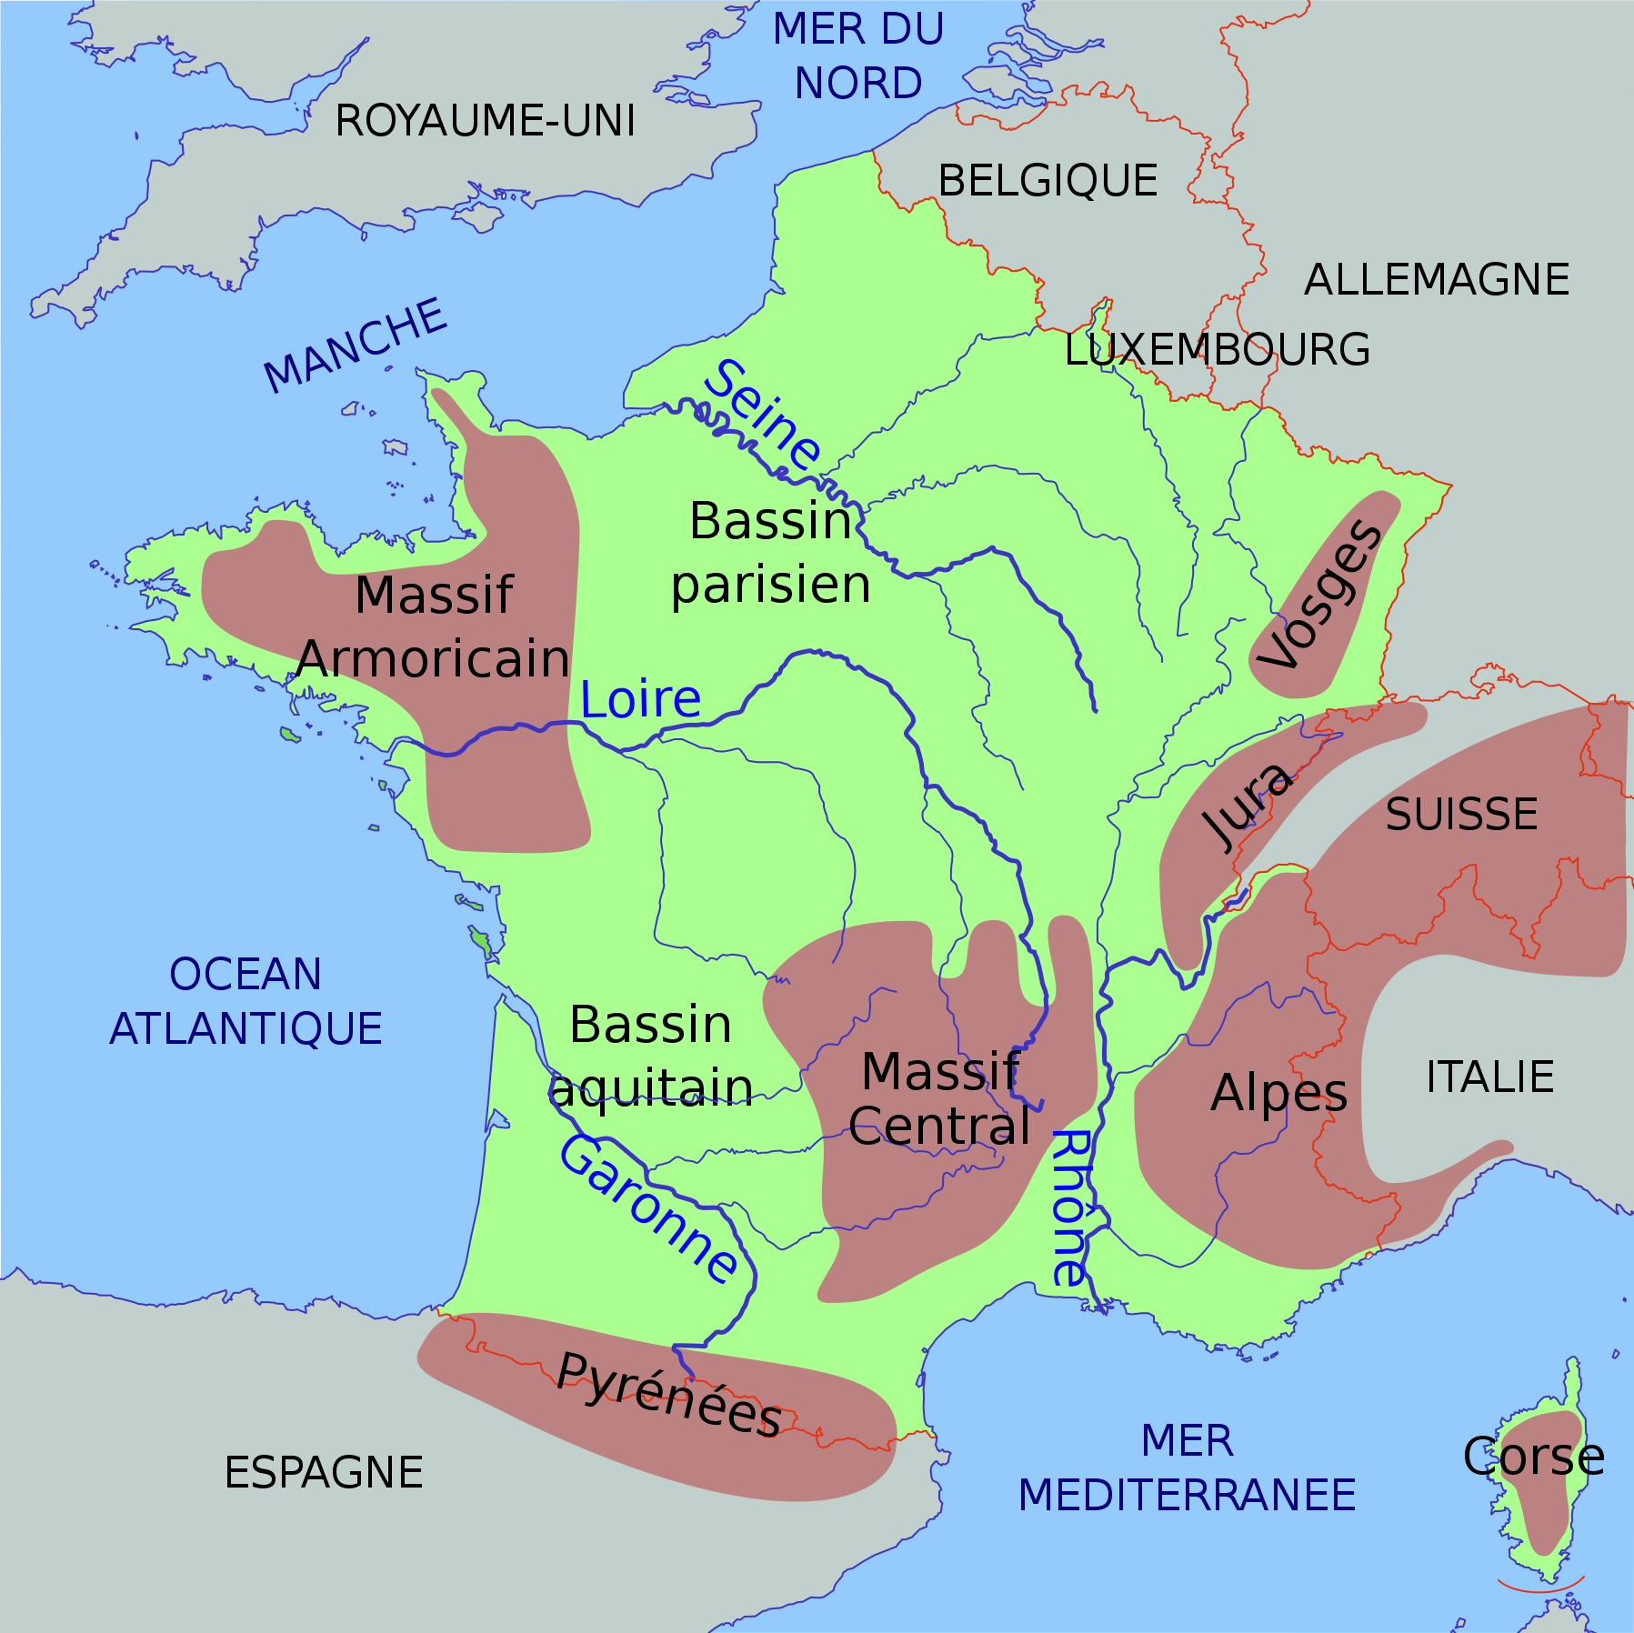

Slide 8
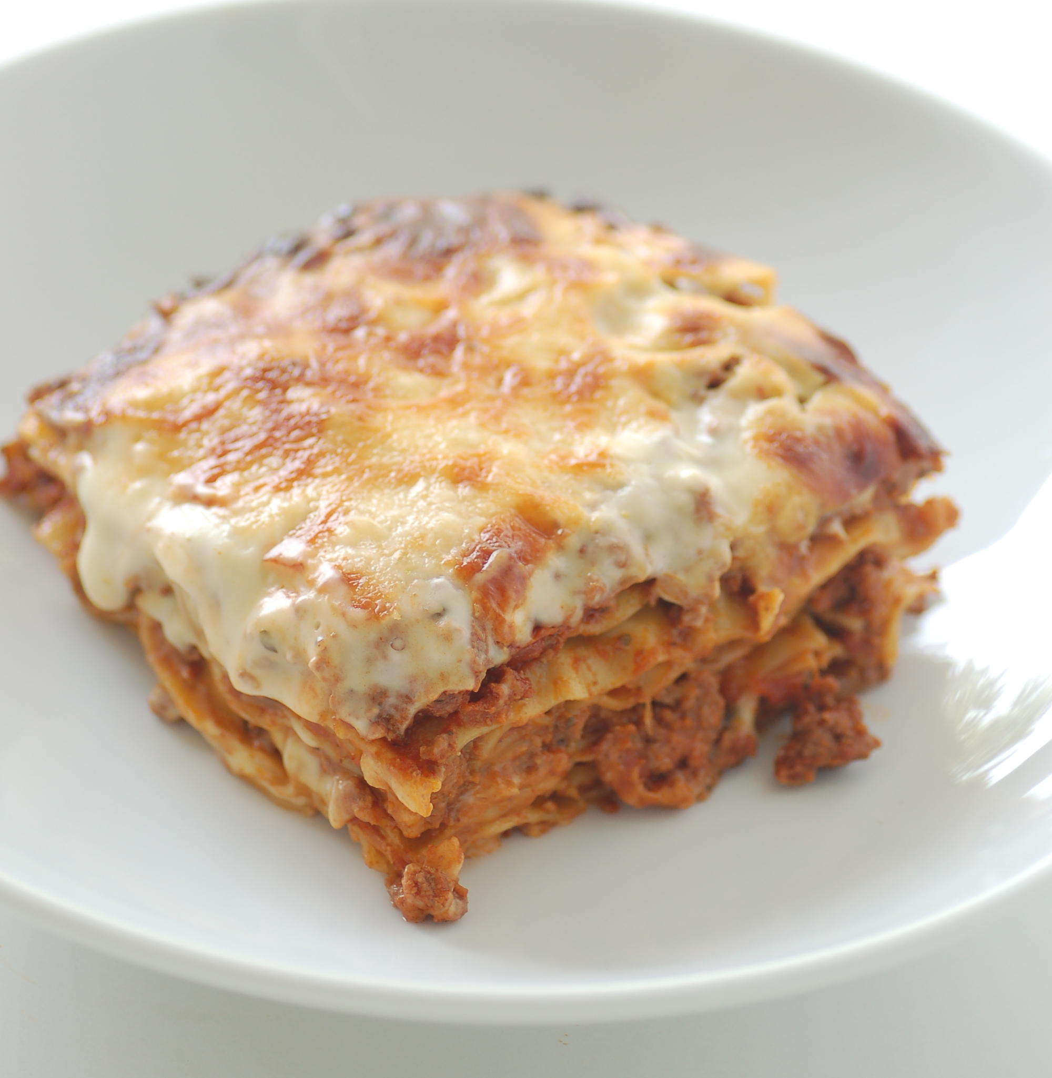
lasagne
What sound does the gn make?
Lasagne

Slide 9
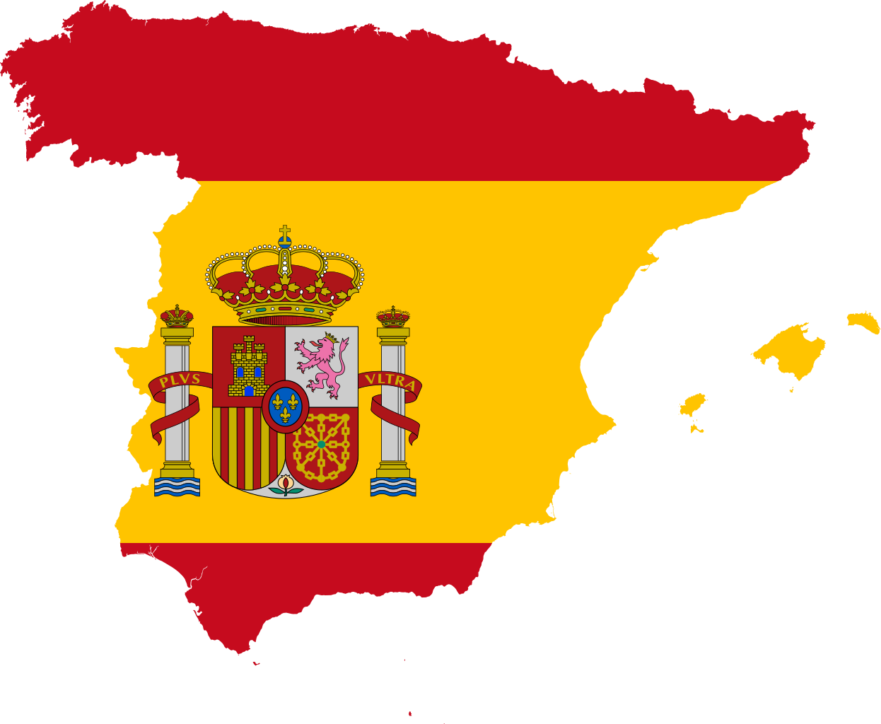
l’Espagne

Slide 10
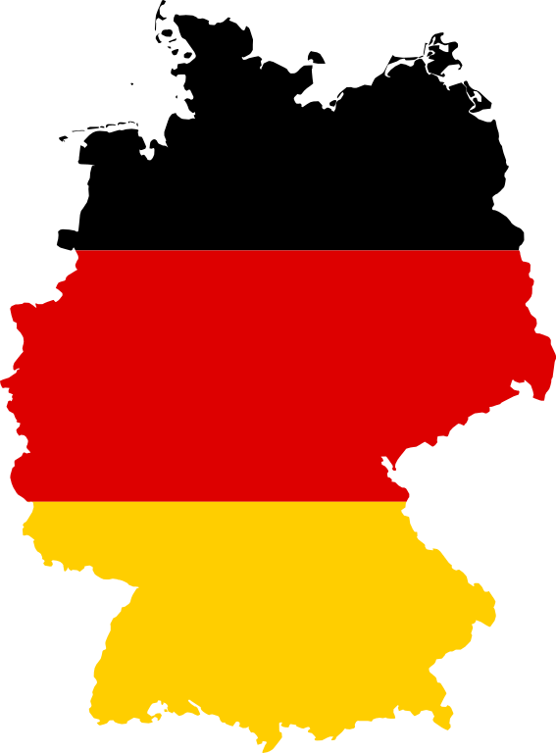
l’Allemagne

Slide 11
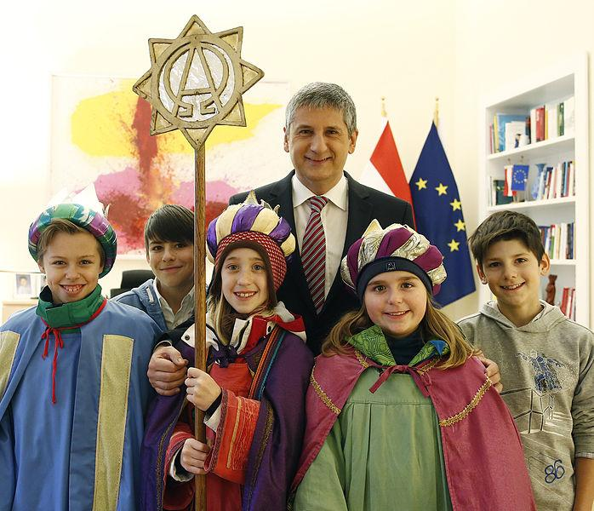

We are now going to look at how Epiphany is celebrated in France and some of France’s neighbouring countries, Switzerland, Germany, Italy.
Which picture do you think relates to each country?
What is each country’s name in French?
La France
A
2. L’Italie
3. La Suisse
B
4. L’Allemagne
C
Answers
1-C France
2 - B Italy
3 D - Switzerland
4 - A Germany(and in Austria too!
D
All of the above.

Slide 12
We are now going to look at how Epiphany is celebrated in France and some of France’s neighbouring countries, Switzerland, Germany, Italy.
Which picture do you think relates to each country?
What is each country’s name in French?
La France
A
2. L’Italie
3. La Suisse
B
4. L’Allemagne
C
Answers
1-C France
2 - B Italy
3 D - Switzerland
4 - A Germany(and in Austria too!
All of the above.

Slide 13
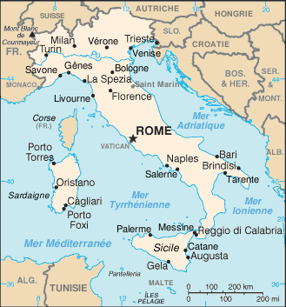
L’Italie
It is said that “la befana” a witch-like figure distributes gifts to children on 6th January. This is a version of a poem learnt by Italian children.
La Befana vien di notte Con le scarpe tutte rotte Col vestito alla romana Viva, Viva La Befana!
The English translation is:
La Befana comes by night With her shoes all tattered and torn She comes dressed in the Roman way Long life to the Befana!

Slide 14
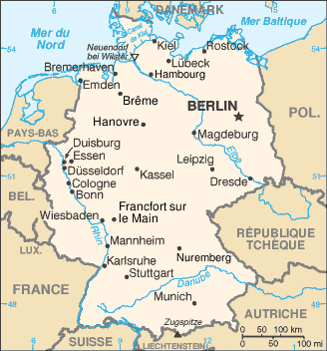
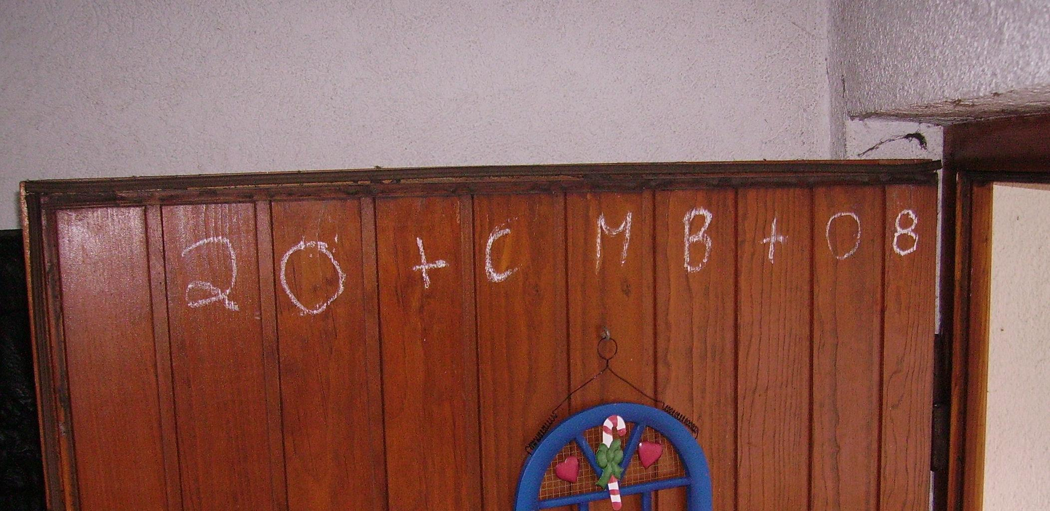
L’Allemagne
Here children dress as the Three Kings and go from door to door sometimes singing traditional songs.
They mark the new year and the initials C. M. B on each door for luck.
Some say this stands for the Kings’ names, Caspar, Melchior and Balthazar. It actually is for a Latin sentence Christus mansionem benedicat (Christ bless this house).

Slide 15
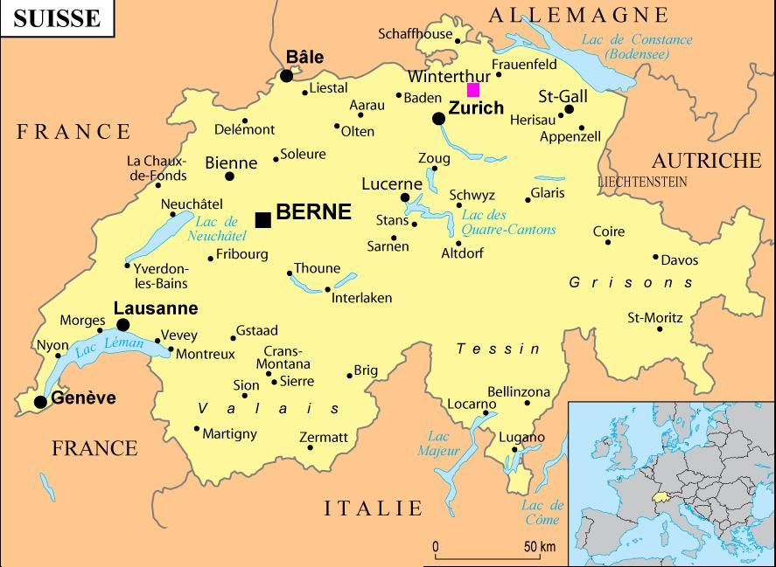
La Suisse
Switzerland - la Suisse - shares borders with all of these countries and Austria too.
This means their traditions and languages are influenced by their many close neighbours.
French, Italian, German are all official languages of Switzerland, as is Rometsch.
Depending on which border you live closest to will mean which Epiphany tradition you are most likely to do in your household.

Slide 16
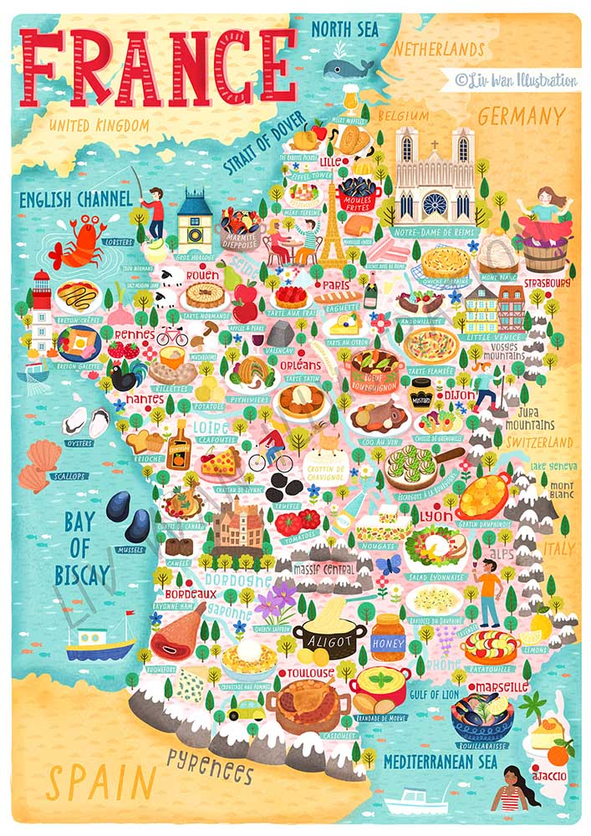
Traditions map
Draw map of Europe and label some of the countries in French.
Draw (or find and cut out) some pictures of Epiphany traditions and put them on the correct country.
You can add some written information about how Epiphany is celebrated. You can find this in this presentation or your own research.

Slide 17
