Slide 1
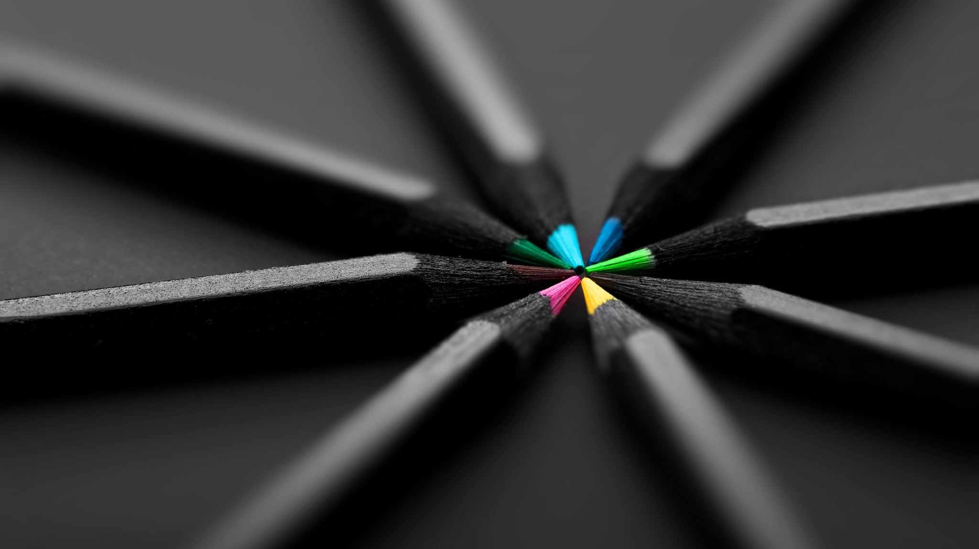
ART
different artists

Slide 2
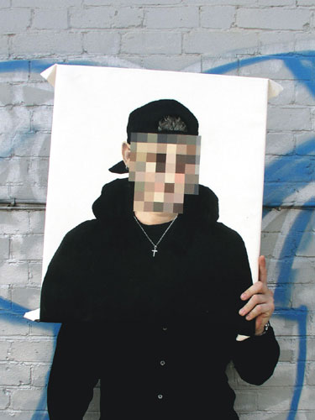
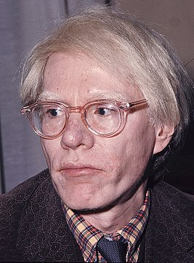
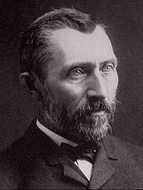
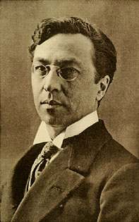
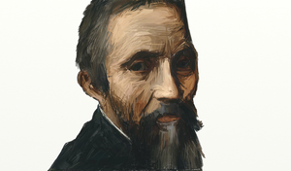
Which artist’s work did you like the best?
What type of art is your favourite?
Why is it your favourite?
T

Slide 3
Vincent van Gogh
1853 - 1890
Vincent van Gogh was a Dutch impressionist painter.
He was well known for painting, drawing still life, portraits and self portraits.
Some of Vincent van Gogh’s most famous art includes:
Sunflowers
The starry night
The potato Eaters
Portrait of Dr Gachet
And of course many self portaits.

Slide 4
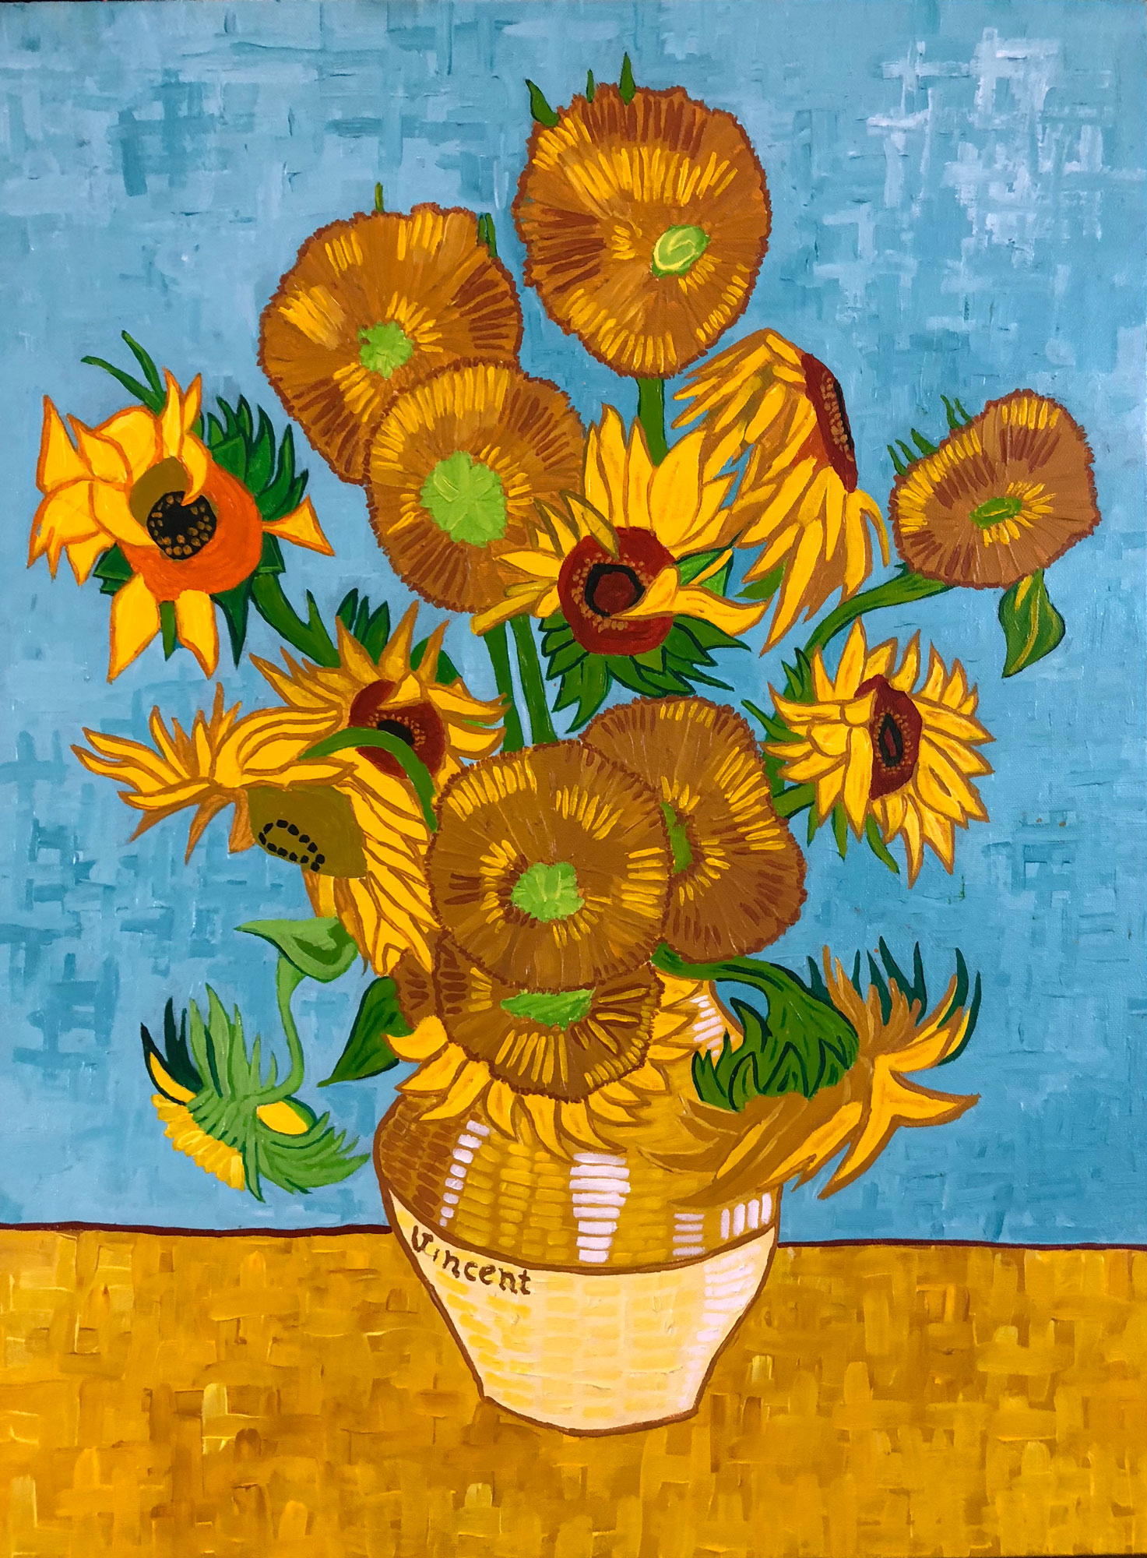
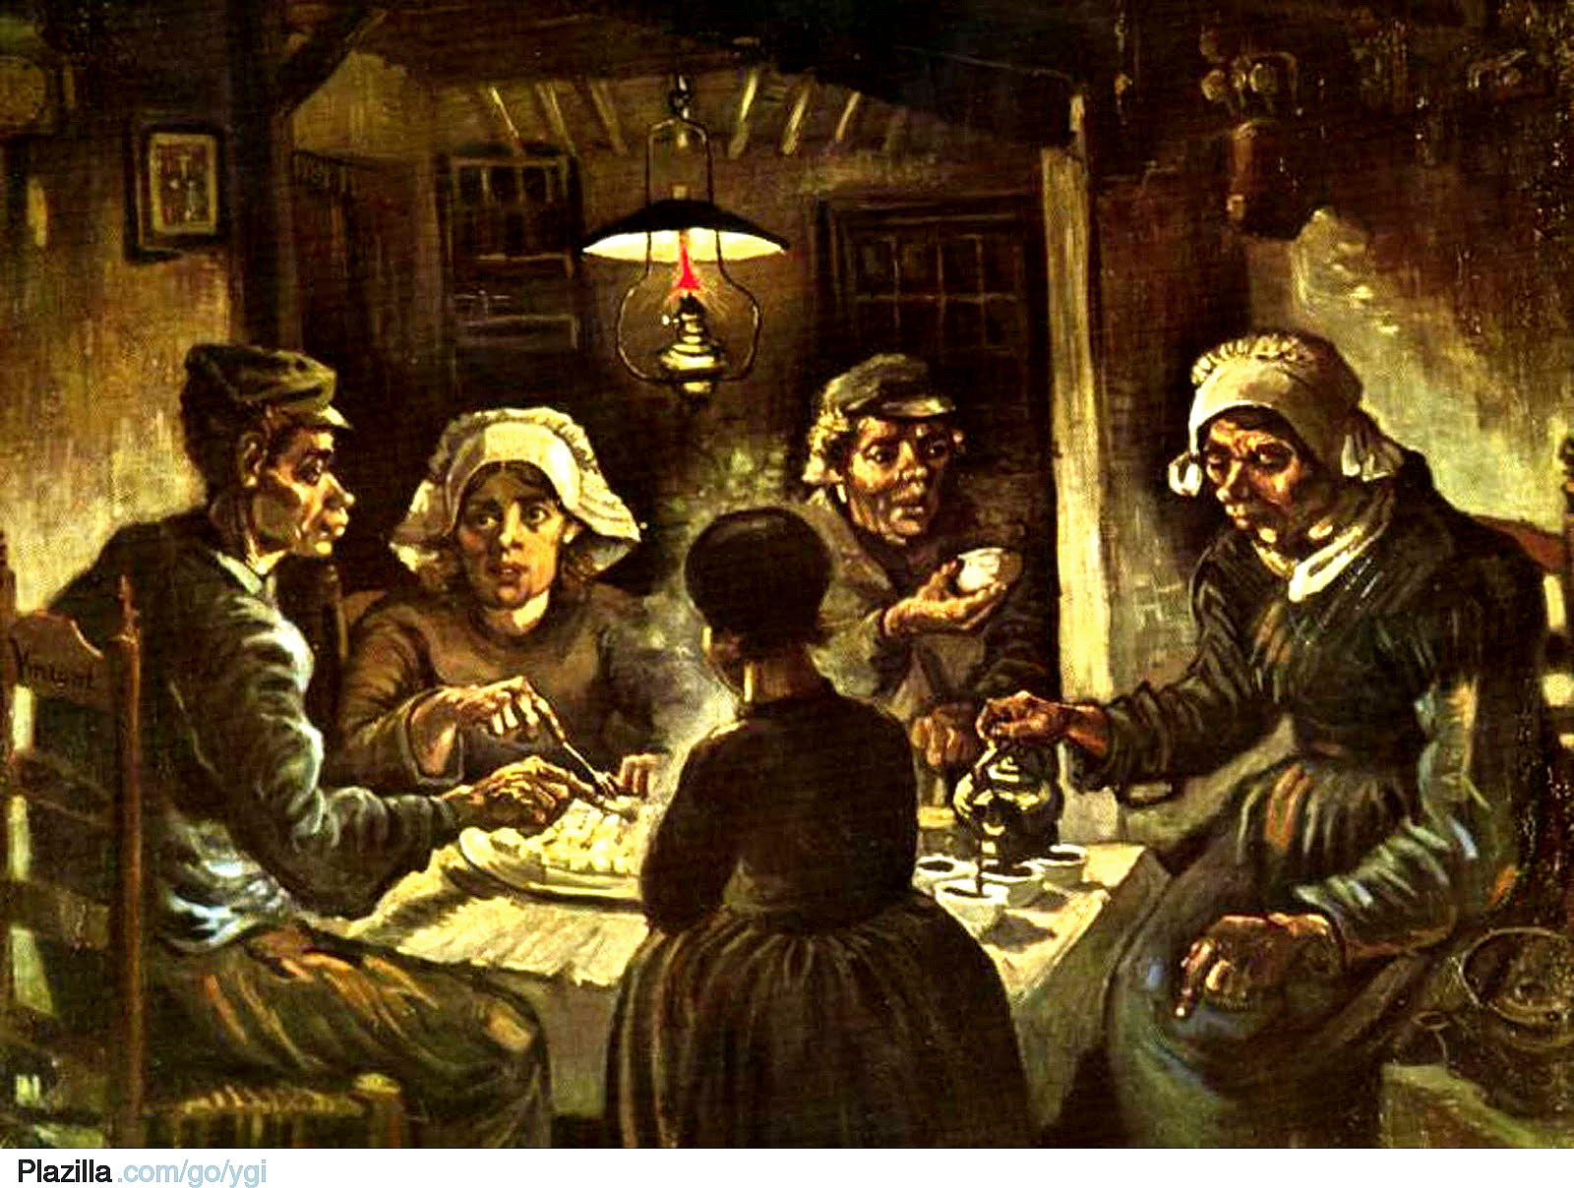
Sunflowers
The Potato Eaters

Slide 5
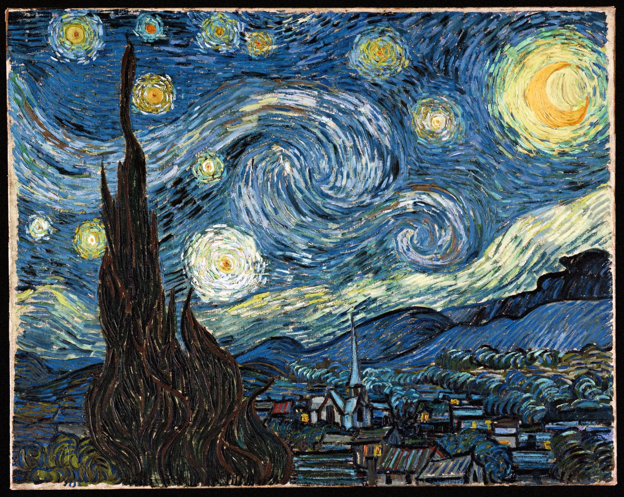
The starry night

Slide 6
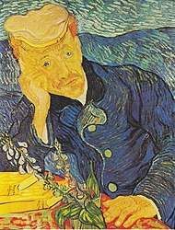
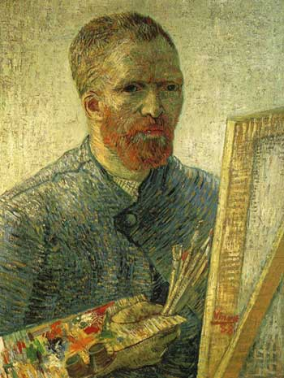
Portrait of Dr Gachet
Self Portrait

Slide 7
Wassily Kandinsky
1866 - 1944
Wassily Kandinsky was a Russian painter, he was a pioneer of abstract art
Some of Wassily Kandinsky’s famous artwork include:
Several Circles
Composition VIII
Circles in a circle
Color study. Squares with concentric circles

Slide 8
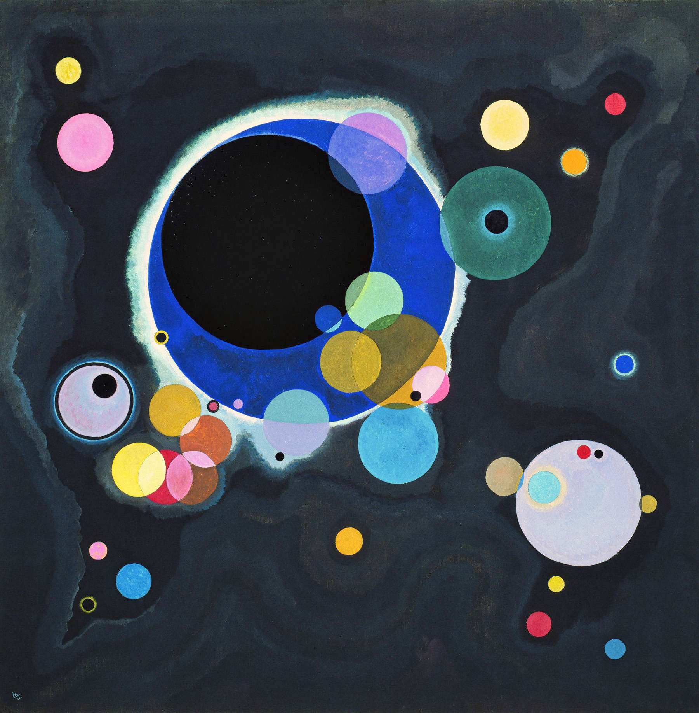
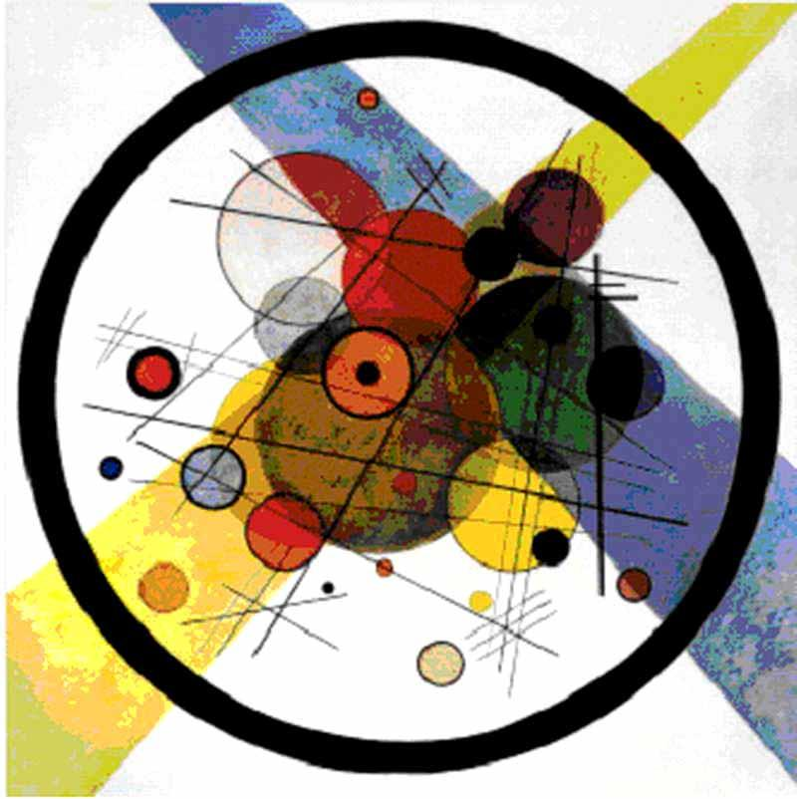
Circles in a circle
Several circles

Slide 9
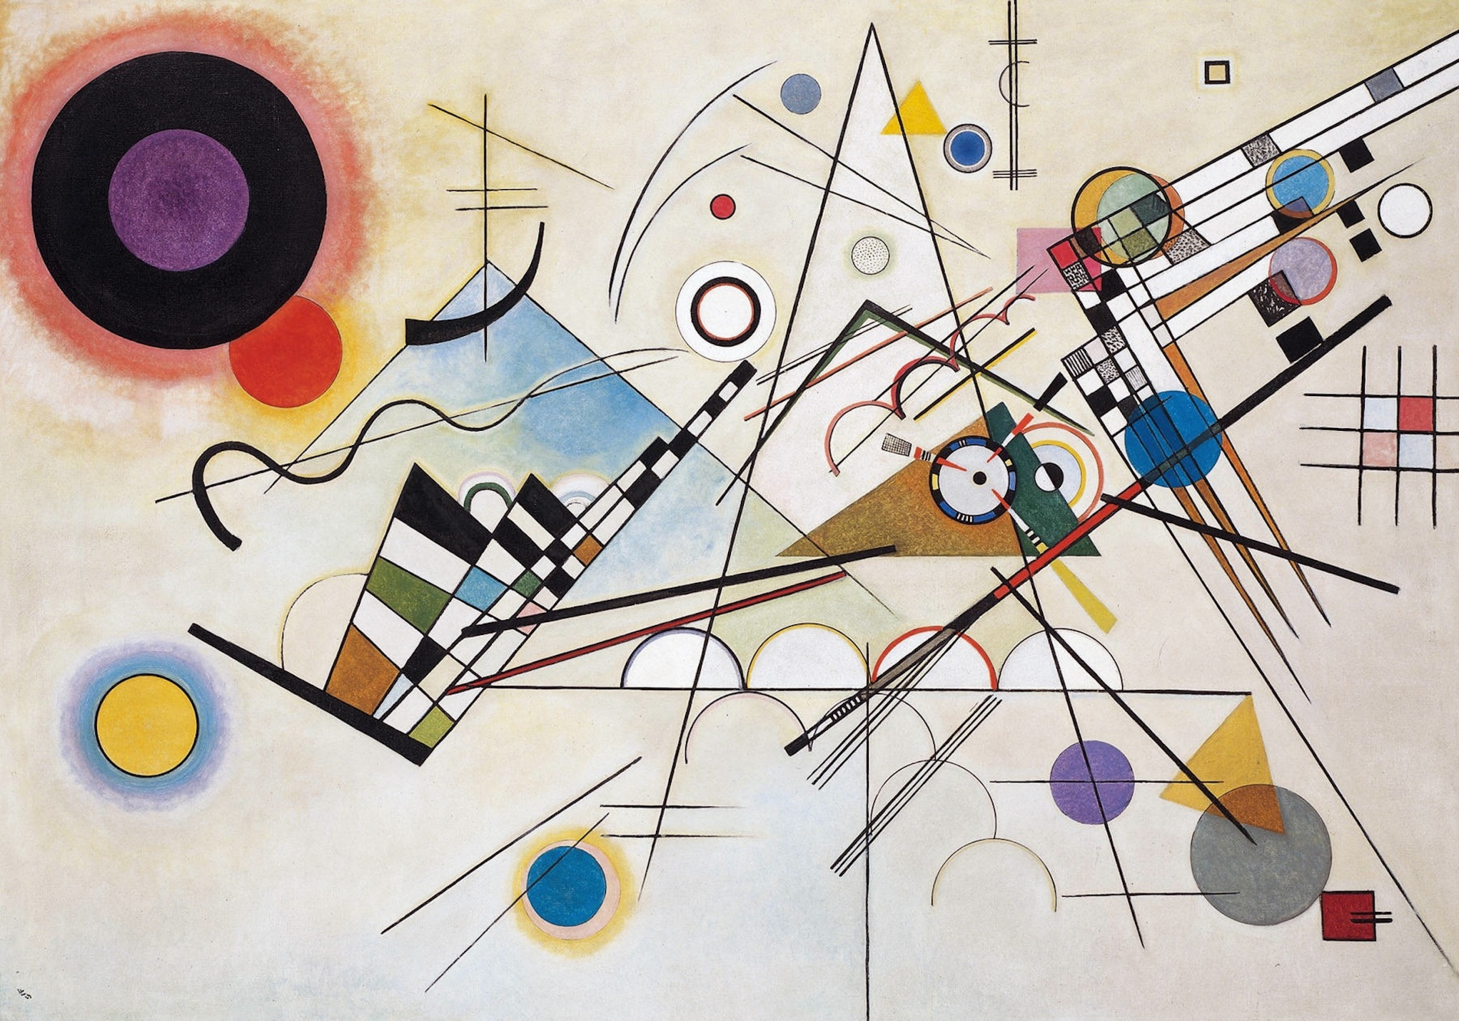
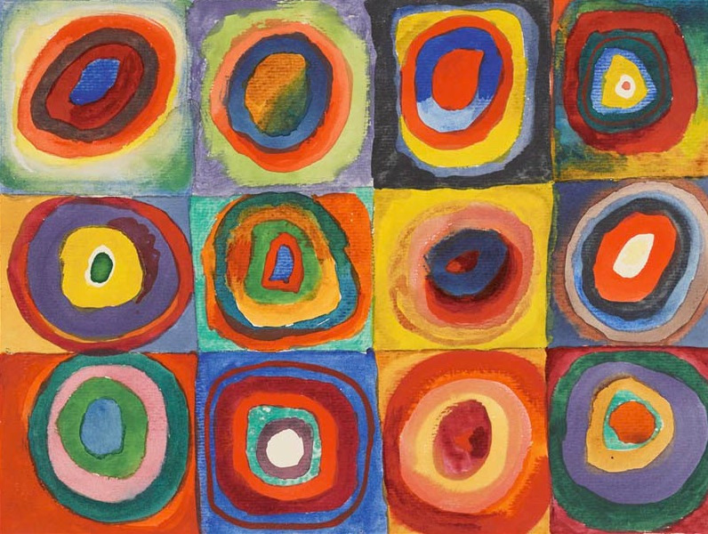
Color study, squares with concentric circles
Composition VIII

Slide 10
Michaelangelo
Michaelangelo is a famous Italian sculptor, painter, architect and poet. He is most famous for painting The Sistine Chapel ceiling and alter.
Before painting The Sistine Chapel he created a very famous sculpture, David which is a masterpiece of Renaissance sculpture.

Slide 11
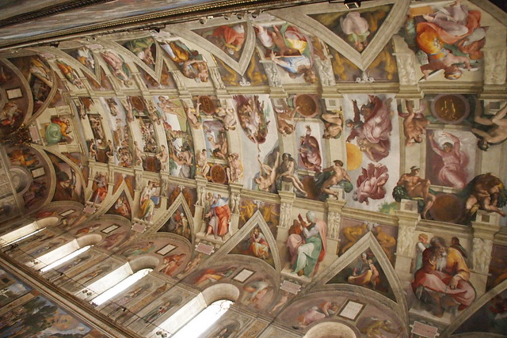
The Sistine Chapel ceiling

Slide 12
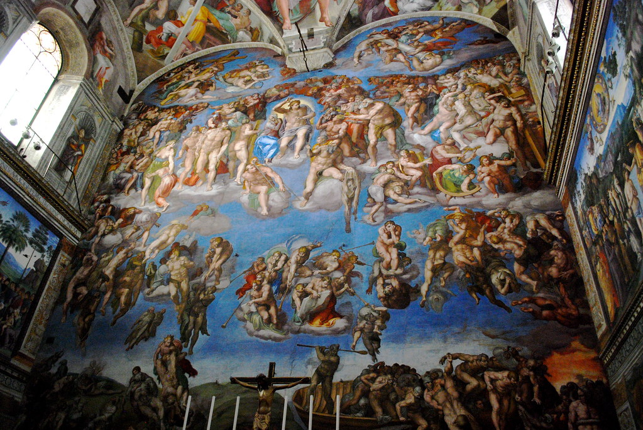
The Last Judgement

Slide 13
Look back at your art from last week.
This week you are going to create your
own piece of art in the same style of
the artist you chose last week.
Remember to add a title to your art
Work.
Will you be the next Kandinsky
or Van Gogh???

