Slide 1

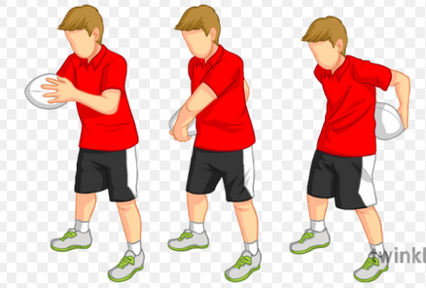
EYFS and KS1 (Reception, Y1 and Y2) - I can sit and roll a ball along the floor around my body using 2 hands (now try with 1 hand) - I can sit and roll a ball down to my toes and back up again, then around my body using two hands - I can stand and roll a ball down to my toes and back up, the around my body using two hands - I can perform the above but using only 1 hand
Fundamental 5- Coordination
Ball Skills
Lower KS2 (Y3 and Y4)
Complete all KS1 activities then try the following:
- I can stand with my legs apart and move a ball around 1 leg 16 times in less than 20 seconds or less (try left then right)
- I can move a ball around my waist 17 times in less than 20 seconds (Try in both directions)
- I can stand with my legs apart and move a ball around alternate legs 16 times in less than 20 seconds
Upper KS2 (Y5 and Y6)
Complete all other activities then try the following:
- I can stand with my legs apart and move a ball in a figure of 8 around both legs 12 times in less than 20 seconds
- I can move a ball around y waist into a figure of 8 around my legs 10 times in less than 20 seconds
- I can hold the ball between my legs with 1 hand at the front and 1 hand at the back holding the ball, I can then switch hand places and catch the ball first with a bounce then without. (try this 20 times)

