Slide 1

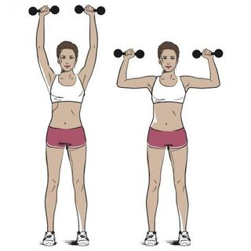
Personal Challenge Shoulder Press
How many times can you shoulder press in 1 minute?
Start with the weight at your chest, slight knee bend and push weight above your head
Safety – Only use a weight you can comfortably lift
Equipment
Weights e.g. melon, tins, shoes
- Timer
Practise, Record your score, Try to beat it
Can you beat it by more than 5?

