Slide 1

Active Northumberland PE and School Sport
PE and Physical Activity Timetable – Key Stage 1 & 2 Spring 2 20211
Activity | Each week we advise you to follow the daily routine, the skill, challenge or PE activity remains the same each day so that your child can become secure in carrying out the activity confidently and with control, challenging themselves to improve their performance each day.
PE Activity 1- Fundamental Movement Skill (10 minutes) | This activity concentrates on a fundamental skill that is an important component of a child's physical literacy development. The aim is to have confident physically literate children that develop a lifelong love of being active. Please note the fundamental cards are differentiated and should be used sequentially. Look out for the videos on Active Northumberland YouTube
PE Activity 2- Personal Challenge (10 minutes) | This is a simple Agility, Balance or Co-ordination Activity for your child to practise and improve and to challenge themselves to be better by the end of each week. The video clip will show you what to do, remember to record your best effort each day. Look out for the videos on Active Northumberland YouTube
PE Activity 3- KS1 Ball Skills KS2 Football Skills Video Lesson for each age group per week More lessons can be found on Oak Academy | Each online video lesson can be accessed by following the link on the timetable or through Active Northumberland YouTube channel Warm-up KS1 Ball Skills – Mrs Robson & Miss Alderslade KS2 Football Skills – Mr Brown Please follow the teaching points to ensure that they learn the correct technique. Practise individually and if in a safe environment link skills together. Supplementary Activities – Youth Sport Trust Wonder Woman. Unleash the power of sport to reconnect, full resources for schools and home
Physical Activity Challenge (30 minutes) | These additional 30 minutes non-curricular activities are to support your family to reach the recommended 60 minutes of physical activity per day. These daily activities are only suggestions as there are many more which can be found on Active Northumberland YouTube & RISE

Slide 2

Active Northumberland PE and School Sport
PE and Physical Activity Timetable – Key Stage 1 & 2
Before you start your Activity
Make sure you are dressed for PE
Make sure you are ready to exercise, remember a warm-up prepares your body to exercise
Make sure you have enough space around you to carry out the activity safely whether you are inside or outside
If something starts to hurt stop the activity straight away and ask for help
Make sure you have a drink of water to keep yourself hydrated
Put some music on and have some fun
Keep Active, Keep Healthy & Keep Smiling

Slide 3
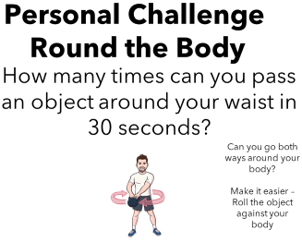


Active Northumberland PE and School Sport
PE and Physical Activity Timetable – Key Stage 1 Week 21
 | Monday | Tuesday | Wednesday | Thursday | Friday
PE Activity 1- Fundamental Movement Skill (10 minutes) | Ball Chasing *See Fundamental Movement Skill Card* | Ball Chasing | Ball Chasing | Ball Chasing | Ball Chasing
PE Activity 2- KS1 Personal Challenge (10 minutes) | Round the Body *See Personal Challenge Card* | Round the Body |  | Round the Body | Round the Body
PE Activity 3- KS1 Ball Skills | Throwing With Miss Alderslade | Show Compassion for All Individual Quest | Throwing with Miss Alderslade | Show Compassion for All Individual Quest | Throwing with Miss Alderslade
Physical Activity Challenge (30 minutes) | School Games – Northumberland Castle Virtual Challenge | Active Northumberland – Active at Home Schools | Active Northumberland – Active at Home Schools | Youth Sport Trust – After School Sports Club Live at 5pm | School Games – Northumberland Castle Virtual Challenge

Slide 4
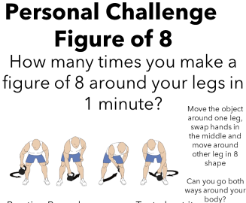
Active Northumberland PE and School Sport
PE and Physical Activity Timetable – Key Stage 2 Week 2
 | Monday | Tuesday | Wednesday | Thursday | Friday
PE Activity 1- Fundamental Movement Skill (10 minutes) | Ball Chasing *See Fundamental Skills Card* | Ball Chasing | Ball Chasing | Ball Chasing | Ball Chasing
PE Activity 2- KS2 Personal Challenge (10 minutes) | Figure of 8 *See Personal Challenge card* | Figure of 8 |  | Figure of 8 | Figure of 8
PE Activity 3- KS2 Football Skills | Speed Dribbling with Mr Brown | Ball Mastery Part 2 | Speed Dribbling with Mr Brown | Ball Mastery Part 2 | Speed Dribbling with Mr Brown
Physical Activity Challenge (30 minutes) | School Games – Northumberland Castle Virtual Challenge | Active Northumberland – Active at Home Schools | Active Northumberland – Active at Home Schools | Youth Sport Trust – After School Sports Club Live at 5pm | School Games – Northumberland Castle Virtual Challenge

