Slide 1

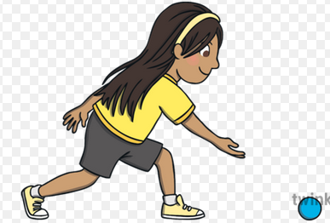
EYFS and KS1 (Reception, Y1 and Y2) - I can roll a ball 10m, chase and collect it in a balanced position - I can chase a ball rolled 10m by a partner and collect it in a balanced position - Starting in a seated/ lying position, I can throw a bouncing ball 10m, chase it and collect it remaining balanced (now try this with a partner throwing the ball)
Fundamental 7- Agility
Ball Chasing
Lower KS2 (Y3 and Y4)
Complete all KS1 activities then try the following:
- I can chase a rolled ball, let it roll through my legs then collect it whilst remaining balanced (try with a different sized ball)
- I can chase a thrown bouncing ball, let it roll through my legs then collect it whilst remaining balanced (try with a different sized ball)
- I can chase a rolled ball, get in front of it and stop it with my knee sideways (long barrier position)
Upper KS2 (Y5 and Y6)
Complete all other activities then try the following:
- I can roll and chase a large ball, stopping it with my head in a front support position
- I can stand facing a partner, ask them to feed the ball over my head, then turn and catch it after 1 bounce
- I can stand facing away from a partner, ask them to feed the ball over my head, react and catch after 1 bounce

