Slide 1

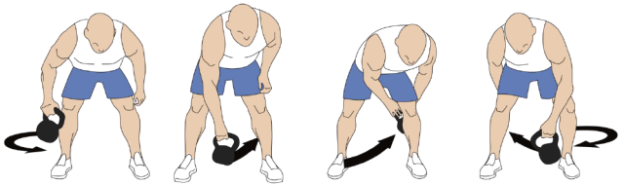
Personal Challenge
Figure of 8
How many times you make a figure of 8 around your legs in 1 minute?
Move the object around one leg, swap hands in the middle and move around other leg in 8 shape
Can you go both ways around your body?
Equipment
Ball / socks / soft toy
- Timer
Practise, Record your score, Try to beat it
Can you beat it by more than 5?

