Slide 1

Active Northumberland PE and School Sport
PE and Physical Activity Timetable – Key Stage 1 & 2 Spring 1 20211
Activity | Each week we advise you to follow the daily routine, the skill, challenge or PE activity remains the same each day so that your child can become secure in carrying out the activity confidently and with control, challenging themselves to improve their performance each day.
PE Activity 1- Fundamental Movement Skill (10 minutes) | This activity concentrates on a fundamental skill that is an important component of a child's physical literacy development. The aim is to have confident physically literate children that develop a lifelong love of being active. Please note the fundamental cards are differentiated and should be used sequentially.
PE Activity Personal Challenge (10 minutes) | This is a simple Agility, Balance or Co-ordination Activity for your child to practise and improve and to challenge themselves to be better by the end of each week. The video clip will show you what to do, remember to record your best effort each day.
PE Activity 3- Gymnastics (10 minutes) | This Activity is a specific Gymnastics skill that is part of a Gymnastics Theme. Please follow the teaching points to ensure that they learn the correct technique. Practise individually and if in a safe environment link skills together. Where there is a video clip please access the link on the timetable. You will be able to see further differentiated tasks or relevant Gymnastics Cards with visuals & teaching points
Physical Activity Challenge (30 minutes) | These additional 30 minutes non-curricular activities are to support your family to reach the recommended 60 minutes of physical activity per day. These daily activities are only suggestions as there are many more which can be found on YouTube https://www.youtube.com/channel/UCnP_2E9H6RmYXHEYVh4rrFQ A useful website with lots more examples is https://www.weareteachers.com/virtual-pe-classes/

Slide 2

Active Northumberland PE and School Sport
PE and Physical Activity Timetable – Key Stage 1 & 2
Before you start your Activity
Make sure you are dressed for PE
Make sure you are ready to exercise, remember a warm-up prepares your body to exercise
Make sure you have enough space around you to carry out the activity safely whether you are inside or outside
If something starts to hurt stop the activity straight away and ask for help
Make sure you have a drink of water to keep yourself hydrated
Put some music on and have some fun
Keep Active, Keep Healthy & Keep Smiling

Slide 3
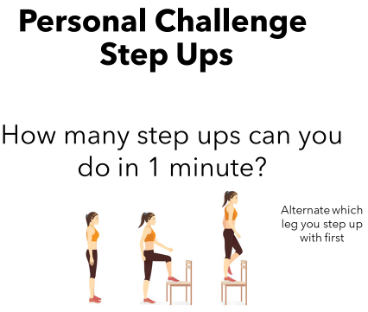
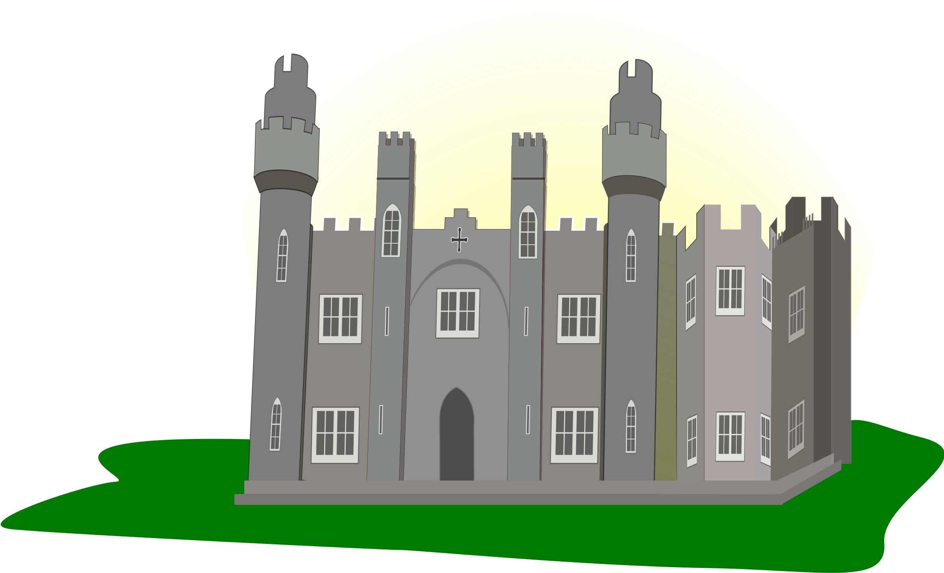

Active Northumberland PE and School Sport
PE and Physical Activity Timetable – Key Stage 1 Week 5 1
 | Monday | Tuesday | Wednesday | Thursday | Friday
PE Activity 1- Fundamental Movement Skill (10 minutes) | Floor Work *See Fundamental Movement Skill Card* | Floor Work | Floor Work | Floor Work | Floor Work
PE Activity 2- KS1 Personal Challenge (10 minutes) | Step Ups *See Personal Challenge Card* | Step Ups |  | Step Ups | Step Ups
PE Activity 3- KS1 Gymnastics (10 minutes) | Rock and Roll *See KS1 Gym Card* | Rock & Roll Gymnastics #ThisIsPE Video | Rock and Roll | Rock & Roll Gymnastics #ThisIsPE Video | A Routine Matter *See KS1 Gym Card*
Physical Activity Challenge (30 minutes) | School Games – Northumberland Castle Virtual Challenge | Youth Sport Trust – After School Sports Club Live at 5pm | Active Northumberland – Active at Home Schools | School Games – Northumberland Castle Virtual Challenge | Active Northumberland – Active at Home Schools
Active Northumberland Active at Home Schools primary sessions live daily at 10am on Facebook

Slide 4
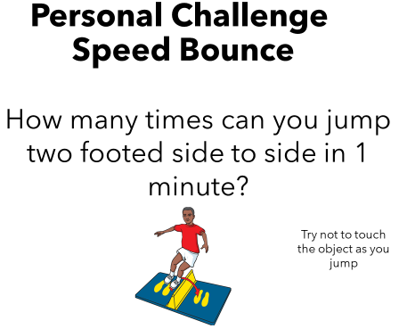
Active Northumberland PE and School Sport
PE and Physical Activity Timetable – Key Stage 2 Week 5
 | Monday | Tuesday | Wednesday | Thursday | Friday
PE Activity 1- Fundamental Movement Skill (10 minutes) | Floor Work *See Fundamental Skills Card* | Floor Work | Floor Work | Floor Work | Floor Work
PE Activity 2- KS2 Personal Challenge (10 minutes) | Speed Bounce *See Personal Challenge card* | Speed Bounce |  | Speed Bounce | Speed Bounce
PE Activity 3- KS2 Gymnastics (10 minutes) | Gymnastics Body Management Activities 3 *See KS2 Gym Cards* | Horizontal Climbing #ThisIsPE Video | Gymnastics Body Management Activities 3 | Horizontal Climbing #ThisIsPE Video | Key Step Gymnastics Session 3 Routine
Physical Activity Challenge (30 minutes) | School Games – Northumberland Castle Virtual Challenge | Youth Sport Trust – After School Sports Club Live at 5pm | Active Northumberland – Active at Home Schools | School Games – Northumberland Castle Virtual Challenge | Active Northumberland -Active at Home Schools
Active Northumberland Active at Home Schools primary sessions live daily at 10am on Facebook

