Slide 1

KS 2 Gymnastics Key Steps Floor Routine
In your PE lessons at school, you would very likely have been learning the skills and routines of British Gymnastics Key Step 1 and Key Step 2 Routine. At home we would like Y3 and Y4 pupils to attempt Key Step 1 and Y5 and Y6 pupils Key Step 2, however, you are welcome to try both. Each Key step has been split into 3 practice sessions. Session 1 and 2 to practice and learn the moves and session 3 to consolidate the learning and perfect the final sequence.​
You can view these routines on You tube (copy and paste the links into a browser)​
https://aspiregymnasticsclub.org/key-step-floor-routines/​
https://www.youtube.com/watch?v=MACrnNx9nik​
https://www.youtube.com/watch?v=iksSHmpwLB8​
​
You won't have the same space you have at school or mats but most of the routines can be done without a mat and within a small clear space. Keep reading this presentation to see if it's possible for you to do at home. Ask an adult to check your safe practice space.​
The following pages list the actions in the routine and crosses out actions that aren't suitable for home learning with a suggested alternative. Read the whole presentation first before you attempt any home gymnastics.

Slide 2
Safety and Learning Tips
So, are you ready to have a go at learning the skills for the routines?​
Before you do let's make sure it's safe for you.......​
Don't try any of the crossed-out actions at home, forward rolls and backward rolls need a gymnastic mat and cartwheels need a big safe space. Each practice session can be done in 10-20 minutes.​
Do ask an adult to check if your area is safe enough to use ( size of space, objects around the room)​
When performing any of the actions remember to keep your core muscles strong ( stomach and lower back) and keep good posture ( head up, shoulders back)​
Any actions you don’t feel confident to do, leave them out or replace them with an action you have learnt at school, enjoy doing and is safe to do. ​
Don’t expect to get the actions right first time, some will take lots of practice, stick with it!

Slide 3
Warm Up - 5 to 10 minutes​
Step left and right for 16 counts​
Punch arms in front of you for 16 counts ( keep arms strong)​
March on the spot for 16 counts (nice high knees)​
Punch arms above head for 16 counts ( keep arms strong)​
Bottom kicks on the spot for 16 counts ( feet kick behind to bottom)​
Punch low to high and low again ect for 16 counts​
Pretend you have a skipping rope and skip for 16 counts​
Front crawl arms for 8 then skip again for 16​
Back crawl arms for 8 then skip again for 16 ( if it's getting tough march instead)​
Stretch up tall for 8 counts, squat down small for 8 , stretch out wide for 8​
Circle wrist one way and the other , circle hips one way and the other, circle one ankle one way and the other and then repeat on the other ankle​
Give your body a good wiggle or shake and you should be ready to start your practice.
Before each practice session remember to warm up and stretch. Make this easier by halving the number of each action or harder by doubling. Play a lively tune in the background to keep time to .​

Slide 4
Year 5 and 6 – Gymnastics Key Steps Floor Routine Session 3
Well done, you have now learnt the whole routine and are ready to put practice 1 and 2 together to complete the routine.​
Watch the video again to remind you, look at the gymnast's good body posture, can you focus on this in your performance.​
Ask an adult to video you so you can watch your performance. How can you make it better? Perform again and try to improve. ​
You could perform your routine to music and try to keep in time to it. Songs like Havannah are nice and slow, you must not use a fast tune​
Good luck. Your teacher may like to see this routine when you return to school!

Slide 5
Year 5 and 6 – Gymnastics Key Steps Floor Routine Session 3
Standing showing good posture, lift leg and arms and step forward​
Forward Roll – crouch to tuck and then double rock to standing .​
Three traveling steps.​
Arabesque​
1/2 jump turn​
Backward roll crouch to supported tuck , rock back and then forwards onto knees.​
Front support and press up​
Turn through side support​
Shoulder stand, rock to stand​
Pivot and Cartwheel add a Y balance.

Slide 6
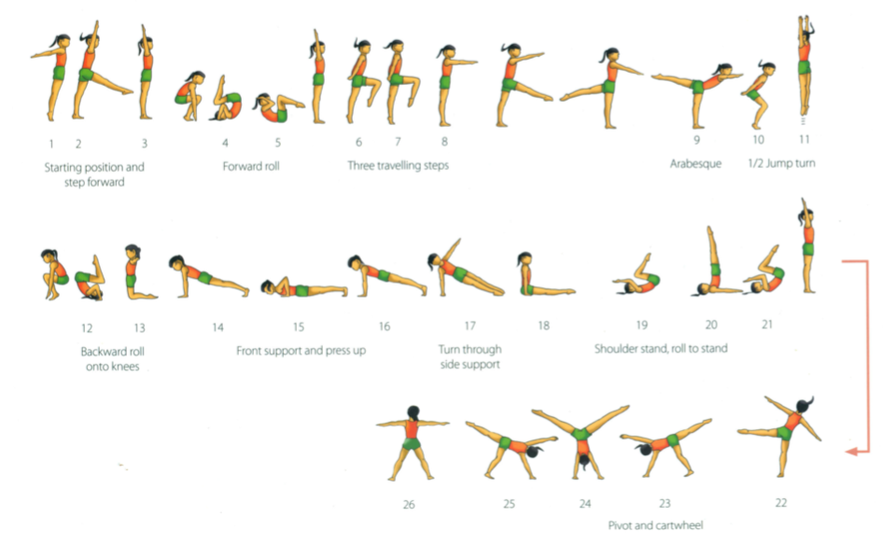
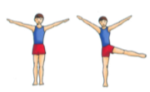
Year 5 and 6 – Gymnastics Key Steps Floor Routine Session 3
Crouch to tuck and then double rock to standing
Crouch to supported tuck , rock back and then forwards onto knees
Pivot into Y Balance

