Slide 1

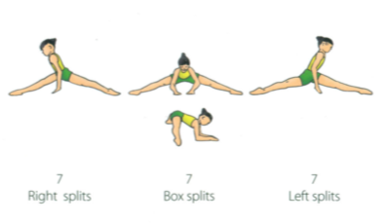
Year 5 and 6 – Gymnastics Body Management Activities 3
Try each of these skills individually then see if you can link them together to make a short sequence.
Splits- Teaching Points
In right and left leg splits ensure hips and shoulders are square and level .
In box splits, keep both legs straight.
Use arms to support body weight and ease down into splits as far as you can go.

Slide 2
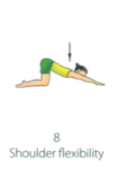
Year 5 and 6 – Gymnastics Body Management Activities 3
Try each of these skills individually then see if you can link them together to make a short sequence.
Shoulder flexibility- Teaching Points
Keep knee joint at 90 degrees.
Keep arms shoulder width apart.
Push arm pits down towards the floor.
Try not to arch the back.

Slide 3
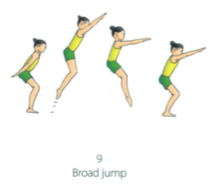
Year 5 and 6 – Gymnastics Body Management Activities 3
Try each of these skills individually then see if you can link them together to make a short sequence.
Broad Jump- Teaching Points
- Take arms back behind you before take off to enable swing through, giving you extra length to your jump.
- Keep feet shoulder width apart.
- Push through feet and extend legs fully.
-Bend knees on landing (no more than 90 degrees).

