Slide 1
Teacher note – you may wish to skip the title page of this PowerPoint as the first activity is to guess what the items have in common.

Slide 3
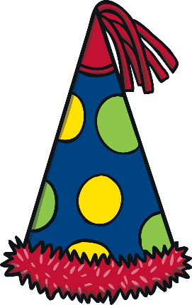


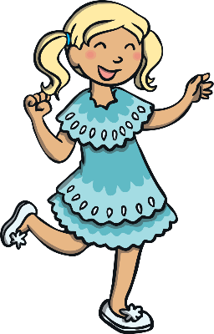
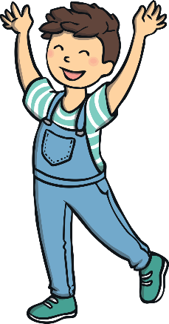
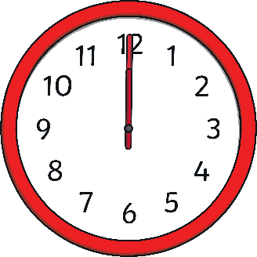
Guess the Clues
Can you work out what these clues are about?
We are going to learn about New Year.

Slide 4
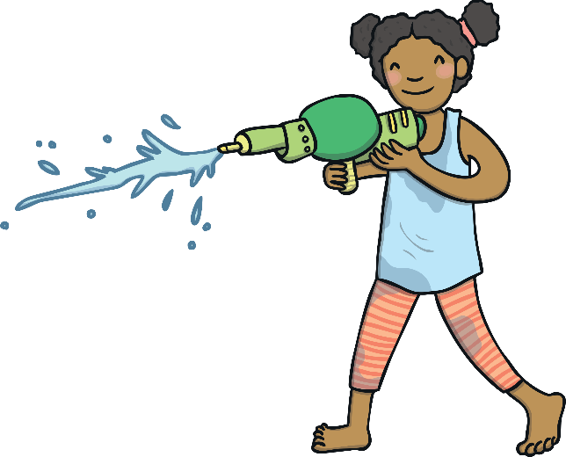
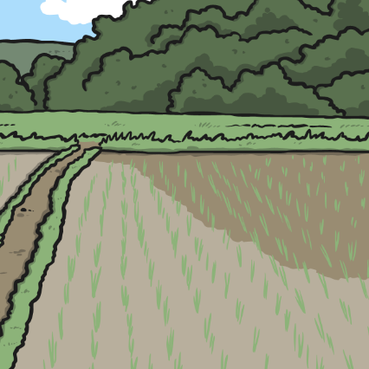
Different New Year Festivals
New Year is a festival that celebrates the end of one year and the start of another. Lots of cultures have special new year festivals. They are at different times of the year.
Chinese New Year – this festival is in February. People celebrate by watching special dragon dances, giving gifts of money in red envelopes and having a special meal with family and friends.
Rosh Hashanah – this is the Jewish new year. It happens in autumn.
Jewish people will celebrate by visiting the synagogue (their
special place) and by eating apples dipped in honey.
Thai New Year – this happens in April. Thai people celebrate
by throwing water everywhere and having water fights!

Slide 5

New Year
In lots of places, the new year is celebrated on 31st December and 1st January. The old year ends and the new year starts at midnight.
Talk About It
Can you think of any other festivals that happen in December?

Slide 6

How is New Year Celebrated?
31st December is called New Year’s Eve. On New Year’s Eve, people might have or go to a party.
Talk About It
If you were planning a New Year’s Eve party, what would it be like? Who would you invite? What games would you play at the party? What music would you listen to? What would your guests eat and drink?

Slide 7
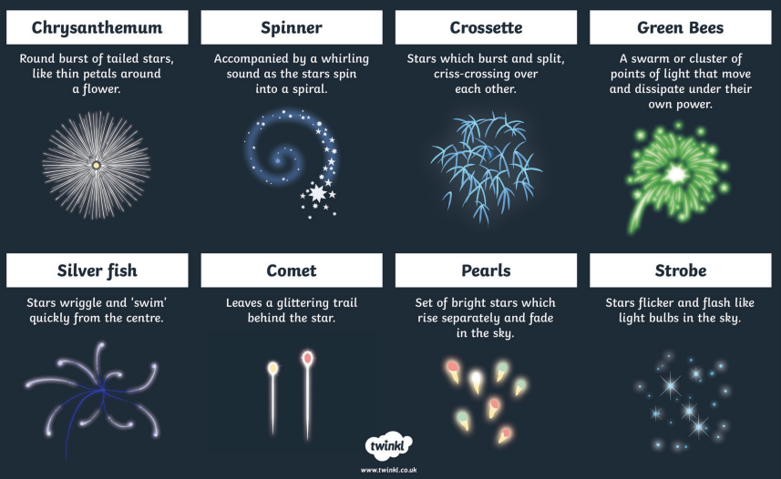
How is New Year Celebrated?
Some people watch firework displays. Why not have a go at drawing some of these firework effects?

Slide 8
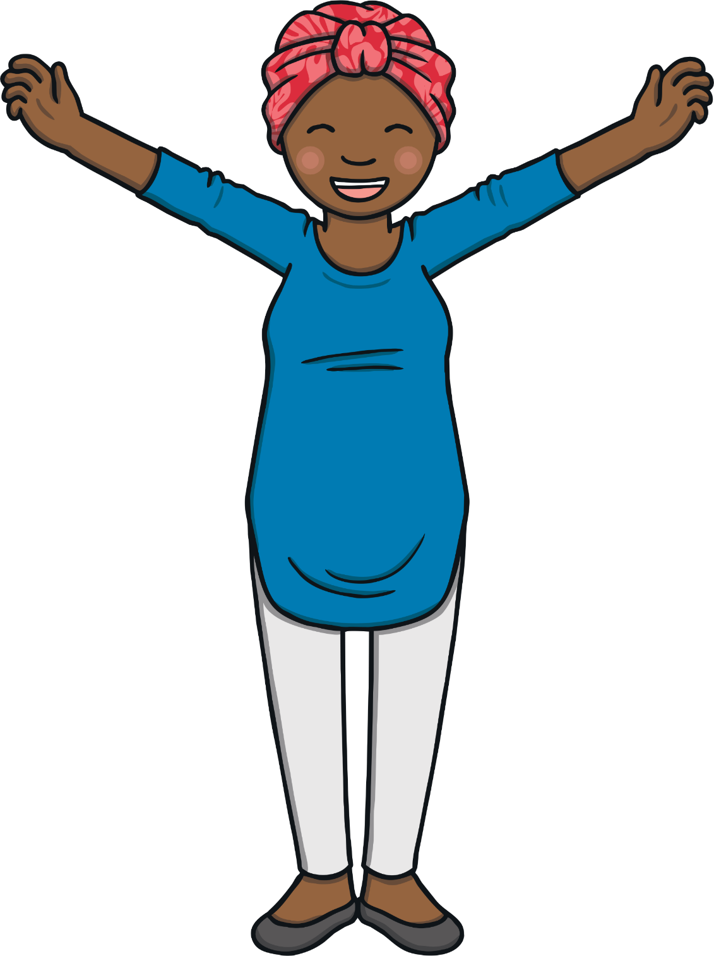
How is New Year Celebrated?
However people celebrate, the important part of the
evening is the countdown to midnight.
Just before the clock strikes 12,
people will countdown from 10 to 1.
They will then cheer and say ‘happy
New Year’ to people.
Try It!
Let’s pretend the clock is about to strike 12. Countdown from 10 and then wish people a happy new year.

Slide 9
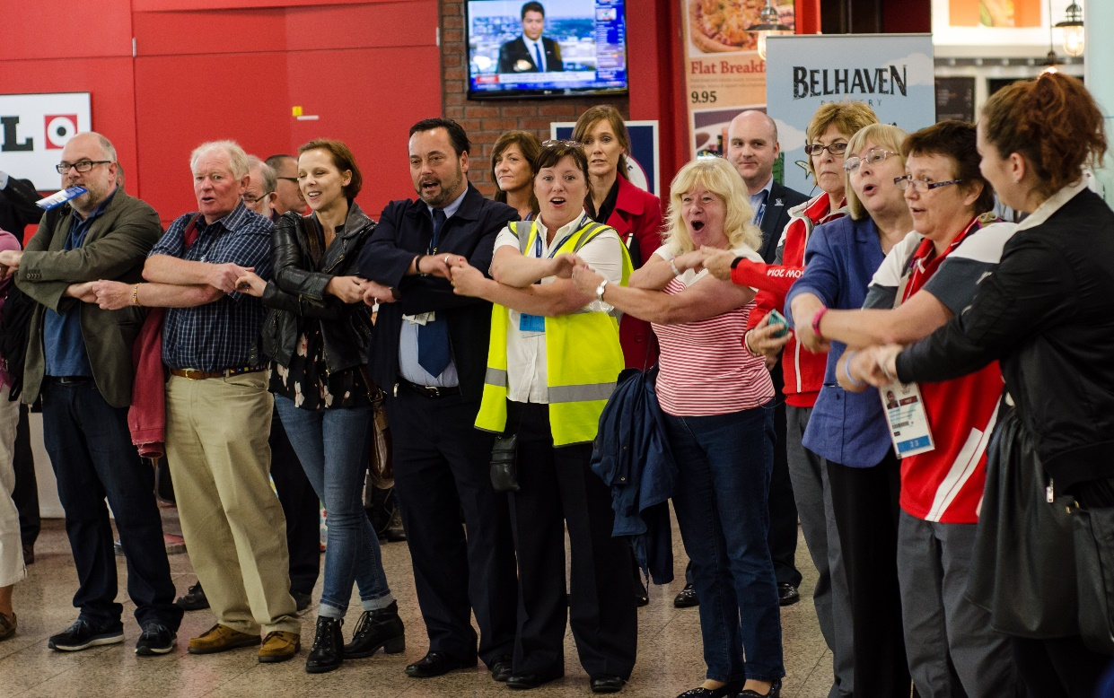
Auld Lang Syne
After the countdown, people cross their arms over the bodies and join hands with the people standing next to them. They then sing a special song called ‘Auld Lang Syne’ which is an old Scottish way of saying ‘days gone by’.

Slide 10
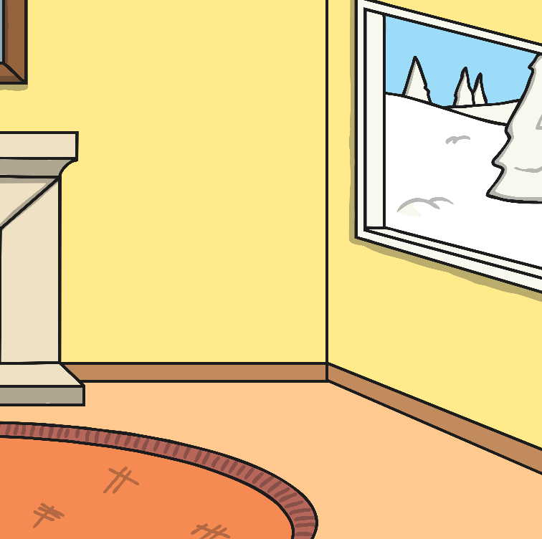
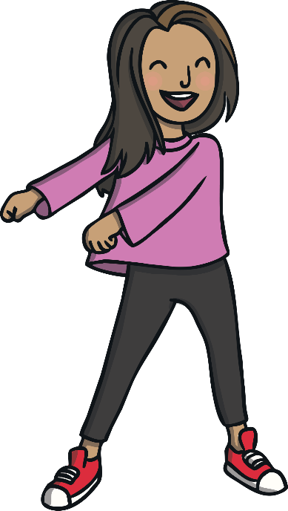
Auld Lang Syne
The words of the first verse and the chorus are:
Should auld acquaintance be forgot,
And never brought to mind?
Should auld acquaintance be forgot,
And auld lang syne!
For auld lang syne, my dear,
For auld lang syne.
We’ll take a cup o’kindness yet,
For auld lang syne.
Try It!
Let’s pretend it’s New Year. Cross your arms over your body and then hold hands with the people next to you. As you sing the song, bounce your arms up and down.

Slide 11
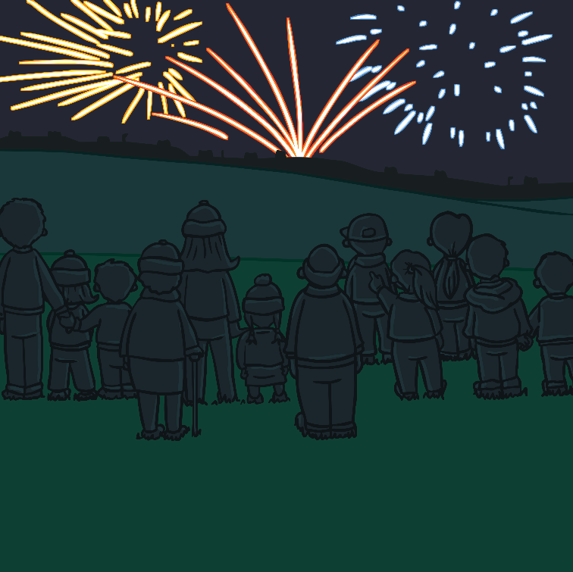
New Year’s Resolutions
Another thing that lots of people do at New Year is to make New Year’s resolutions. A resolution is a promise that you are going to do something.
Some things people set as resolutions might be
to get more exercise, to practise spellings every
day or to learn a musical instrument.
Try It!

Slide 12

New Year Around the World
Click on the pins to find out about different New Year’s traditions around the world.
Brazil – Lentils represent money in Brazil, so Brazilians eat them at New Year
in the hope that they will have lots of money in the coming year.
Denmark – Plates are smashed on people’s door steps as it is meant to
bring luck.
Spain – It is considered lucky to eat a grape each time the clock chimes at midnight. These 12 grapes are meant to bring you 12 months of luck!
Scotland – Some Scottish people go ‘first-footing’ at New Year. The aim is to
be the first person to visit a person’s house in the new year.

