Slide 1
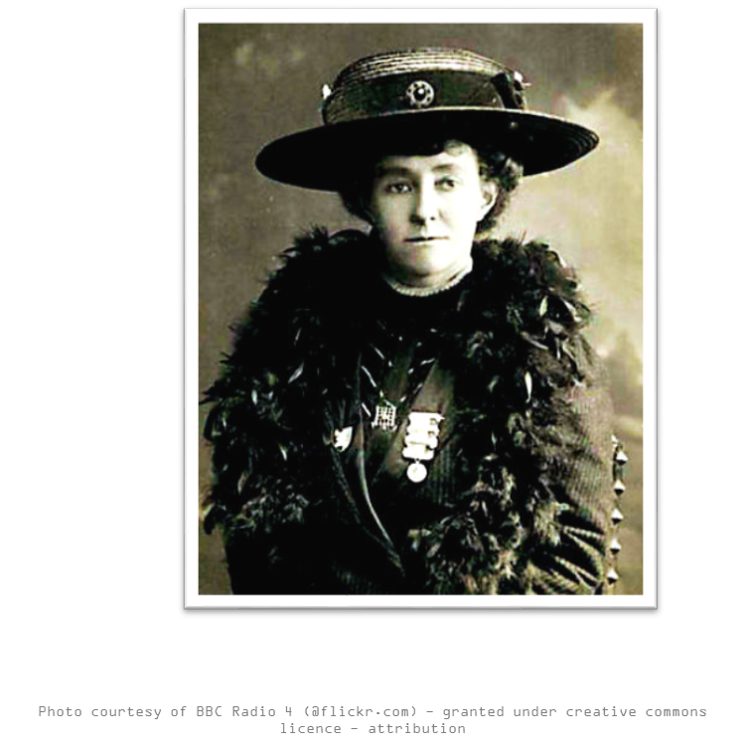
Who is this? Why is she important?

Slide 2
Emily Davidson
Women haven't always had the same rights as men. It was thought that women were not clever or important enough.
A long time ago women were not allowed the right to vote in the UK. That meant that when there were big decisions to be made, women’s opinions did not matter.
Women were not allowed to:
Women were not allowed to vote (it was thought that they weren’t intelligent enough to understand what went on in the world of politics.)
Women were not allowed to own property like houses.
Women were not allowed to do ‘important’ jobs, e.g. doctors or lawyers.
Women were not seen as important enough for girls and young women to go to school and university.
Women were not allowed to play sport.
Women were not allowed to join the military (army).
Women were not allowed to shop on their own.

Slide 3
So what did Emily Davidson do?
There were many women - and men too - who fought hard to get the law changed.
A group of people called suffragettes came together to try and change this.
Emily Davison was one of the most famous members of the group.
She went to extreme measures to continue their campaign; they smashed windows, burned down churches and chained themselves to buildings.
Emily Wilding Davison was born in London in 1872 and became a teacher.

Slide 4
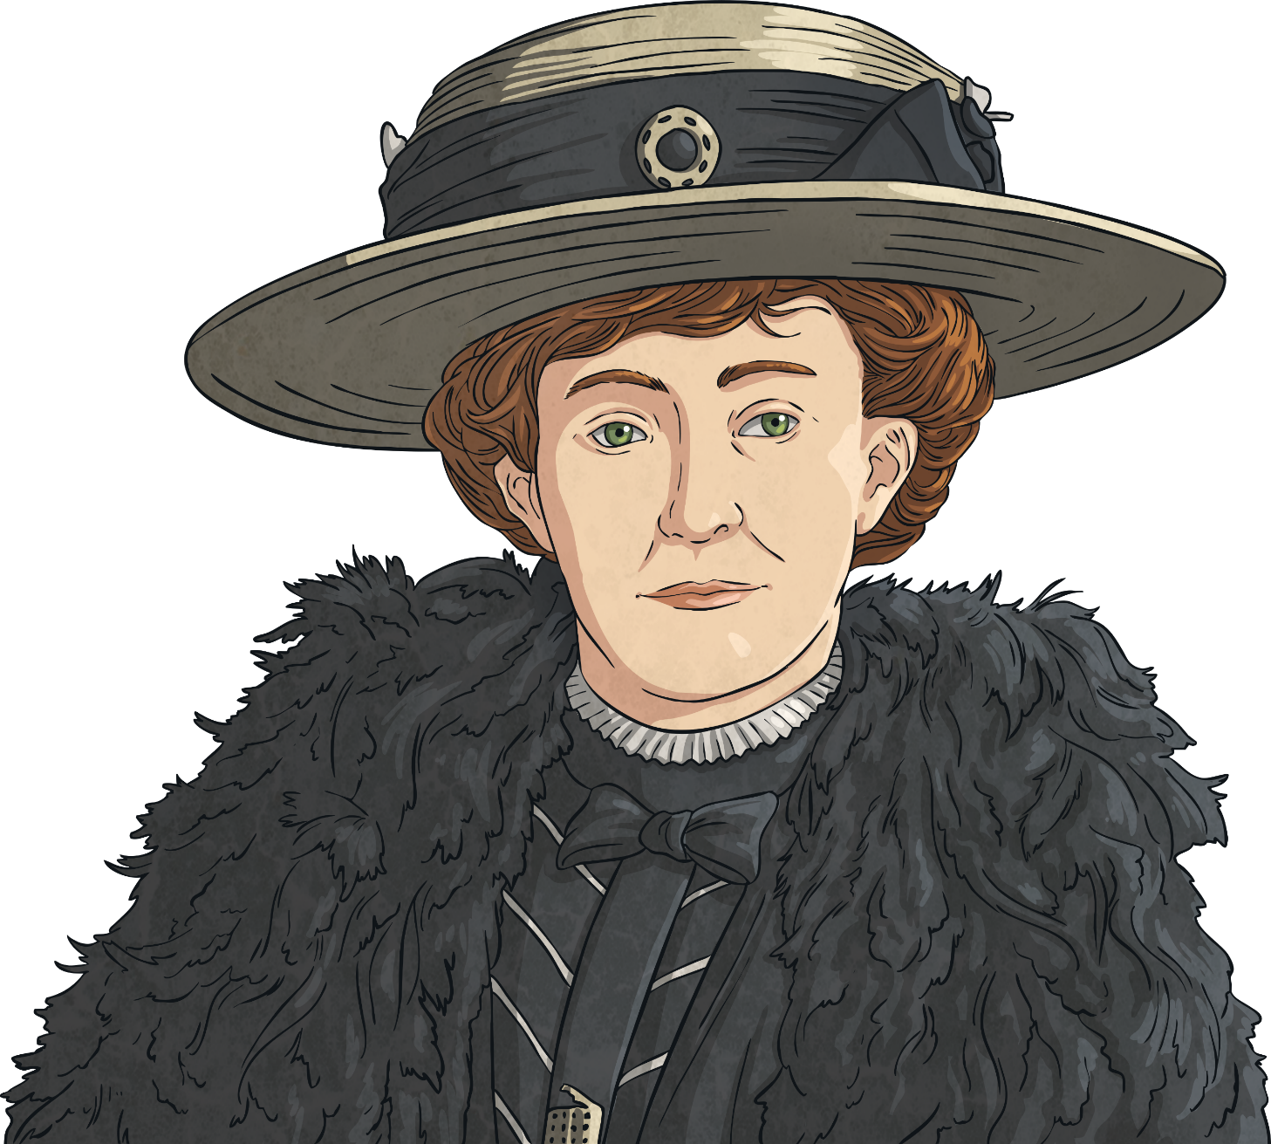
Emily Davison’s Life
Emily Davison was sent to jail 9 times during her life for breaking the law.
She is best known for stepping out in front of King George V’s horse during a horse race.
It is thought that Emily Davison was trying to attach a ‘Votes for Women’ sign to the King’s horse and was trampled.
Emily Davison died in hospital a few days later on 8 June 1913 as a result of her injuries.

Slide 5
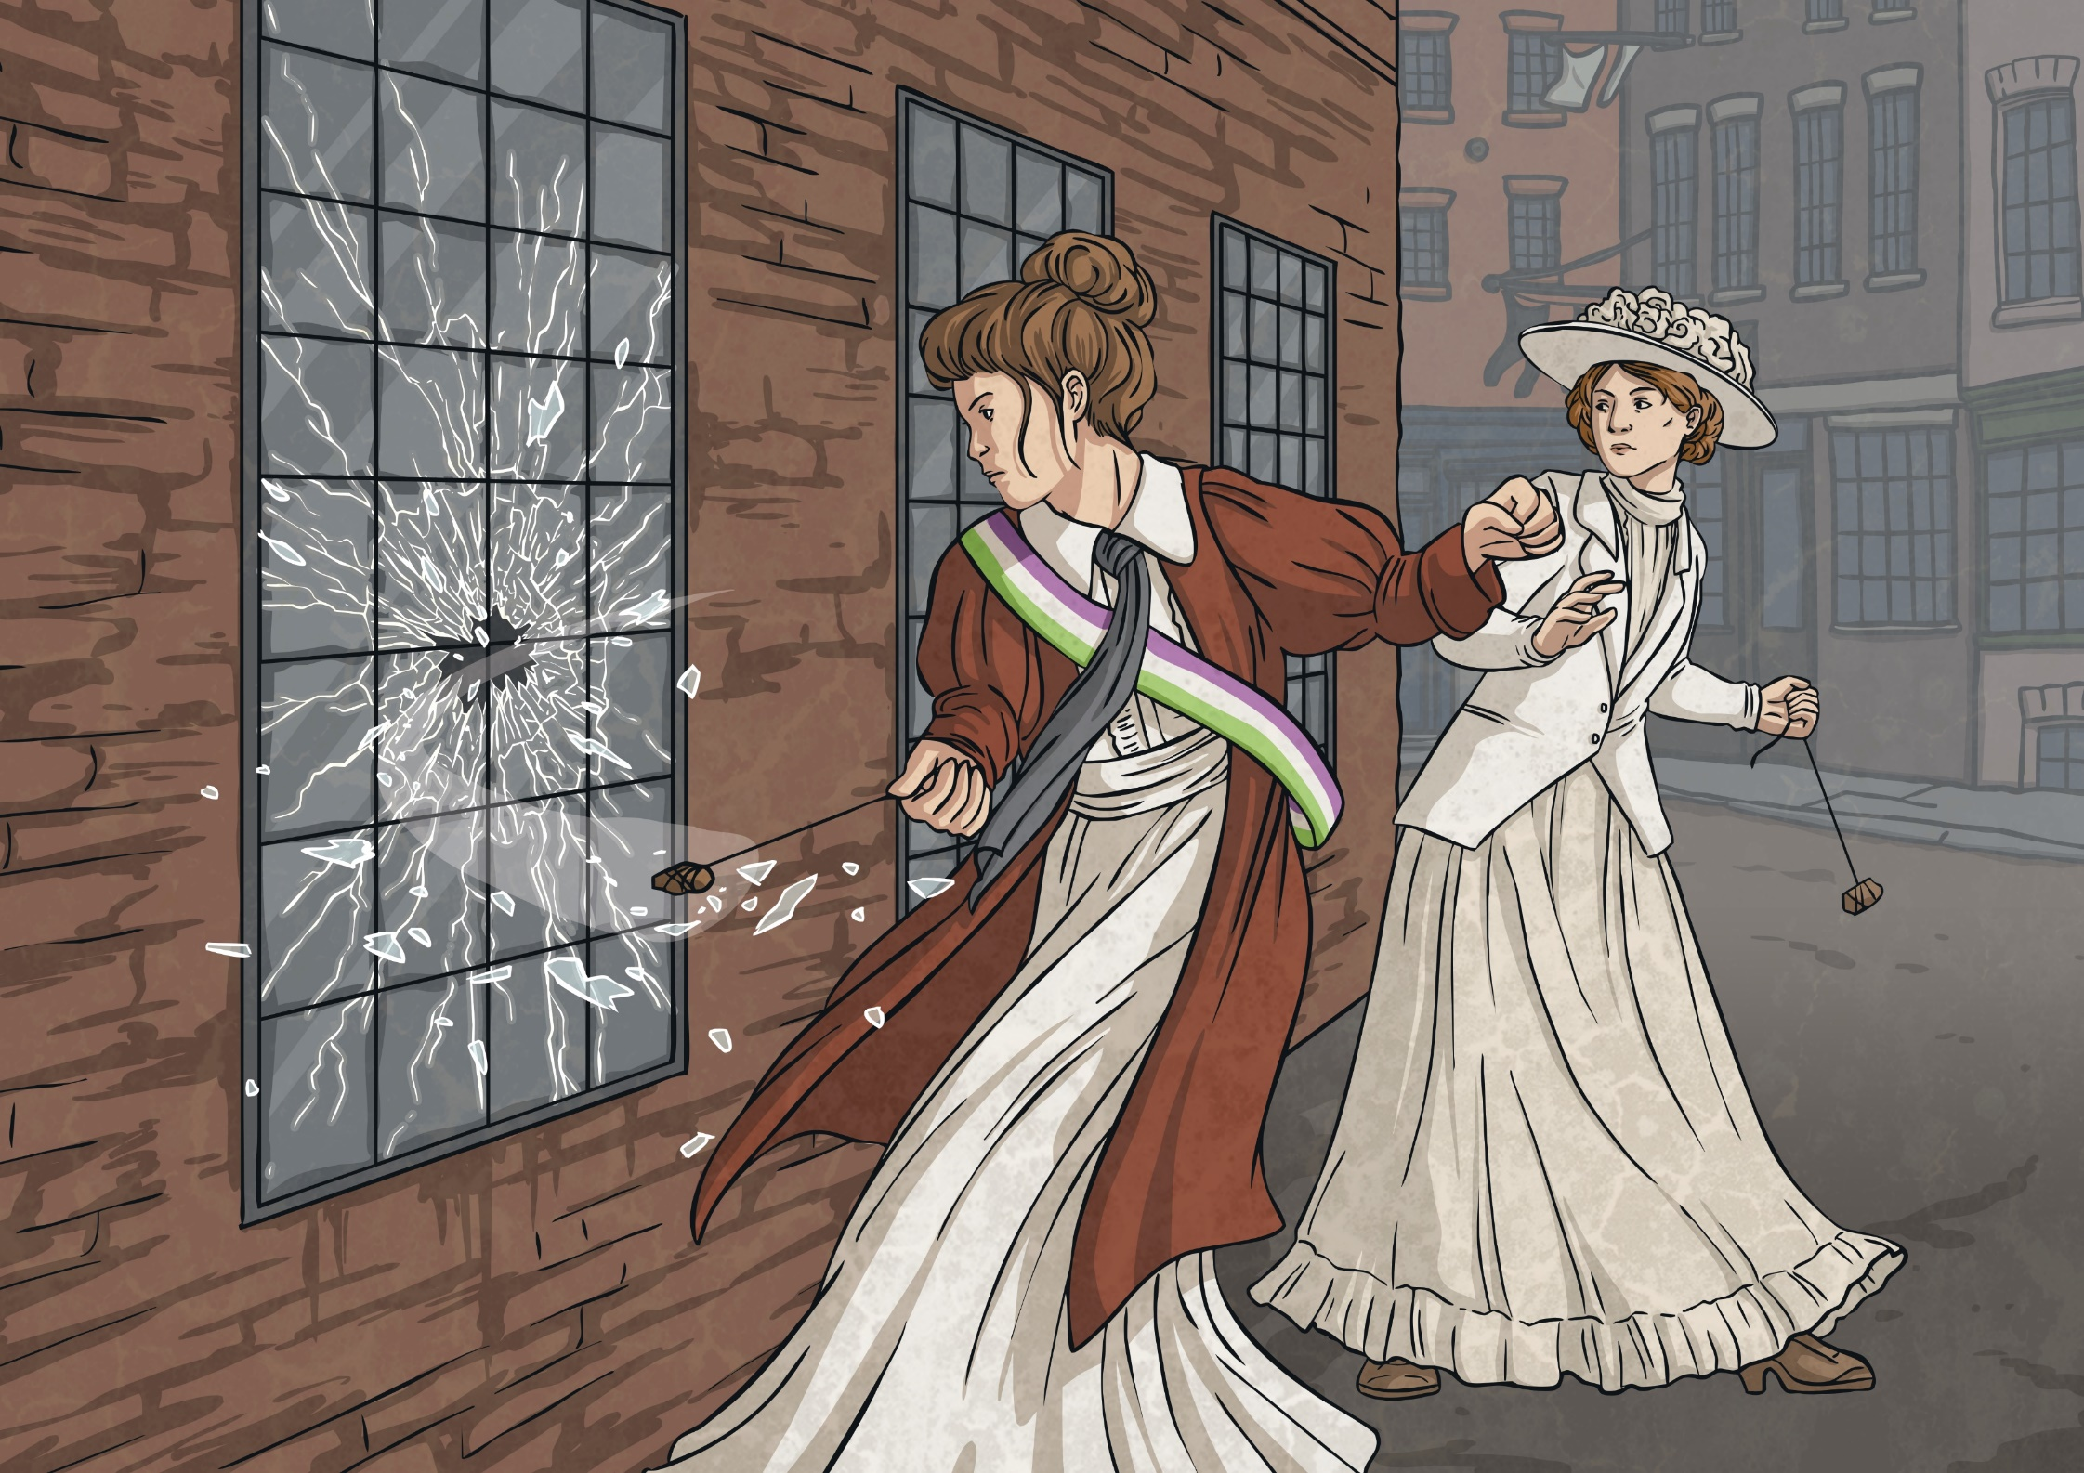

Slide 6
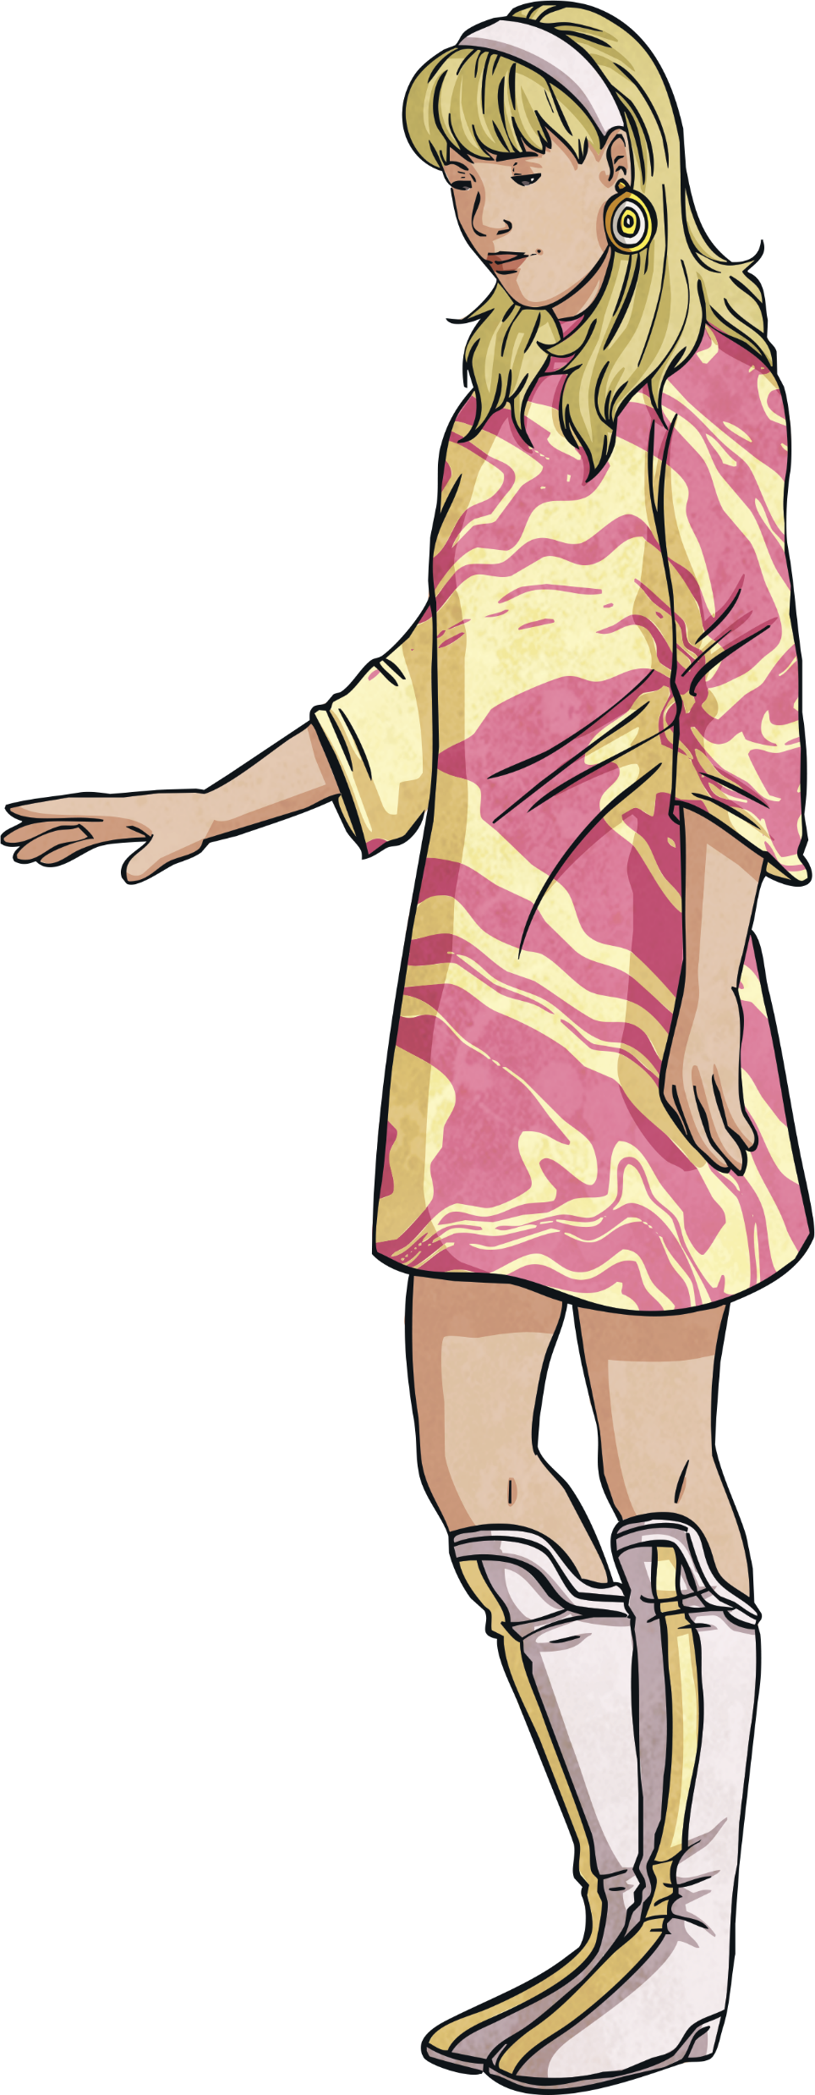
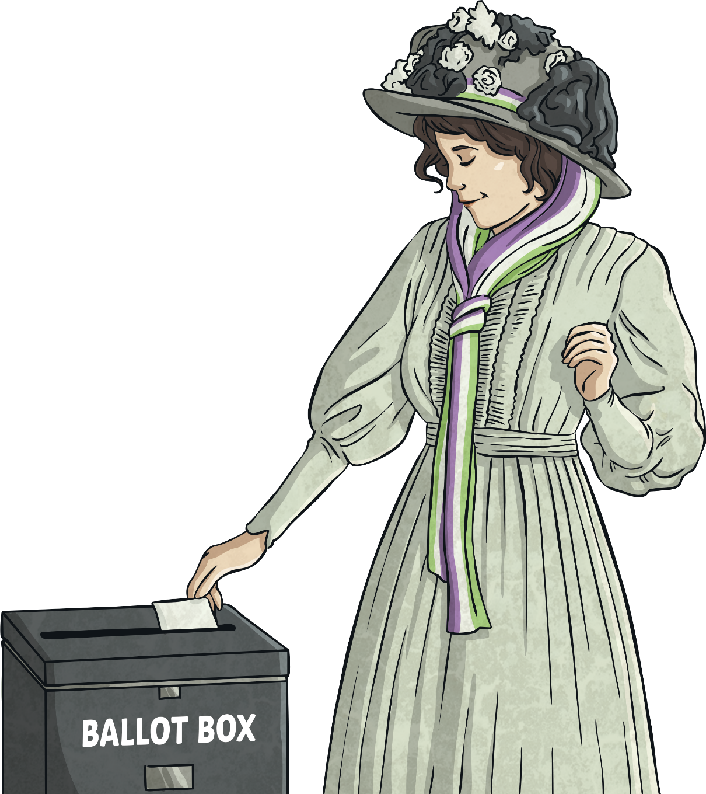
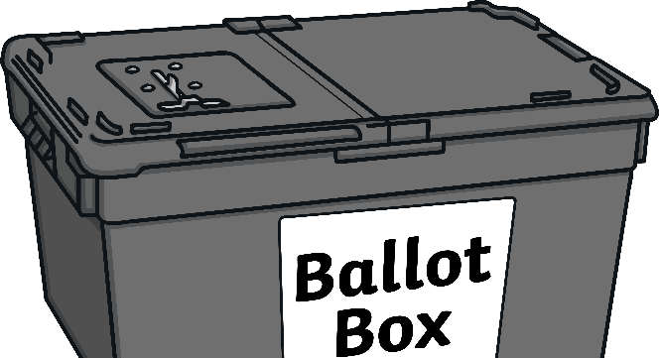
Rights for Women
Can you complete the worksheet? Can you write on one side of the table what women were not allowed to do and on the other side write down all the things women can do today?

