Slide 1
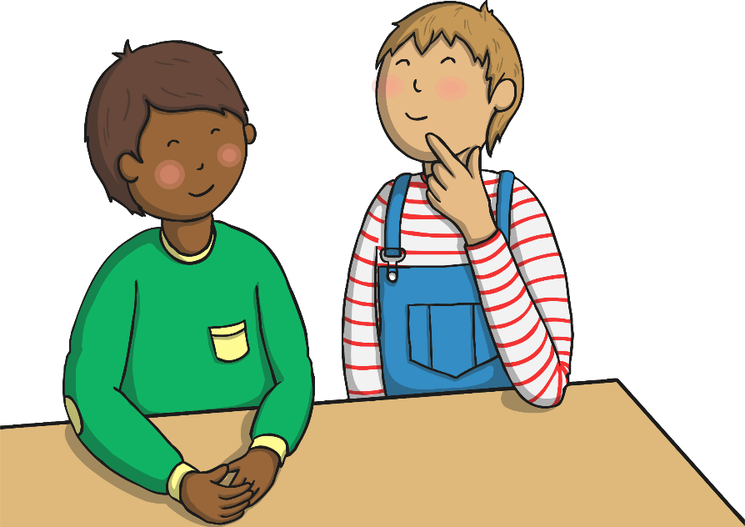
Homophones
These words all sound the same, but they are spelt differently, and have different meanings.
to
too
two

Slide 2

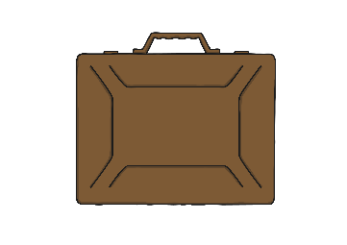
to
‘to’ is a preposition when it comes before a noun.
The children are going to the shop.
They went to London.
I need to go to work today.
I’m going to tidy the house tomorrow.
‘to’ has lots of meanings, but if ‘too’ and ‘two’ don’t make sense, you probably need to use ‘to’!

Slide 3
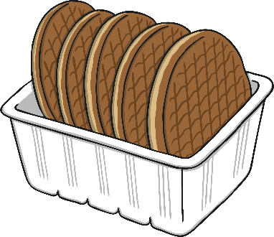
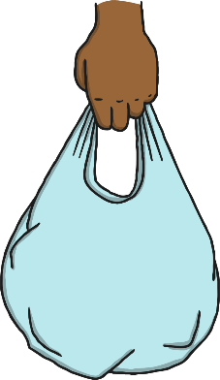
too
‘too’ can mean ‘as well’ and ‘also’.
May I come shopping too?
I like cakes, but I like biscuits too.
‘too’ can also be used to show excess.
I have eaten too much food.
The bag was too heavy.

Slide 4
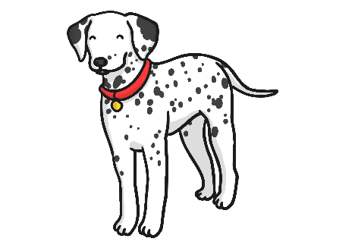
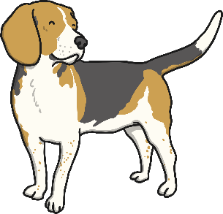
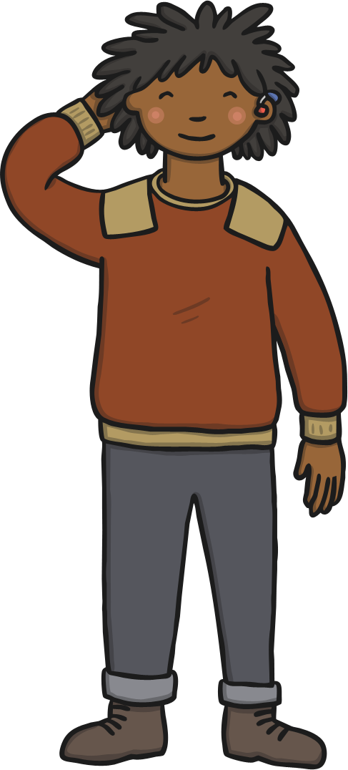

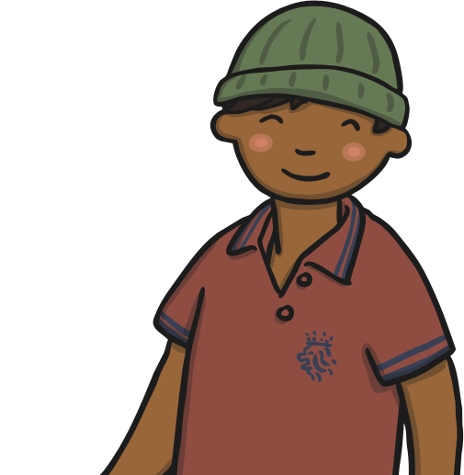
two
‘two’ means the number ‘2’.
There are two dogs running in the park.
I have two brothers and one sister.

Slide 5
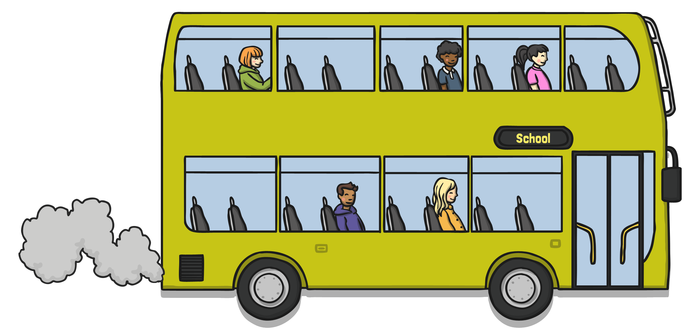
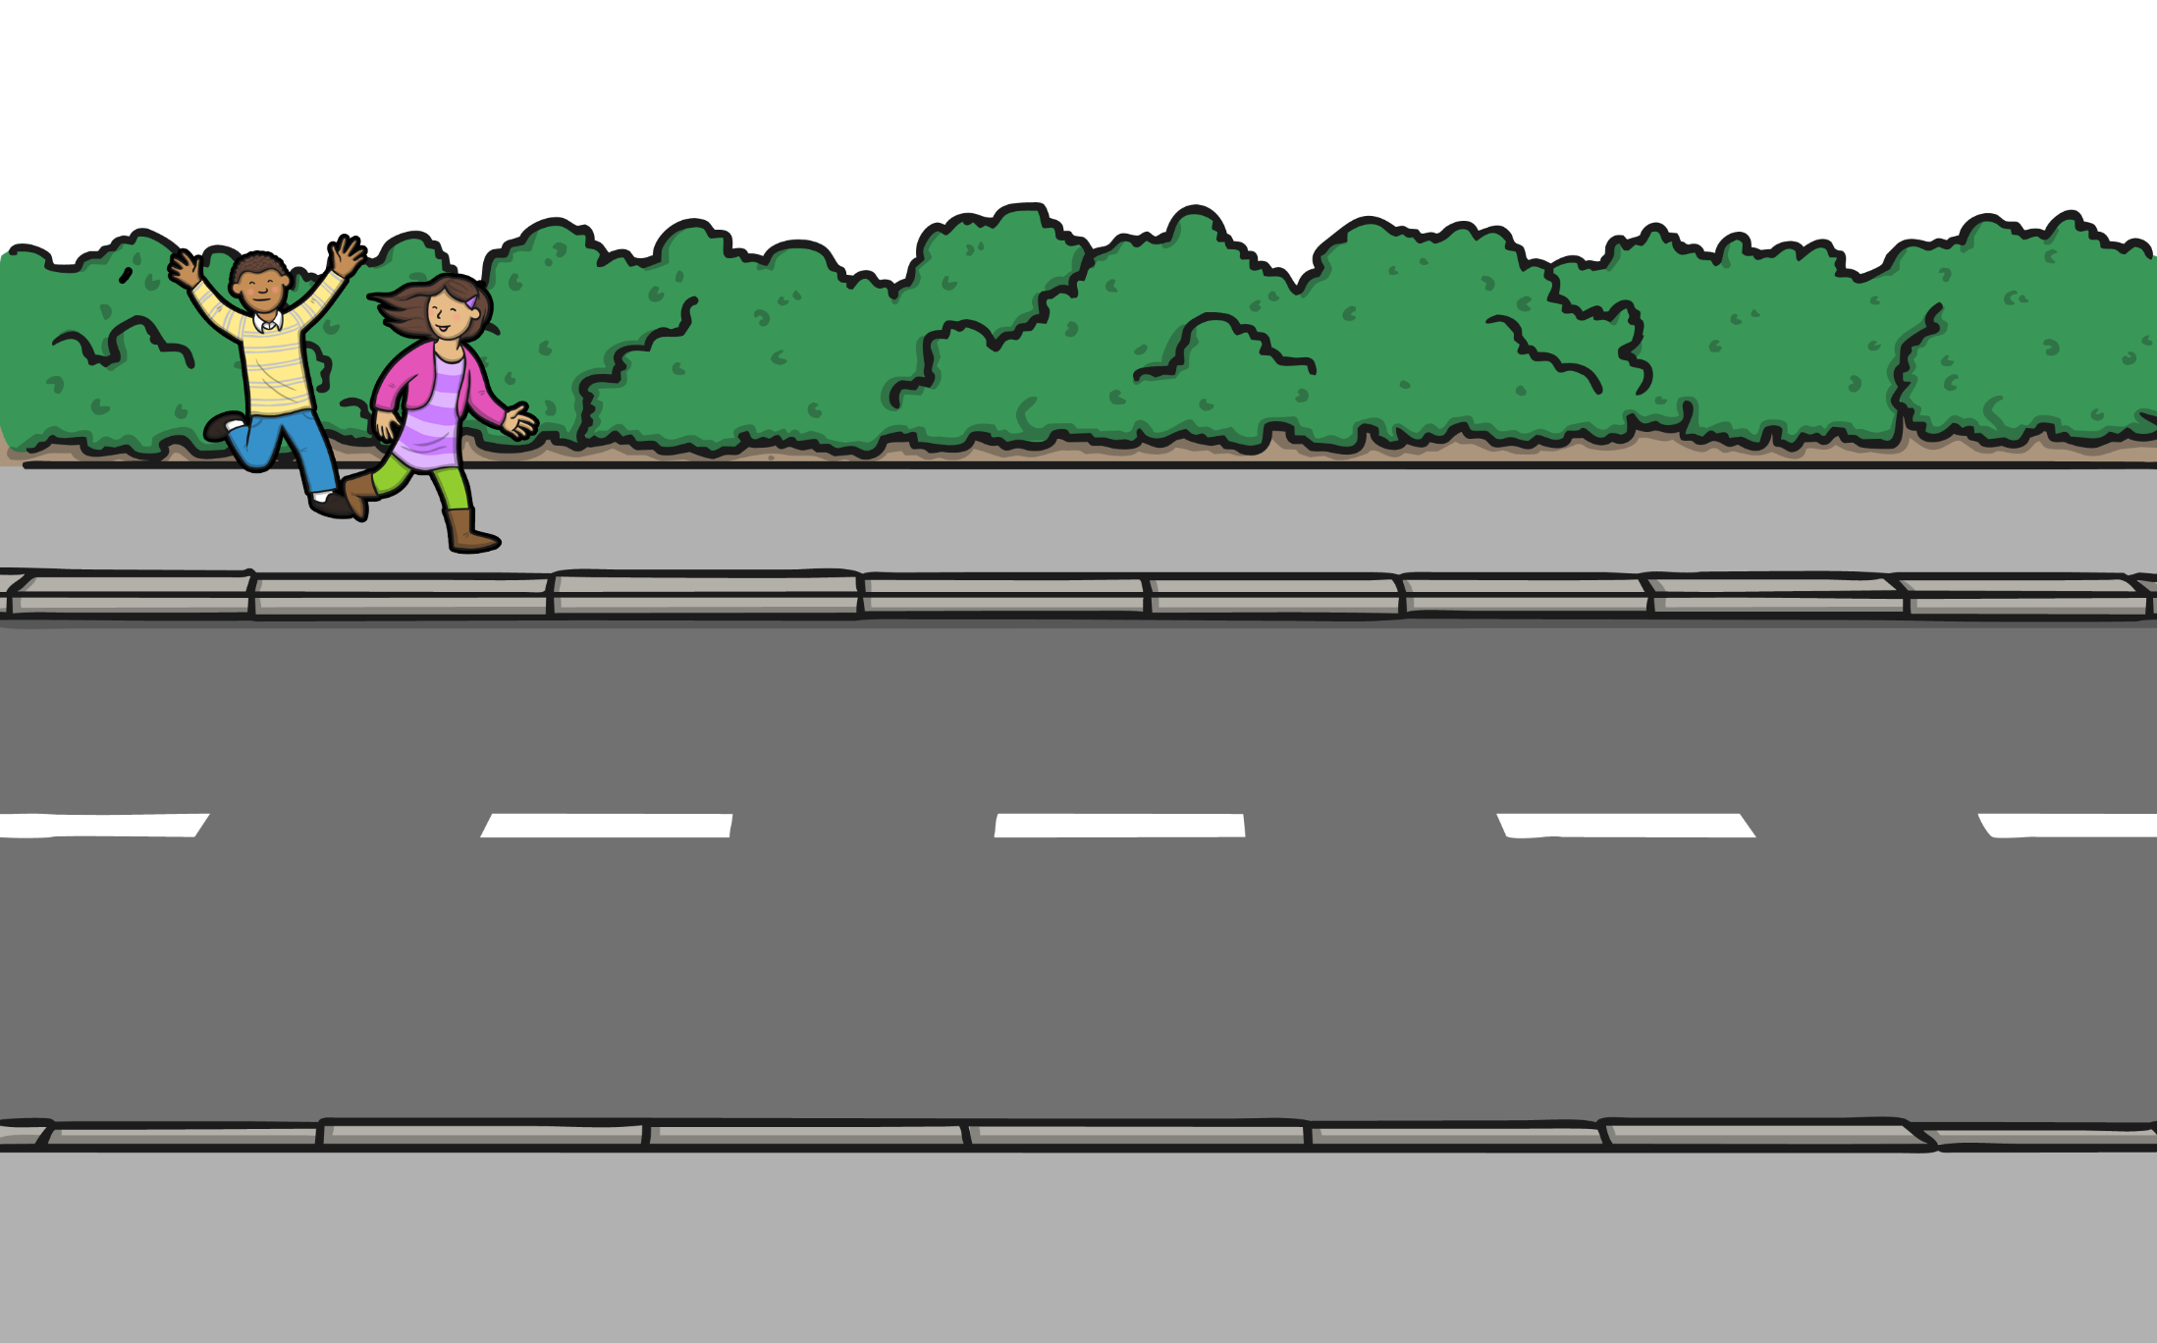
to, too and two
Two children wanted to catch the bus to school, but they were too late.

Slide 6
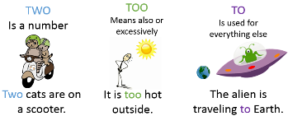

Slide 7

Homophones
These words all sound the same, but they are spelt differently, and have different meanings.
there
their
they’re

Slide 8
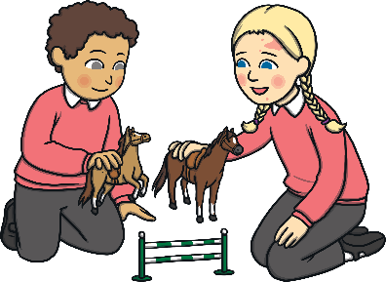
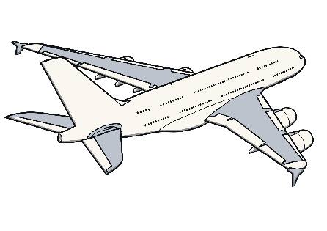
there
‘there’ refers to a place or position.
The children are playing over there.
There is an aeroplane in the sky.

Slide 9
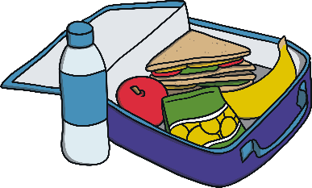
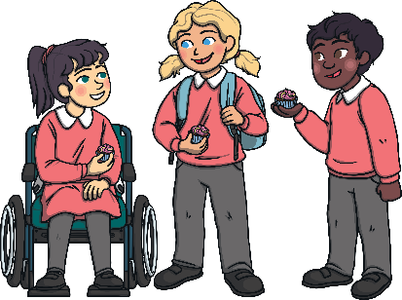
their
‘their’ is a possessive adjective. This means it shows ownership
or belonging.
Their lunch was very tasty.
The children are wearing their school uniform.

Slide 10
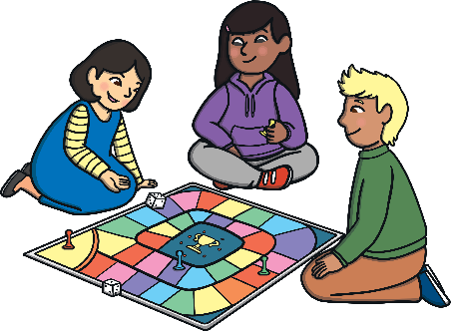
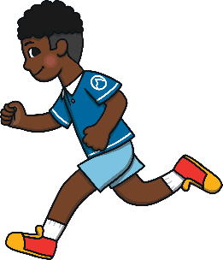
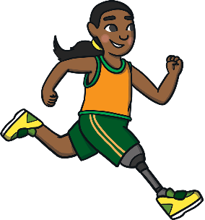
They’re
‘they’re’ is a contraction. This means it is a shorter way of saying
‘they are’.
They’re playing a game together.
They’re running around the track.

Slide 11
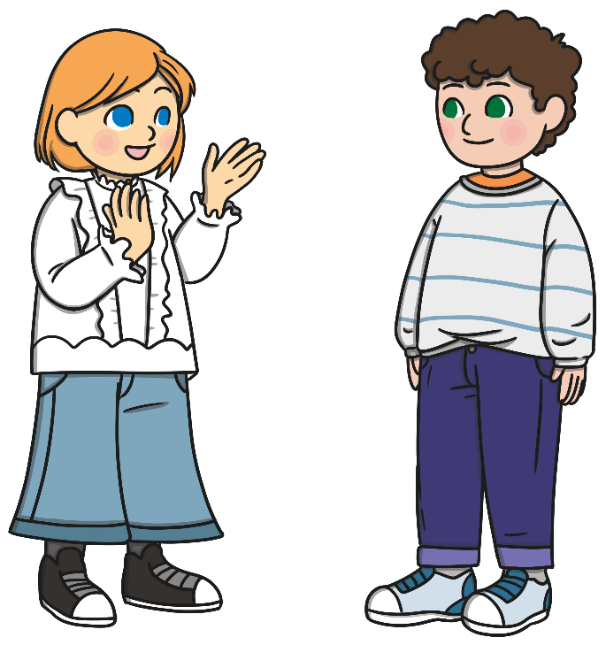
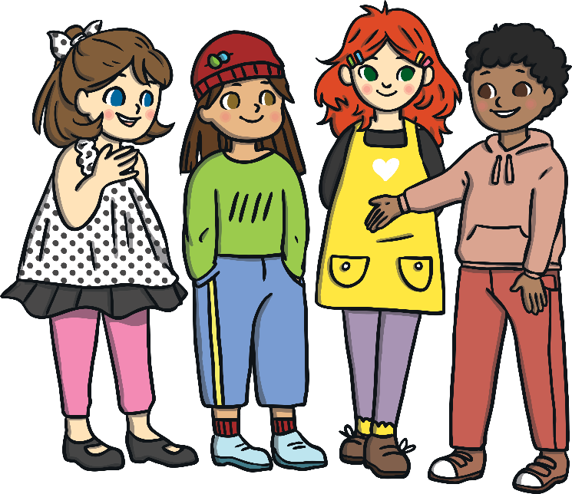
there, their and they’re
They’re all talking to their friends over there.

Slide 12
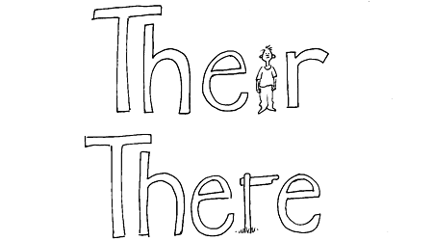

Slide 13
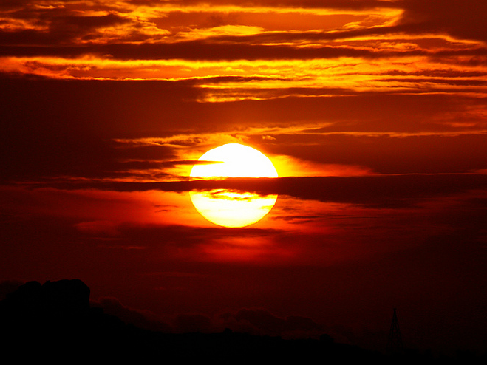
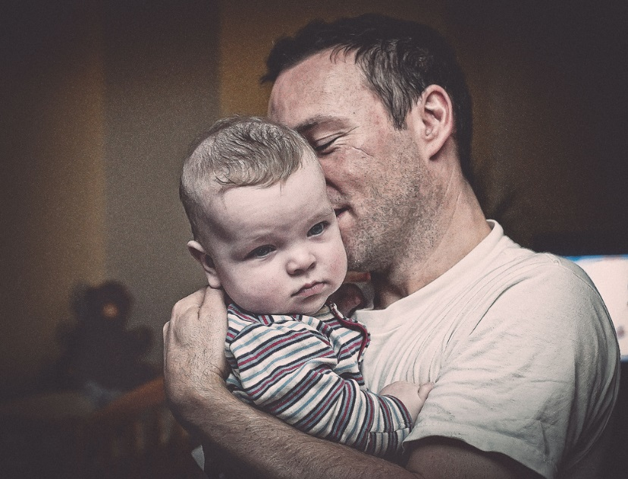
Can you work out the homophones from the following clues?
A boy around whom the planets revolve
sun
son
Photo courtesy of VinothChandar and Lies Thru a Lens @flickr.com) - granted under creative commons licence - attribution

Slide 14
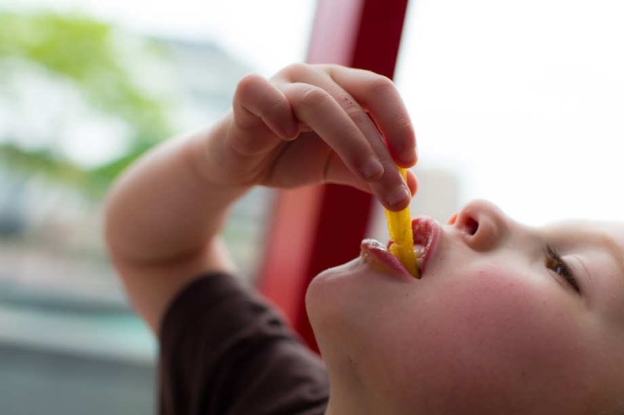
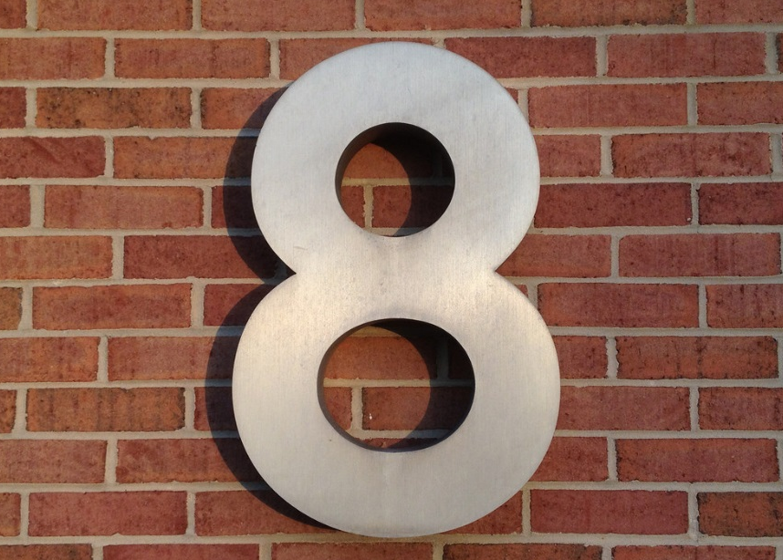
Can you work out the homophones from the following clues?
Swallow a number
ate
eight
Photo courtesy of Michael Bentley and woodleywonderworks @flickr.com) - granted under creative commons licence - attribution

Slide 15
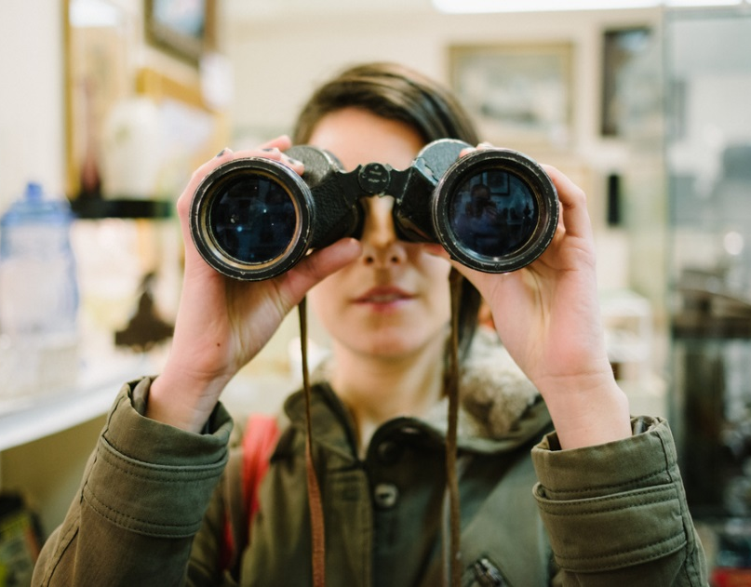
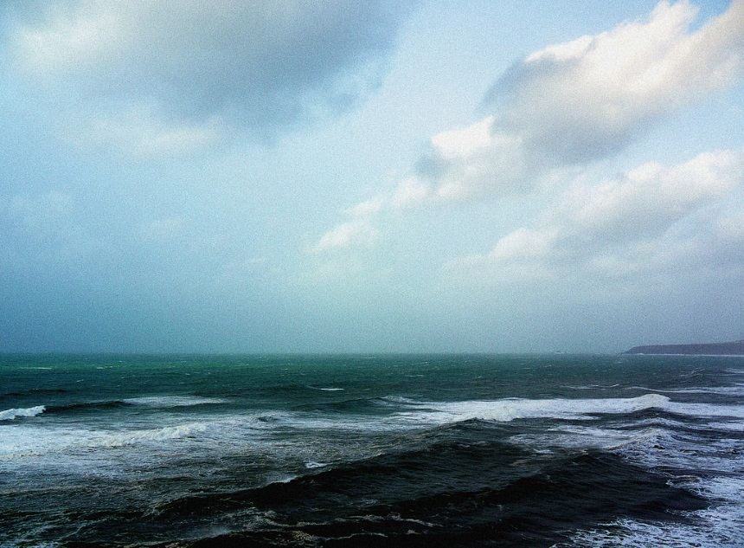
Can you work out the homophones from the following clues?
Look at the ocean
see
sea
Photo courtesy of chase_elliot and Martin Brigden @flickr.com) - granted under creative commons licence - attribution

