Slide 2
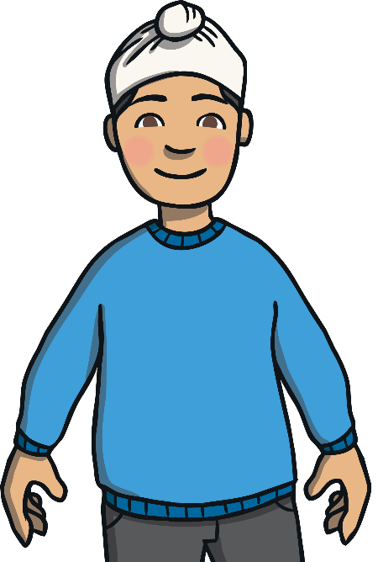
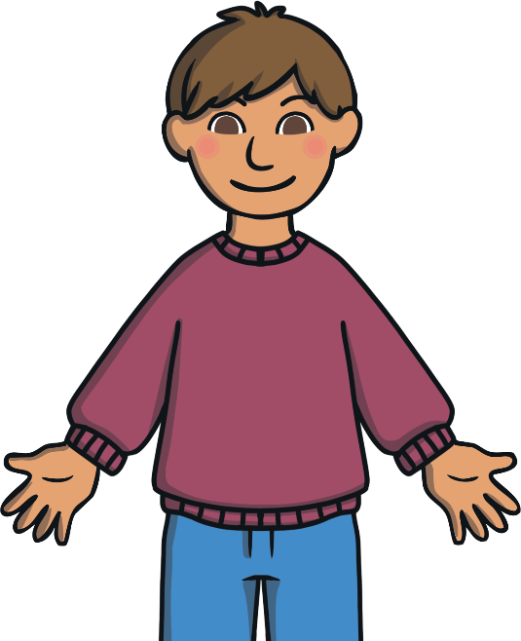
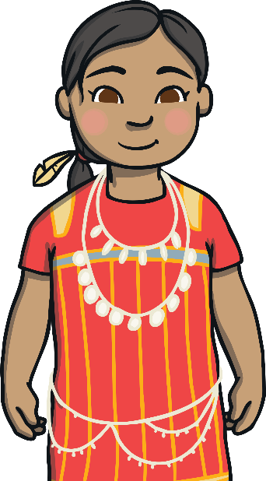
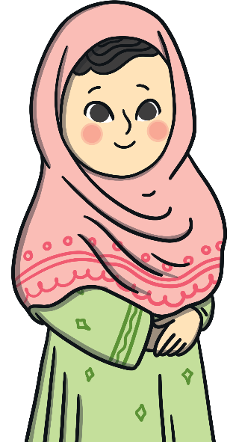
Different Beliefs
People have many different beliefs and gods that they worship.
They may have different clothes and pray in different
ways in different places but everyone is special!

Slide 3

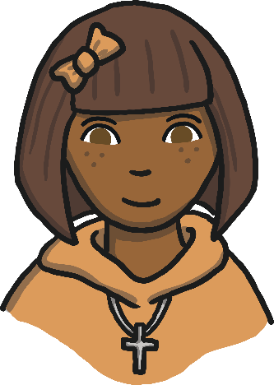
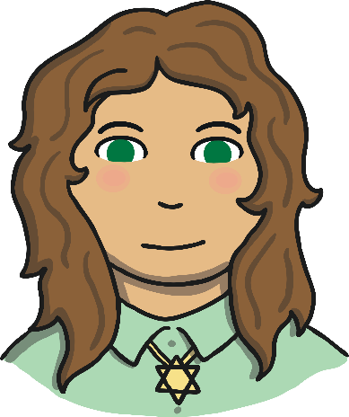
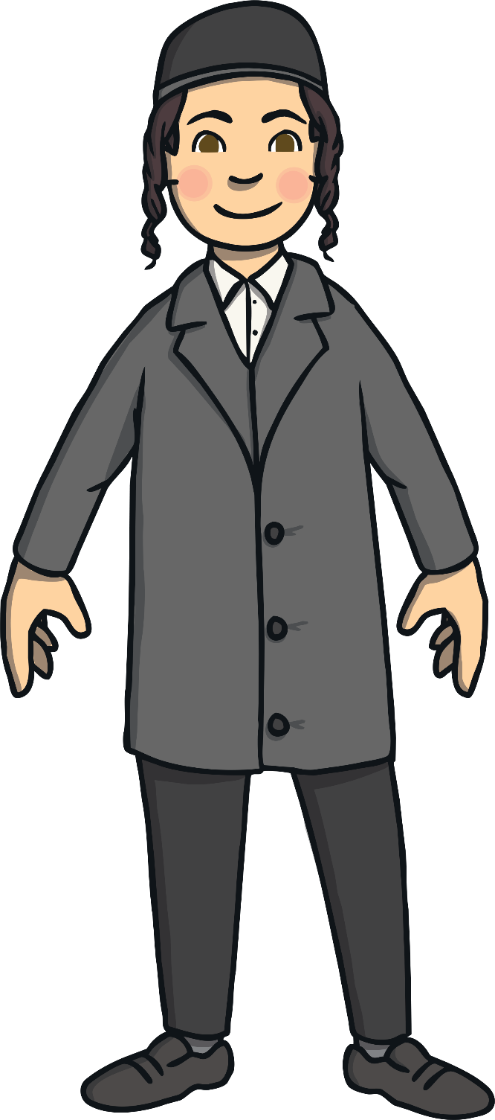
            Some Christian children like to wear a cross and chain.
Some Jewish children like to wear a Magen David (star of David).
Some Jewish boys wear a kippah.

Slide 4

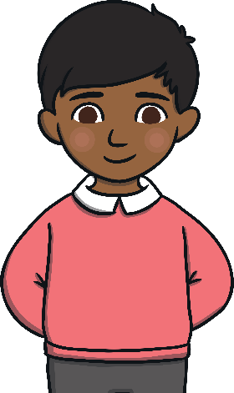
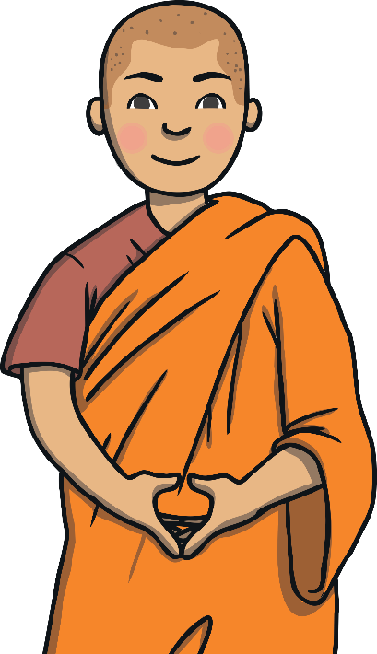
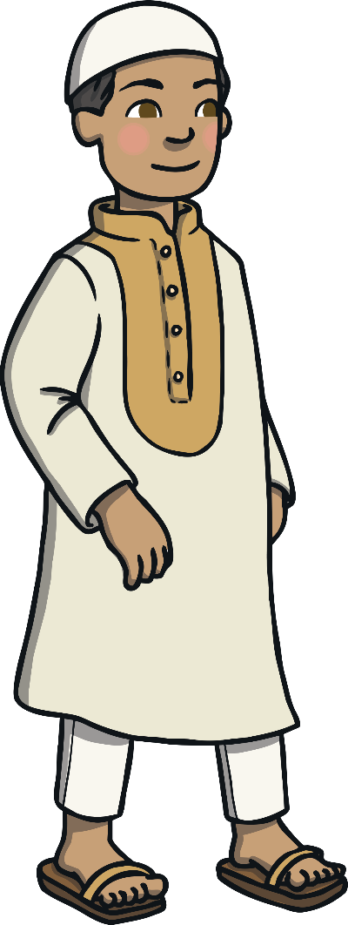
      Some Sikh boys like to have their hair short.
      Some Sikh boys wear a patka over their hair.
Some Muslim Boys like to wear a topi on their head.
Some Buddhist boys like to have their head shaven.

Slide 5
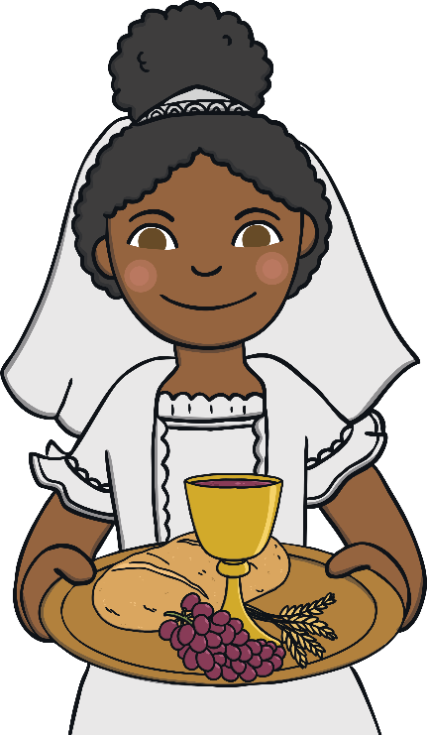

Sometimes, you can see things in different
religions which are quite similar to others.
A Christian girl may wear a headdress to their first communion which covers their hair.
A Muslim girl may wear a hijab which covers their hair also.

Slide 6
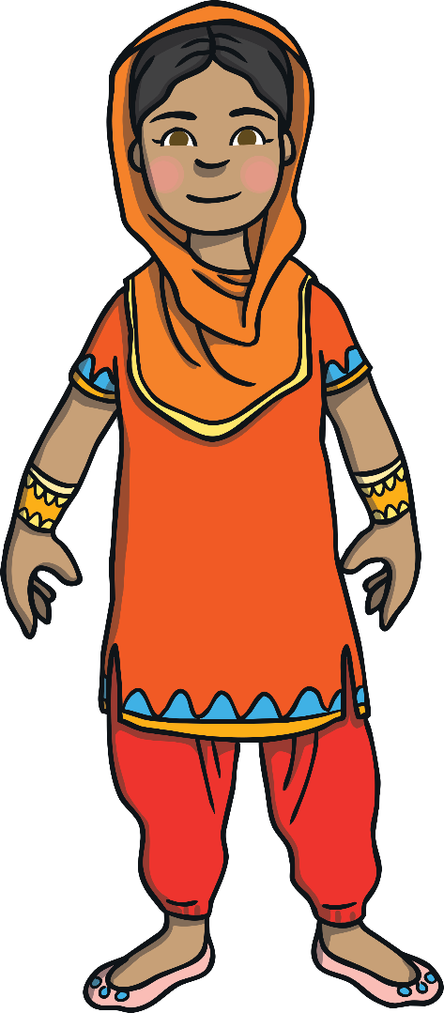
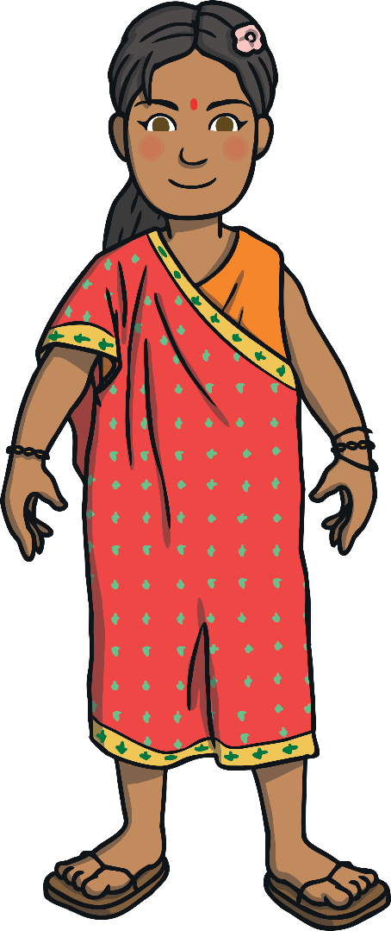
Some Sikh girls wear shalwar kameez.
Some Hindu
girls wear a sari.

Slide 7
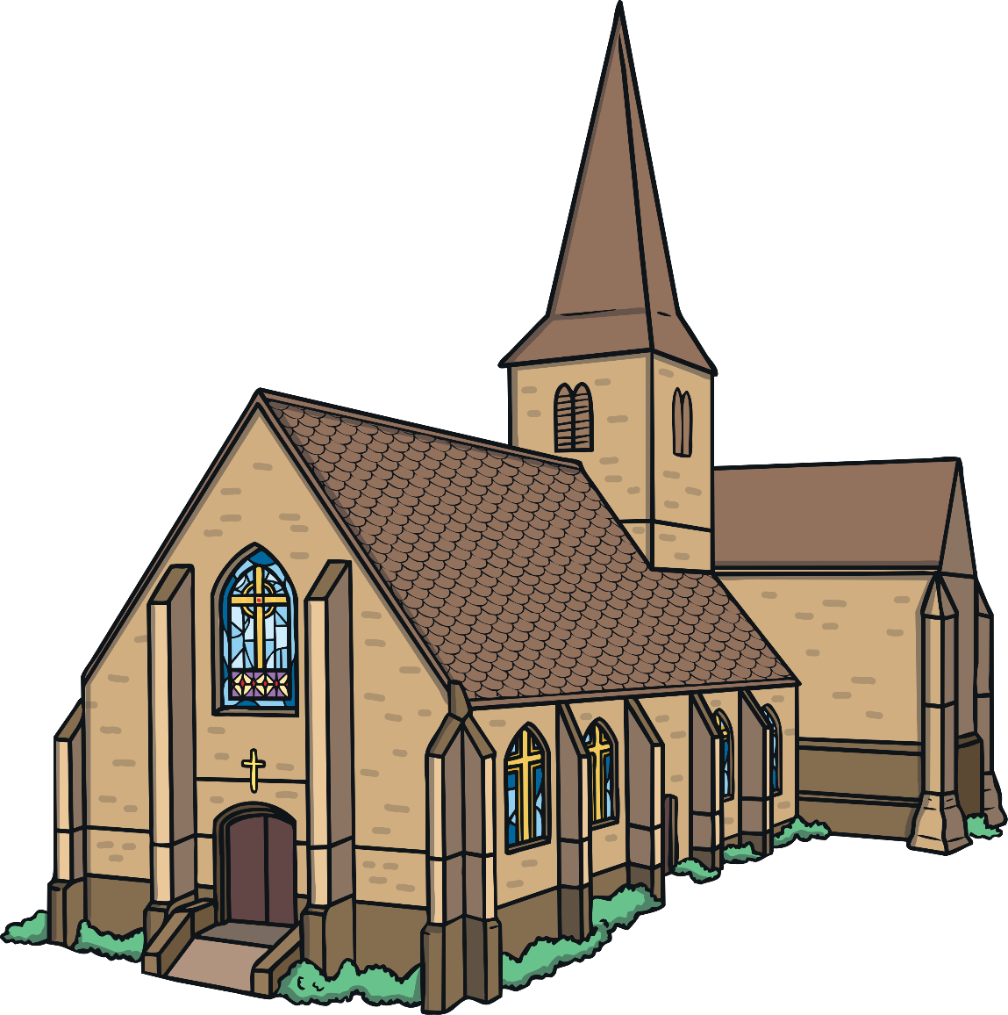
Christians worship in a church.

Slide 8
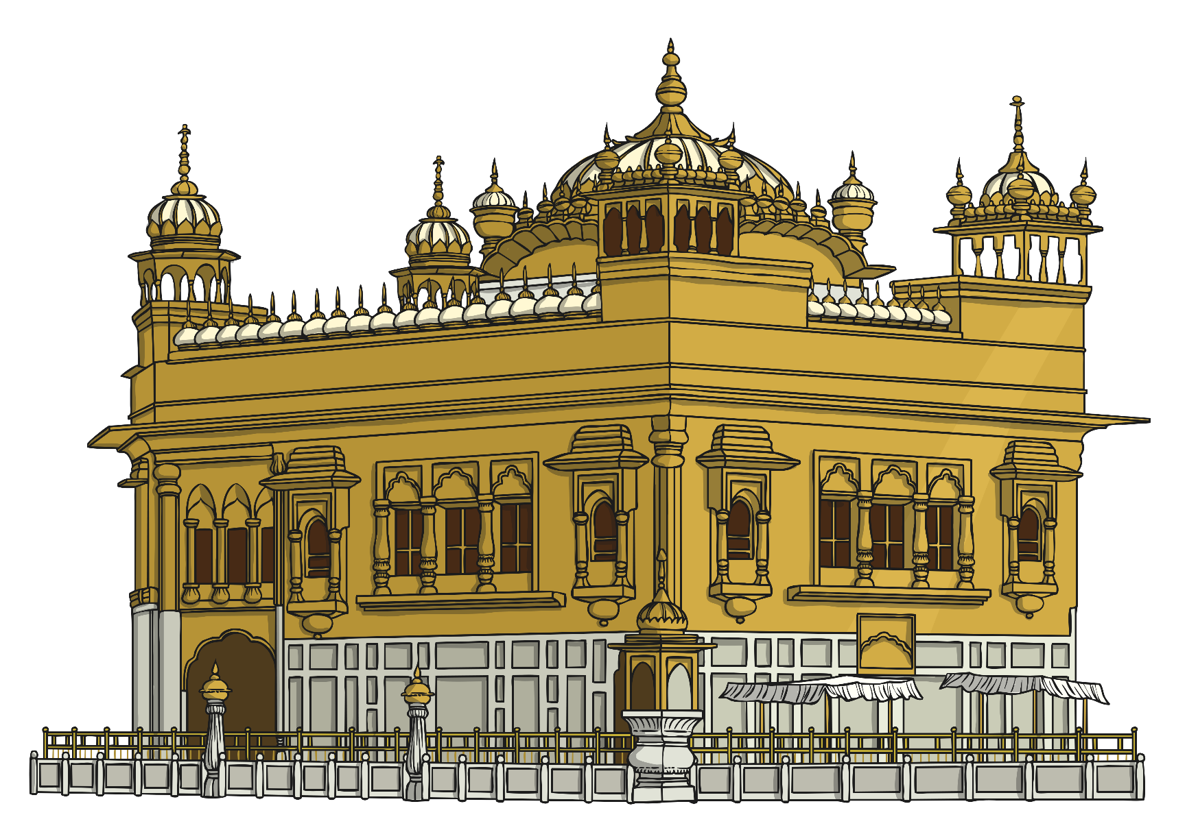
Sikhs worship at a gurdwara.

Slide 9
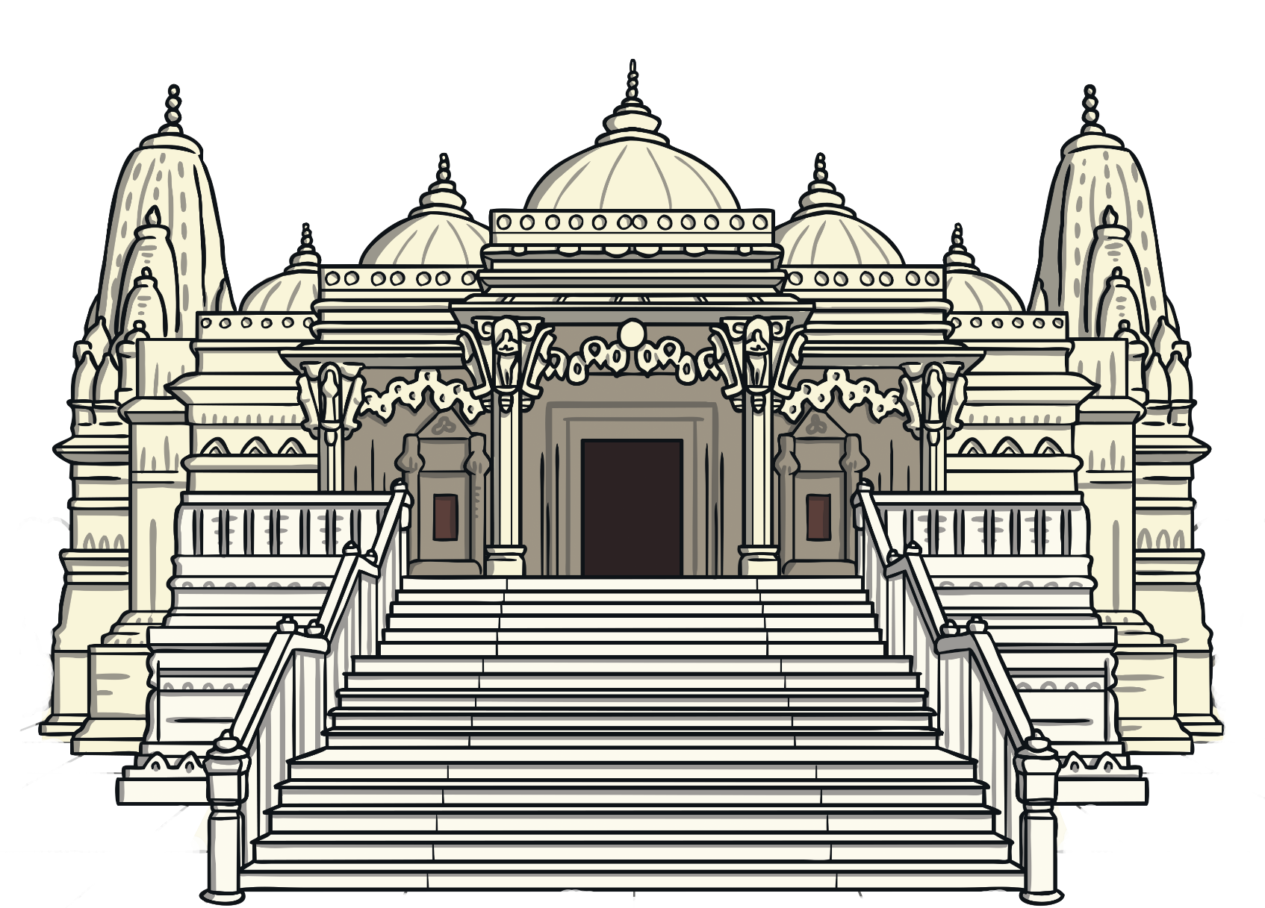
Hindus worship in a mandir.

Slide 10
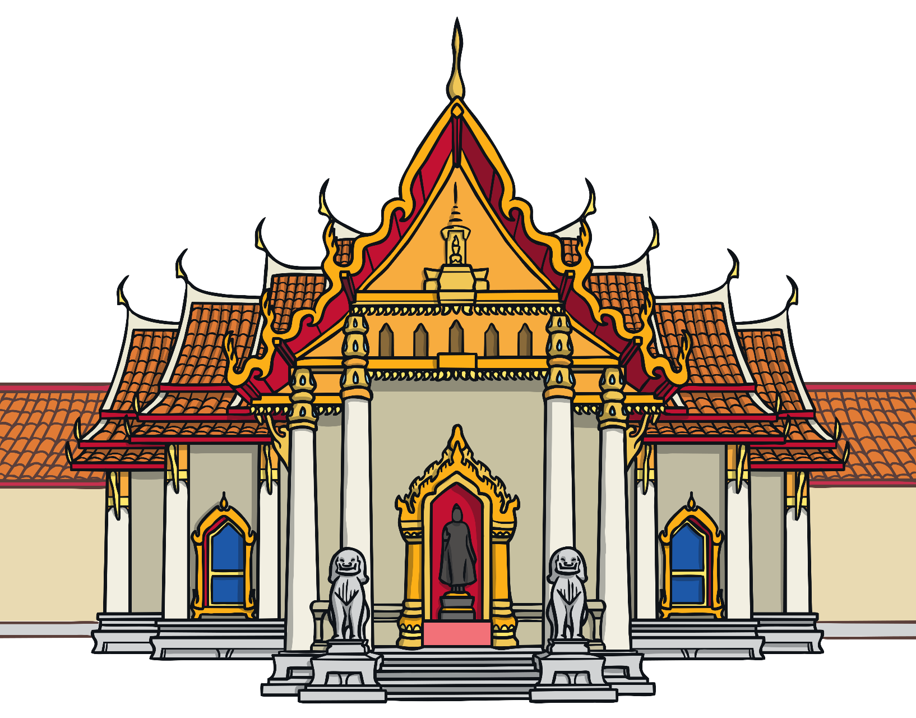
Buddhists worship in a wat.

Slide 11
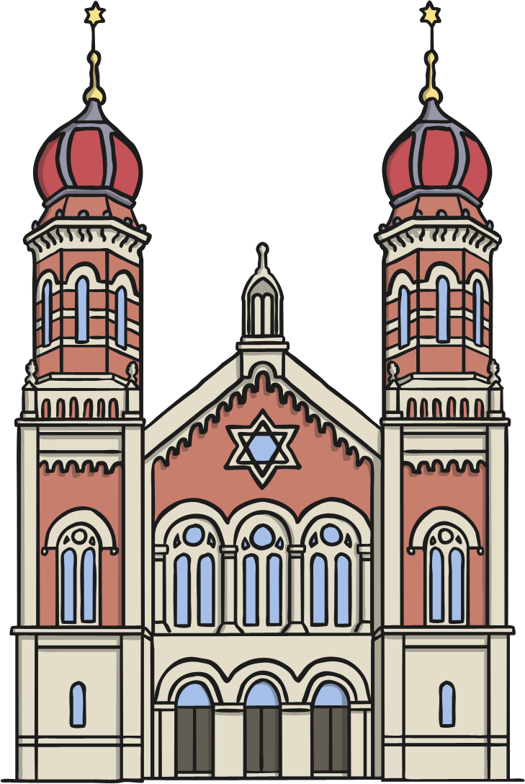
Jews worship in a synagogue.

Slide 12
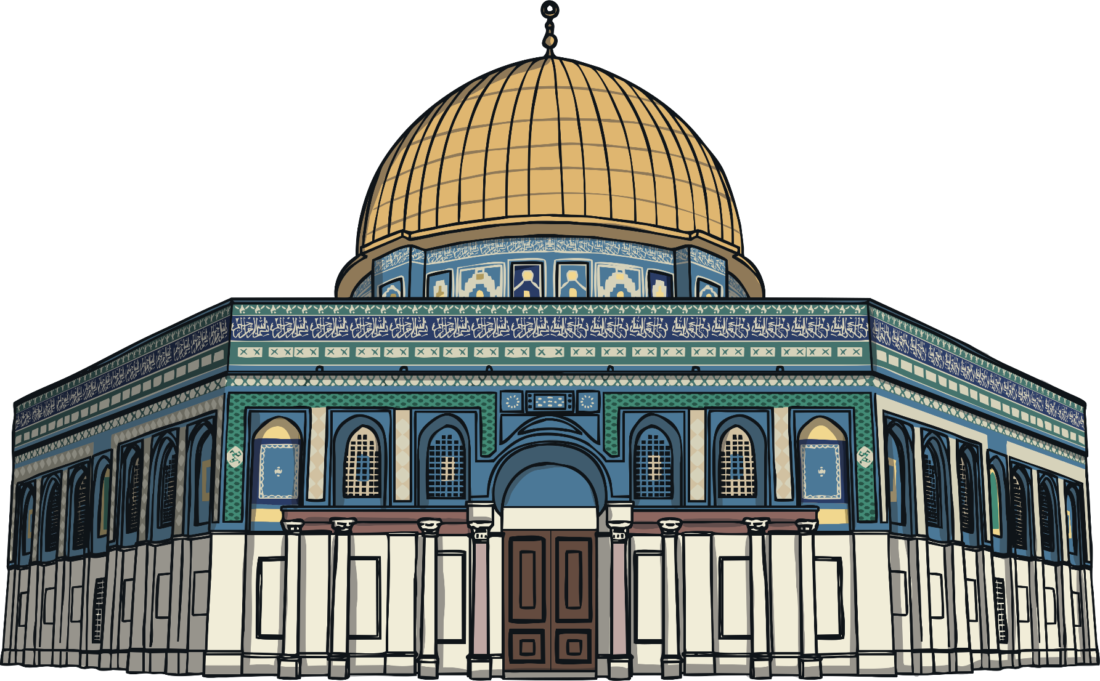
Muslims worship in a mosque.

Slide 13
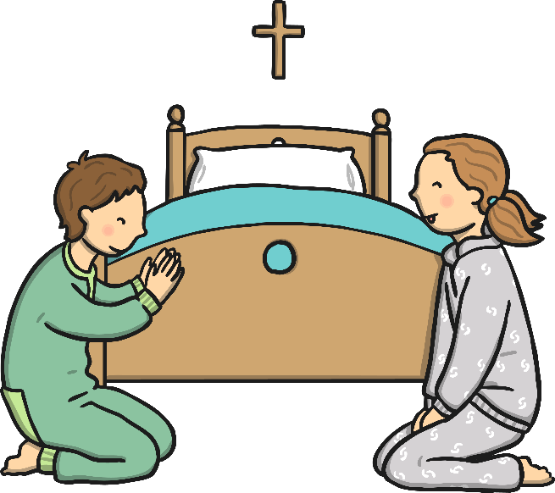
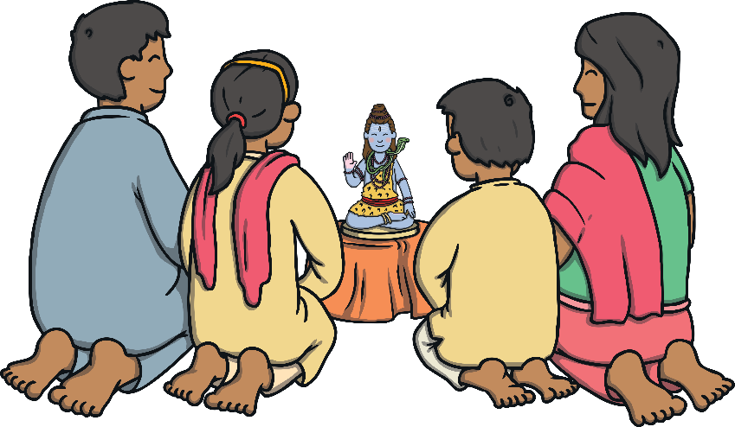
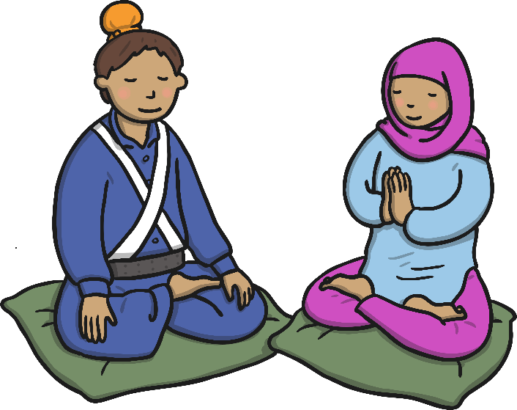
In a Hindu home, many girls help their mothers set up the family shrine each morning.
In a Christian home, some children will say prayers before they go to bed.
In a Sikh
home, children usually say prayers in the mornings and evenings.

Slide 14
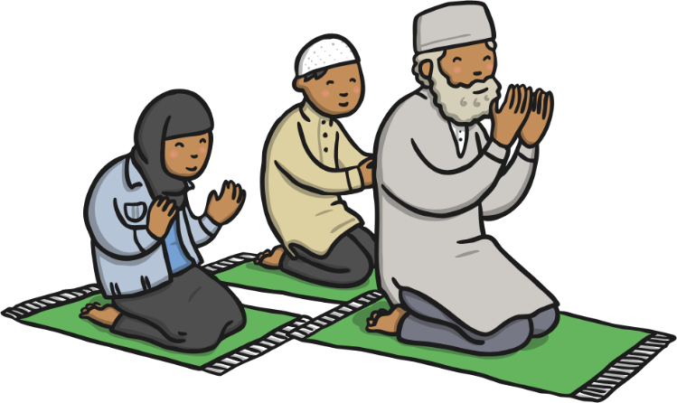
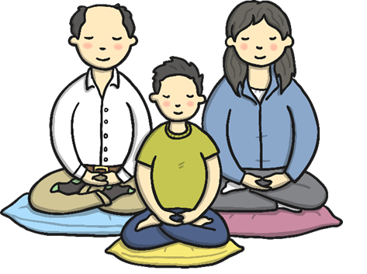
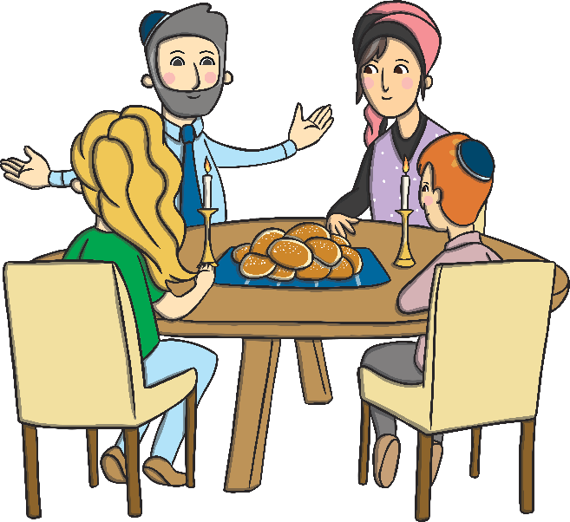
In a Buddhist home, the family may meditate in silence.
In a Muslim home, it is usually the Father that leads the family prayers every morning and evening.
In a Jewish home, a family meal is
usually eaten every Friday evening
and the father blesses his children.

Slide 15
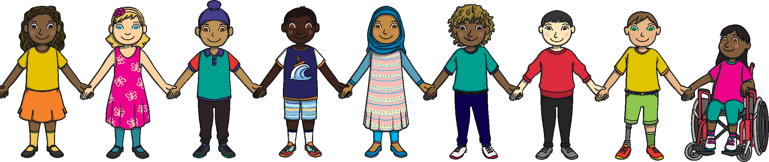
Be lovely to everyone,
no matter what they believe in.

