Slide 2
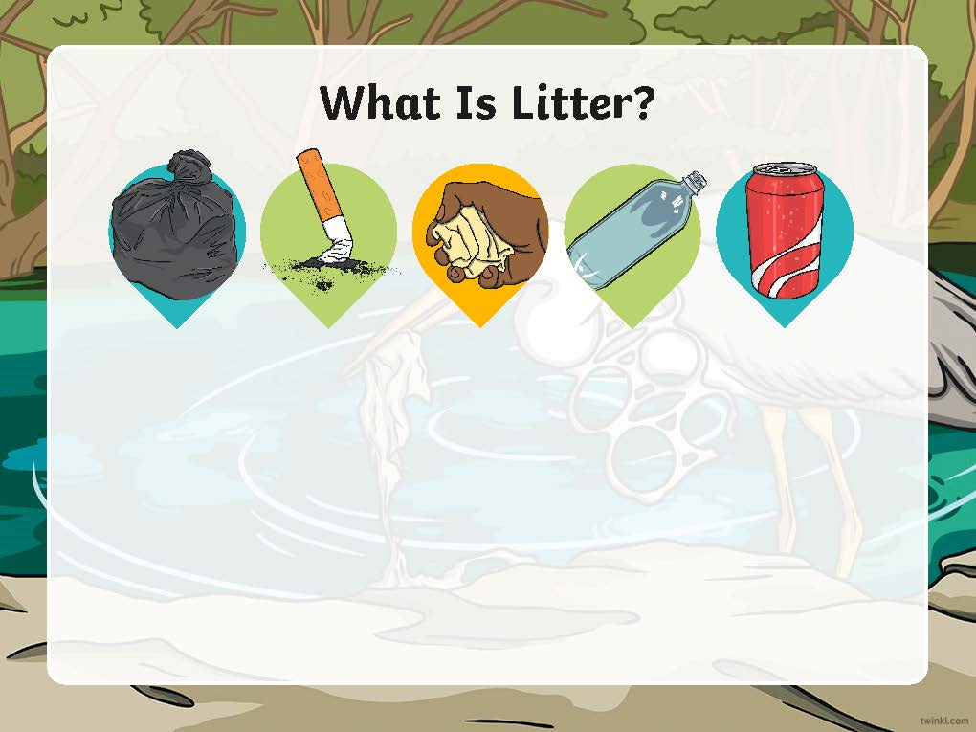
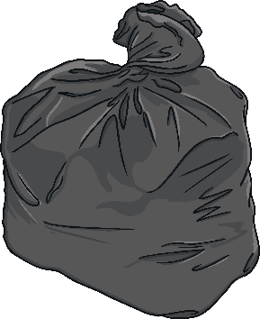
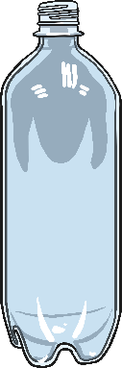

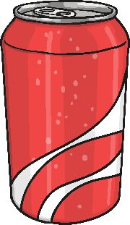
What Is Litter/Rubbish?
Litter, or rubbish, are items like used plastic, paper, cans and bottles that are left behind by people.
Litter can be harmful to animals, the environment and people. It can cause heath risks, fires and endanger or kill wildlife.

Slide 3
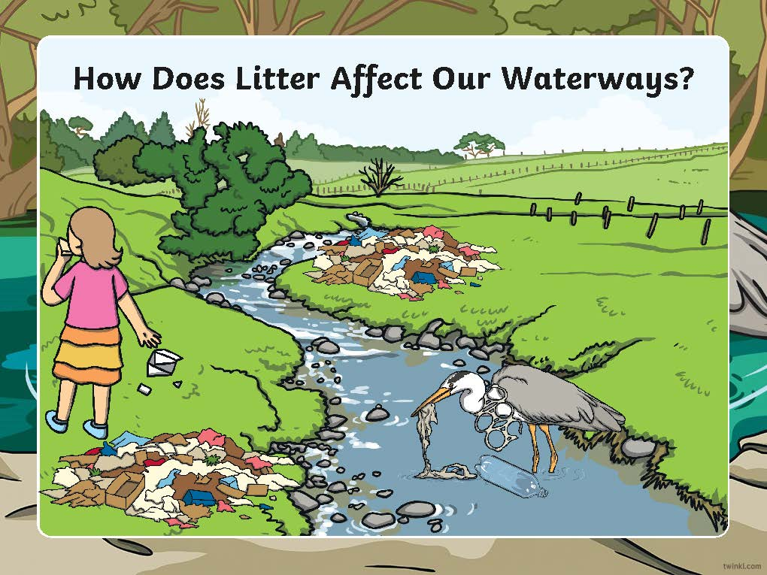
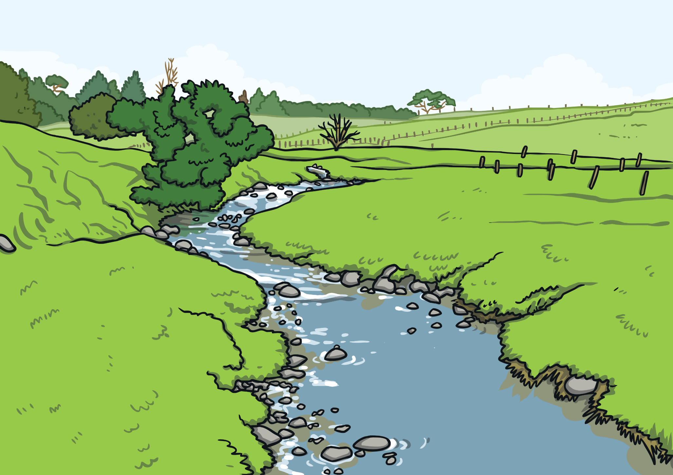
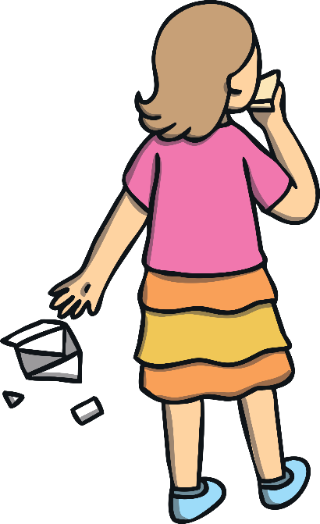
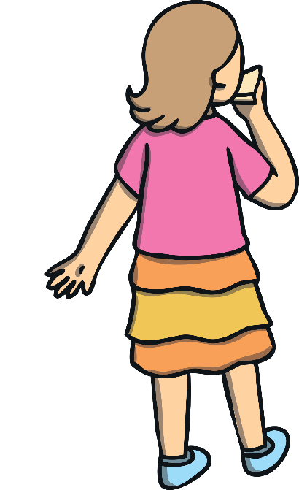
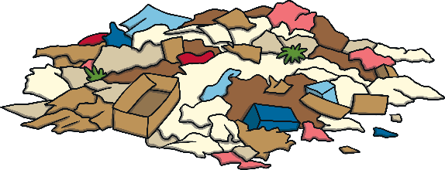

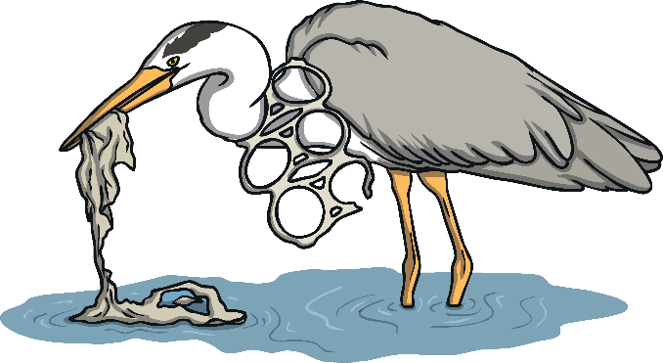



How Does Litter Affect Our Waterways?

Slide 4
How Does Litter Affect Our Waterways?
When litter is dropped on land, the wind and rain carry it into our stormwater drains. It ends up in our creeks, rivers and oceans.
It takes a long time to break down - if ever.
All too animals such as seabirds and mammals, including turtles and whales, think plastic/litter is food. This can make animals sick or can even kill them.

Slide 5
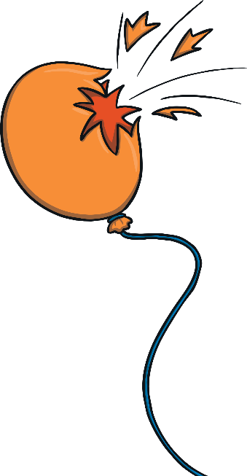
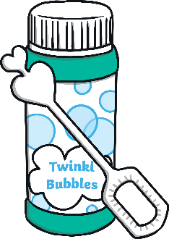
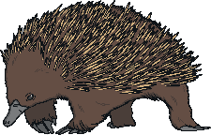

Where Can a Balloon End Up?
A balloon that goes up must come down. It can harm the environment and animal life.
Balloons are similar to plastic bags. They are often mistaken for food and swallowed, which can cause injury or death to animals.
A good alternative to balloons are bubbles!

Slide 6
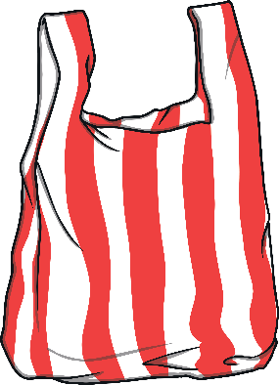
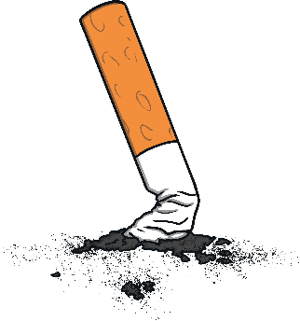

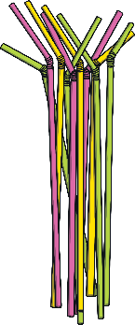
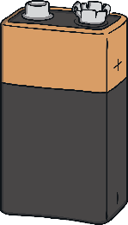
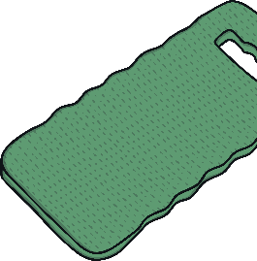
The Time It Takes for Litter to Breakdown
Cigarette butts
Plastic bags
Chewing gum
Plastic straws
2-5 years
10-30 years
20-25 years
50 years
Batteries
Aluminium cans
Styrofoam
100 years
200 years
500 years

Slide 7

What Can We Do?
Always put litter in a bin and recycle where possible.
Make sure litter can’t blow away.
When you are at the beach, river or park, make sure you take all your litter home with you to put it in the general waste, recycling and green waste bins.
If possible, pack a litter free meal or picnic.
If you see litter (even if its not yours) do the right thing and bin it (wash your hands afterwards). Help reduce the amount of litter that gets washed into our rivers and oceans.
Use bubbles instead of balloons and paper straws instead of plastic straws.
If you see an injured bird, fish or mammal, report it to your local ranger or the RSPCA.

