Slide 2
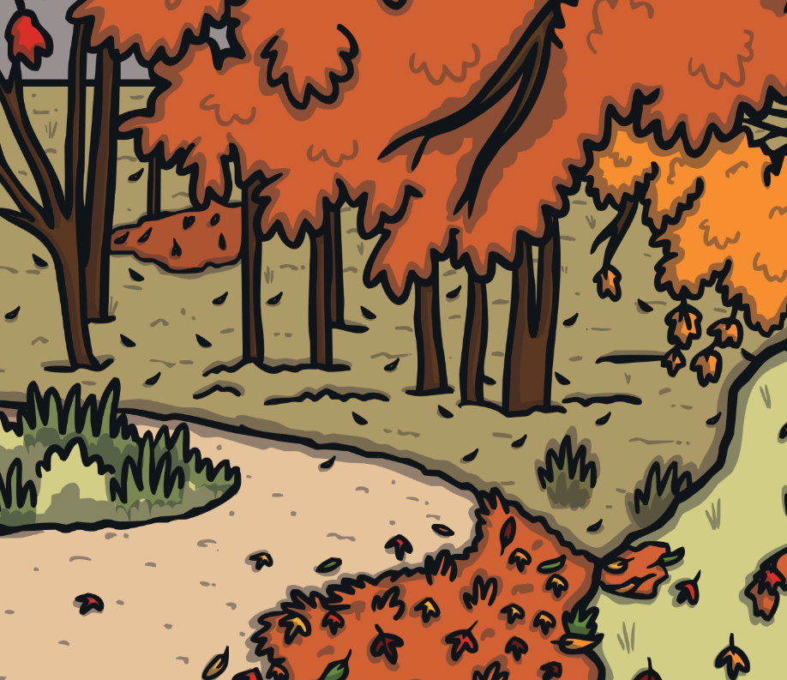
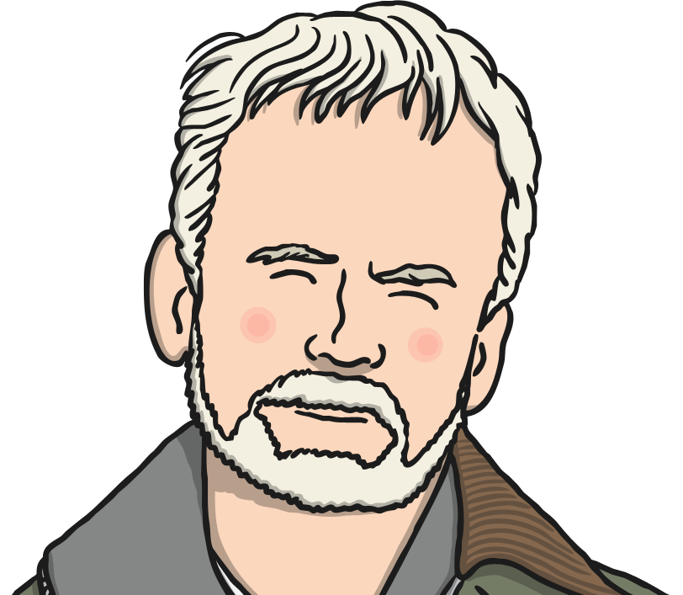
Who Is Andy Goldsworthy?
Andy Goldsworthy is a British artist, known for his sculptures and photography.

Slide 3
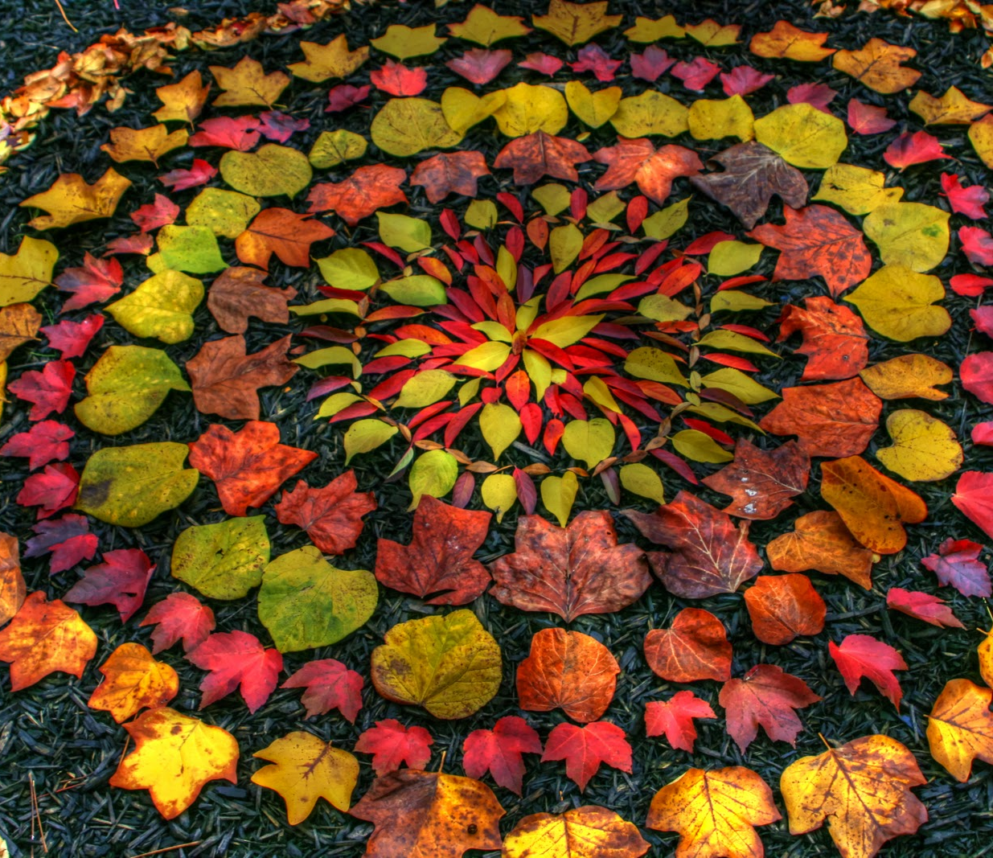
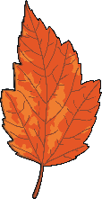
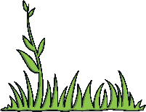
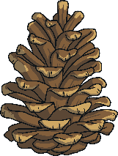
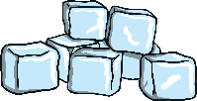
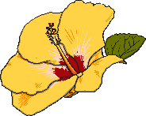
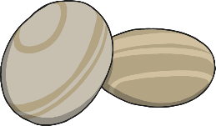
Land Art
Andy makes land art sculptures with natural materials on sites in the UK and around the world.
Which natural materials can
you think of that he could use
to make sculptures?
leaves
twigs
pebbles
rocks
ice
flowers
grass
pine cones
Did You Know?
Andy has even used human hair and cow dung in his work!

Slide 4
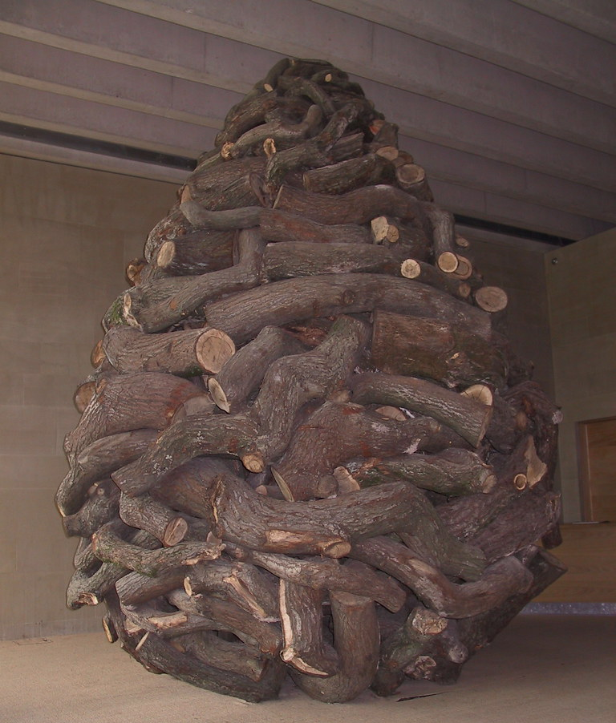
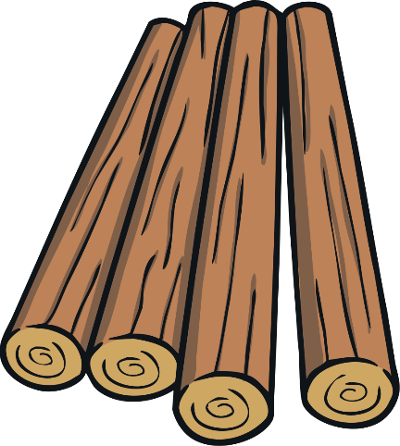

Which Natural Materials?
Talk About It
Which natural materials are
used in this sculpture by Andy
Goldsworthy?
wooden logs

Slide 5
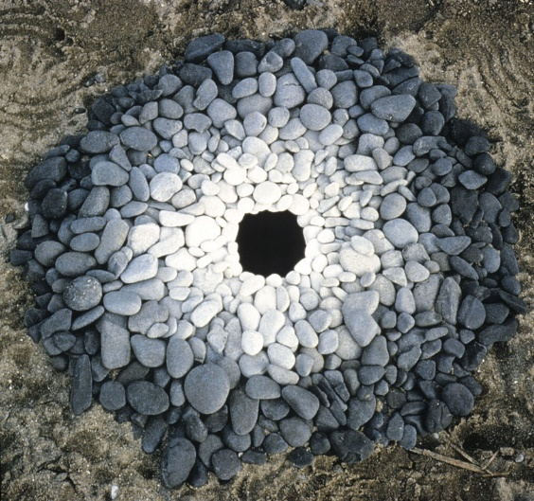
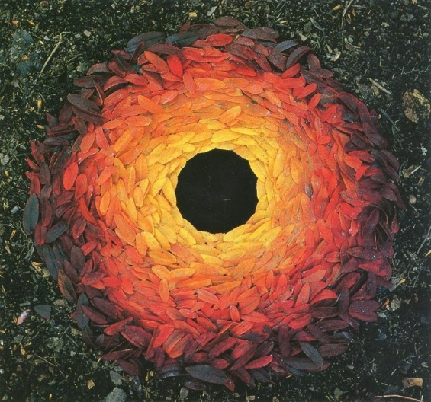
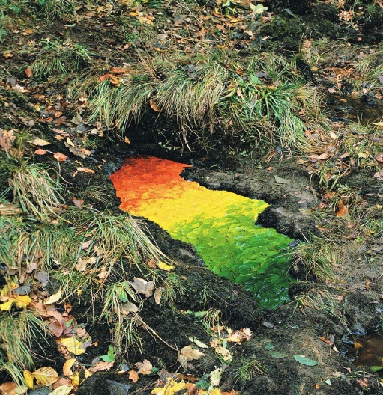
“We often forget that we are nature” Andy Goldsworthy
Andy Goldsworthy’s art makes us think about the world around us and how nature is art.
I wonder if you could create your own land art outside? Maybe you could use stones, leaves, pine cones, twigs etc.

