Slide 1


Geography
Let’s Go to China
Year One
Geography | Year 2 | Let’s Go to China | From Dragons to Dim Sum | Lesson 5

Slide 2
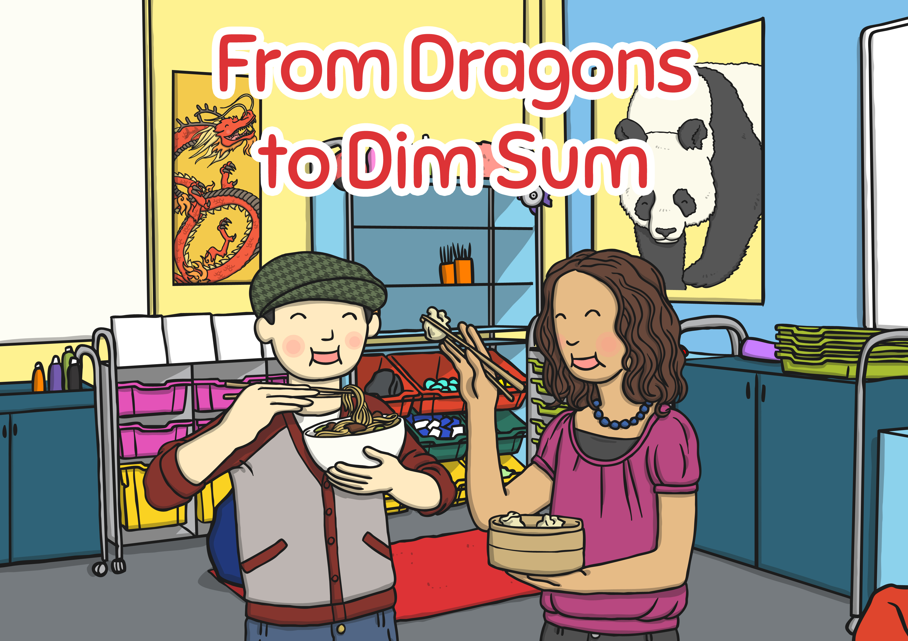


Slide 3
Aim
I can understand what Chinese culture is like.
Success Criteria
I can explain the word culture to an adult.
I can describe 3 (or more) things which happen in Chinese New Year.
I can begin to understand some similarities and differences between Chinese culture and the culture of our own country.

Slide 4
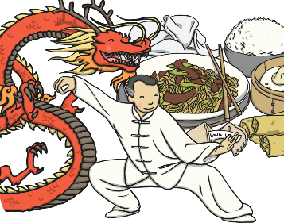
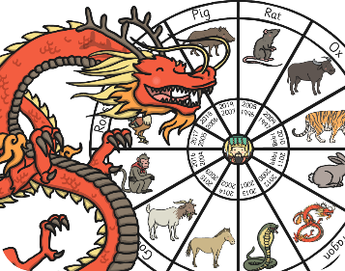
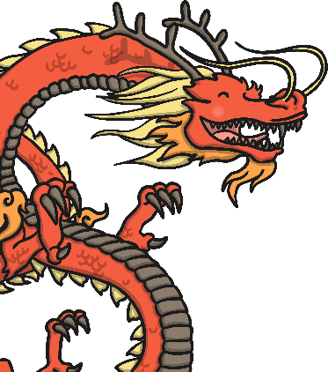
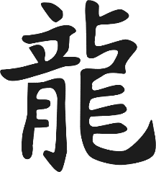
Key Words
traditions
festivals
celebrations
culture
debt
dragon
Chinese New Year
symbol

Slide 5


Let’s Go to China Quick Quiz
Eyes down!
It’s time to show what you have learnt so far.
How many questions can you answer?

Slide 6

1
What animal is China famous for?
a
donkey
b
lion
c
giant panda
d
cow

Slide 7
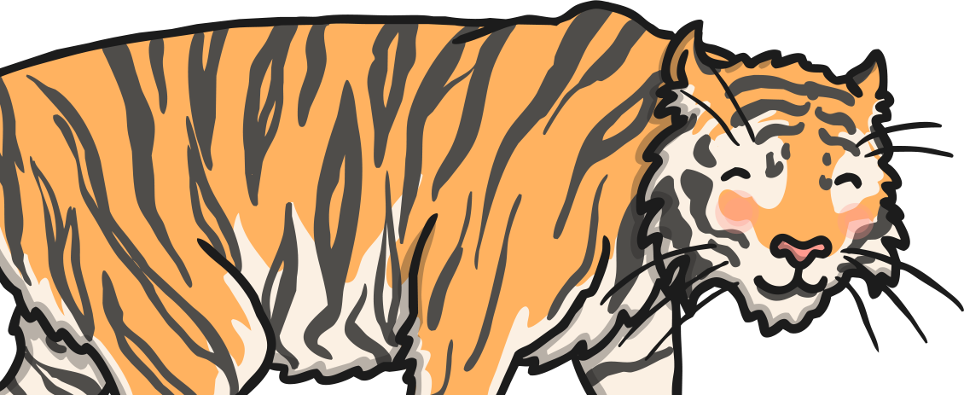
Go Back
Yikes! Try again!

Slide 8
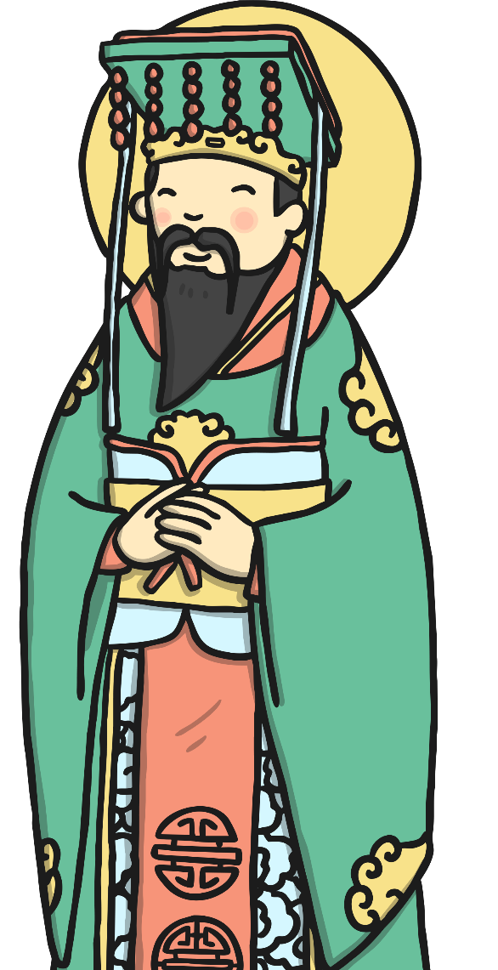
Next!
Correct.
Well done!

Slide 9
2
In which continent can China be found?
a
Asia
b
Antarctica
c
Europe
d
Africa

Slide 10
Go Back
Yikes! Try again!

Slide 11
Next!
Correct.
Well done!

Slide 12
3
What is the main language spoken in China?
a
Hakka
b
Mandarin Chinese
c
Asian
d
English

Slide 13
Go Back
Yikes! Try again!

Slide 14
Next!
Correct.
Well done!

Slide 15
4
What is the currency of China?
a
dollars
b
cents
c
pounds
d
yuan

Slide 16
Go Back
Yikes! Try again!

Slide 17
Next!
Correct.
Well done!

Slide 18
5
What colour is considered lucky in China?
a
orange
b
yellow
c
red
d
green

Slide 19
Go Back
Yikes! Try again!

Slide 20
Next!
Correct.
Well done!

Slide 21
6
What is the Capital City of China?
a
Beijing
b
Hong Kong
c
Shanghai
d
Chengdu

Slide 22
Go Back
Yikes! Try again!

Slide 23
Next!
Correct.
Well done!

Slide 24
7
What is another word for air pollution?
a
clouds
b
mist
c
smog
d
smoke

Slide 25
Go Back
Yikes! Try again!

Slide 26
Next!
Correct.
Well done!

Slide 27
8
One of the longest rivers in China is?
a
Amazon
b
Yangtze River
c
Chengdu River
d
Green River

Slide 28
Go Back
Yikes! Try again!

Slide 29
Next!
Correct.
Well done!

Slide 30
9
A major Chinese landmark is:
a
The Great Pyramid
b
paddy fields
c
The Hanging Gardens of Babylon
d
The Great Wall

Slide 31
Go Back
Yikes! Try again!

Slide 32
Next!
Correct.
Well done!

Slide 33
10
In China, children go to school for how many days per week?
a
6
b
3
c
5
d
5 ½

Slide 34
Go Back
Yikes! Try again!

Slide 35
Next!
Correct.
Well done!

Slide 36
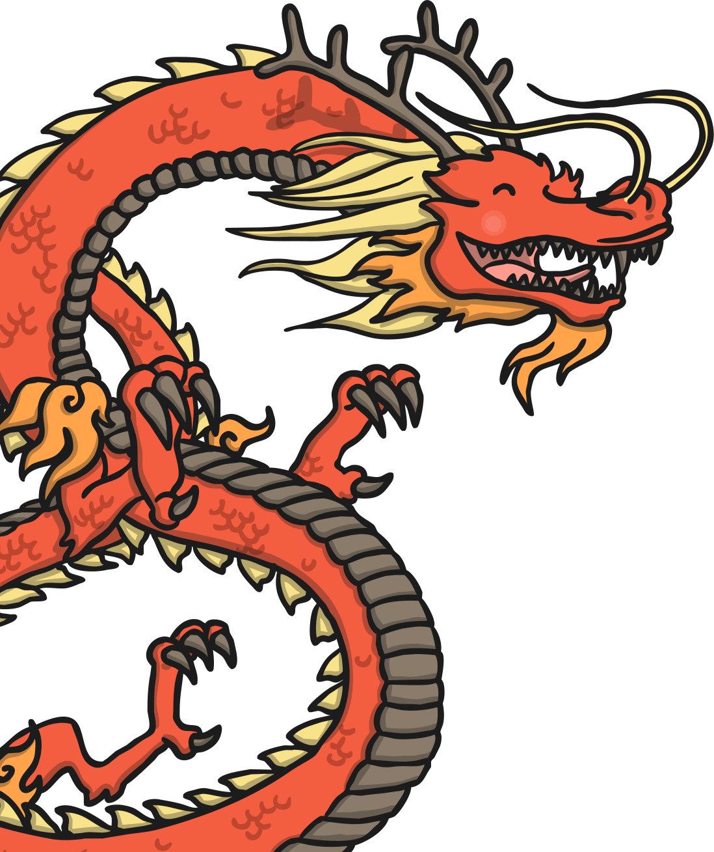
You’ve completed the quiz. Amazing!

Slide 37

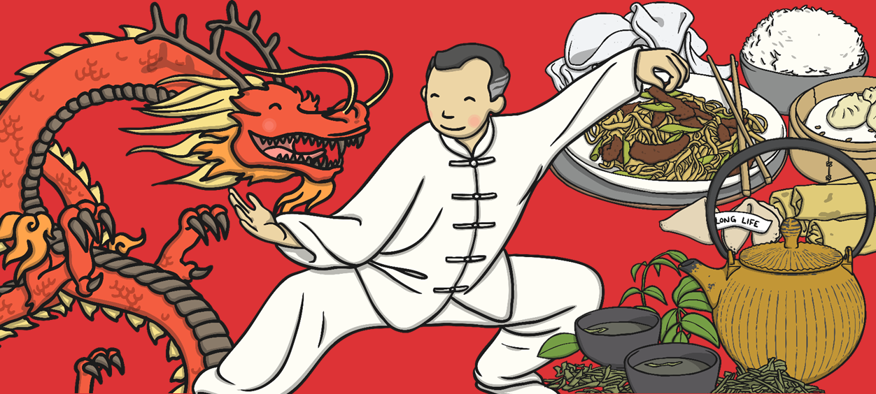
What Is Culture?
We all belong to a culture!
We can show our culture in different ways, like how we dress, what we eat, how we speak (language), what we believe (religion) and how we play.

Slide 38

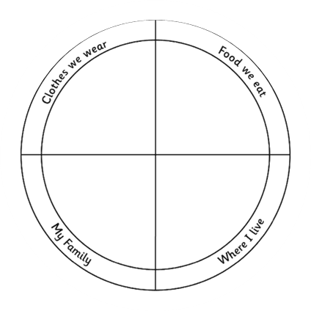
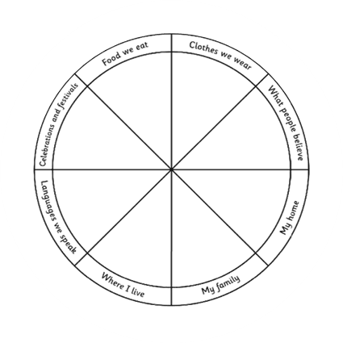
My Culture Pizza
What is your culture like?
What traditions, dress, language, religions exist in your culture?
Think about your own culture.
You are going to make your own culture pizza to show all the ingredients that go into your own culture.

Slide 39
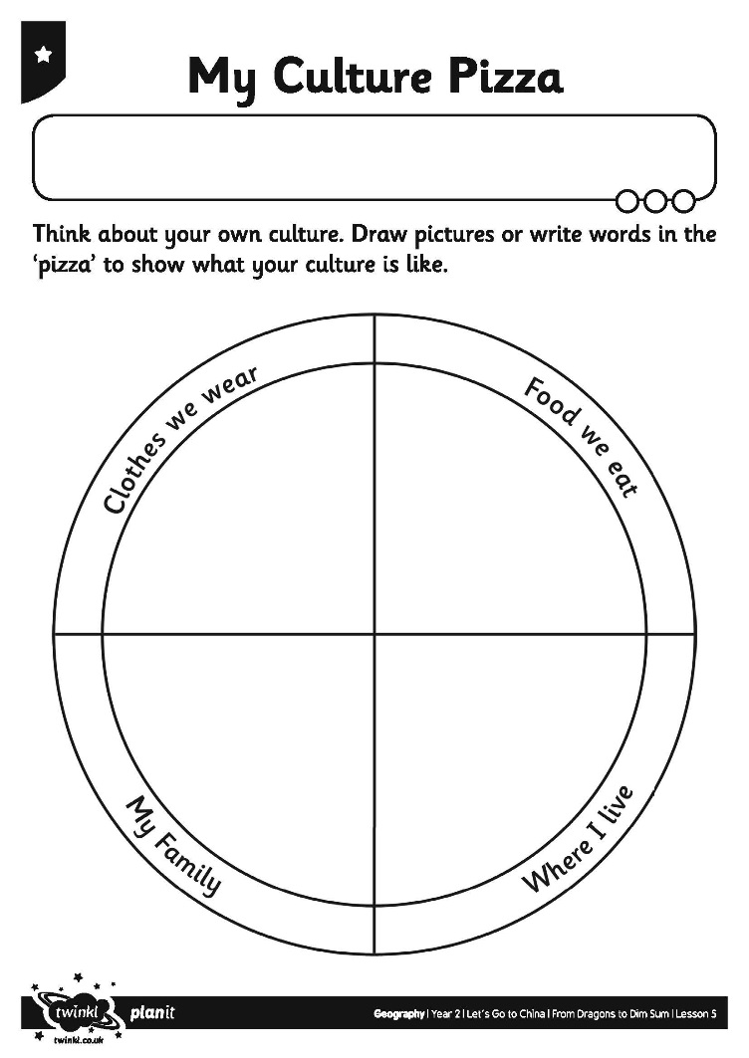
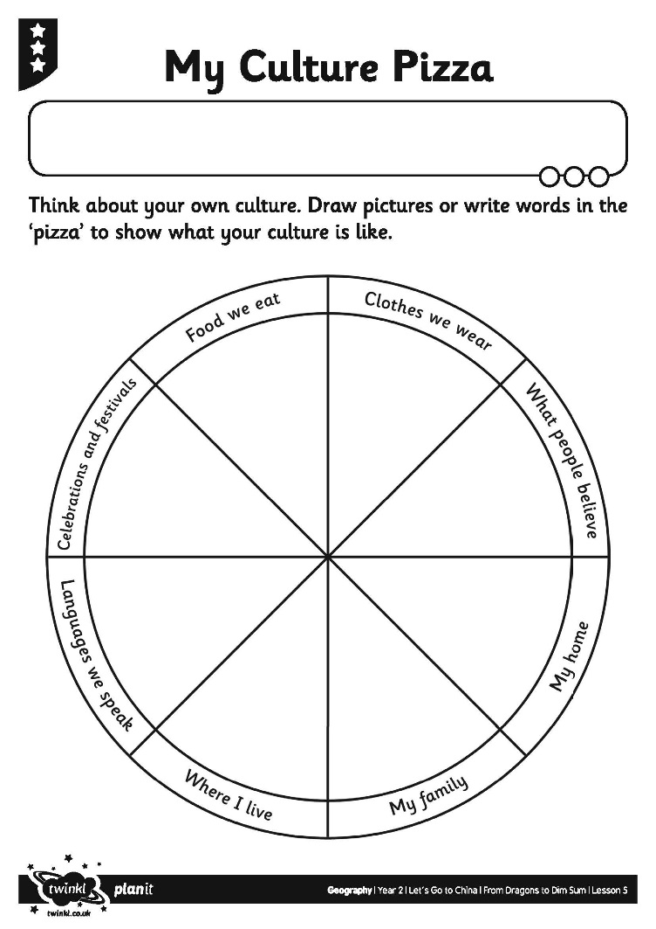
My Culture Pizza

Slide 40
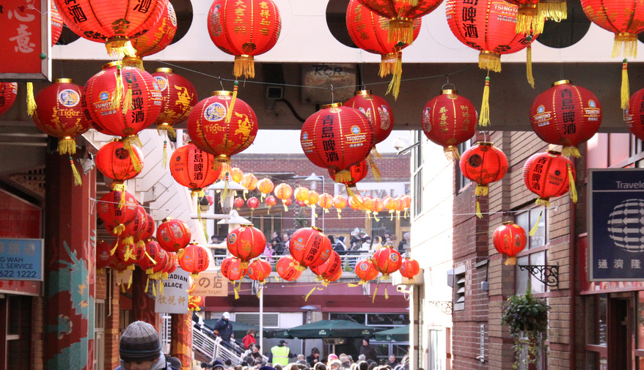
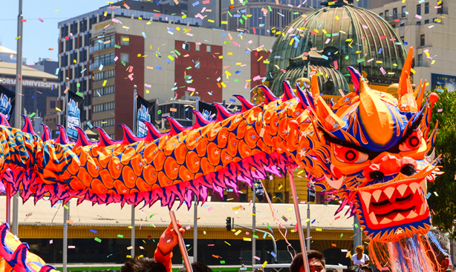
Gong Hey Fat Choy!
Chinese New Year is a very important part of Chinese culture and Chinese life in general.
This year Chinese New Year will be on the 12th of February. The New Year lasts about a week or more.
Each New Year, China celebrates an animals from the story of the ‘Great Race’. This year the Animal is the Ox.
Photo courtesy of ahisgett and PreciousBytes (@flickr.com) - granted under creative commons licence – attribution

Slide 41
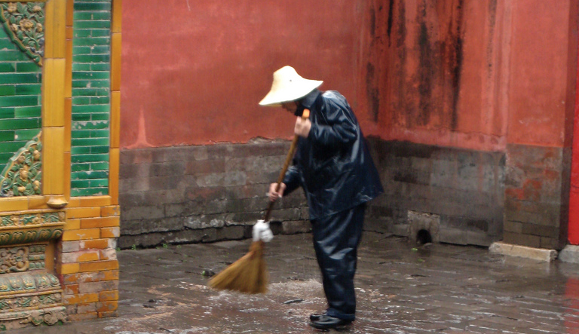
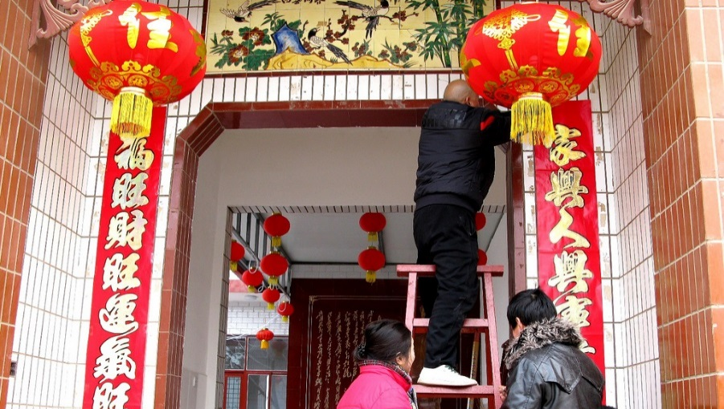
Gong Hey Fat Choy!
Preparing for Chinese New Year
There are lots of preparations before Chinese New Year begins. Chinese people spring clean their homes to sweep away any bad luck.
Houses are decorated with paper scrolls, lanterns, flags and bright colours.
Photo courtesy of borkur.net and caitriana (@flickr.com) - granted under creative commons licence – attribution

Slide 42
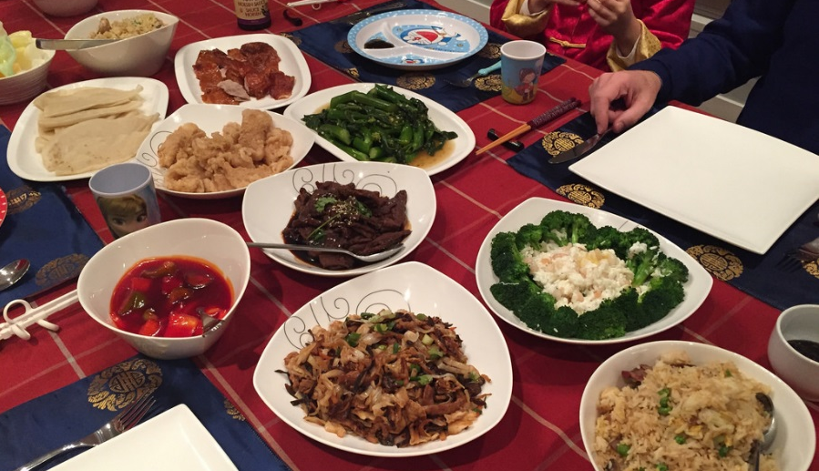
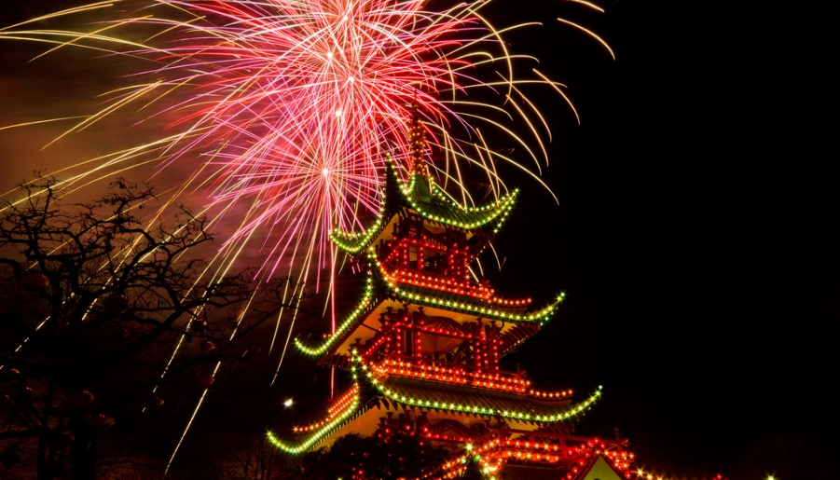
Gong Hey Fat Choy!
New Year’s Eve
On New Year’s Eve families all gather together and have a large, traditional feast of fish and chicken.
People set off fireworks and stay up late to scare off evil spirits.
Photo courtesy of Marc van der Chijs and Stig Nygaard (@flickr.com) - granted under creative commons licence – attribution

Slide 43
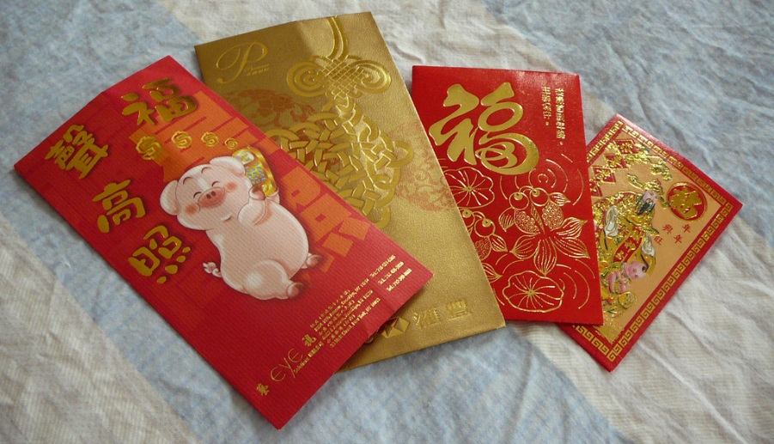
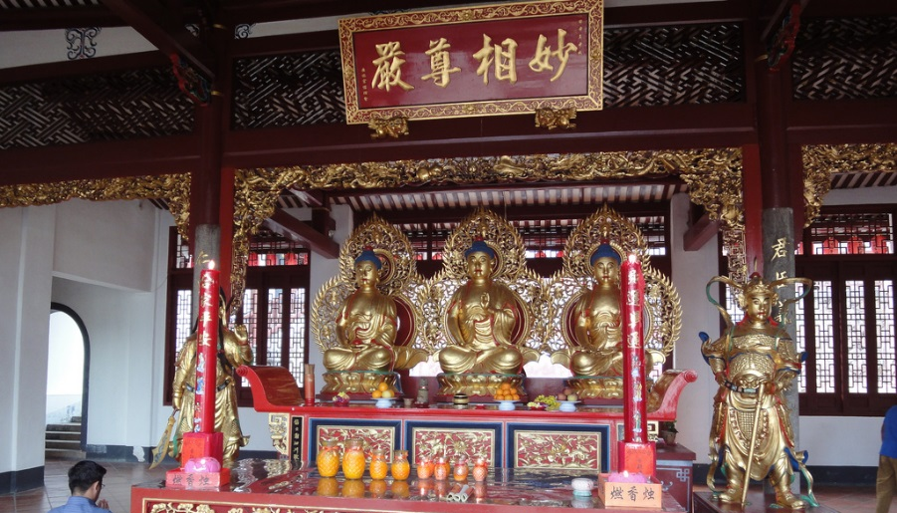

Gong Hey Fat Choy!
New Year’s Day
Children are very excited on New Year’s Day. They receive red envelopes filled with money and sweets under their pillow!
Everyone in the family starts the day with new clothes from head to toe. Red is a very popular colour as it is thought to be lucky in Chinese culture.
Families visit each other and the temple to worship Gods and welcome the new year.
Photo courtesy of Ksionic and Marufish (@flickr.com) - granted under creative commons licence – attribution

Slide 44
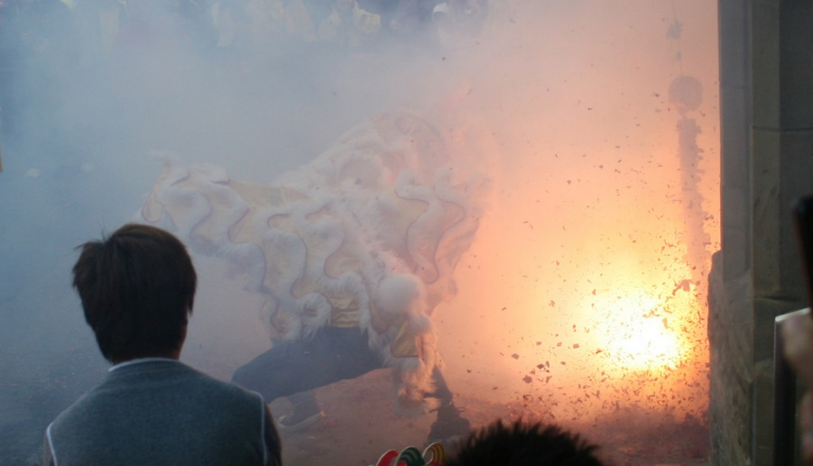
Gong Hey Fat Choy!
Other Special Events
People throw firecrackers to keep away bad spirits.
On the 15th day, the Lantern Festival is held. There are dragon and lion dancing parades in the street! Dragons have been part of Chinese culture for many years and are an important Chinese symbol.
Photo courtesy of mrmanc and PreciousBytes (@flickr.com) - granted under creative commons licence – attribution

