Slide 1


Slide 3

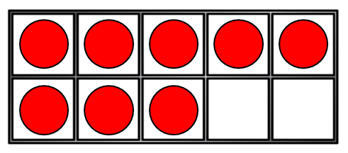
1) How many?
2) 4 + ? = 10
3) 10 = 3 + ?
4) How many more do we need to make 10?

Slide 4
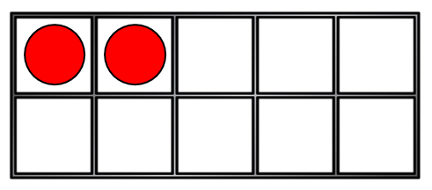
1) How many?
2) 4 + ? = 10
3) 10 = 3 + ?
4) How many more do we need to make 10?
10
6
7
2

Slide 6
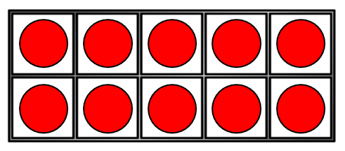
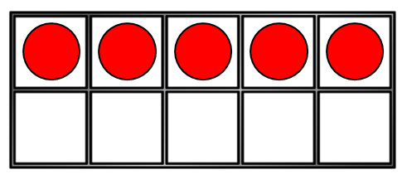
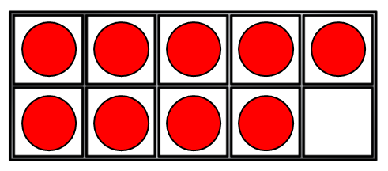
Making 10
If
+
15
10 + 5 =
Then
+
?
15
9 + 6 =

Slide 7
Making 10
If
+
12
10 + 2 =
Then
+
?
12
9 + 3 =

Slide 8
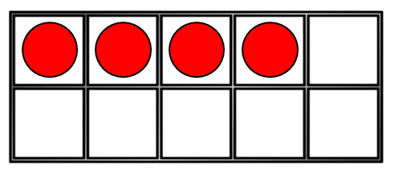
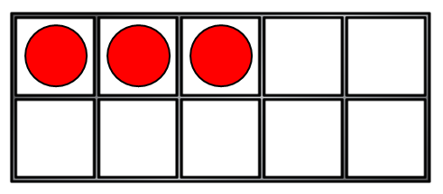
Making 10
Change
9 + 4 =
13
+
Into 10 +
+
10 + 3 =
13

Slide 9

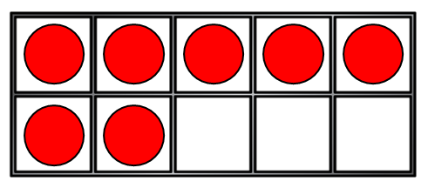
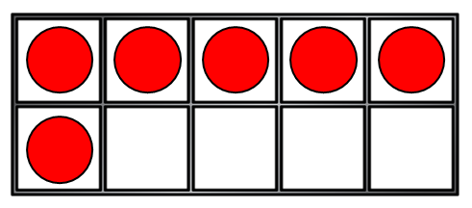
Making 10
Have a think
Change
9 + 7 =
16
+
Into 10 +
+
10 + 6 =
16

Slide 10
Have a go at questions 1 and 2 on the worksheet

Slide 11
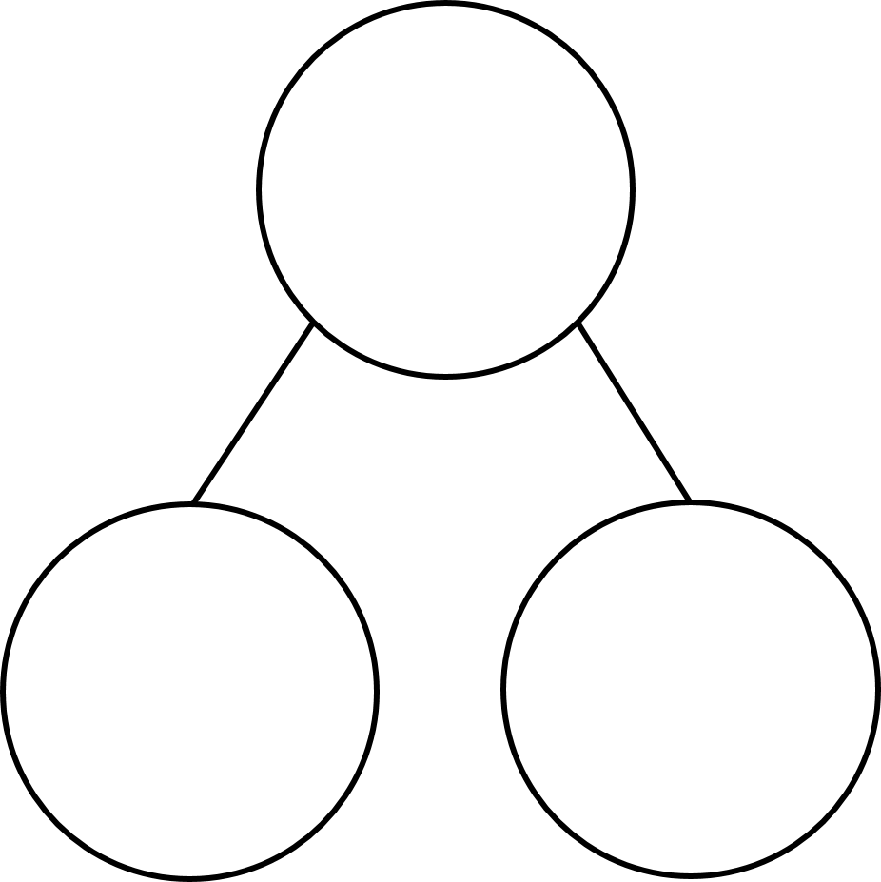
Making 10
9 + 7
9 + 1 = 10
1
6
7 = 1 + 6
+
9 + 7 = 10 + 6
10 + 6 = 16

Slide 12
Making 10
Have a think
9 + 4
9 + 1 = 10
1
3
4 = 1 + 3
+
9 + 4 = 10 + 3
10 + 3 = 13

Slide 13
Making 10
8 + 5
8 + 2 = 10
2
3
5 = 2 + 3
+
8 + 5 = 10 + 3
10 + 3 = 13

Slide 14
Making 10
Have a think
9 + 5
1
4
9 + 5 = 10 + 4
10 + 4 = 14

Slide 15
Have a go at question 3 on the worksheet

