Slide 1


Slide 3
1) What comes next? 13, 14, 15, ___
2) What comes next? 13, 12, 11, ___
3) Nineteen is one more or less than twenty
4) Twelve is one more or less than thirteen

Slide 4
16
1) What comes next? 13, 14, 15, ___
2) What comes next? 13, 12, 11, ___
3) Nineteen is one more or less than twenty
4) Twelve is one more or less than thirteen
10

Slide 6




Finding one more is like
adding one!
I will give you one more straw!
I have 3 tens
and 2 ones
One more than 32 is 33

Slide 7
Finding one less is like
subtracting one!
I will take away one straw!
I have 3 tens
and 2 ones
One less than 32 is 31

Slide 8



What is one more?
One more than 15 is 16

Slide 9
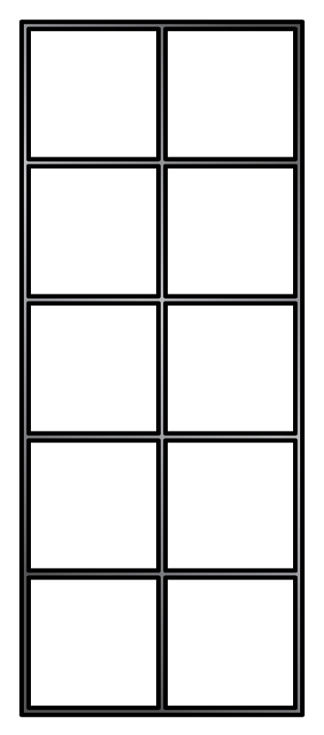

What is one more?
One more than 29 is 30

Slide 10

What is one less?
One less than 28 is 27

Slide 11
What is one less?
One less than 40 is 39

Slide 12

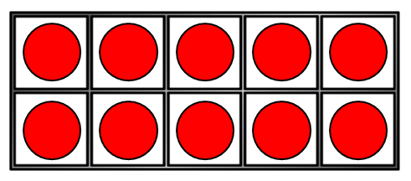
Have a think
Let’s build 23
and find one more
One more than 23 is 24

Slide 13
Have a think
Let’s build 48
and find one less
One less than 48 is 47

Slide 14
Have a go at question 1 on the worksheet

