Slide 1


Slide 3
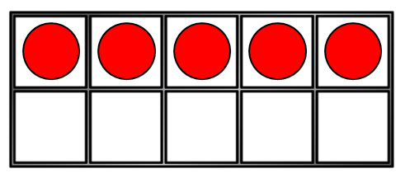
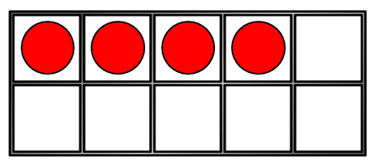
1) What is one more than 9?
2) 6 + ? = 10
3) How many?
4) These are number bonds to ___
5 + 2
3 + 4

Slide 4
1) What is one more than 9?
2) 6 + ? = 10
3) How many?
4) These are number bonds to ___
10
4
9
7
5 + 2
3 + 4

Slide 6
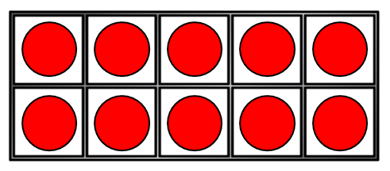
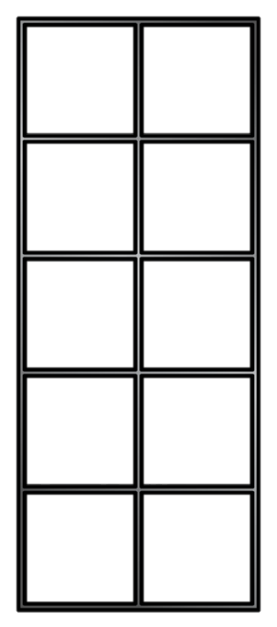
Using number bonds
12 + 3 =
15
+ =
1 ten + 2 ones
add 3 ones
1 ten + 5 ones

Slide 7
Using number bonds
17 + 2 =
19
+ =
1 ten + 7 ones
add 2 ones
1 ten + 9 ones

Slide 8

Using number bonds
Have a think
11 + 6 =
17
+ =
1 ten + 1 one
add 6 ones
1 ten + 7 ones

Slide 9
Have a go at questions 1 and 2 on the worksheet

Slide 10
15 + 4 =
19
14 + 5 =
19
4 + 15 =
19
5 + 14 =
19
1
1
2
3
4
2
3
4
5
4
5
6
7
8
9
10
11
12
13
14
15
16
17
18
19
20
What is the same?
What is different?

Slide 11
Have a think
16 + 2 =
18
12 + 6 =
18
2 + 16 =
18
6 + 12 =
18
4
5
6
7
8
9
10
11
12
13
14
15
16
17
18
19
20

Slide 12
Have a go at questions 3 and 4 on the worksheet

