Slide 1


Slide 3
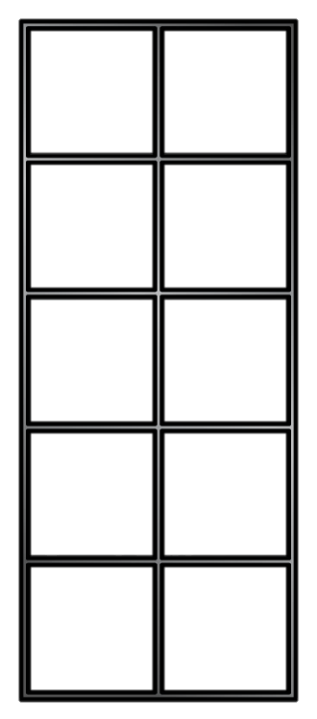
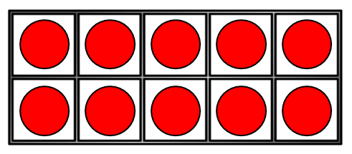

1) What is 12 $−$ 2 =
2) 12 $−$ 7 =
3) 12 $−$ 4 =
4) Use the number line 13 $−$ 6 =
2
3
4
5
6
7
8
9
10
11
12
13
14
15
16
17

Slide 4
1) What is 12 $−$ 2 =
2) 12 $−$ 7 =
3) 12 $−$ 4 =
4) Use the number line 13 $−$ 6 =
10
5
8
7
2
3
4
5
6
7
8
9
10
11
12
13
14
15
16
17

Slide 6


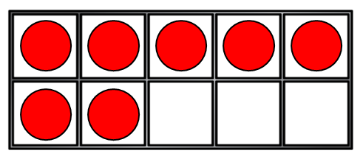
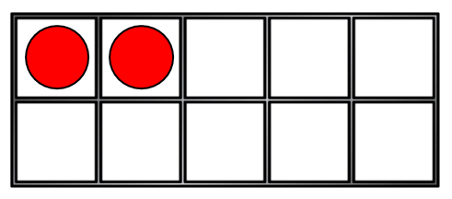
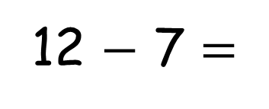
Let’s compare!
Alex
Eva
12
7
Who has more?
How many more does Eva have?
5
12 $−$ 7 =
5

Slide 7


Let’s compare!
Who has more?
Eva
12
Alex
7
How many more does Eva have?
5
12 $−$ 7 =
5

Slide 8

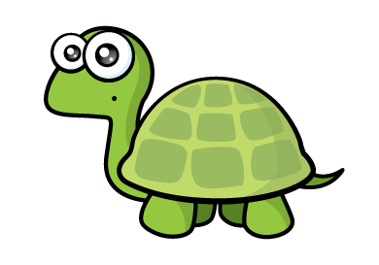


Let’s compare!
Have a think
Who has more?
Tiny
13
Tommy
9
How many more?
4
13
$−$
9
=
4

Slide 9
Have a go at questions 1 and 2 on the worksheet

Slide 10


Let’s compare!
There are 15 buttons.
There are 8 pink.
How many are green?
15
$−$
8
=
7

Slide 11
Let’s compare!
Have a think
There are 16 buttons.
There are 7 pink.
How many are green?
16
$−$
7
=
9

Slide 12
Have a go at question 3 on the worksheet

Slide 13

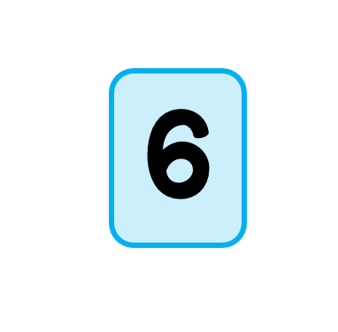



Question 4
$$−$$
=
14
$−$
6
=
8

Slide 14
Question 4
$$−$$
=
14
$−$
9
=
5

Slide 15
Have a go at question 4 on the worksheet

Slide 16
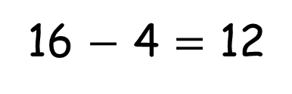
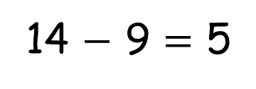
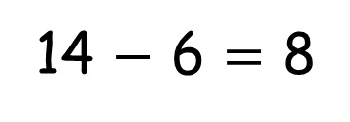
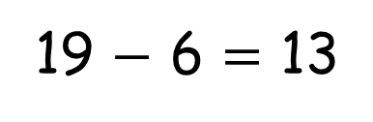
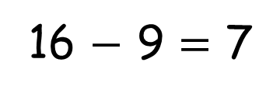
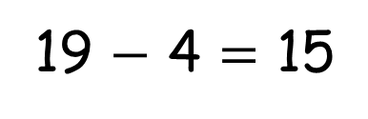
14 $−$ 6 = 8
14 $−$ 9 = 5
16 $−$ 9 = 7
16 $−$ 4 = 12
19 $−$ 4 = 15
19 $−$ 6 = 13

