Slide 1


Slide 3
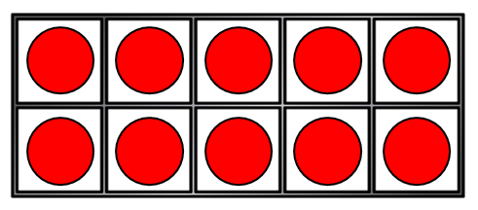


1) How many counters?
2) How many counters?
3) How do you spell 20?
4) Each of these pictures are equal to __

Slide 4
1) How many counters?
2) How many counters?
3) How do you spell 20?
4) Each of these pictures are equal to __
10
20
twenty
10

Slide 6

Counting on from 20
10
20
30
20 | 21 | 22 | 23 | 24 | 25 | 26 | 27 | 28 | 29 | 30

Slide 7
Counting on from 30
10
20
30
40
30 | 31 | 32 | 33 | 34 | 35 | 36 | 37 | 38 | 39 | 40

Slide 8

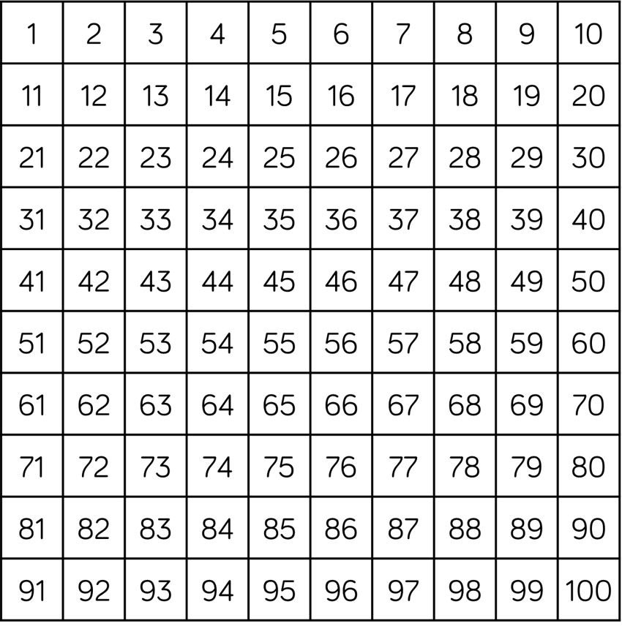
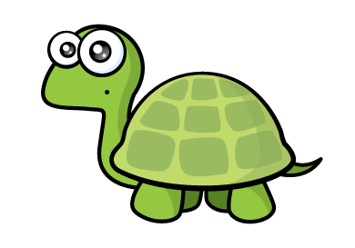
Counting to 50
Have a think
Each row has 10!

Slide 9
Counting to 50
Have a think
Those numbers are harder to remember!

Slide 10
Counting to 50
Have a think
Ten more than
20 is 30!

Slide 11
Counting to 50
Have a think
All of the numbers at the end of the row have a zero!

Slide 12
Counting to 50
Have a think
I can see patterns in the rows and columns!

Slide 13
Have a think
Counting to 50
What do you notice?

Slide 14
You can practice making 5 groups of 10

