Slide 1


Slide 3
1) How many counters?
2) How many counters?
3) Which representations show 6?

Slide 4
1) How many counters?
2) How many counters?
3) Which representations show 6?
5
10

Slide 6
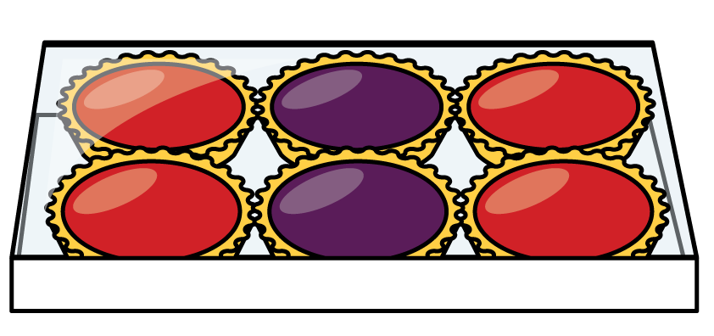
How many tarts?
3
3
2 2 2

Slide 7
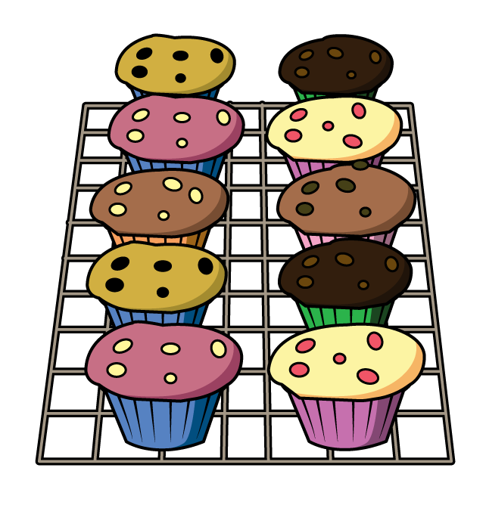
How many cakes?
2
2
2
2
2
5 5

Slide 8

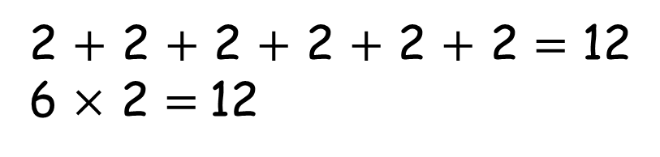
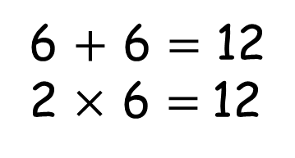
What is an array?
6 columns
2 rows
6 $+$ 6 $=$ 12
2 $×$ 6 $=$12
2 $+$ 2 $+$ 2 $+$ 2 $+$ 2 $+$ 2 $=$ 12
6 $×$ 2 $=$12

Slide 9


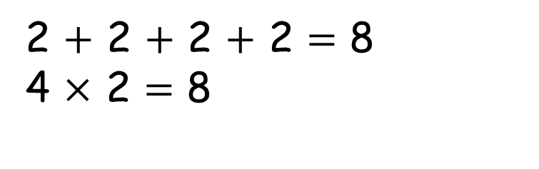
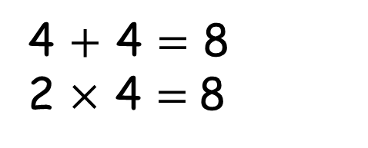
Have a think
4 $+$ 4 $=$ 8
2 $×$ 4 $=$8
2 $+$ 2 $+$ 2 $+$ 2 $=$ 8
4 $×$ 2 $=$ 8

Slide 10

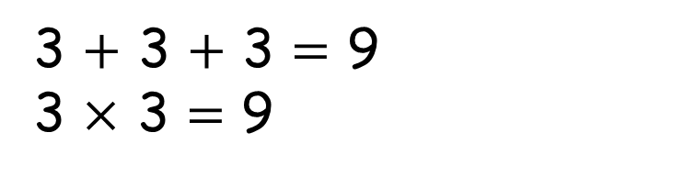
Have a think
You can’t make an array because 9 is an odd number
3 $+$ 3 $+$ 3 $=$ 9
3 $×$ 3 $=\text{9}$

Slide 11
Have a go at questions 1 - 4 on the worksheet

Slide 12
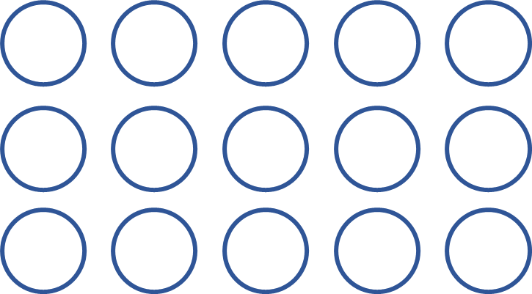
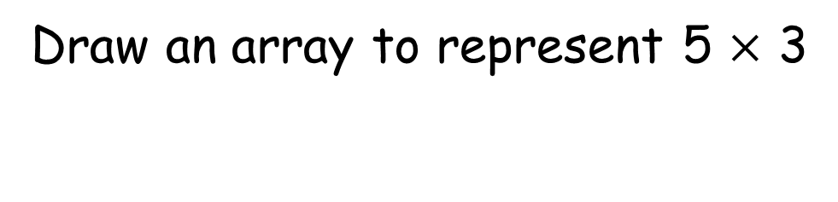
Draw an array to represent 5 $×$ 3
Have a think

Slide 13
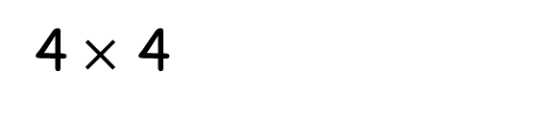
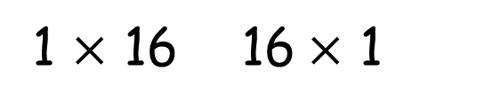
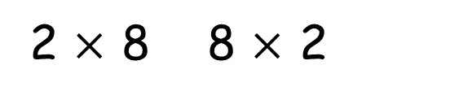
How many different arrays can you build with 16 counters?
1 $×$ 16 16$×$ 1
4$×$ 4
2 $×$ 8 8 $×$ 2
Have a think

Slide 14



16$×$ 1
halve
double
8 $×$ 2
halve
double
4$×$ 4

Slide 15




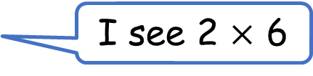

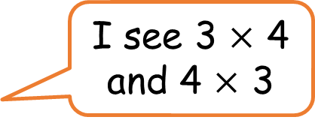
What do you see?
Have a think
I see 6 $×$ 2
I see 2 $×$ 6
I see one 12 and twelve 1s
I see 3 $×$ 4
and 4 $×$ 3

Slide 16
Have a go at the rest of the questions on the worksheet

