Slide 1


Slide 3




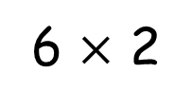
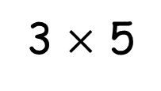
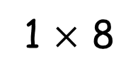
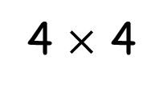
Some of these are incorrect, can you draw a correct representation?
3 $×$ 5
4 $×$ 4
1 $×$ 8
6 $×$ 2

Slide 4
Some of these are incorrect, can you draw a correct representation?
3 $×$ 5
4 $×$ 4
1 $×$ 8
6 $×$ 2

Slide 6

What do you see?
3
4
There are ____ equal groups of ____
3
4
There are ____ lots of ____
3
4
____ multiplied by ____

Slide 7

What do you see?
Have a think
6
2
There are ____ equal groups of ____
6
2
There are ____ lots of ____
6
2
____ multiplied by ____

Slide 8

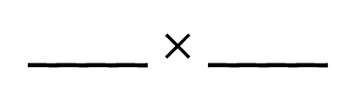
Have a think
4
5
There are ____ equal groups of ____
4
5
There are ____ lots of ____
4
5
____ multiplied by ____
4
5
____ $×$ ____

Slide 9
Have a go at question 1 on the worksheet

Slide 10
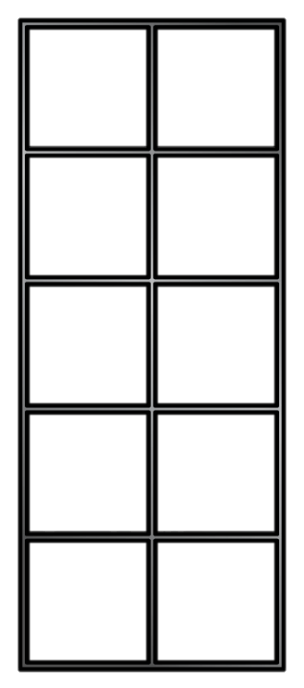
6
3
There are ____ lots of ____
6
3
____ multiplied by ____
6
3
____ $×$ ____
Notes:
How could I represent this?

Slide 11
Have a go at questions 2 and 3 on the worksheet

Slide 12


Have a think
I think I can write 4 different multiplications
I think there are 8

Slide 13
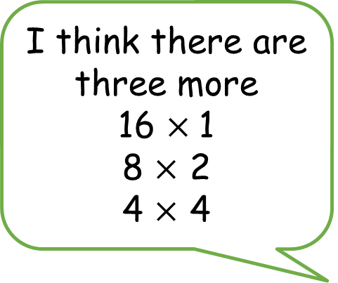
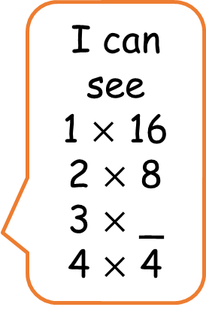
I think there are three more
16 $×$1
8 $×$ 2
4 $×$ 4
I can see
1 $×$ 16
2 $×$ 8
3 $×$ _
4 $×$ 4

Slide 14
Have a go at the rest of the questions on the worksheet

