Slide 1


Slide 3
Are these wholes equal?
0
4
1
3
8
4
1
4
7
7
5
9

Slide 4


Are these wholes equal?
0
4
1
3
4
$$=$$
4
8
4
9
8
1
4
$$=$$
14
14
7
7
5
9

Slide 6





3
There are _____ plates.
There are _____ strawberries on each plate.
There are ____ equal groups of ____
5
3
5

Slide 7


5
There are _____ dice.
There are _____ spots on each dice.
There are ____ equal groups of ____
4
5
4
Have a think

Slide 8
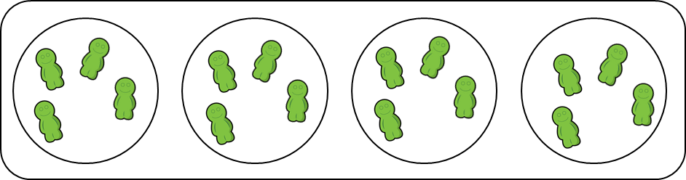
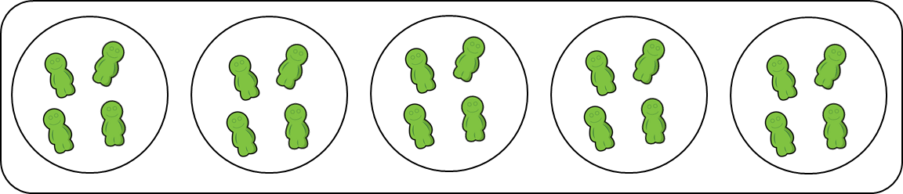
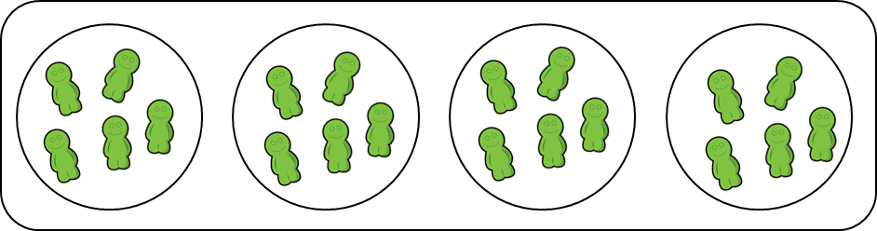
Have a think
4 groups of 5
4 groups of 4
5 groups of 4

Slide 9


Are the groups equal or not equal?
Not equal

Slide 10
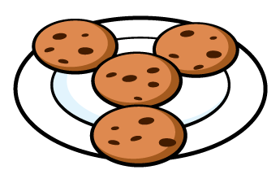
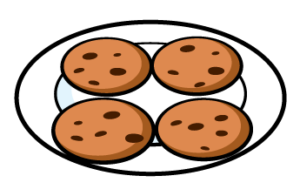
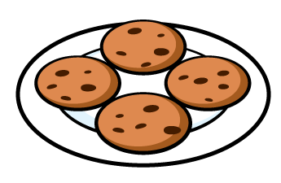
Are the groups equal or not equal?
Equal

Slide 11
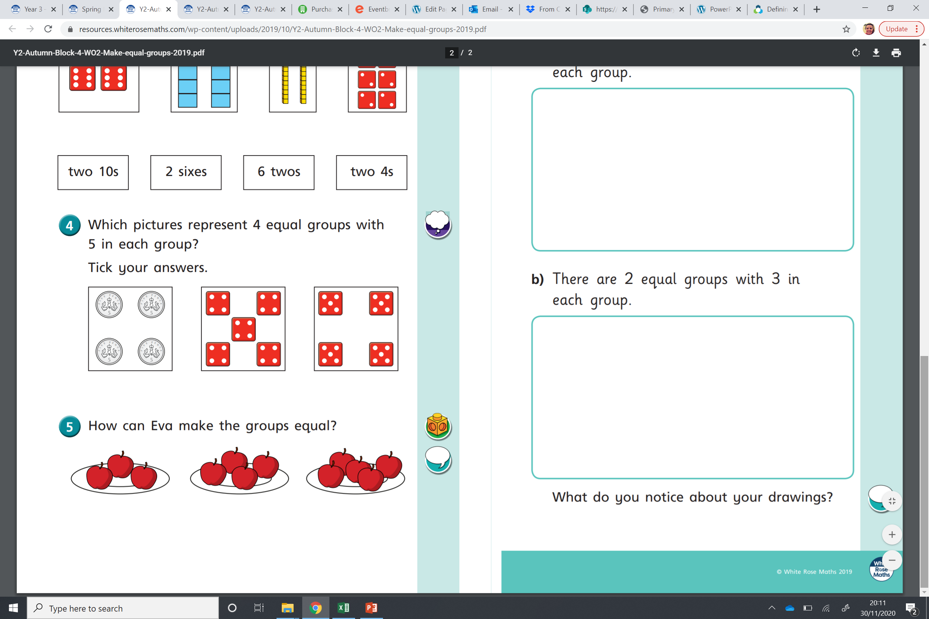
Are the groups equal or not equal?
Not equal

Slide 12
Have a go at the questions on the worksheet

