Slide 1


Slide 3
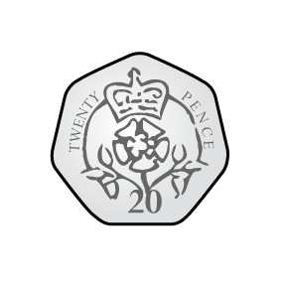
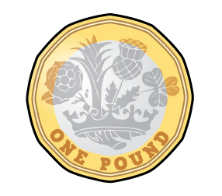
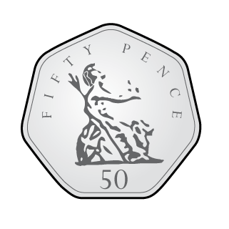
1) Are the groups equal?
2) Draw 3 equal groups with 3 triangles in each group.
3) How many triangles have you drawn altogether?

Slide 4
1) Are the groups equal?
2) Draw 3 equal groups with 3 triangles in each group.
3) How many triangles have you drawn altogether?
9

Slide 6



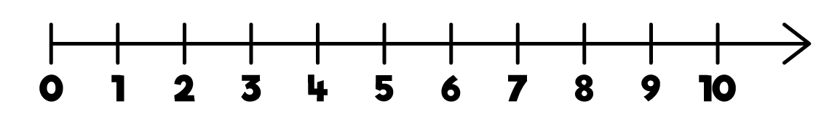



There are equal groups of
3
2
2
$$+$$
2
$$+$$
2
$$=$$
6

Slide 7





There are wheels on each tricycle.
3
There are tricycles.
4
There are equal groups of
4
3
3
$$+$$
3
$$+$$
3
$$+$$
3
$$=$$
12

Slide 8

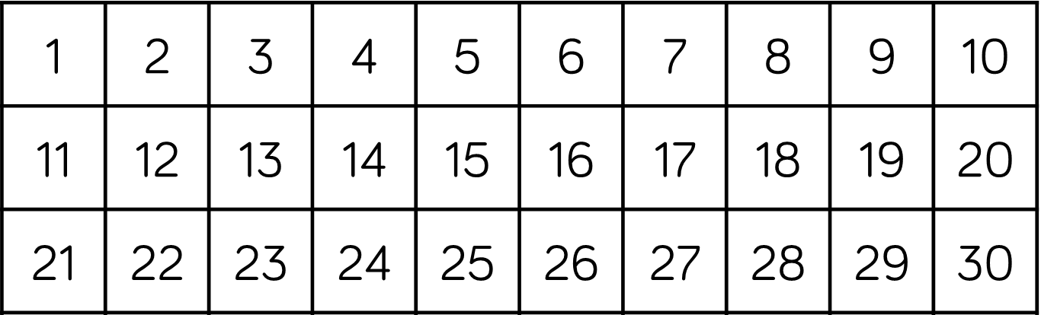




4
There are equal groups of
5
5
$$+$$
5
$$+$$
5
$$+$$
5
$$=$$
20

Slide 9
Have a go at the questions 1 and 2 on the worksheet

Slide 10






3
$$+$$
3
$$+$$
3
$$+$$
3
$$=$$
12
There are equal groups of
4
3
Notes:
How could I represent this?

Slide 11



5
$$+$$
5
$$+$$
5
$$=$$
15
There are equal groups of
3
5
Notes:
How could I represent this?

Slide 12
Have a go at the rest of the questions on the worksheet
Notes:
Remember the symbols

