Slide 1


Slide 3

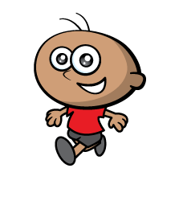

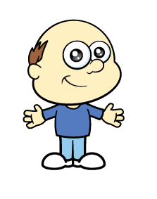

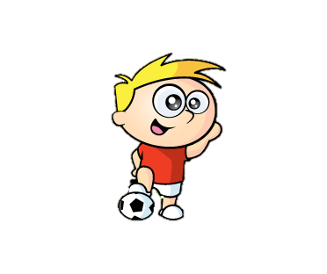
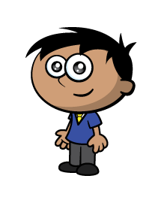




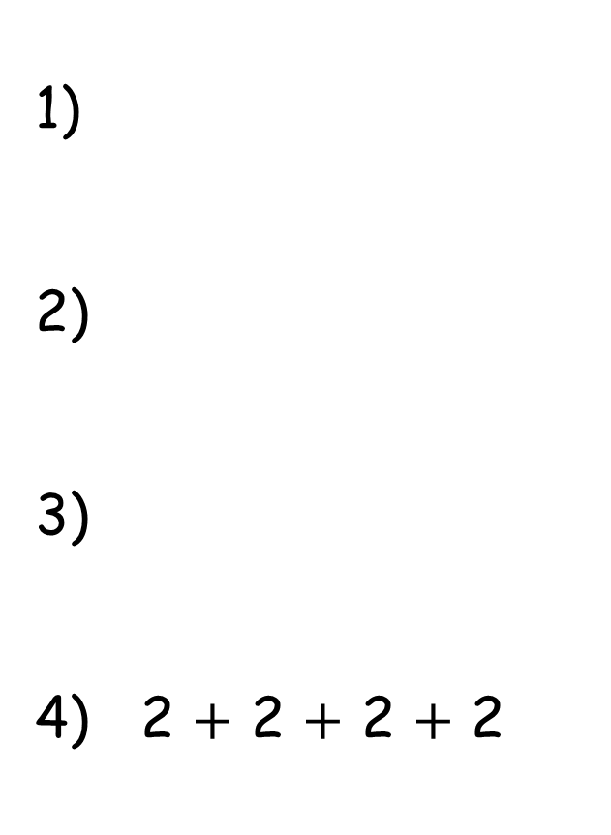
Blue Team Red Team
1)
2)
3)
4) 2 $+$ 2 $+$ 2 $+$ 2
5 $+$ 5

Slide 4


Blue Team Red Team
1)
2)
3)
4) 2 $+$ 2 $+$ 2 $+$ 2
5 $+$ 5
$$=$$

Slide 6





Have a think
There are equal groups of
3
5

Slide 7
Have a think
There are equal groups of
5
3

Slide 8


equal groups
3
3
3
3
unequal groups
Have a
think
4
4
5

Slide 9
Have a go at questions
1 and 2 on the worksheet

Slide 10
There are equal groups of
4
3
Have a
think
There are equal groups of
3
4

Slide 11

I have equal groups.

Slide 12

Have a think
There are equal groups of
2
4
There are equal groups of
4
2

Slide 13
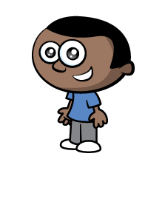


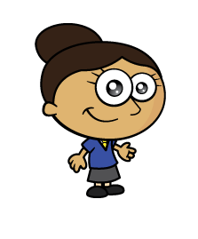




Can you describe how these children are grouped?
There are equal groups of
4
3
There are equal groups of
3
4
Have a think

Slide 14
Have a go at the rest of the questions on the worksheet

